Slide 1
Wednesday 13th January 2021
LO: To think of alternative adjectives

Slide 2

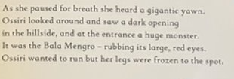
Recap pages 15 and 18.
Think about the descriptions of the Bala Mengro.
Q. What adjectives (describing words) can you recognise?
Q. What are the adjectives describing? A character or a setting?
Q. What is an adjective?
A word naming an attribute of a noun (thing), such as sweet, red, or technical.

Slide 3
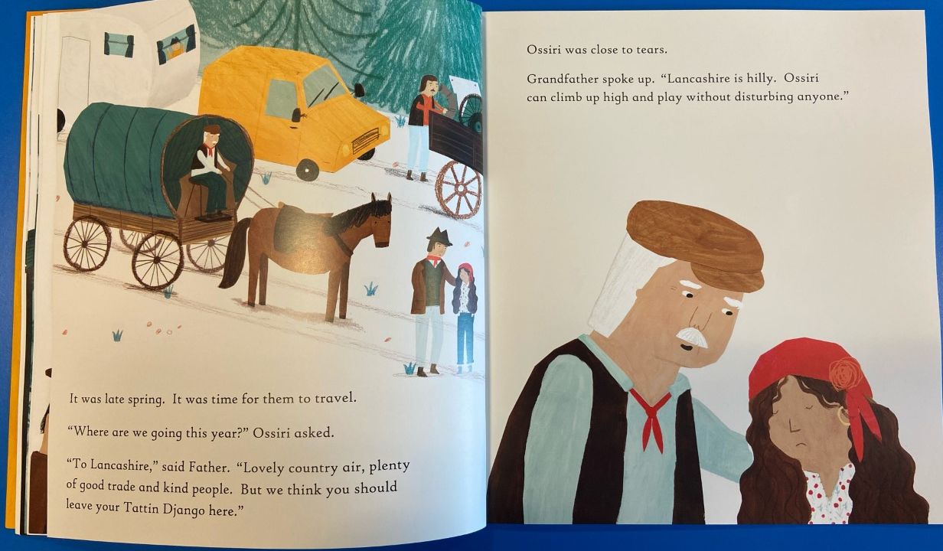
12
11

Slide 4
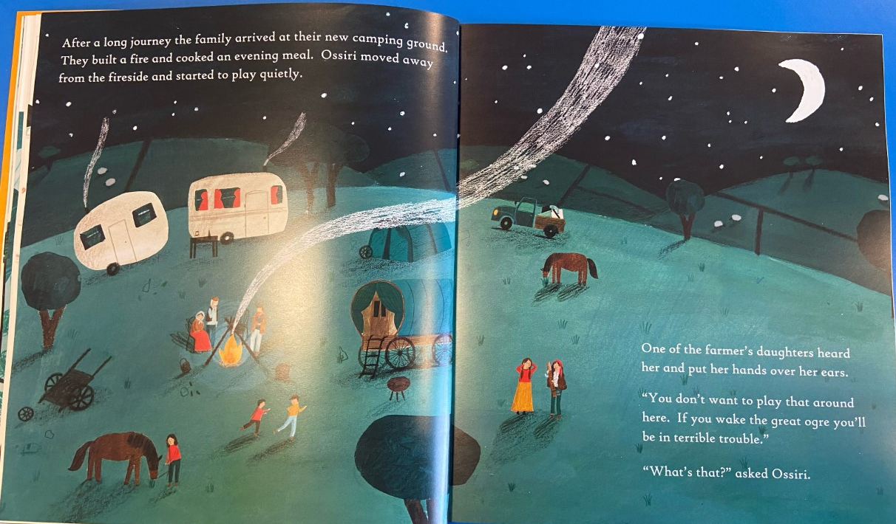
14
13

Slide 5
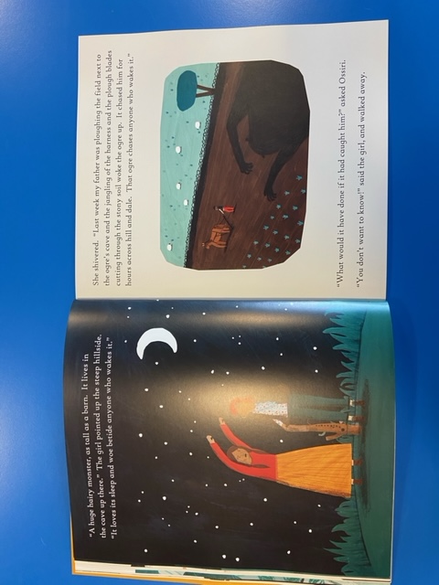
15
16

Slide 6
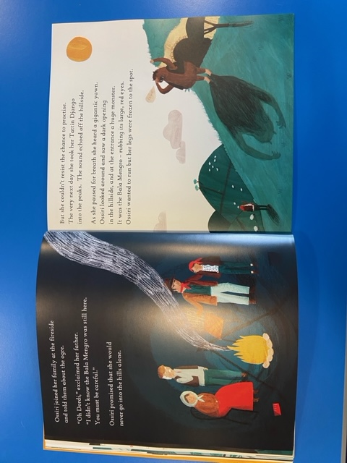
17
18

Slide 7
Your Task Today
To think of new and improved adjectives for those in the text describing the Bala Nengro and its environment.
Try thinking of adjectives which aren't simple, try and be creative, but make sure they mean the same thing.
Eg huge = giant

Slide 8
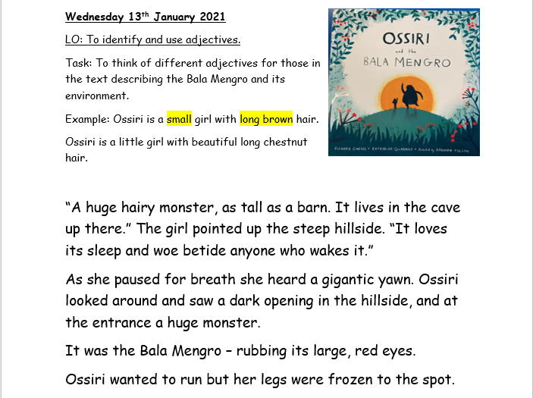
This is the worksheet you can use.
You can find it in today's resources.
Option 1. Print off the word document and highlight the adjectives and write improved ones in their place. Send us a photo.
Option 2. Save the word document and replace the adjectives with improved adjectives. Send us the word document with your changes.
Option 3. Write down as many adjectives you can find from the text and write your alternatives next to them. Send us a photo.

