Slide 1
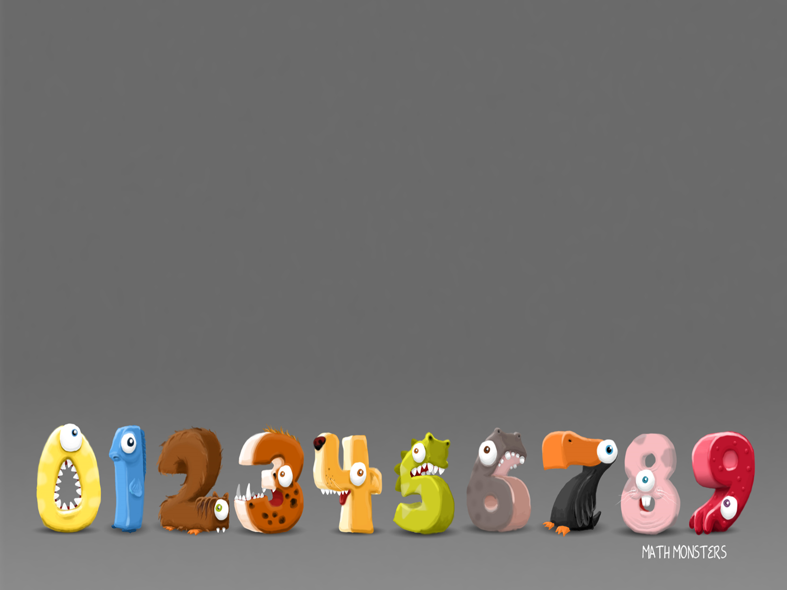
11/1/21
LO: To add equal groups

Slide 2
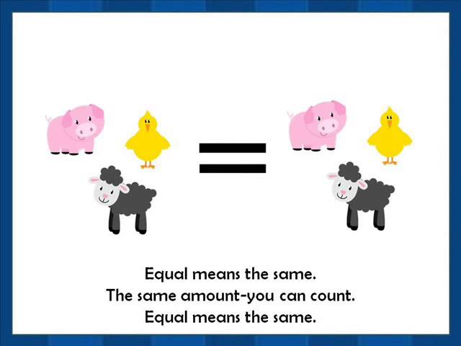
Recap: What does the word equal mean?

Slide 3
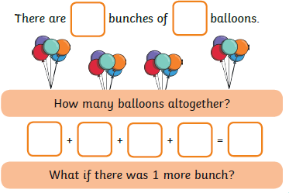
Work out

Slide 4
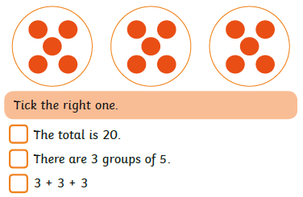
True or False

Slide 5
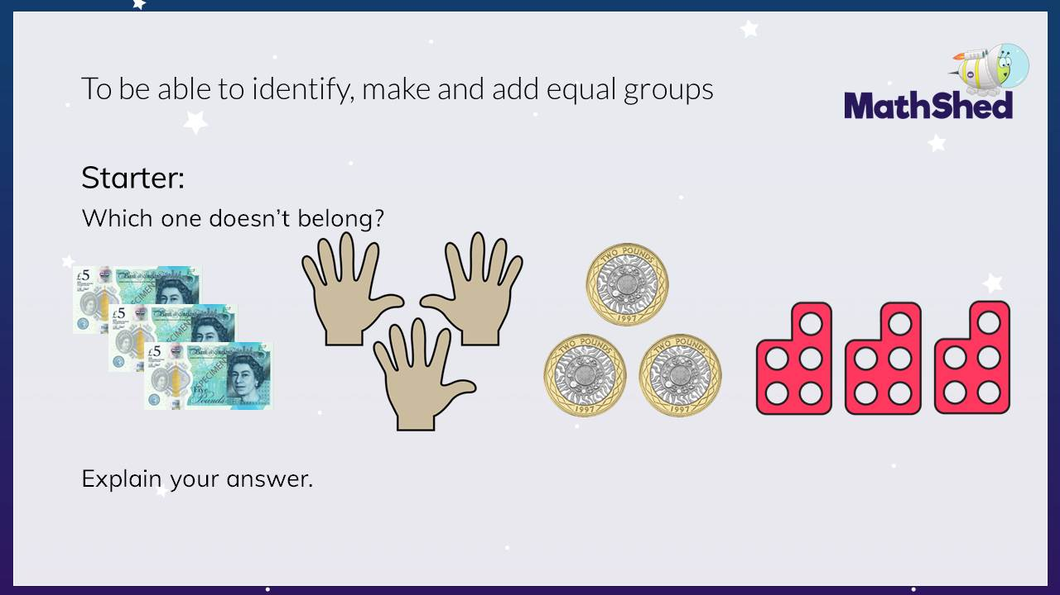

Slide 6
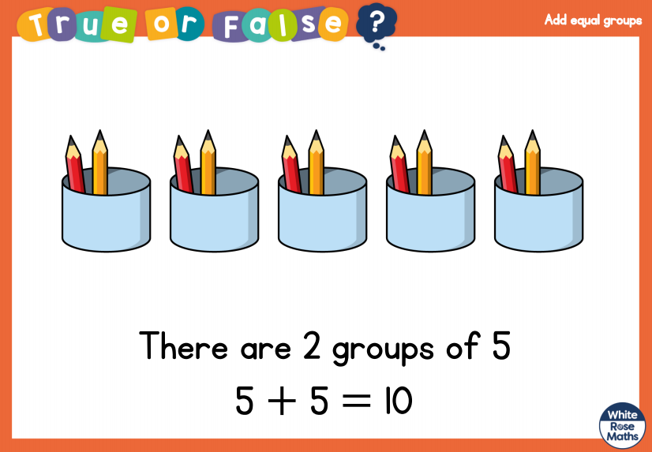

Slide 7
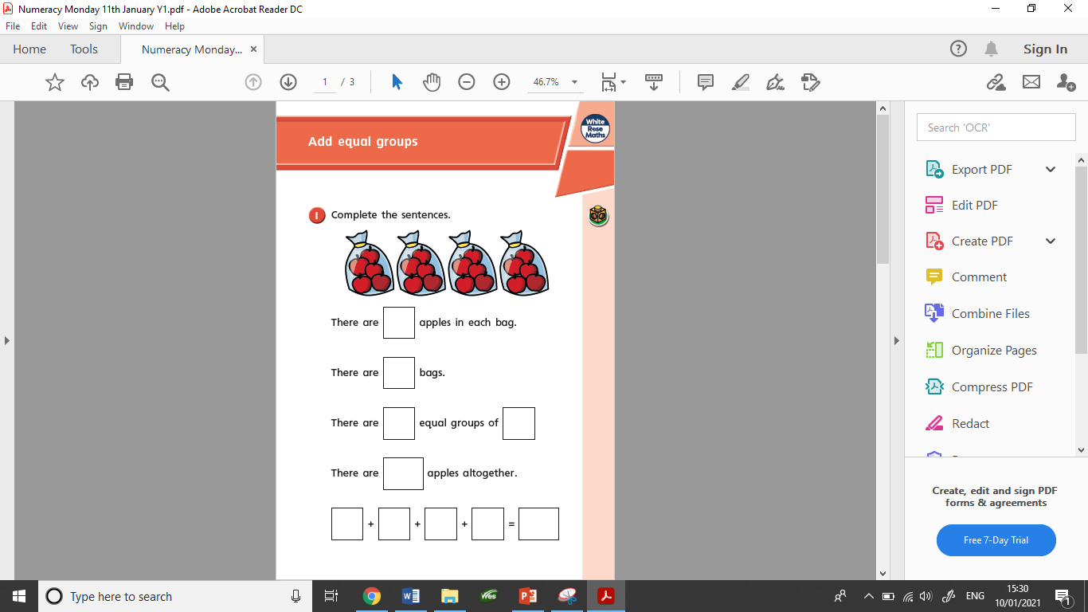
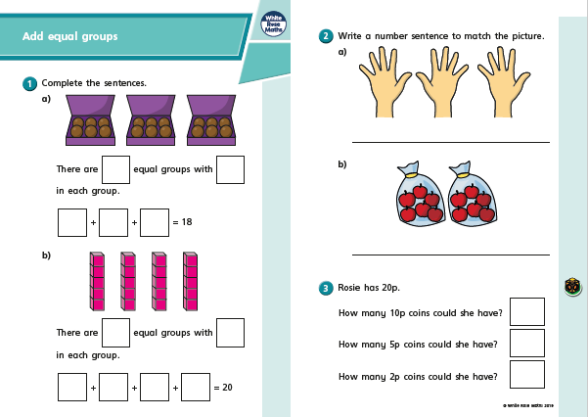
Today’s worksheets

Slide 8
12/1/21
LO: To make doubles

Slide 9
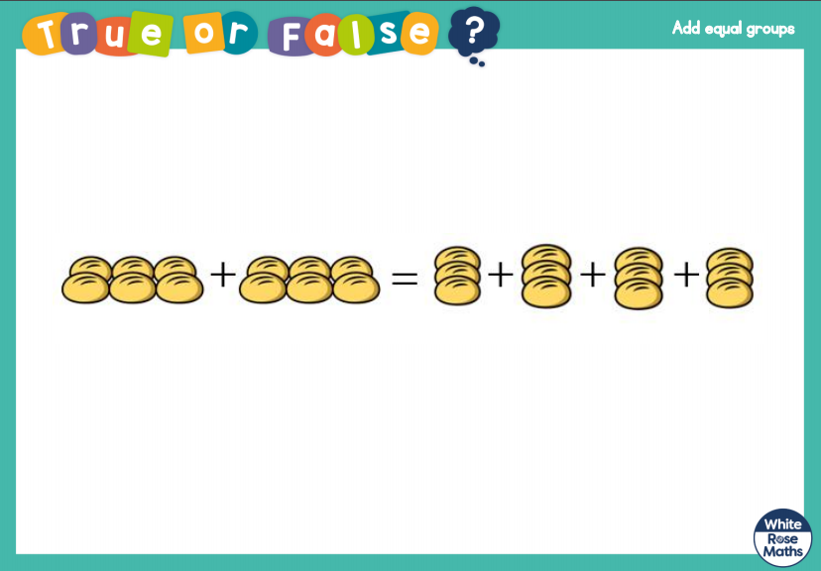

Slide 10
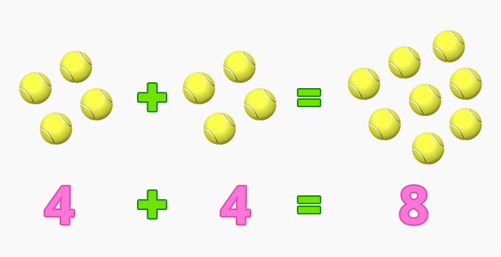
What are doubles?
To get a double of a number, we add the same number to itself. For example, double of 2 is
2 + 2 = 4.

Slide 11
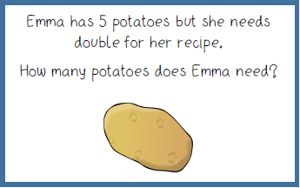
Double 5…
5 + 5 = 10

Slide 12
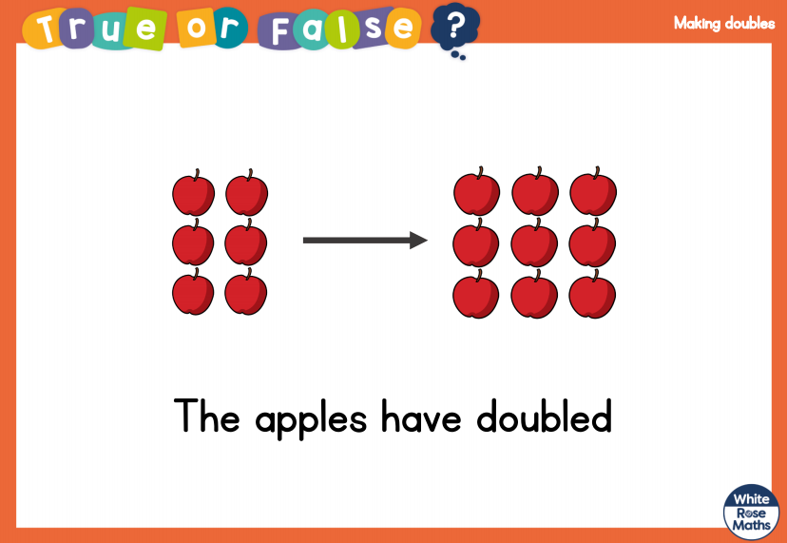

Slide 13
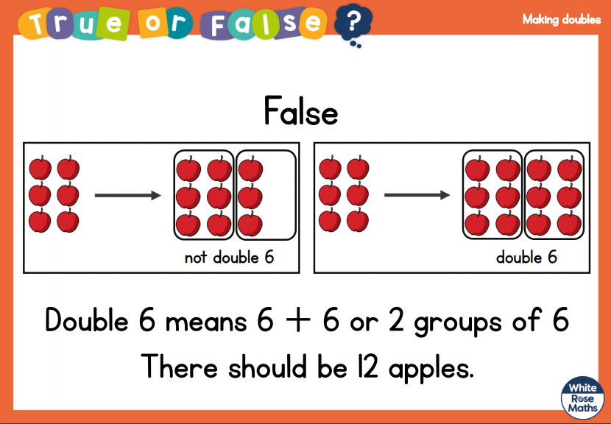

Slide 14
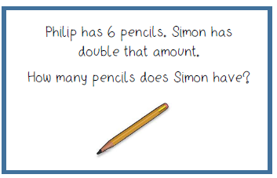
Double 6…
6 + 6 = 12

Slide 15
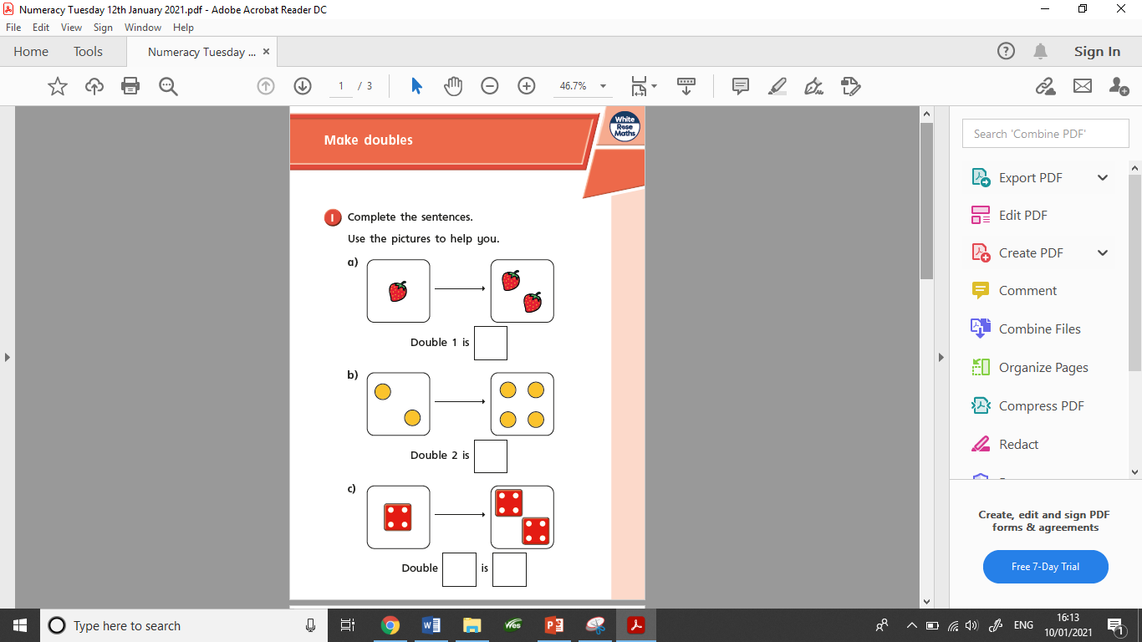
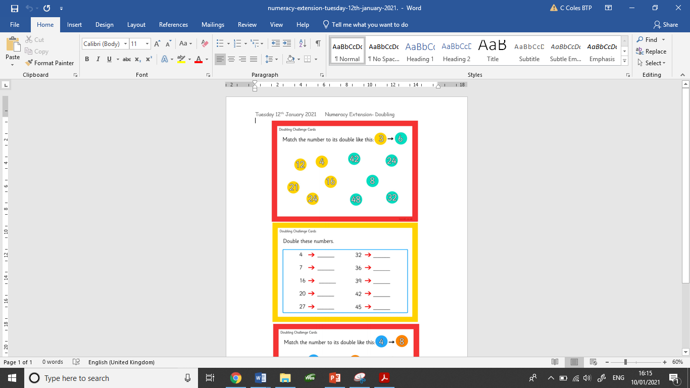
Today’s worksheets

Slide 16
13/1/21
LO: To make arrays
Practical activity

Slide 17
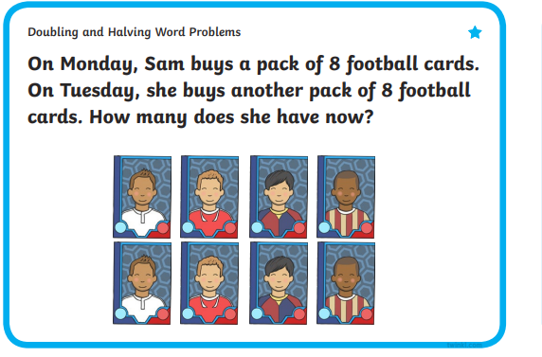
Double 8…
8 + 8 = 16

Slide 18

What are arrays?
An array is an arrangement of a set of numbers or objects in rows and columns. It helps you understand calculations by displaying them visually. It can be really useful when multiplying two numbers.
Columns
Rows

Slide 19
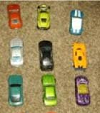
Here is an array made up of toy cars.
There are 3 rows and 3 columns.
Remember to use your knowledge of equal groups to make sure there is the correct amount in each row and column.

Slide 20
Your task
Today your task is to use objects in your house to make arrays.
You can then have a go at writing the number sentence to match the array you have made.

Slide 21
Example
If this was the array I made the number sentences would be…
3 + 3 + 3 = 9
Or
3 x 3 = 9

Slide 22
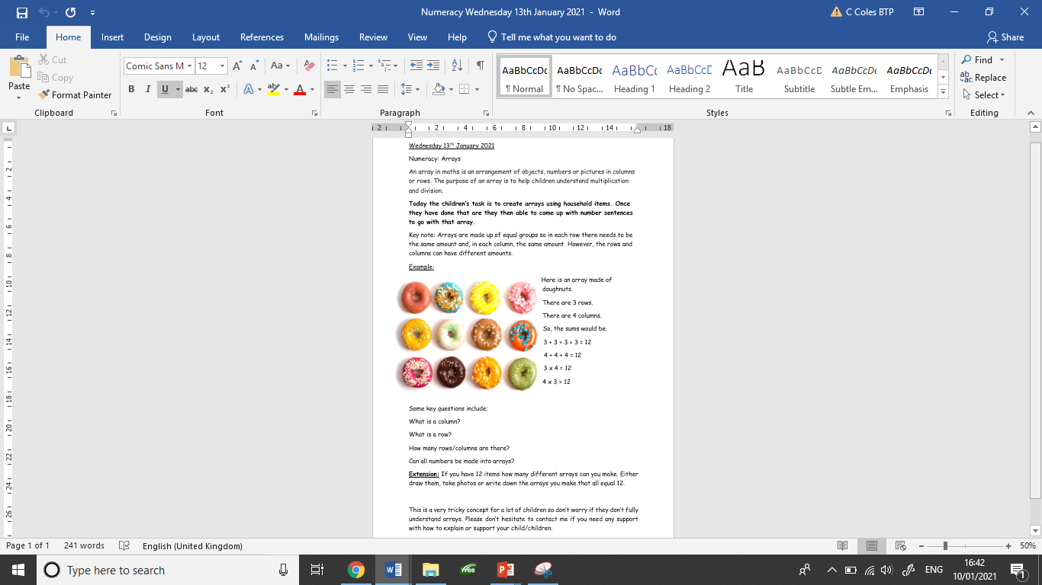
There is a sheet on the class page which may help you with understanding arrays.

Slide 23
14/1/21
LO: To make arrays

Slide 24

True or False
I have correctly made an array
False, because they need to be in equal groups.

Slide 25
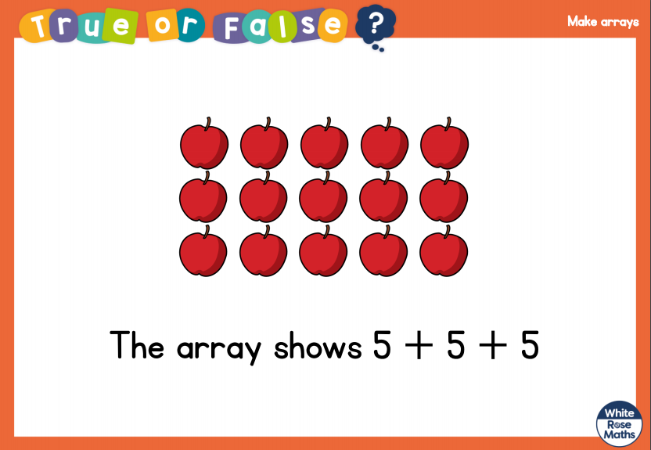

Slide 26
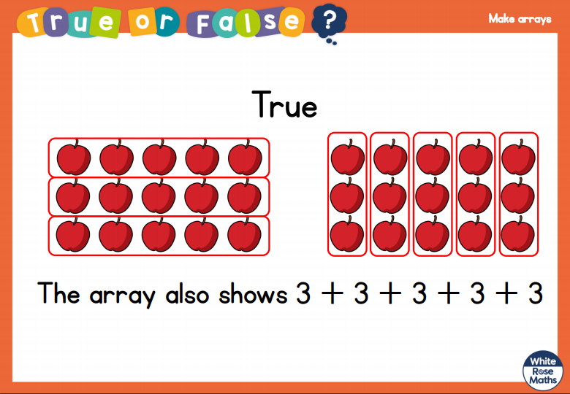

Slide 27
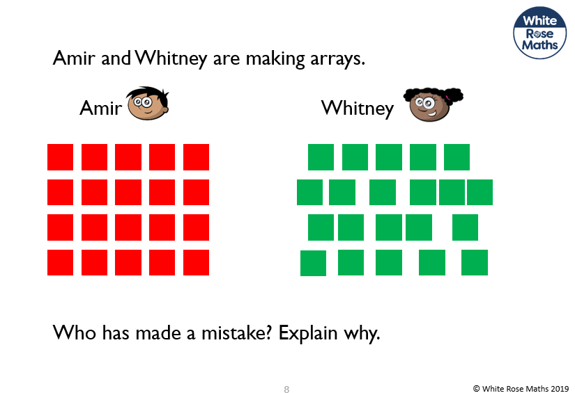

Slide 28
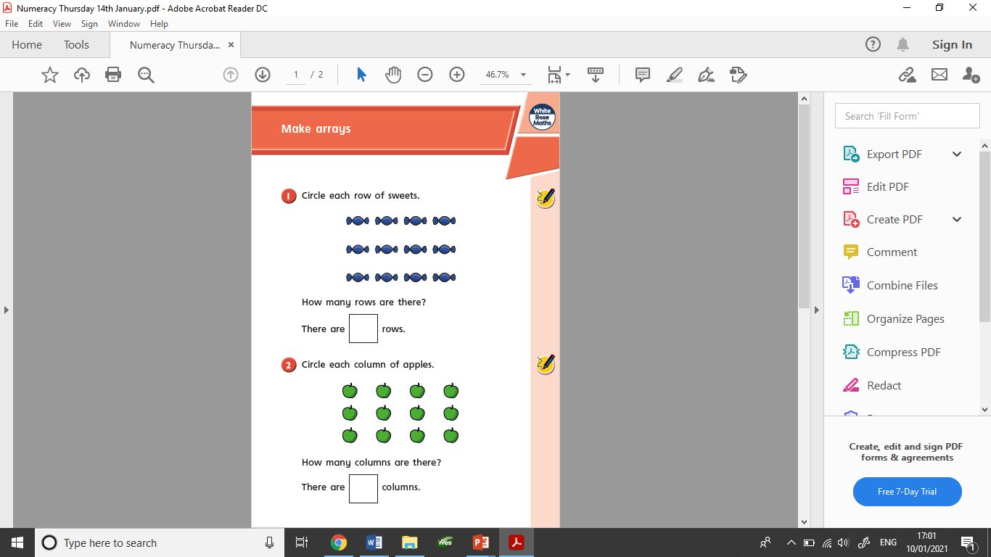
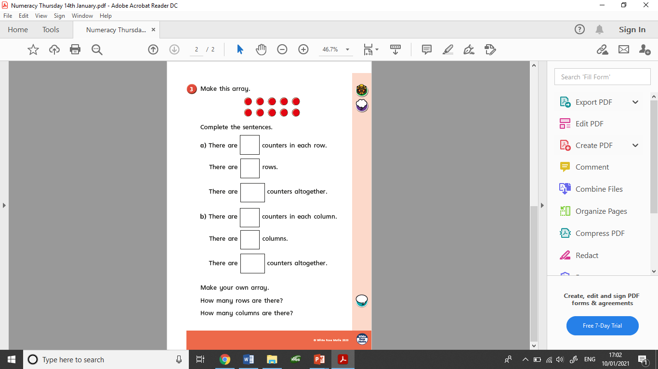
Today’s worksheets

Slide 29
15/1/21
LO: To use arrays

Slide 30

There are two different types of number sentences that you can write about arrays.
The first is repeated addition, this means adding the same number.
4 + 4 + 4 = 12 or
3 + 3 + 3 + 3 = 12
The second is a multiplication sum. This is using the x symbol. You x the number of columns by the number of rows.
3 x 4 = 12 or
4 x 3 = 12

Slide 31

What would the repeated addition sums be for this array?
2 + 2 + 2 + 2 = 8
Or
4 + 4 = 8

Slide 32
What would the multiplication sums be for this array?
2 x 4 = 8
Or
4 x 2 = 8

Slide 33
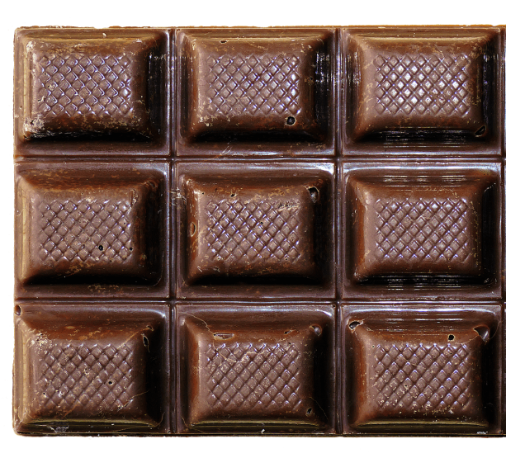
What would the sums be for this array?
3 + 3 + 3 = 9
Or
3 x 3 = 9

Slide 34
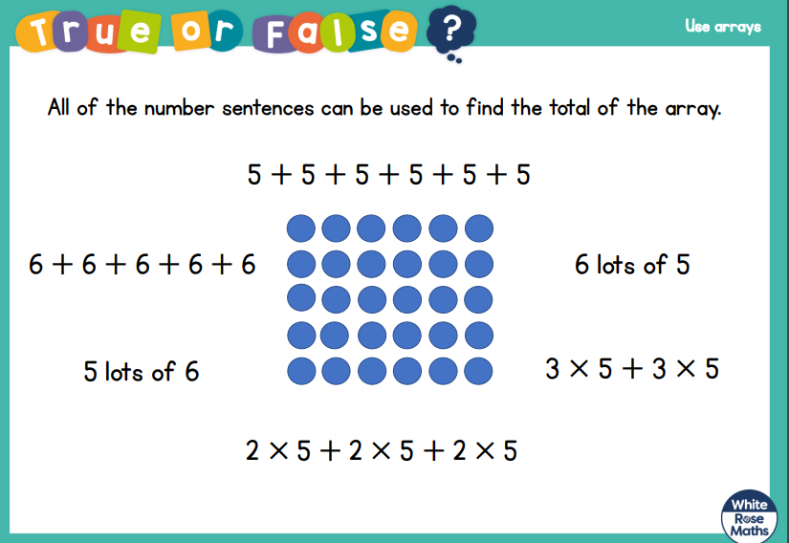

Slide 35
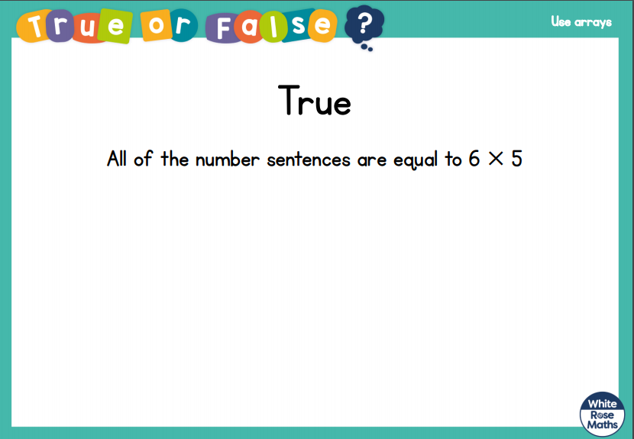

Slide 36
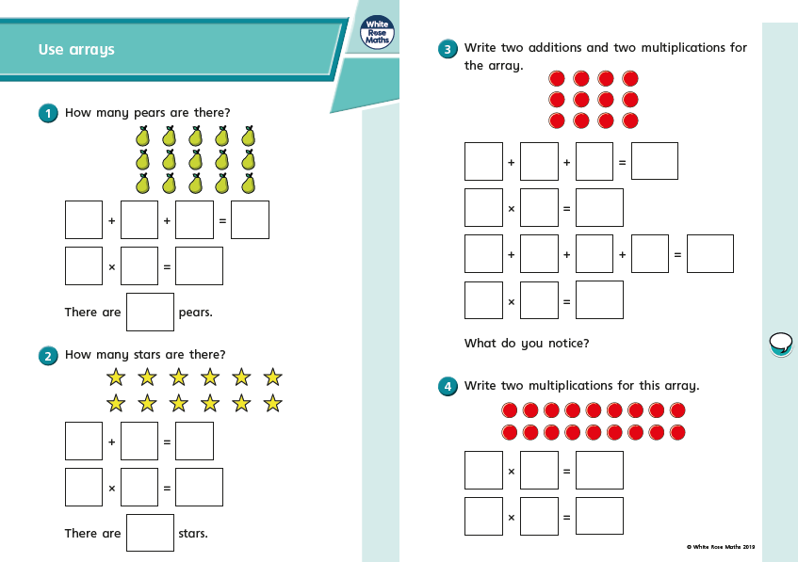
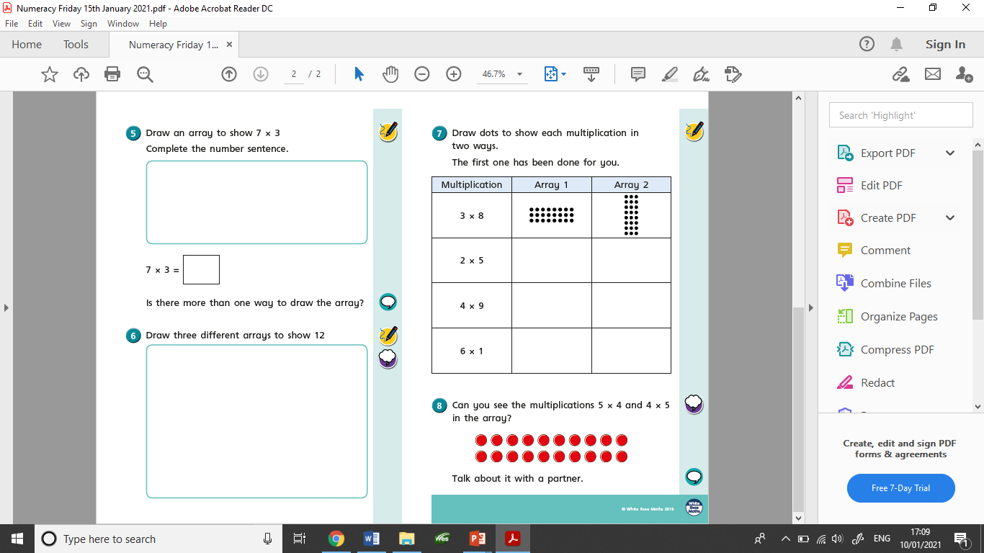
Today’s worksheets

