Slide 1
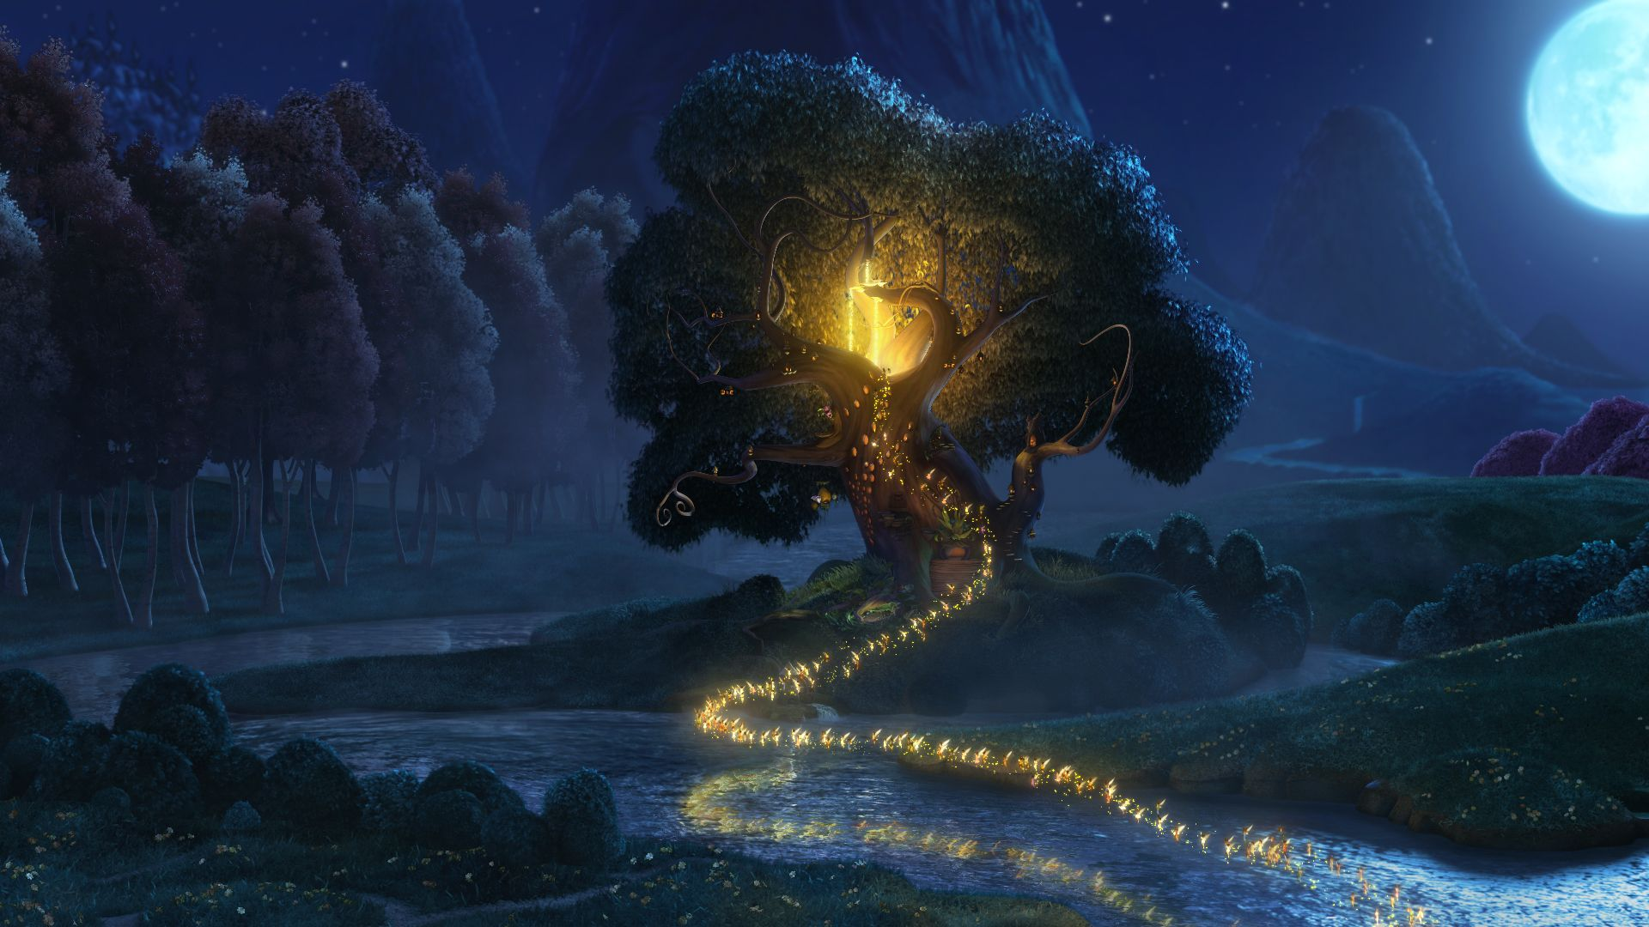
Tuesday 25th May 2021
Paint a picture of your fairy.

Slide 2
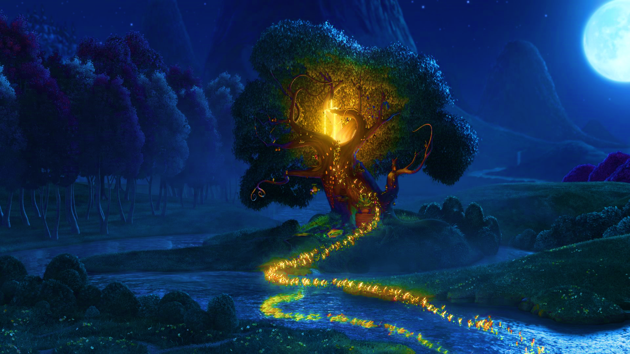
Remember the fairies we looked at yesterday?
Today we will be working on painting a picture of our fairy, including many of the details that make fairies so unique.

Slide 3
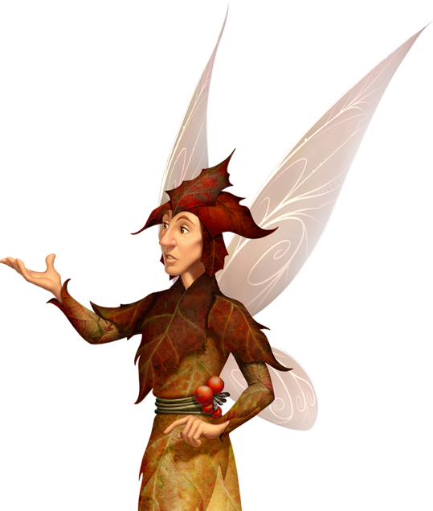
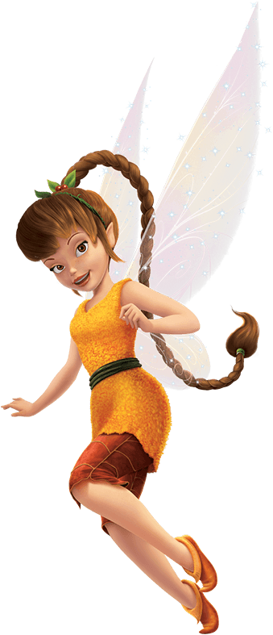
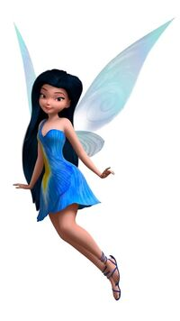
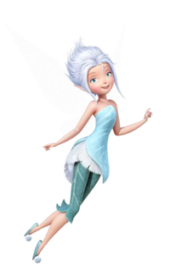
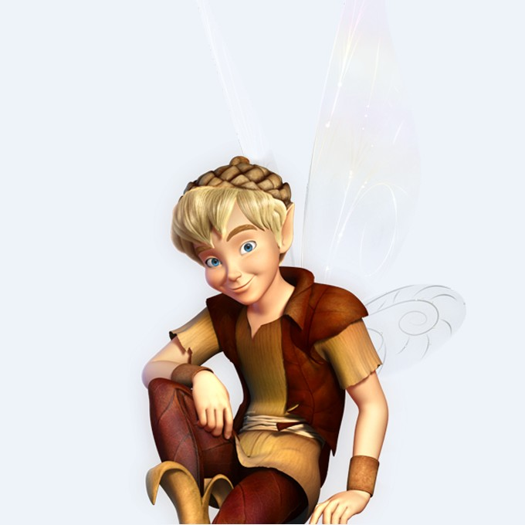
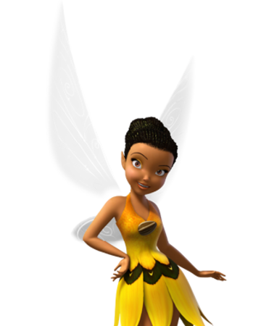
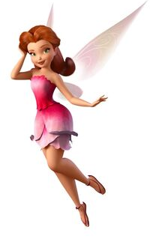
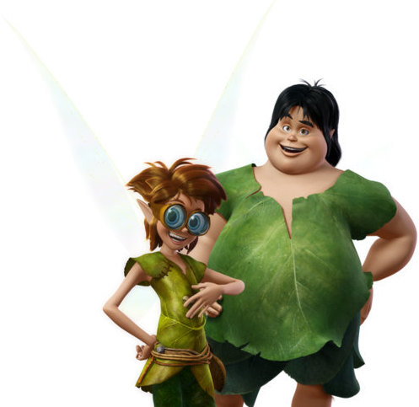
There are lots of types of fairies and they can have different powers.
Water
Winter
Autumn
Animal
Garden
Dust keeper
Light
Tinker

Slide 4
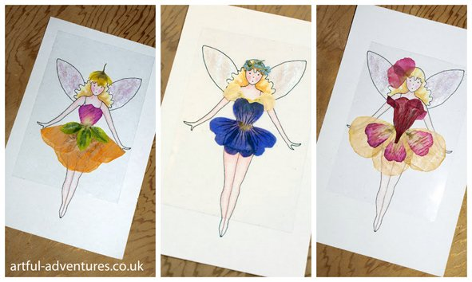
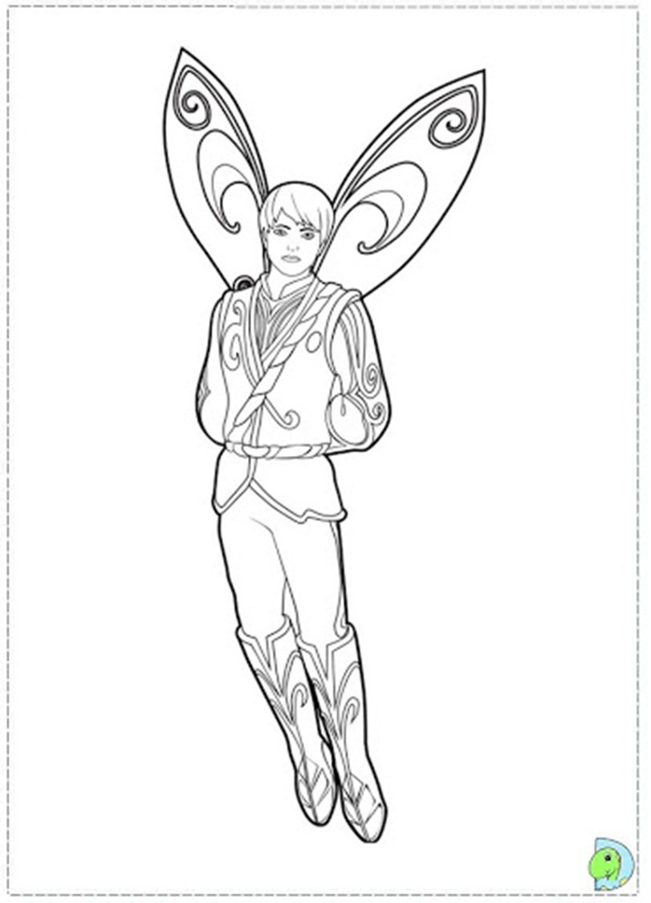
Think about these fairy outfits. Today we will be using tissue paper / coloured paper to create the outfits.
Think what shapes you might need and create your own collage!
Colour in the skin, hair and any parts that are too teeny for tissue paper!
Your Task
Have fun with your collages!

Slide 5



