Slide 1
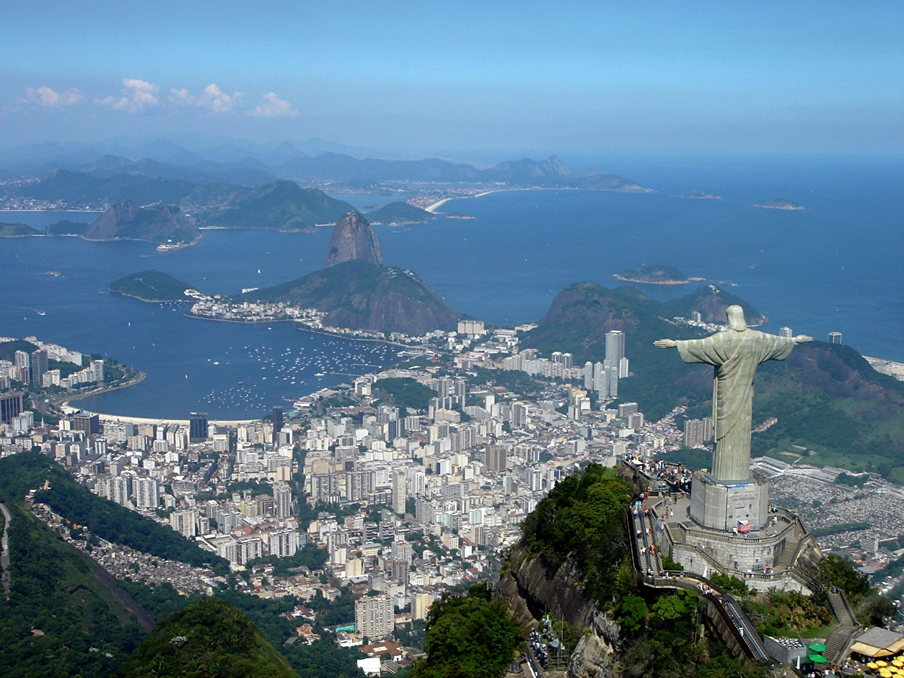
Thursday 7th February
Topic - Geography
LO: To compare Rio de Janeiro with Stratford upon Avon.

Slide 2
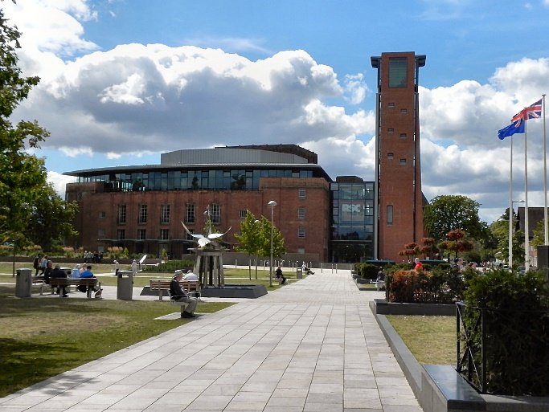
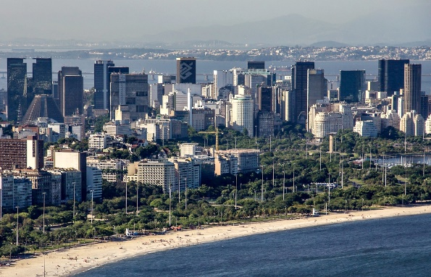
Rio and Stratford
Rio de Janeiro in Brazil and our home town of Stratford in the United Kingdom are very different places.
We will compare these two places to understand how they are different and how they are similar.

Slide 3
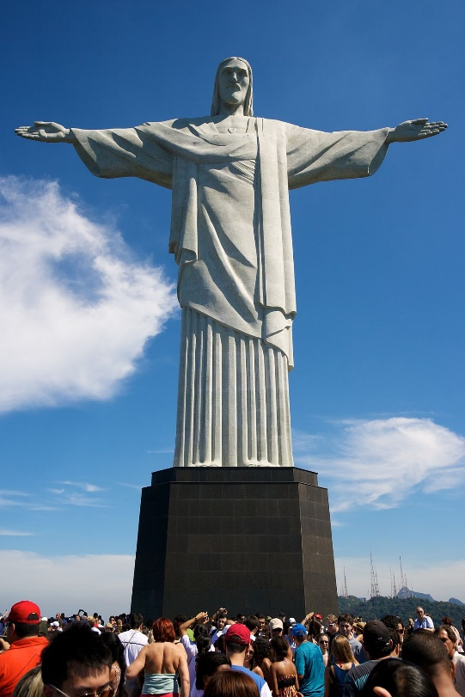
Find out more about Rio de Janeiro
Watch these clips from BBC Bitesize
https://www.bbc.co.uk/bitesize/topics/zyhp34j/articles/zr2h47h

Slide 4

What do we know about Stratford?
We know a lot about Stratford because it is where we live.
We also learnt about Stratford last term in our topic ‘Street Detectives’.
Can you find out about Stratford from your family?

Slide 5
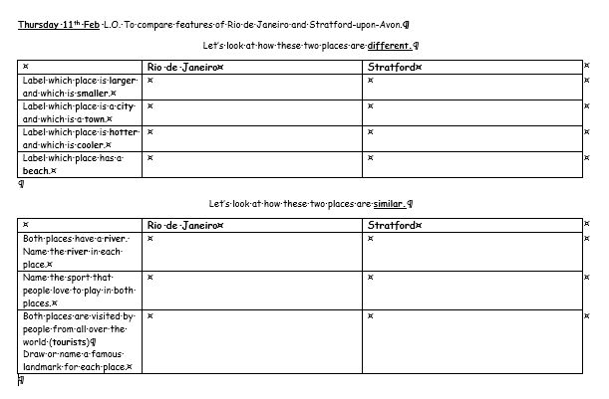
Your Task
Complete the table to find the differences and similarities between Rio and Stratford.
Challenge:
Can you add any more comparisons between these 2 places?

