Slide 1

Wednesday 10th February
L.O. Plan an investigation and explain what you discover.

Slide 2
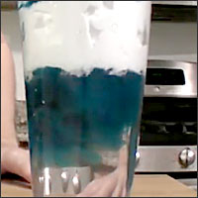
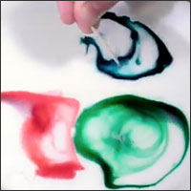
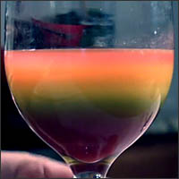
Your Task
Today your task is to plan and carry out an experiment of your choice at home. Lots of ideas can be found using the website linked below.
https://www.sciencefun.org/kidszone/experiments/

Slide 3


Remember before you start your experiment, make a prediction (sensible guess).
This is when you say what you think will happen. Remember to explain why you think this.

Slide 4
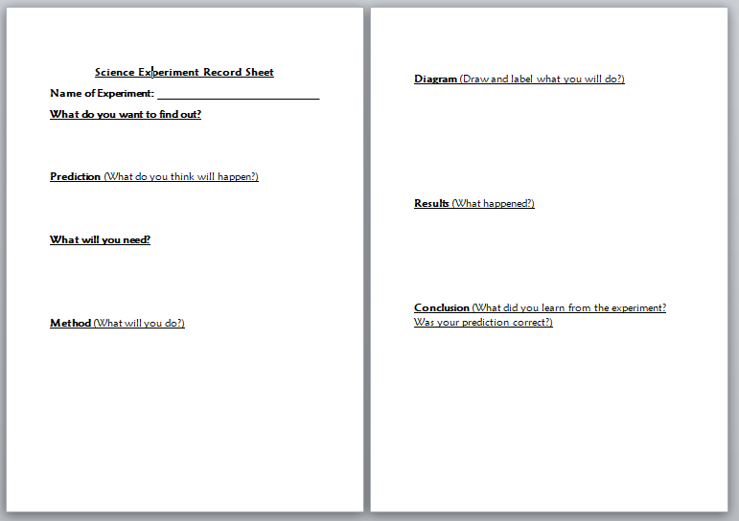
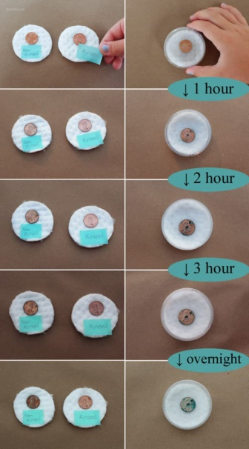
Sharing your results
Option 1
Tell us about your experiment
during the afternoon sharing session.
Option 3
Complete the experiment record sheet which can be found on the school website.
Option 2
Use photographs to record your findings.

