Slide 1
LO: To write a list of things to take to explore the rainforest.
Monday 8th February 2021
To write a list
To explain why you need these items using complete sentences.
Use conjunctions because, so, but & and.

Slide 2


Slide 3


Slide 4
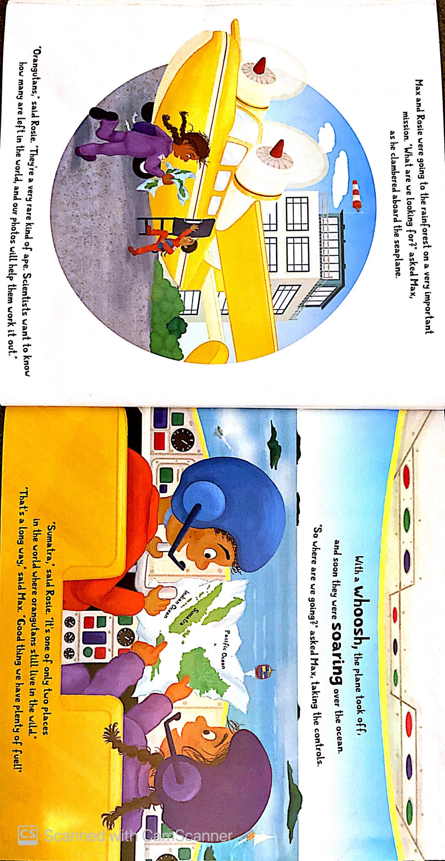
a map

Slide 5
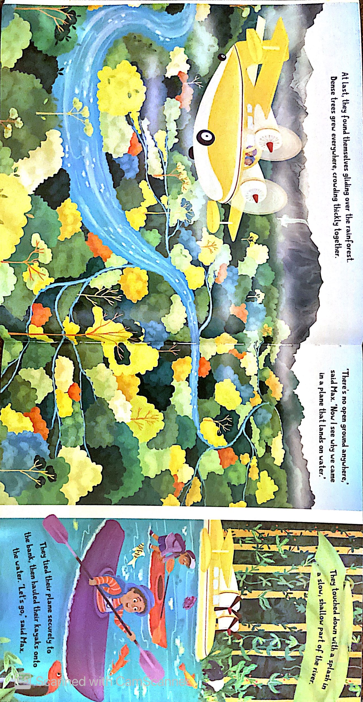
a kayak and paddle

Slide 6
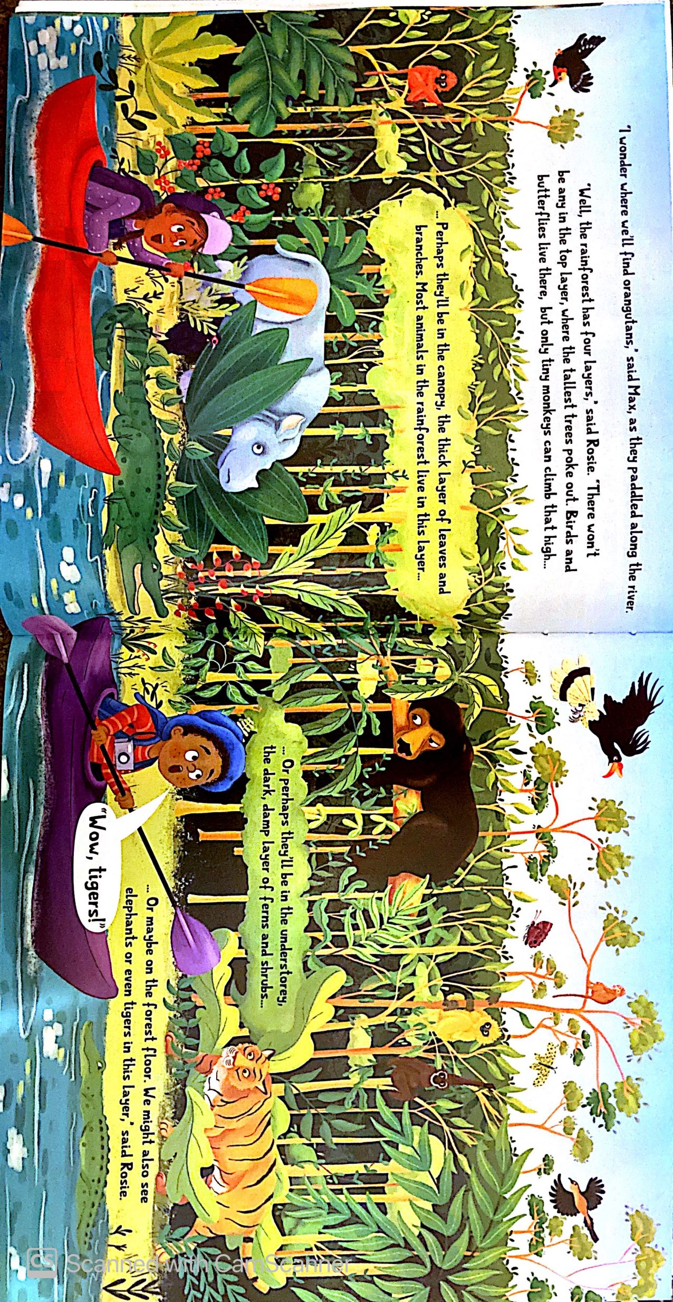
a camera

Slide 7
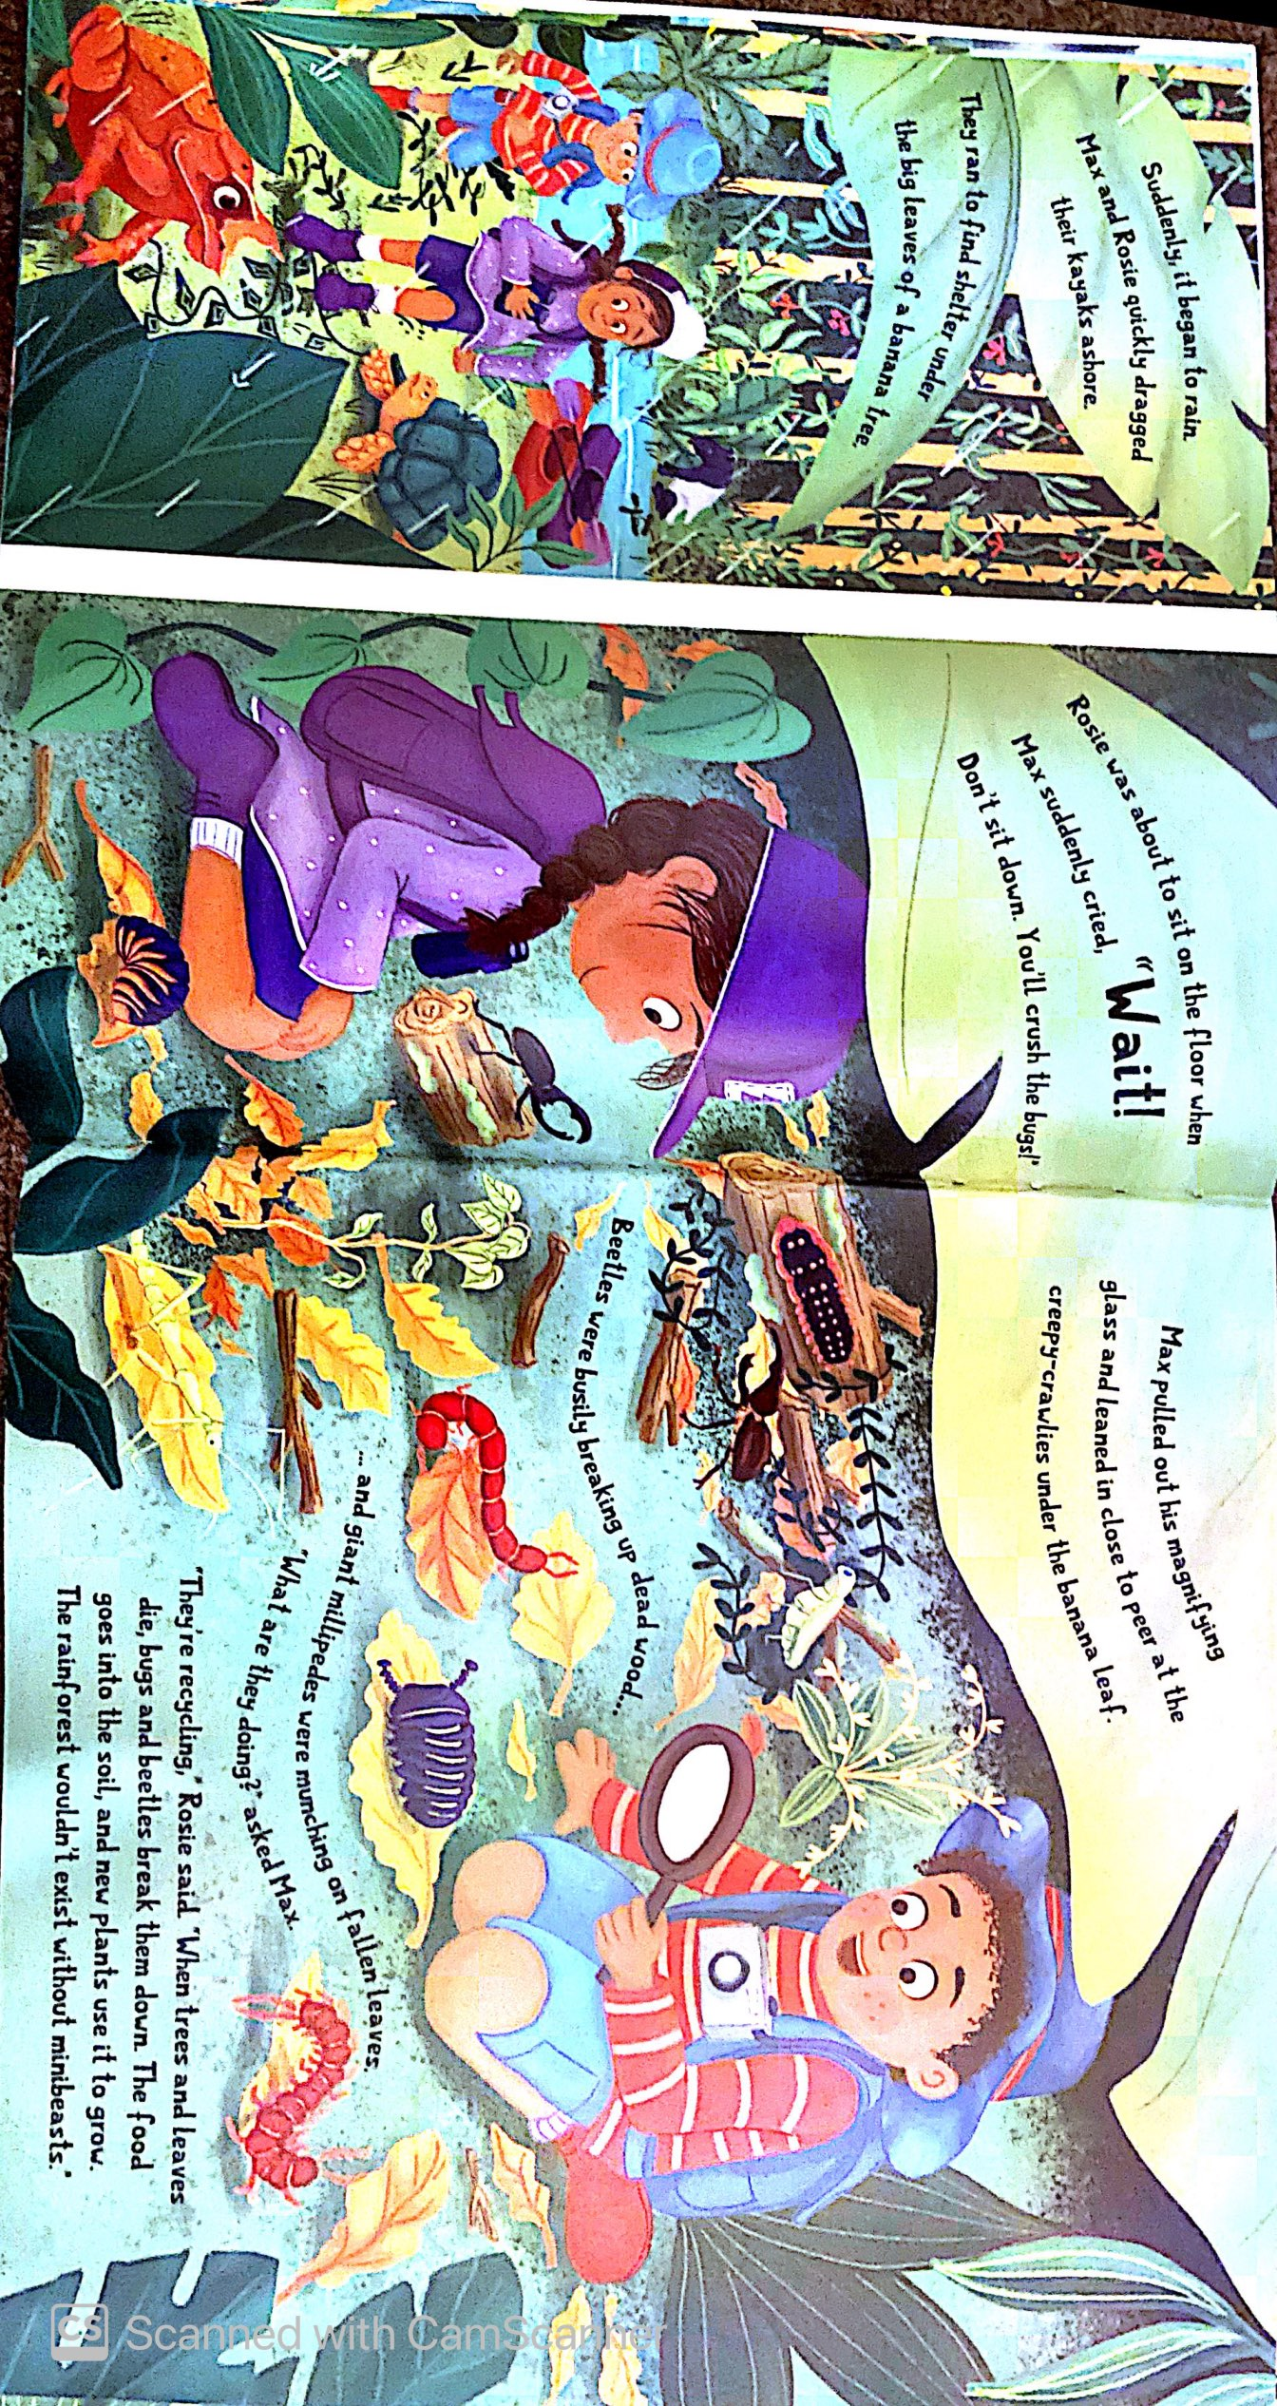
a magnifying glass

Slide 8
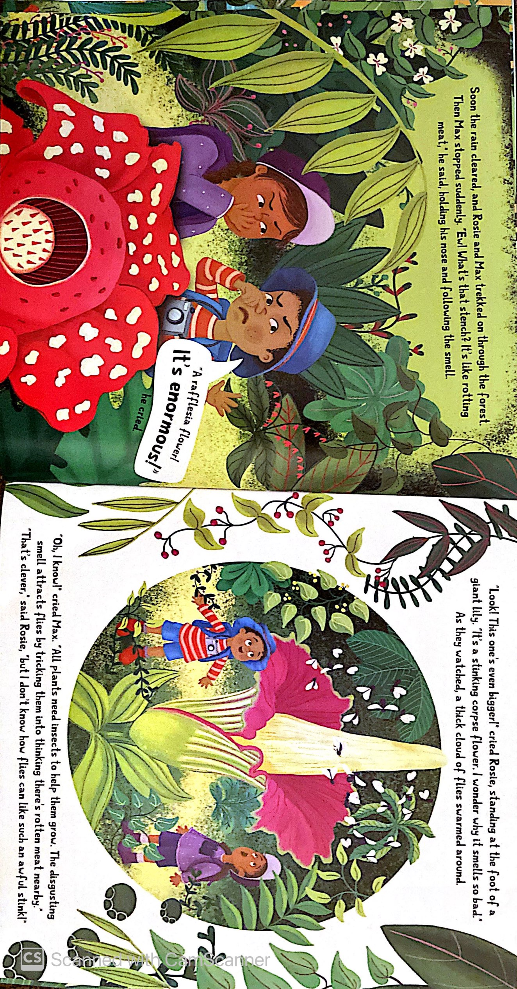
a hat
a pair of binoculars

Slide 9
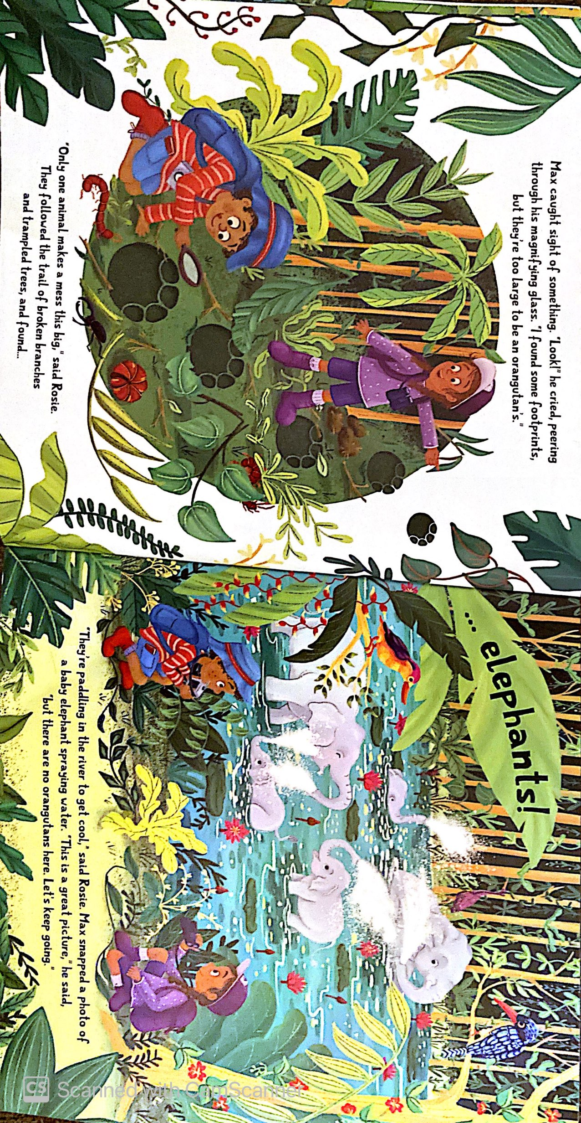
good boots

Slide 10
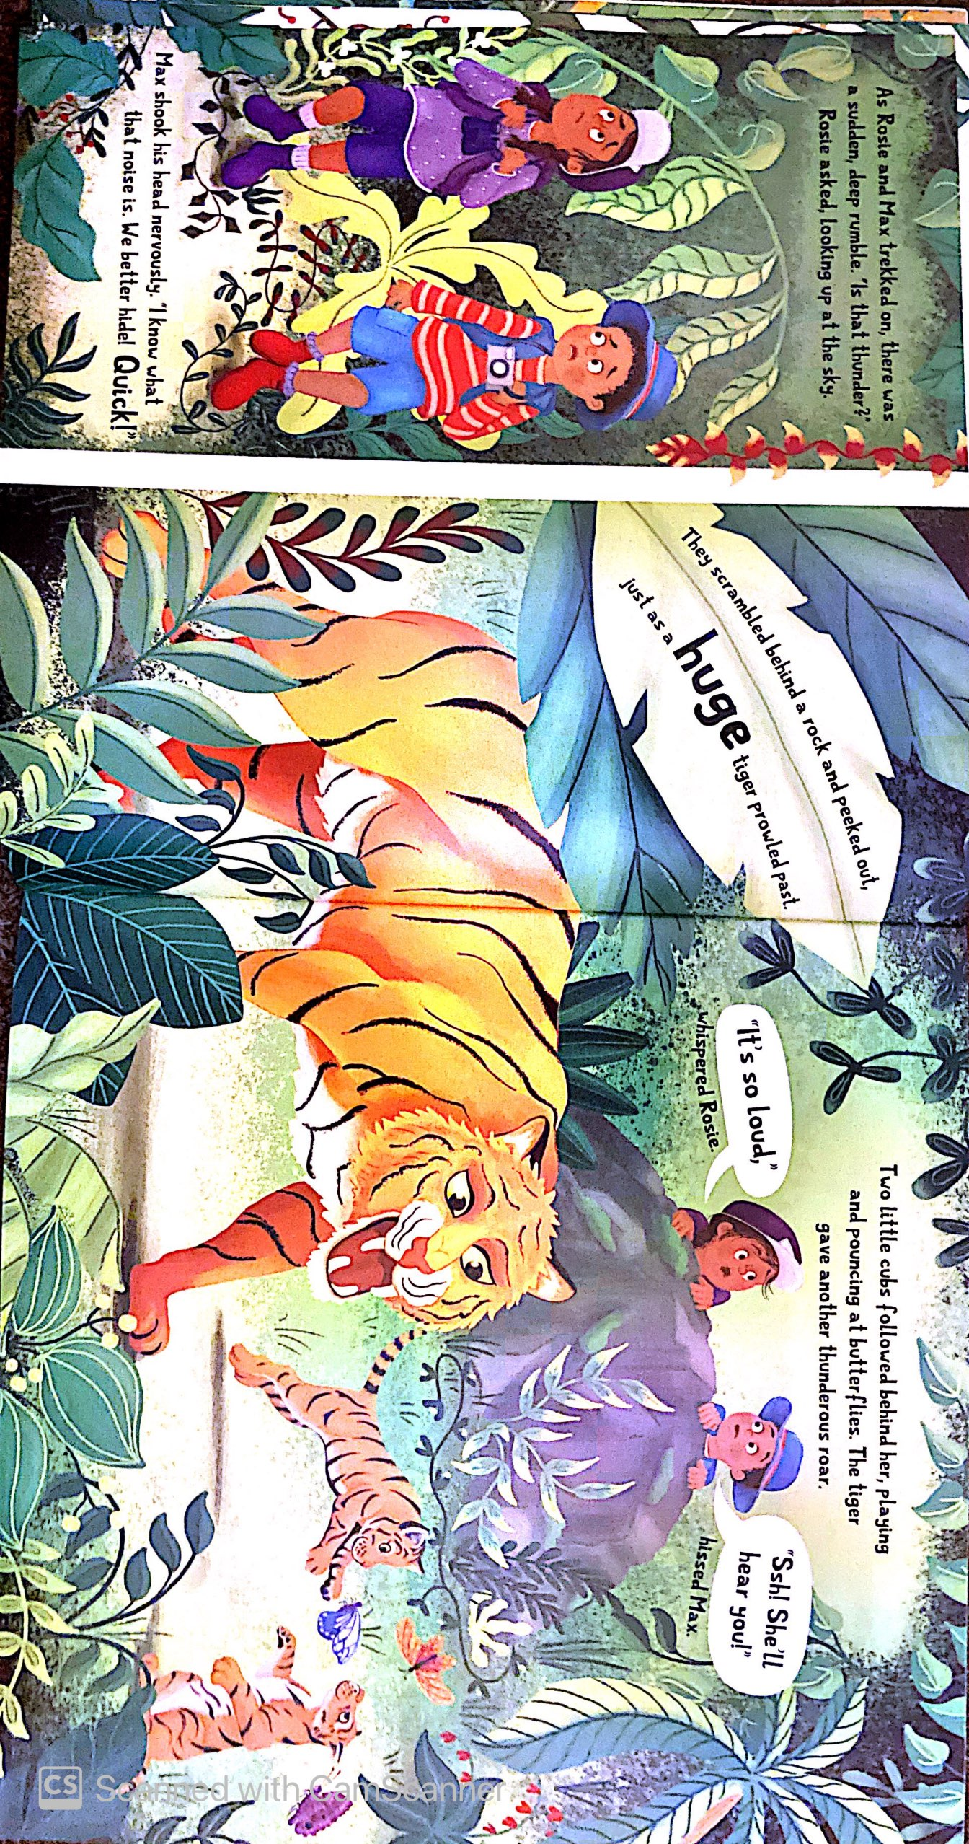
meat to feed hungry tigers

Slide 11
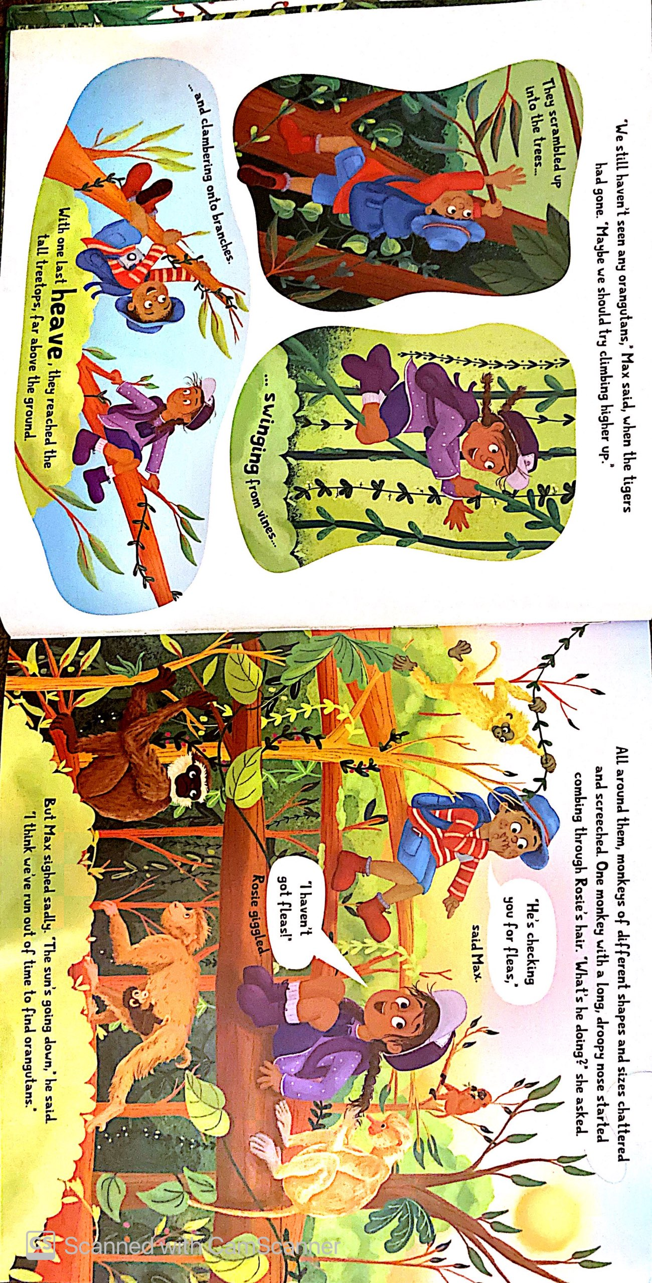
Fruit to eat and feed to monkeys

Slide 12
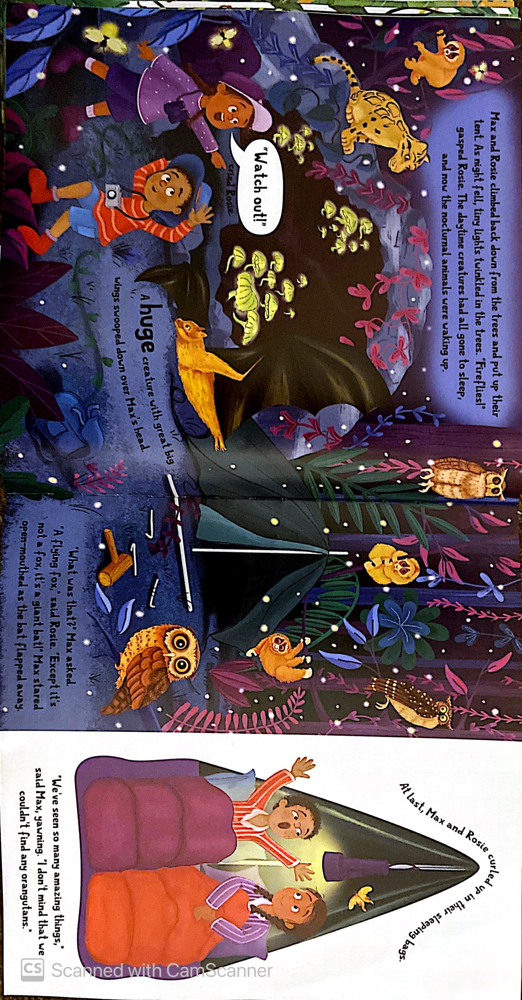
a tent
a torch
A sleeping bag

Slide 13
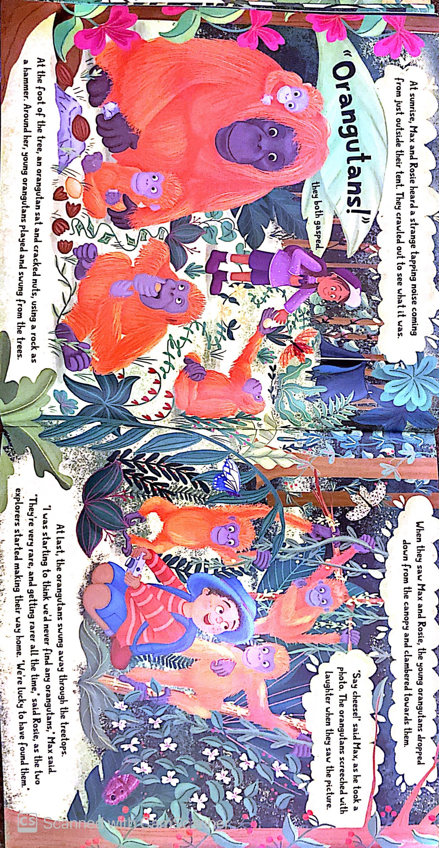

Slide 14
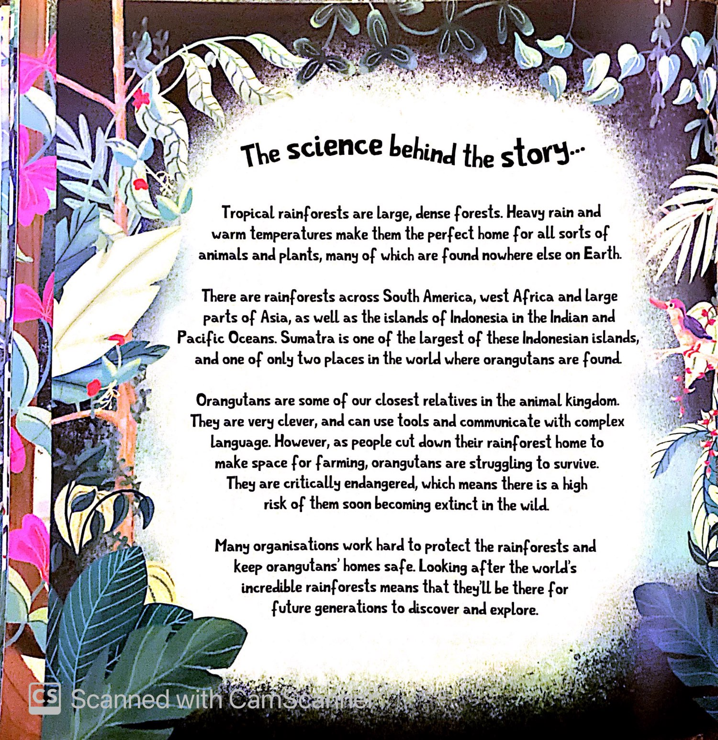

Slide 15
What things did you spot that the children took with them on their journey?
meat to feed hungry tigers
a map
good boots
a tent
Fruit to eat and feed to monkeys
a kayak and paddle
a pair of binoculars
a torch
A sleeping bag
a camera
a magnifying glass
hats

Slide 16
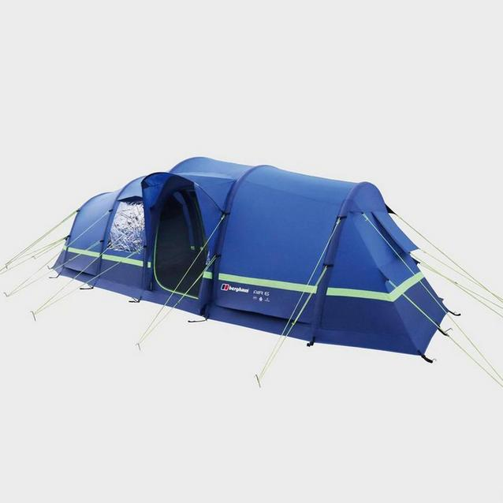
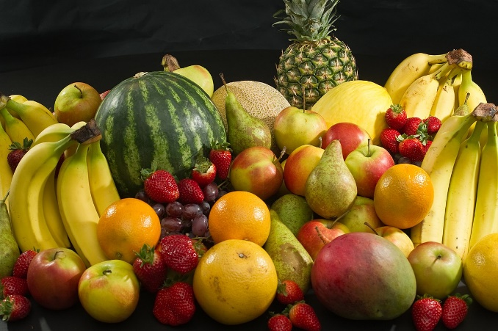
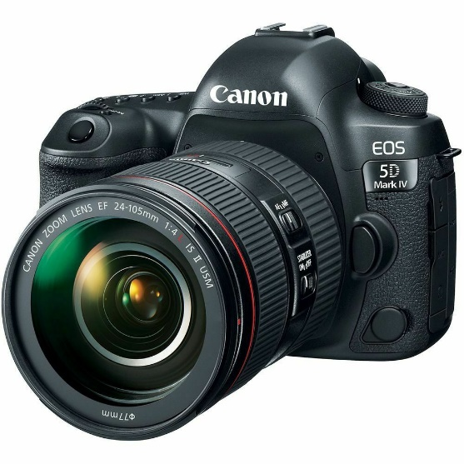
My Packing List for the Rainforest
For my rainforest exploring trip, I would pack:
1) A tent because I would want to stay dry at night.
2) Fruit to eat and to feed monkeys so they won’t chase me.
3) A camera to take photos because I wouldn’t want to forget what I saw.

Slide 17
Your task: create your own list of items to take with you on an adventure to the Amazon Rainforest.
You can use some of the ideas from the story and add your own ideas too!
Option 1: complete the PowerPoint template using online pictures and your own text.
Option 2: Print out the template and add your own drawings and writing.
Option 3: Use a blank piece of paper and create your own list with drawings and text.

Slide 18
My Packing List For My Rainforest Trip
Item 1
1)
2)
3)
Item 2
Item 3

