Slide 1
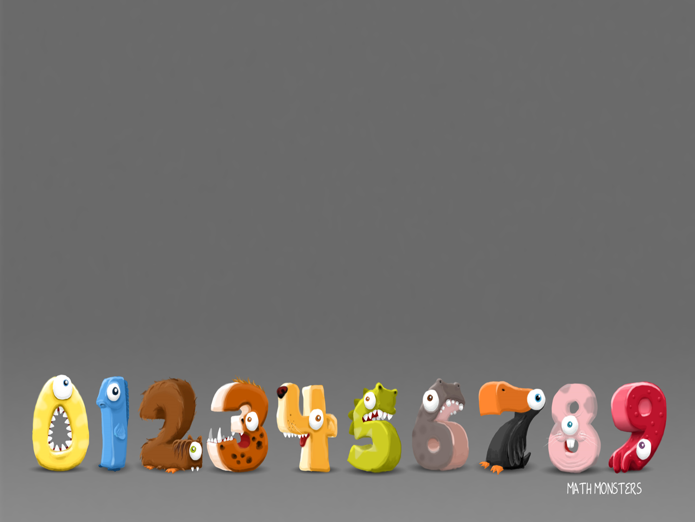
8/2/2021
LO: Divide by 2

Slide 2
When you divide by 2 your are putting the total number into 2 equal groups e.g.
6 ÷ 2 = 3

Slide 3
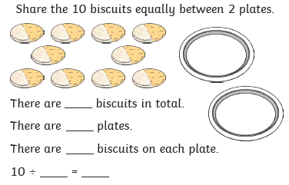

Slide 4
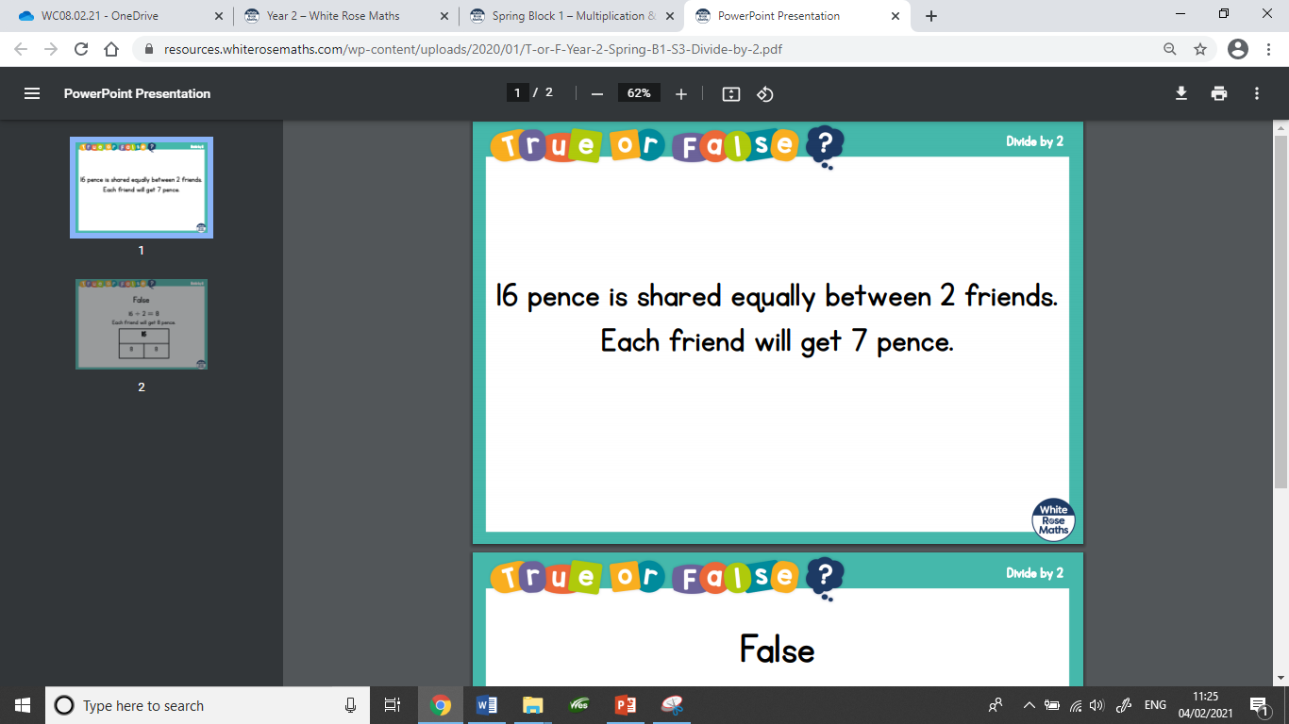

Slide 5
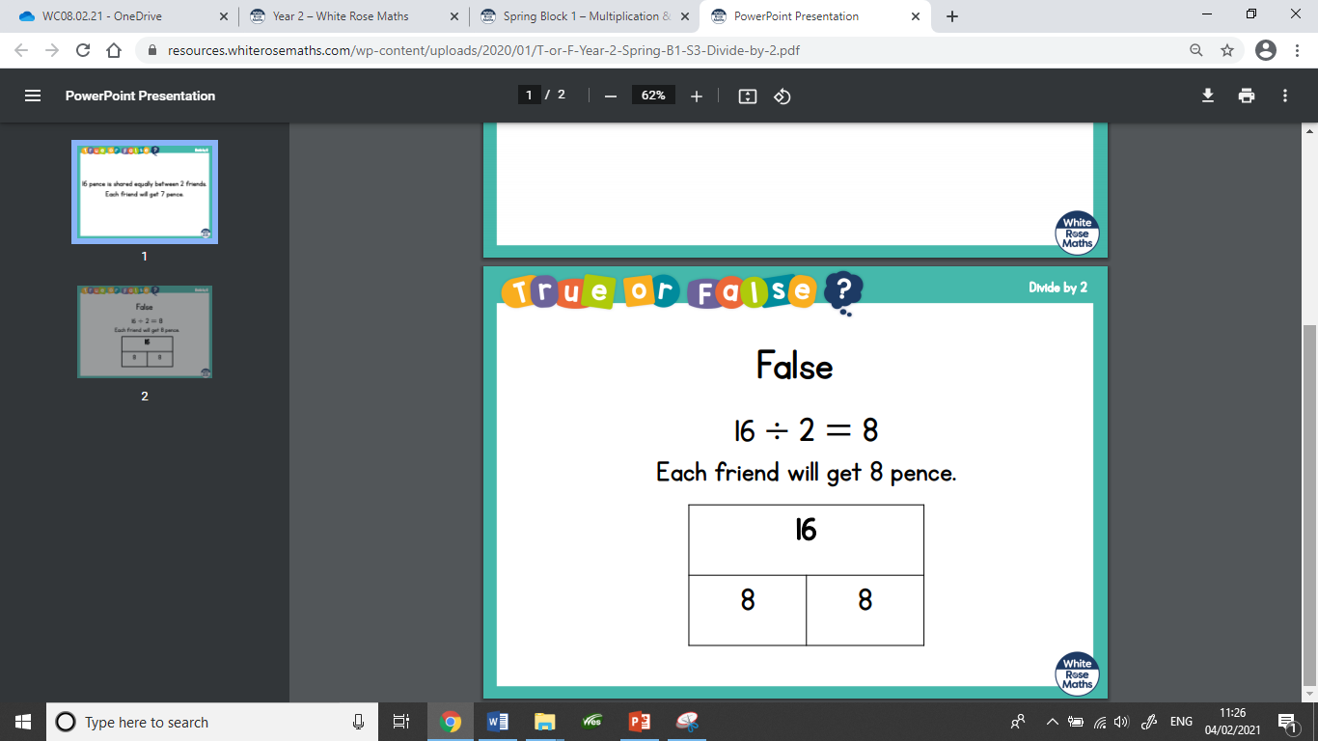

Slide 6


Zach has 16 bananas. He shares them equally between
2 boxes. How many bananas are in each box?
What would the number sentence be?
16 ÷ 2 = 8

Slide 7
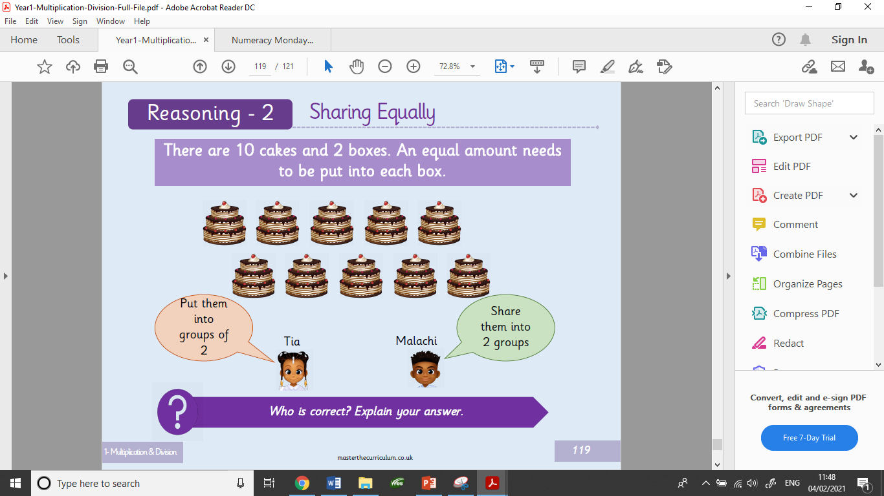

Slide 8
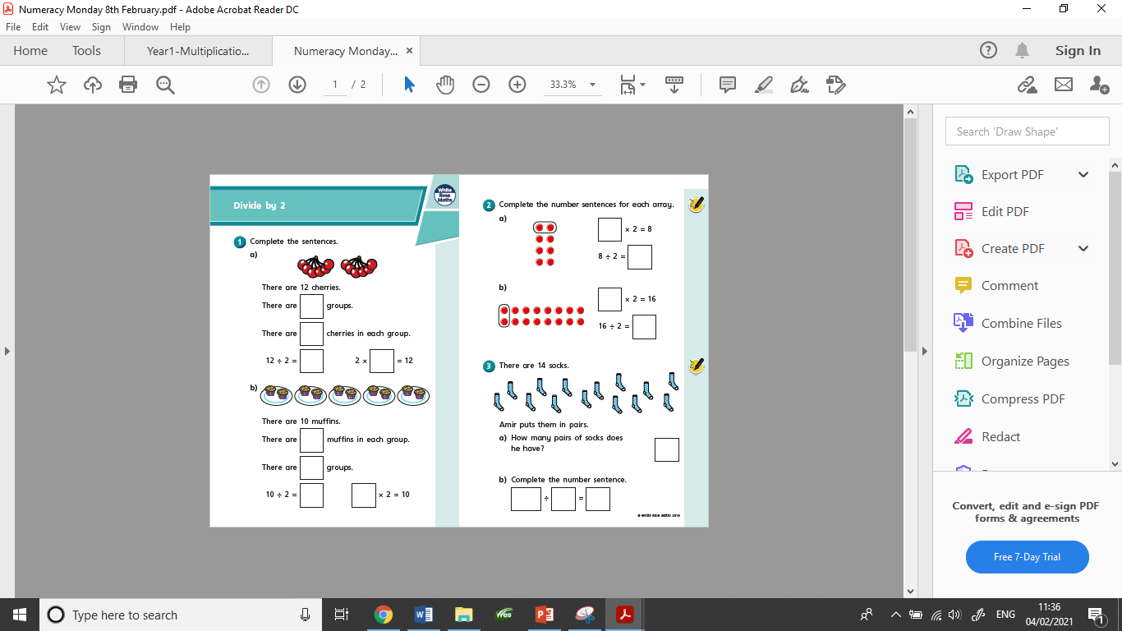
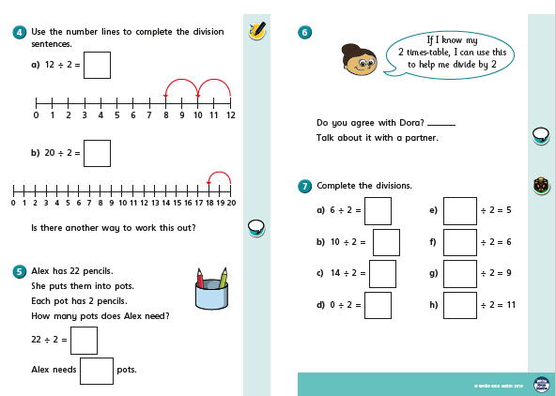
This is the worksheet set today.

Slide 9
9/2/2021
LO: To divide by 5

Slide 10
When you divide by 5 your are putting the total number into 5 equal groups e.g.
10 ÷ 5 = 2

Slide 11
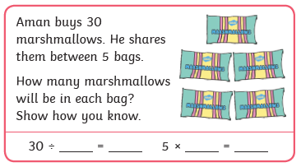

Slide 12
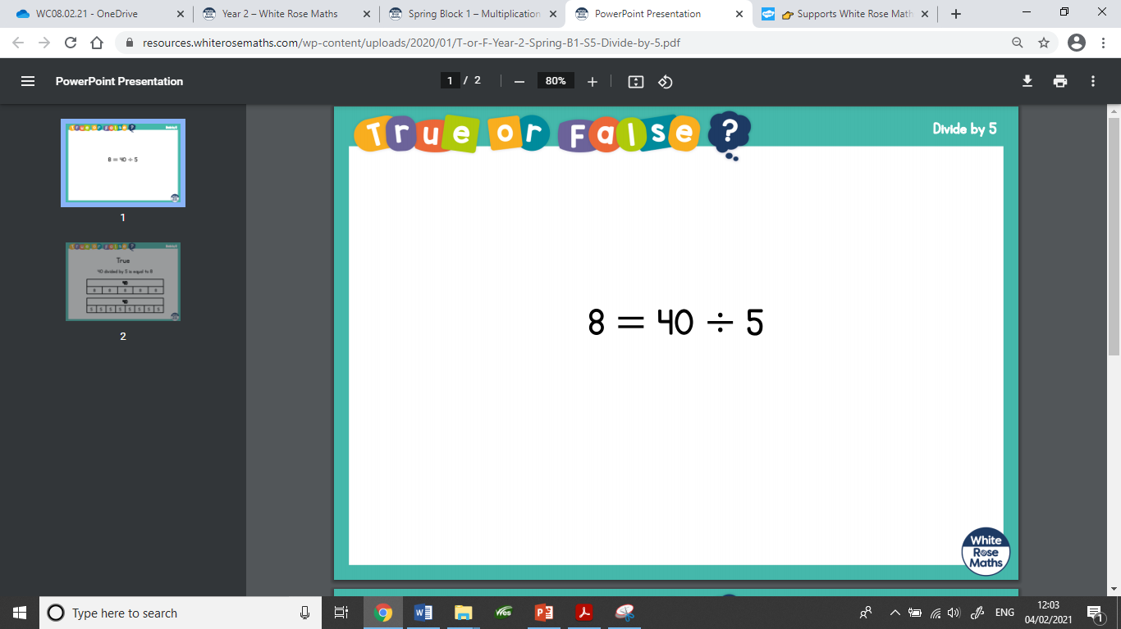

Slide 13
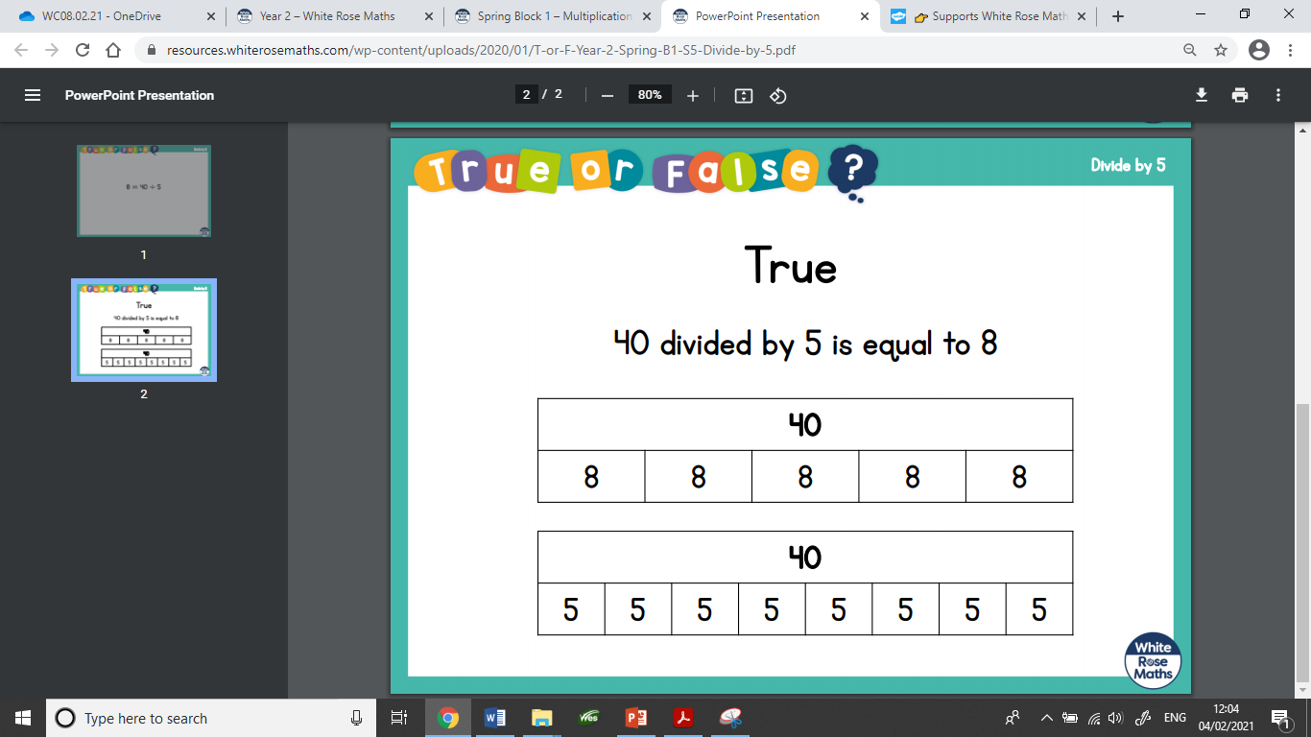

Slide 14
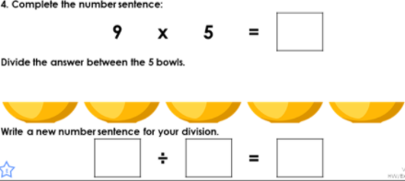

Slide 15
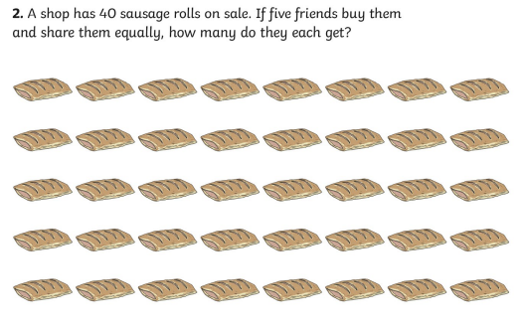

Slide 16
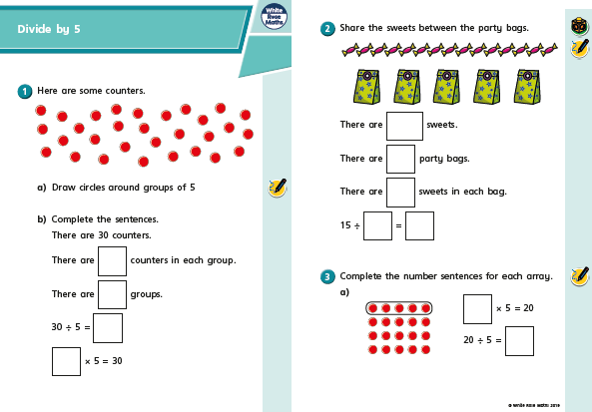
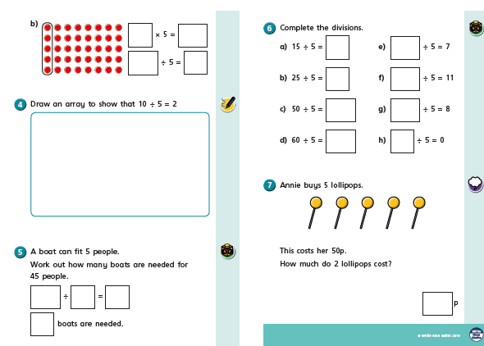
Your set task today.

Slide 17
10/2/2021
LO: Divide by 10

Slide 18
When you divide by 10 your are putting the total number into 10 equal groups e.g.
10 ÷ 10 = 1

Slide 19
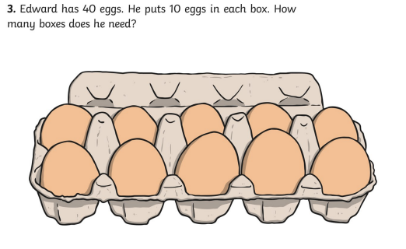

Slide 20
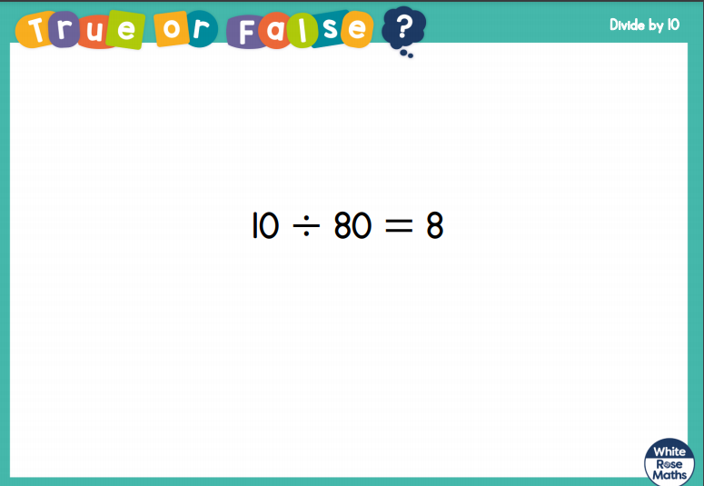

Slide 21
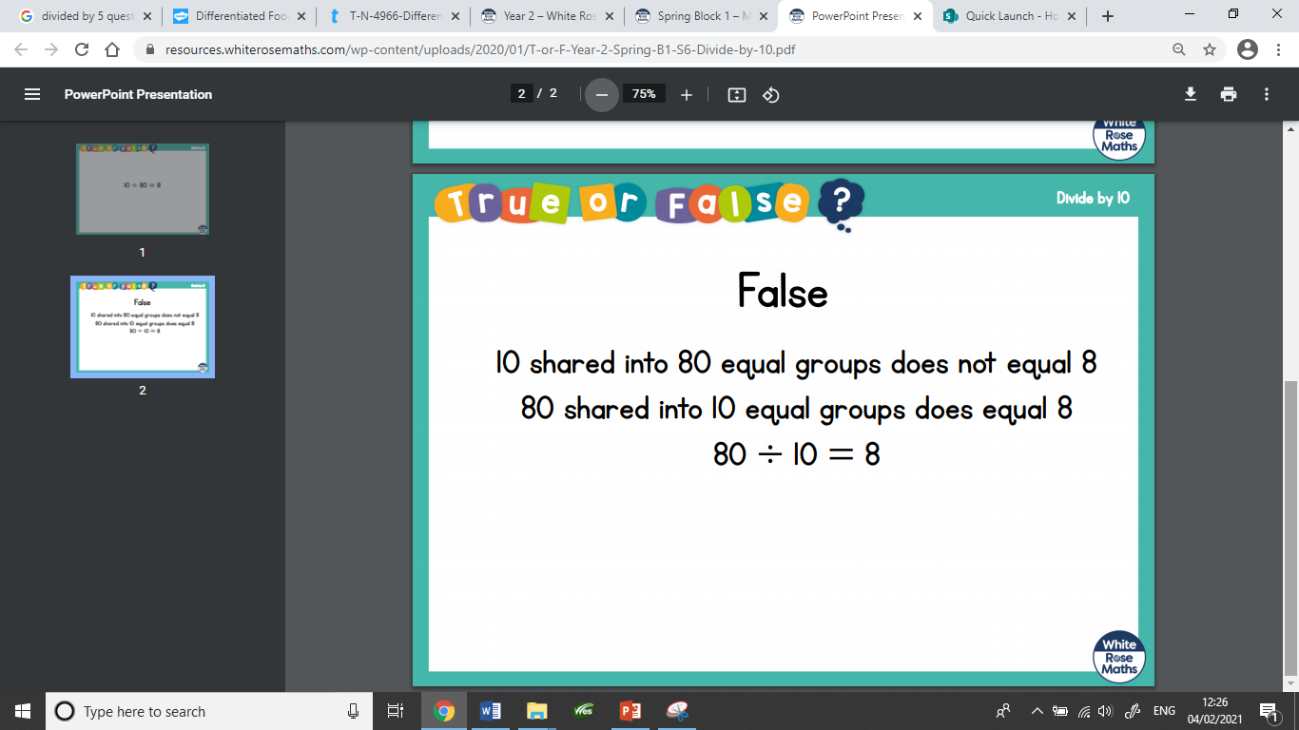

Slide 22
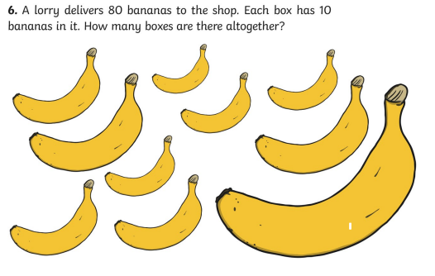

Slide 23
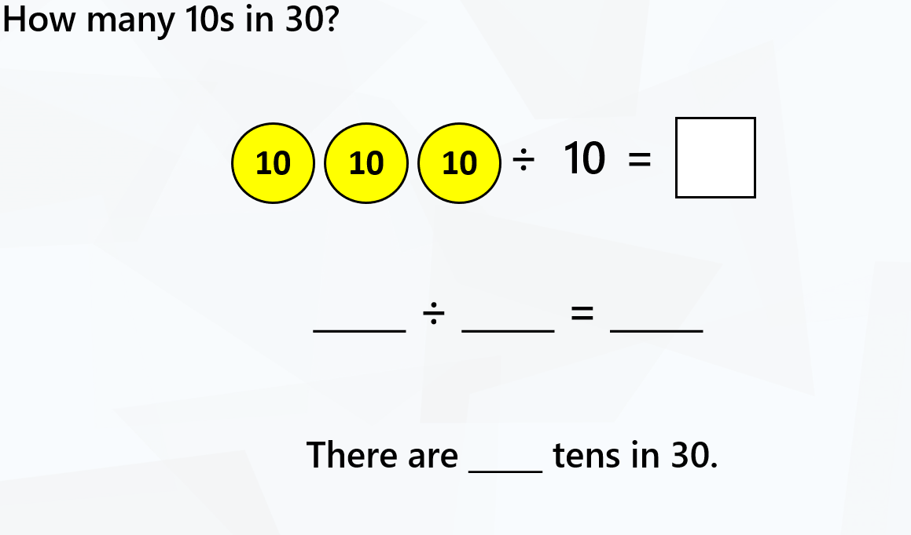

Slide 24
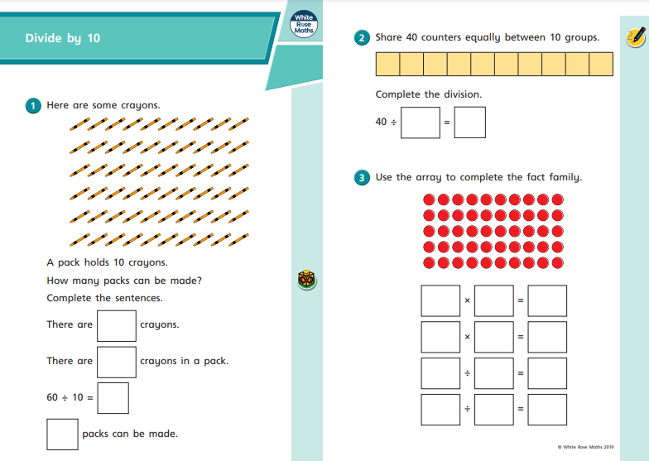
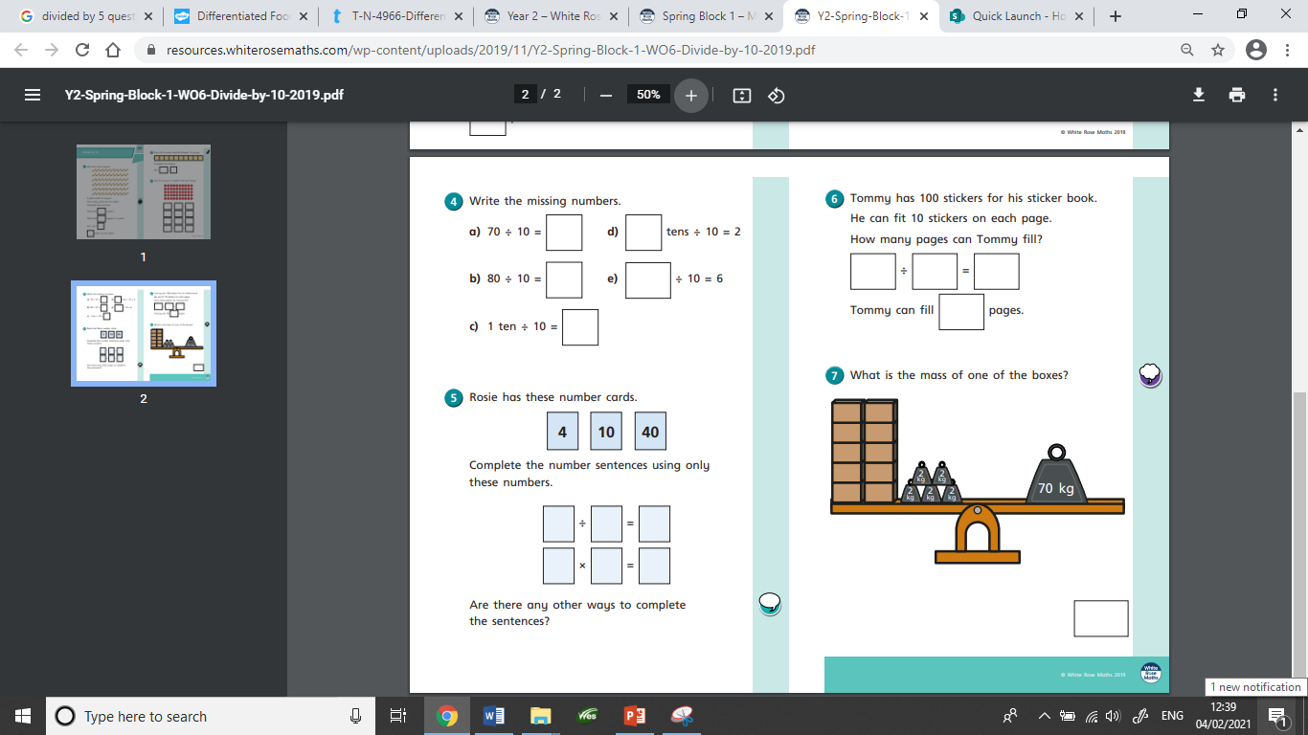
This is the worksheet set today.

Slide 25
11/2/2021
LO: Multiplication Recap

Slide 26
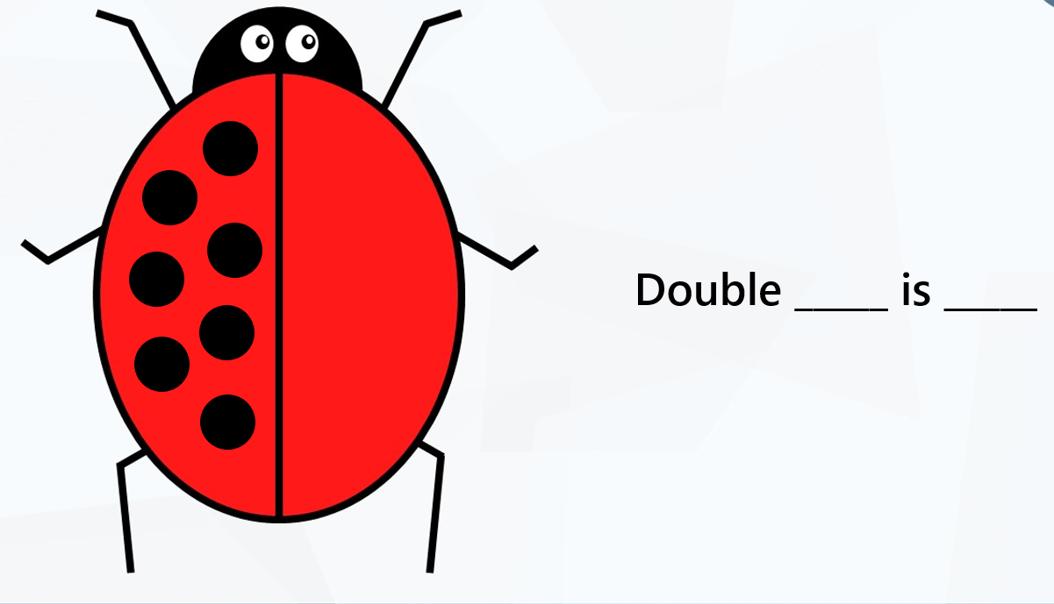

Slide 27
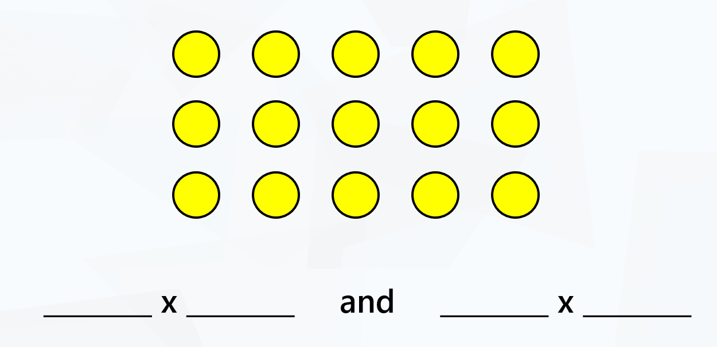

Slide 28
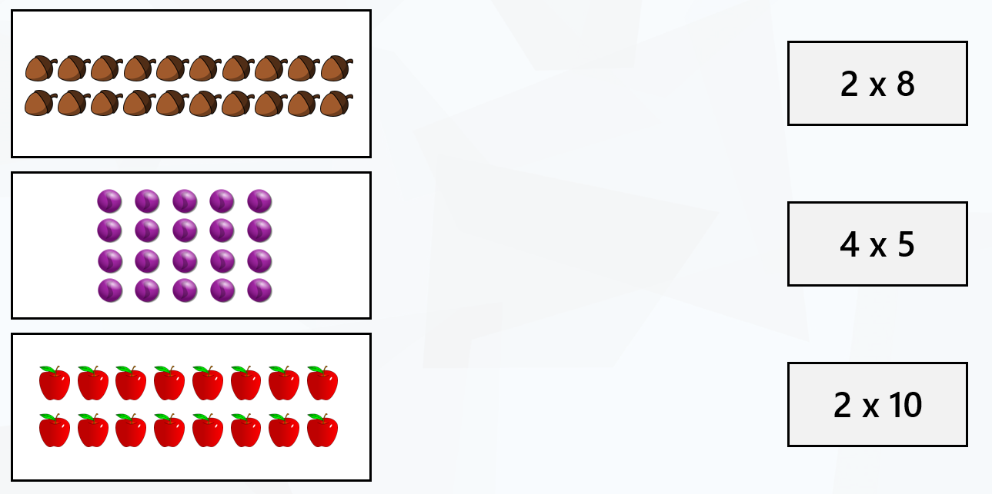

Slide 29
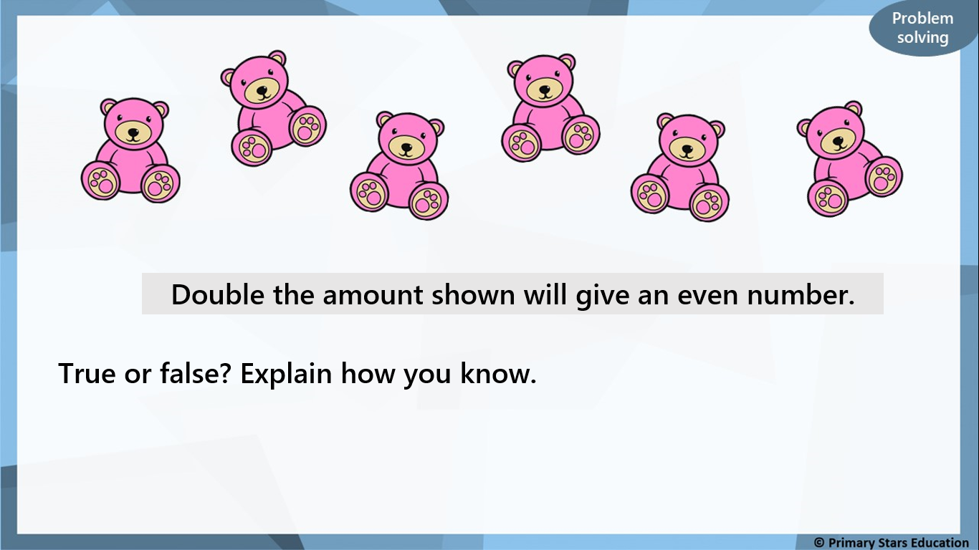

Slide 30
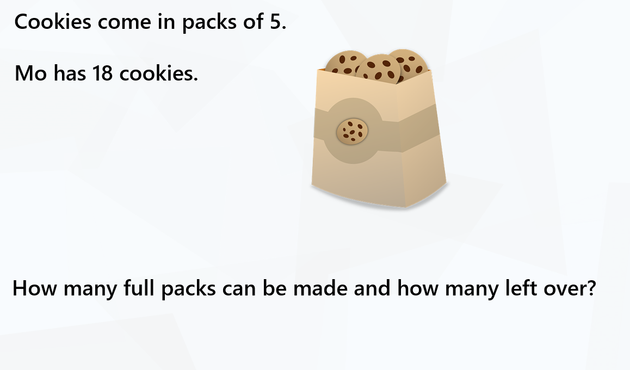

Slide 31
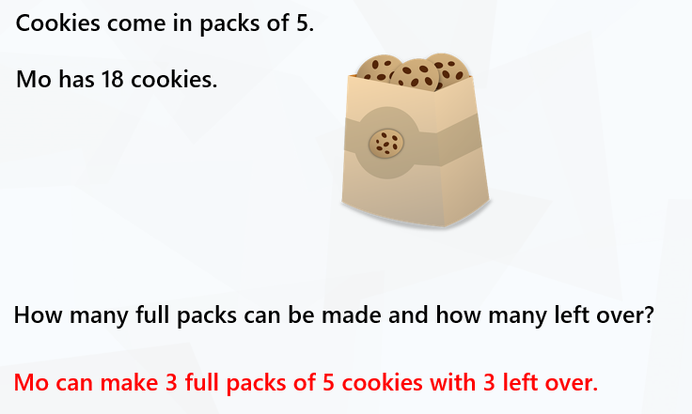

Slide 32
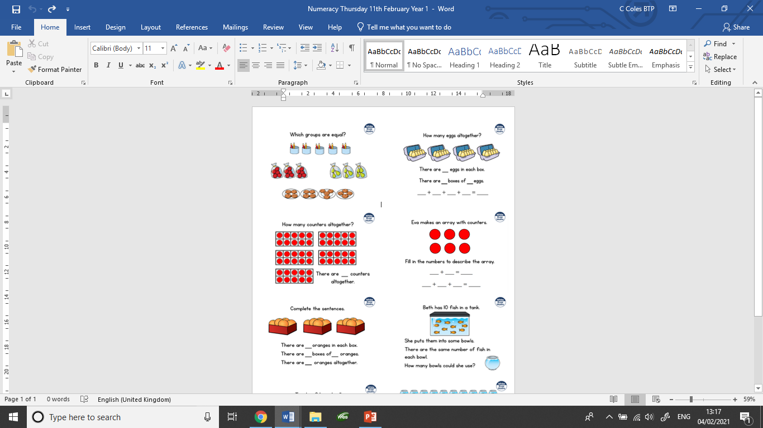
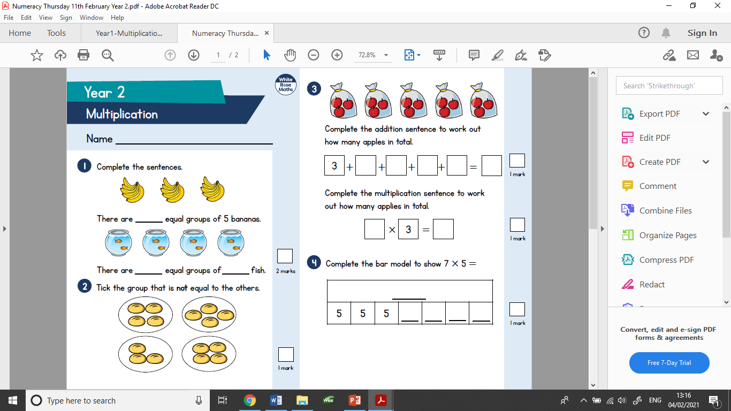
This are the worksheets set today.

Slide 33
12/2/2021
LO: Division Recap

Slide 34
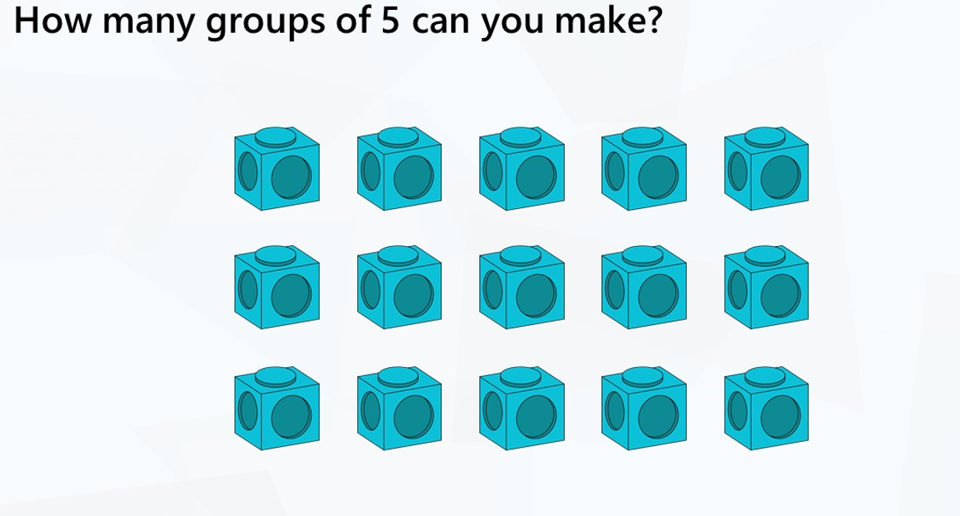

Slide 35
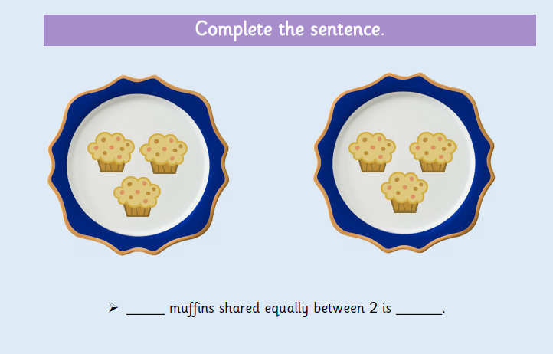

Slide 36
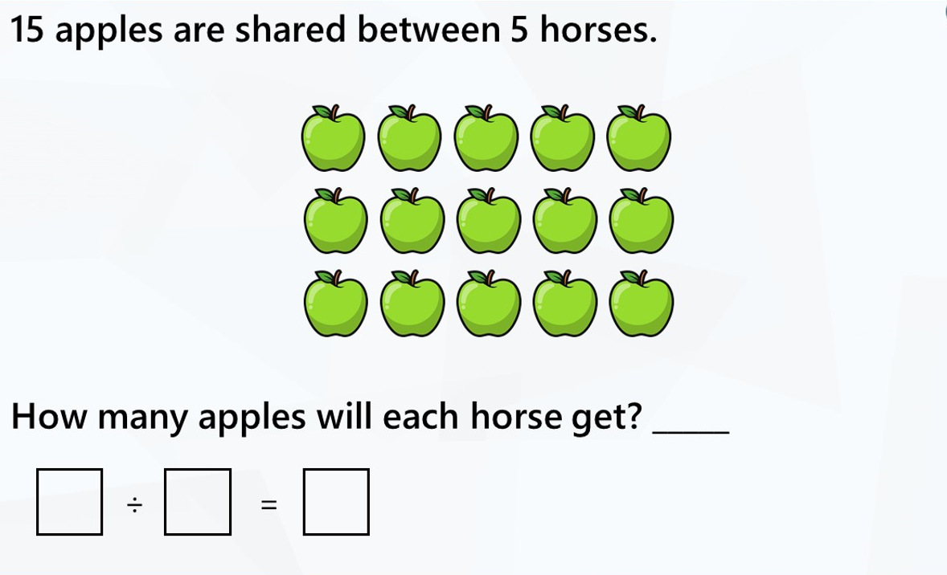

Slide 37
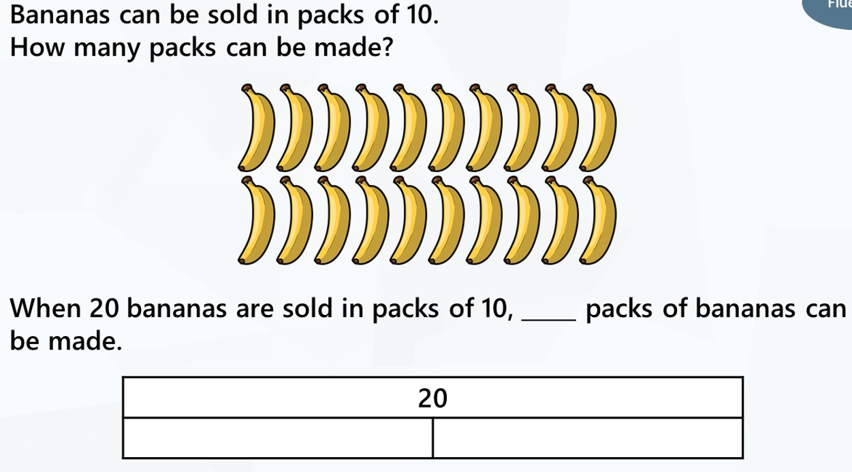

Slide 38
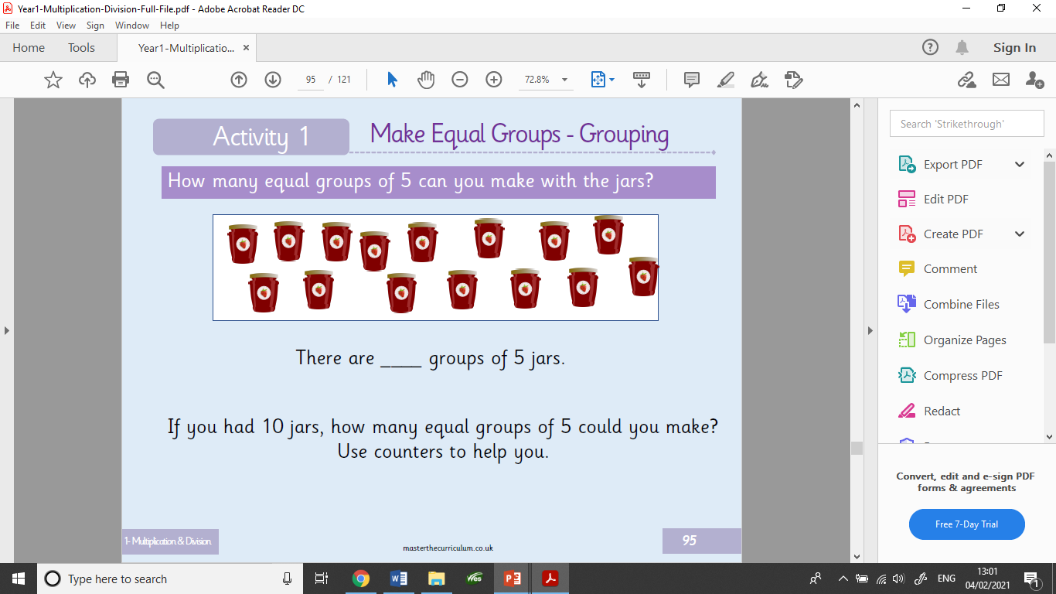

Slide 39
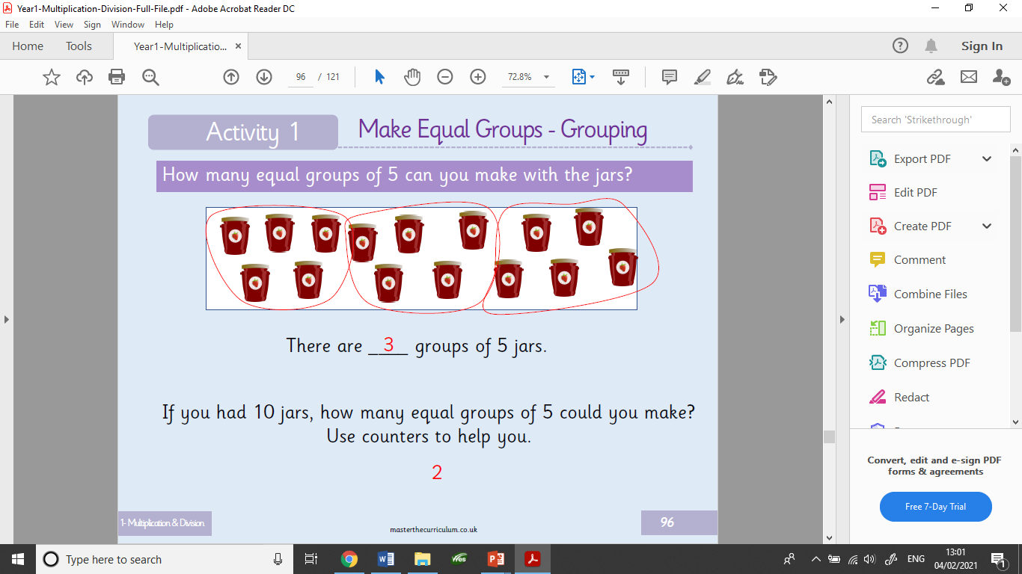

Slide 40
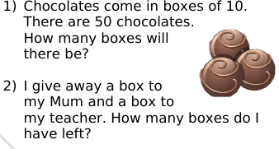
Two part question

Slide 41
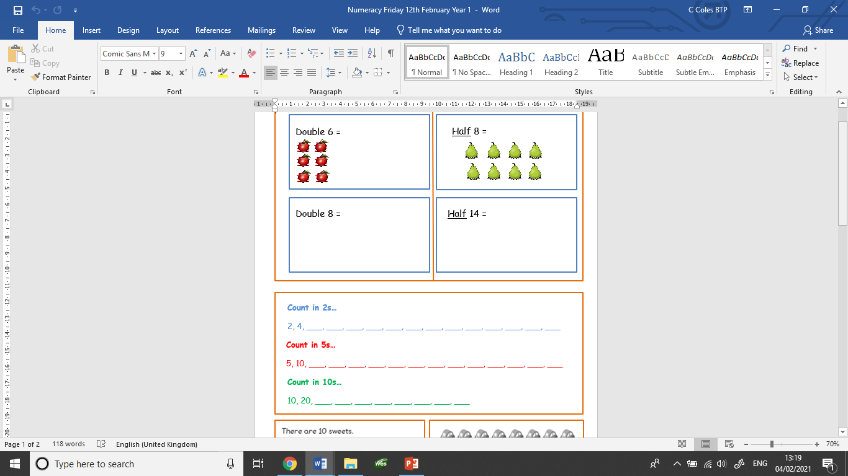
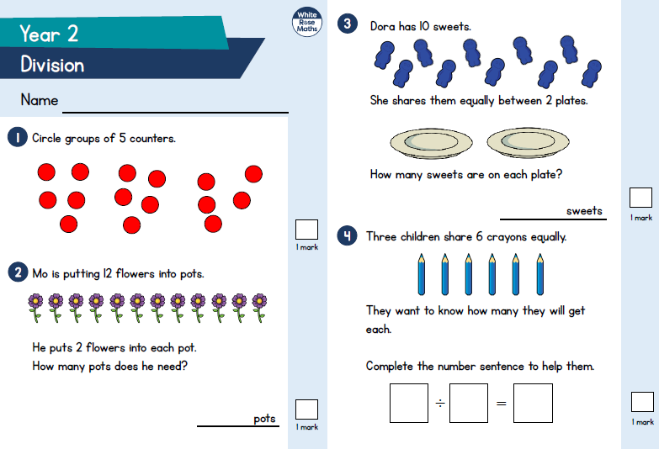
This is the worksheet set today.

