Slide 1
LO: To create your very own lighthouse nightlight.
Tuesday 23rd June 2021

Slide 2
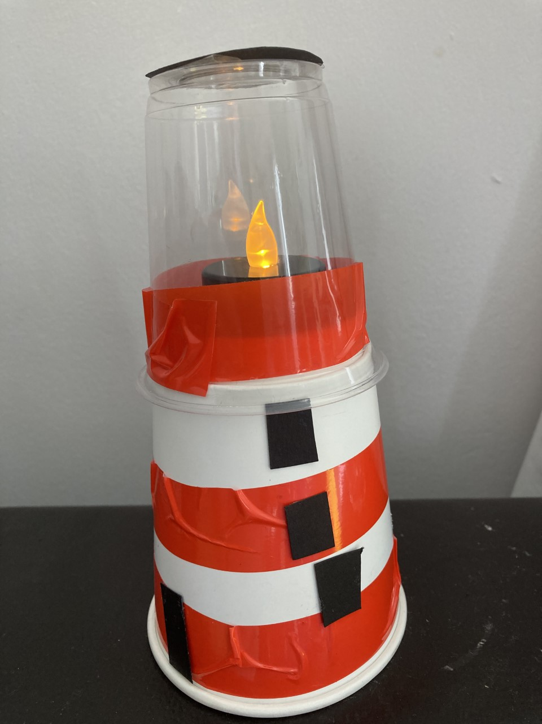
Take a look at this model.
What things will you need?
How will things be attached?
What steps do you think you will take to create it?

Slide 3
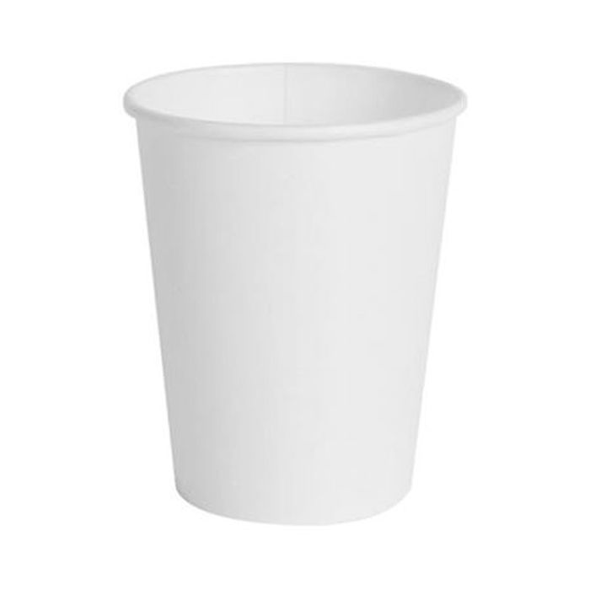
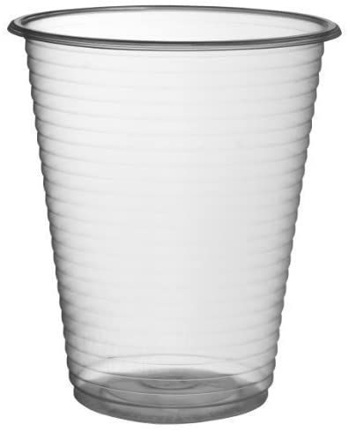
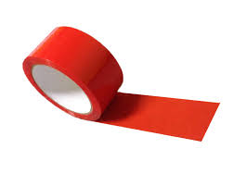

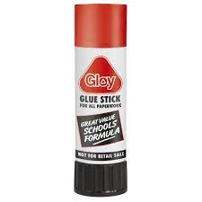
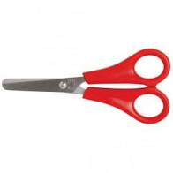
Here are the things you will need.
Materials
a white cup
a clear cup
red tape
black card
Tools
glue
scissors

Slide 4
circle of black card for roof
clear cup
white cup
black card for windows
red tape
black card for door
Your Task:
Draw your design.
Label your design using a ruler.

Slide 5
Instructions
First, stick two stripes of red tape around the white cup.
2) Second, stick one striped of red tape around the bottom of the clear cup.
3) Then, on the black card, draw around the bottom of the clear cup to create a circle.
4) After that, cut out the black circle and stick it on the bottom of the clear cup.
5) Next, cut out three black squares for the windows and stick them on the white cup.
6) Then, cut out a black rectangle and stick it at the bottom of the white cup.
7) Finally, put the clear cup on top of the white cup and you are finished.

