Slide 1
Monday 21st June 2021
LO: Make predictions based on the illustration.

Slide 2
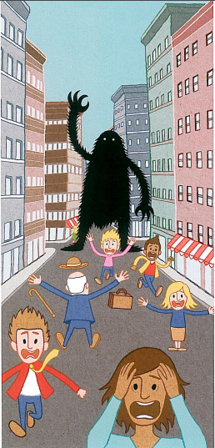
Look at this illustration
Talk to the person next to you about 5 things you notice

Slide 3
What is happening?:
Think of words and phrases to describe what you see and hear as a person that lives here.
What emotions are experienced in this picture?:
Think of words to describe these...

Slide 4
What words would you use to describe the main character?

Slide 5
Your task:
Make a prediction about what you think is happening in the story.
Use the conjunction because to explain you reason.

Slide 6
Example:
I think that the big fuzzy monster is trying to ask the people for directions on how to get to a shop but the people are all running away from it because they are scared the monster is going to eat them.

