Slide 1

Monday 21st June 2021

Slide 2
This week’s Red words
because
don’t
people
other
would

Slide 3

Today’s sound is
ire

Slide 4
ire words
tired
fire
empire
hire
wire
shire

Slide 5



ire alien words

Slide 6
ire sentences
The people were all running because there was a huge fire.
In the past England was a part of the British Empire.
In the book ‘The Hobbit’ people live in a place called the shire.

Slide 7
Tuesday 22nd June 2021

Slide 8
This week’s Red words
because
don’t
people
other
would

Slide 9
Today’s sound is
ire

Slide 10
aw words
retire
admire
inspired
umpire
vampire

Slide 11

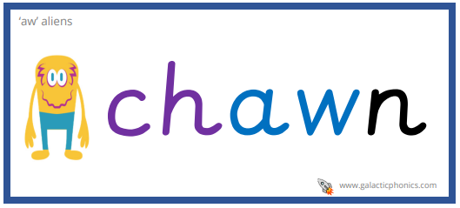
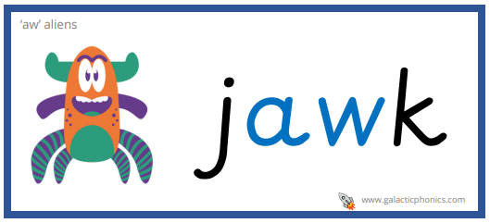
aw alien words

Slide 12
ire sentences
The scary vampire shouted ‘Don’t open that door’ to the terrified girl.
I felt inspired to paint a picture of people walking through the city.
When you get older you can retire, this means you don’t work anymore.

Slide 13
Wednesday 23rd June 2021

Slide 14
This week’s Red words
because
don’t
people
other
would

Slide 15

Today’s sound is
ear

Slide 16
ear words
dear
year
beard
clear
ear
near

Slide 17

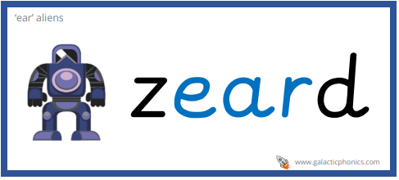
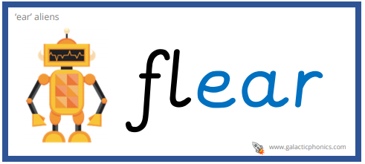
ear alien words

Slide 18
ear sentences
Dylan, Lyla and Poppy are some of the children in the Year 1/2 class.
The tall man with small ears has a great big bushy beard.
Dear diary, I went on a long walk today near the coast and the view was beautiful.

Slide 19
Thursday 24th June 2021

Slide 20
This week’s Red words
because
don’t
people
other
would

Slide 21
Today’s sound is
ear

Slide 22
ear words
nearby
earring
tears
spear
hearing

Slide 23

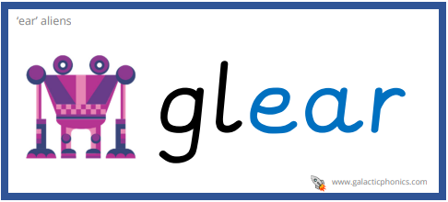

ear alien words

Slide 24
ear sentences
Would you wear big bright pink earrings?
Other people live nearby their friends but I don’t.
When you cry tears normally come out of your eyes and go down your cheeks.

Slide 25
Friday 25th June 2021

Slide 26
This week’s Red words
because
don’t
people
other
would

