Slide 1
Friday 12th March 2021
L.O. To use a story map to write an original story inspired by another author.

Slide 2
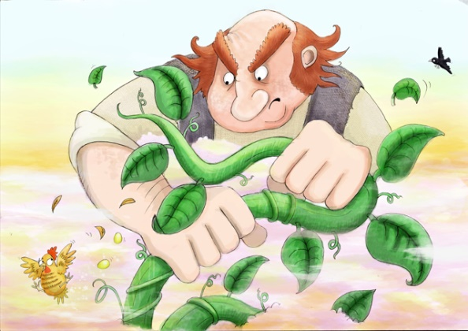
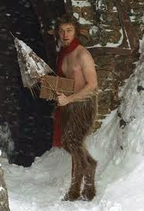

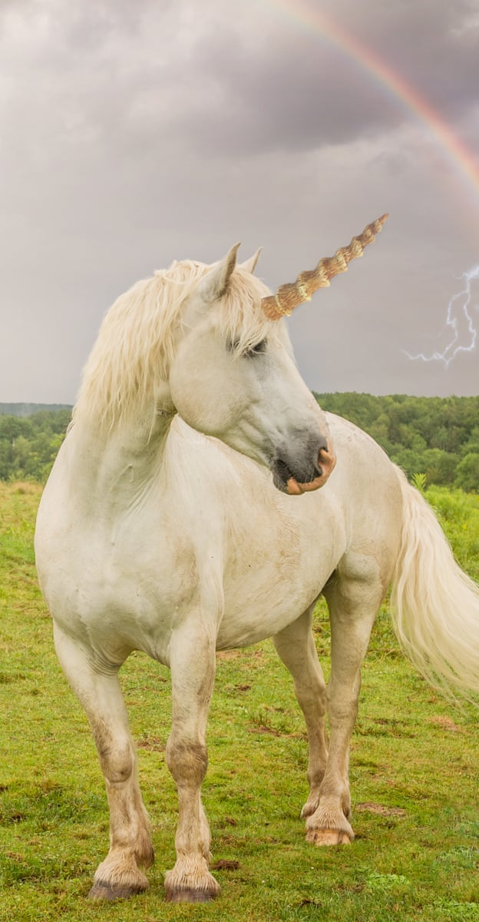

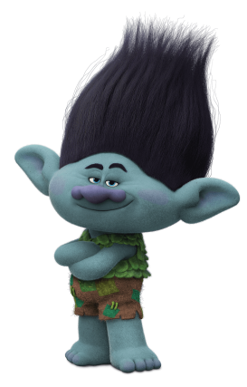

Yesterday you created a story map to plan an original story based on the structure of the story ‘Zog’ by Julie Donaldson except instead of your main character being a dragon, you chose another mythical creature.

Slide 3
Talking Partners Task
Using your story map tell your partner about the story you have planned.
Who are the main characters?
Where is the story set?
What happens?
How does your story end?

Slide 4
Let’s write a super story
Use adjectives to describe the setting
In a magical land, in a deep valley, there is an ancient school hidden in the trunk of a tree. This mysterious tree was covered in winding ivy and soft, green moss and looked like every other tree, but if you look closer you will notice a soft glow coming from inside the trunk because this school, is a school for fairies.

Slide 5
Use adjectives and adverbs to describe the character
It was the first day of school and Twinkle the Fairy was just about to start Reception. She was nervously holding on to her mum. Twinkle was a shy fairy and was worried that she wouldn’t be able to learn how to be a real tooth fairy. She couldn’t even fly yet. “You will be ok”, said Twinkle’s mum but Twinkle wasn’t so sure.

Slide 6
Remember to use your plan to write about the events in order using time sequencing words
Write about each year in order Reception, Year 1, Year 2, Year 3, Year 4, Year 5 then finally Year 6.
Later on
Soon
After that
Next
Meanwhile
A moment later
After a while
Then

Slide 7
Use phrases to make your story exciting
As quick as a flash…
Out of nowhere…
As quick as a bolt of lightening…
All of a sudden…
Suddenly…
His heart began to race…
It got closer and closer and closer until…

Slide 8
Don’t forget to –
Use capital letters and full stops.
Use your story map.
Read, check and improve your work.

