Slide 1
PE
L.O. to Choreograph and perform an Elizabethan Dance

Slide 2
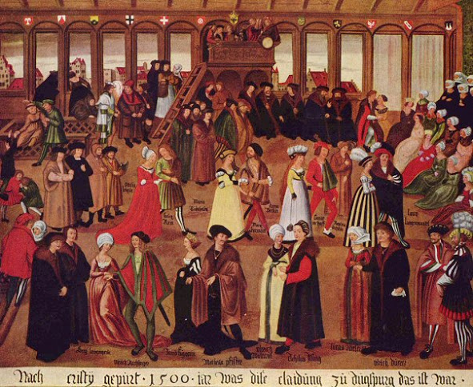
During the reign of Queen Elizabeth I, dance was very important. Rich people would have large parties and banquets. If you were good at dancing people would view you to be important and well educated. During parties everyone would take part in the same dance a bit like when everyone does the Cha Cha Slide or Macarena during parties today.

Slide 3
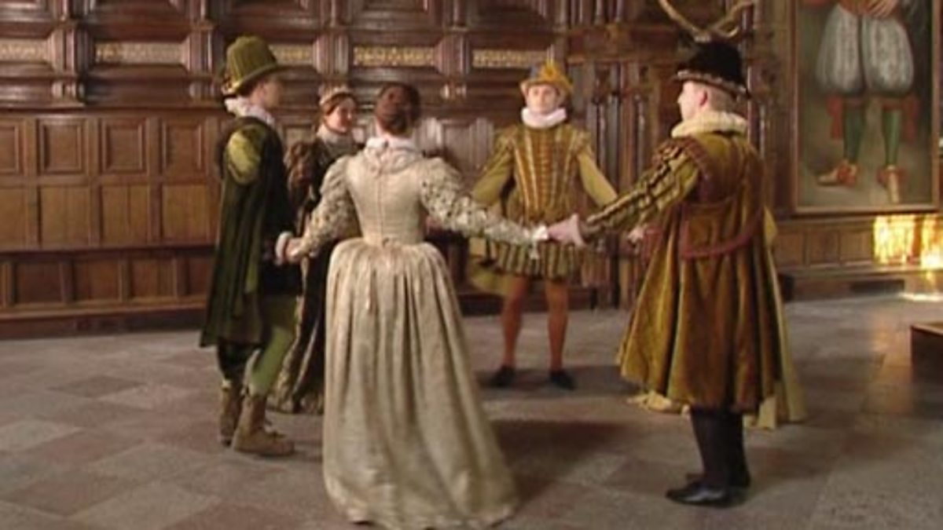
Watch some Elizabethan dancing using the web links below to get some ideas.
https://www.youtube.com/watch?v=s_6nVRITxbY&list=PLgPVSqZbWZi3IkMdNoPQElh2CbNgicFBD&index=3 Elizabethan dancing filmed in Stratford-upon-Avon
https://www.youtube.com/watch?v=F2TsI_jBUjk Elizabethan dancing

Slide 4
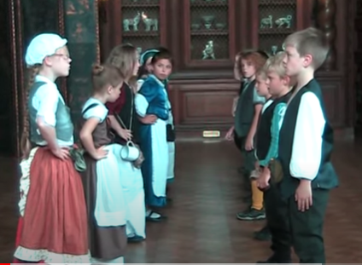
Try learning this Elizabethan dance
1 . Face your partner. If dancing in a group make 2 rows of people facing each other with a gap down the middle to form an alley.
2. Boys bow then girls curtsey.

Slide 5
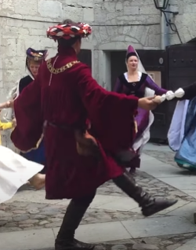
3. Slowly kick your left leg across your body, pointing your toes, then do the same with your right leg.
4. Step 2 steps left and clap with your arms raised to the left hand side.

Slide 6
5. Step 2 steps right and clap with your arms raised to the right hand side.
6. Put your right arm in the air to form and arch with your partner who is standing in front of you. Slowly turn in a circle with your partner in time to the music.
7. Once you have done one full turn and are back to where you started the couple at the bottom of the alley should cross arms and turn as they travel through the middle of the alley and become the pair at the front. Everyone else should clap in time to the music.
8. Start the sequence of moves again from step 1.

Slide 7
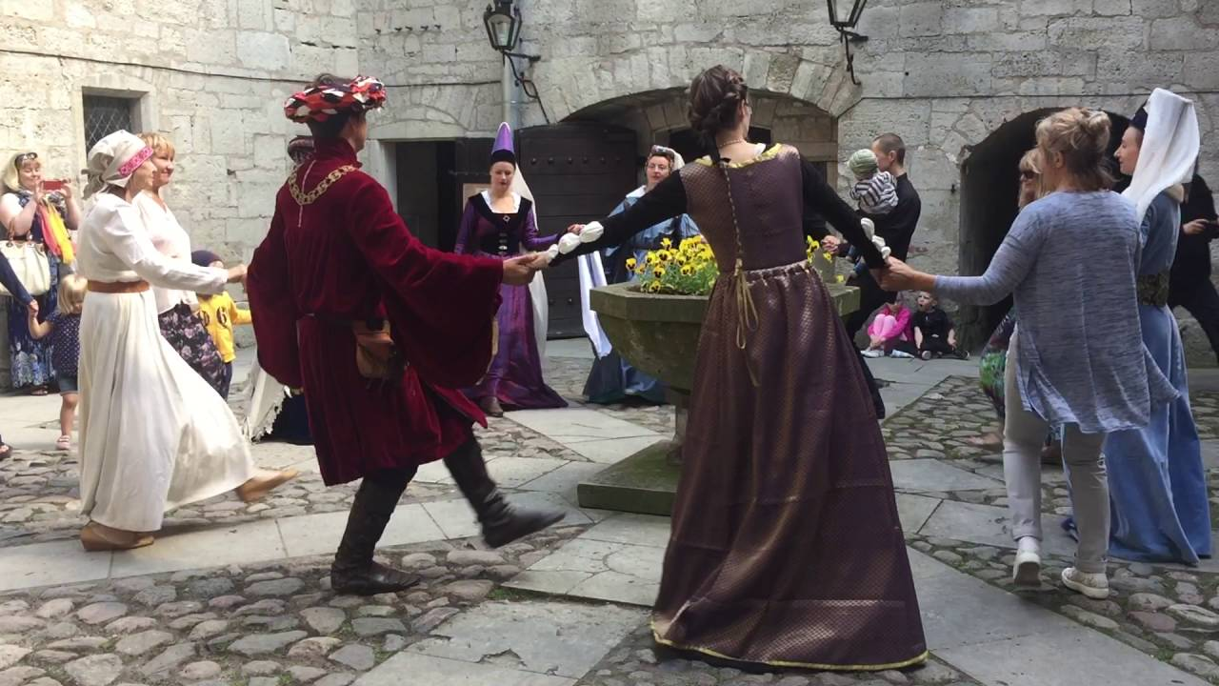
Recommended music for performance -
https://www.youtube.com/watch?v=WT_Zp-GFS_k

