Slide 1
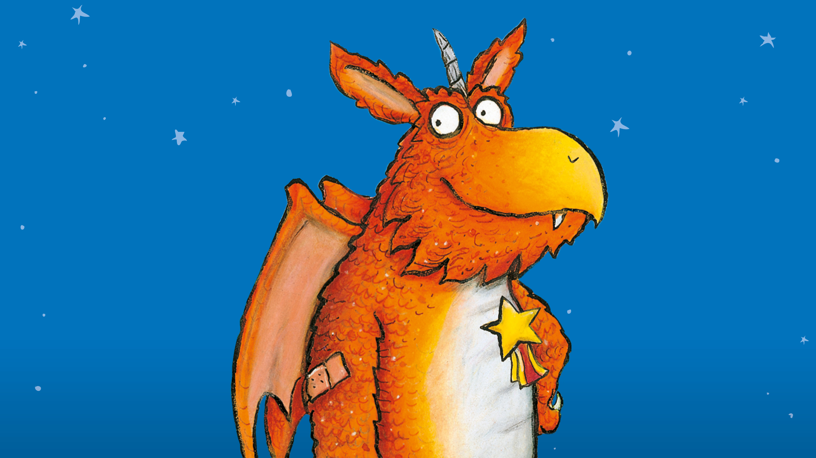
Tuesday 9th March 2021
LO: To write a school report for Zog
Let’s recap on the story of Zog

Slide 2
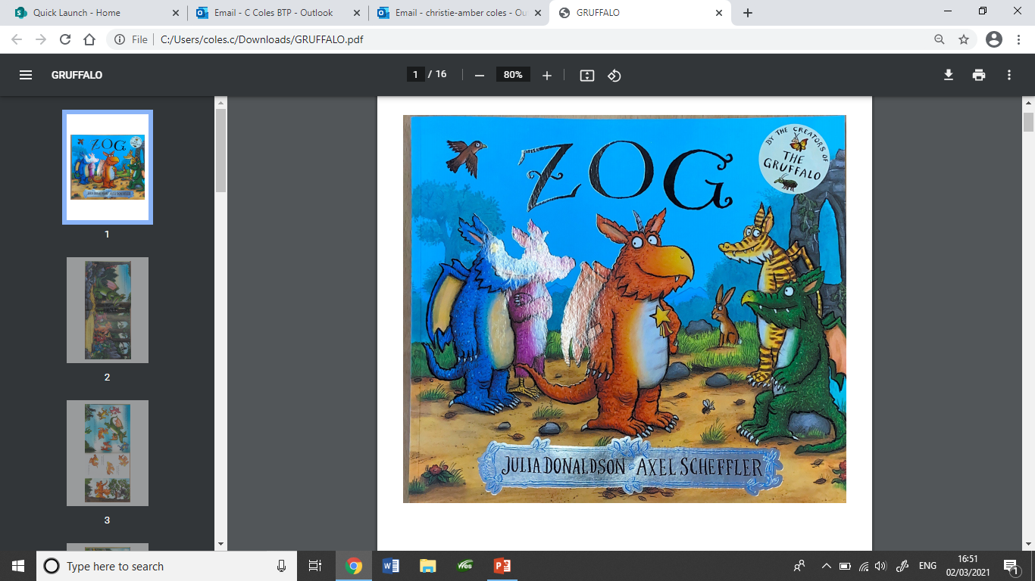

Slide 3
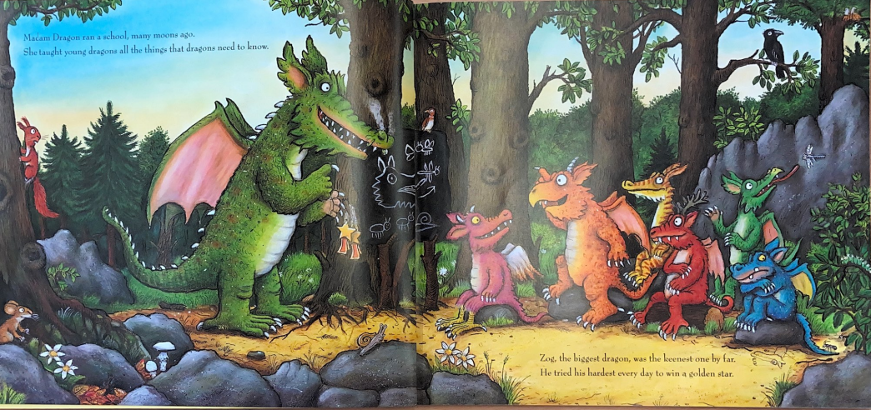

Slide 4
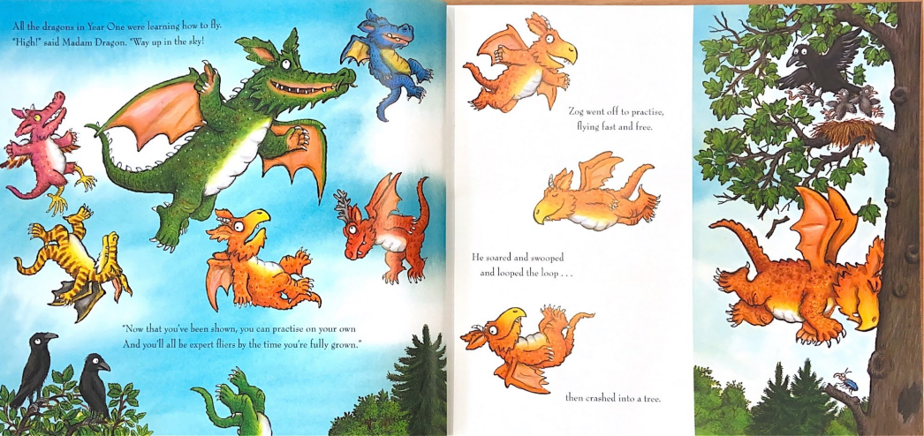

Slide 5
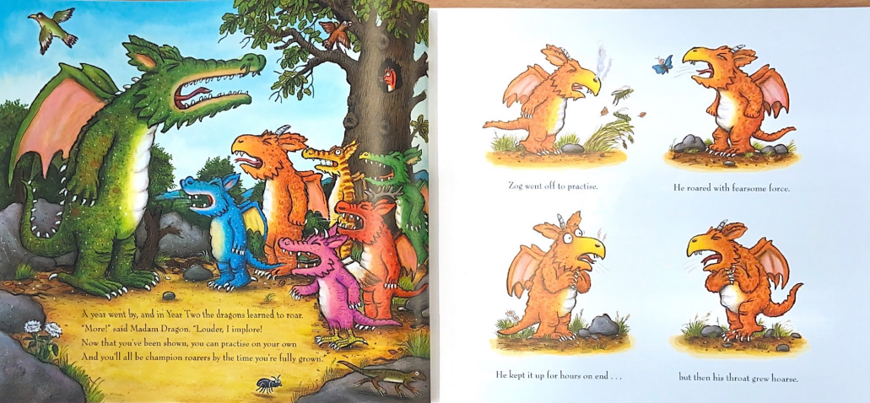

Slide 6
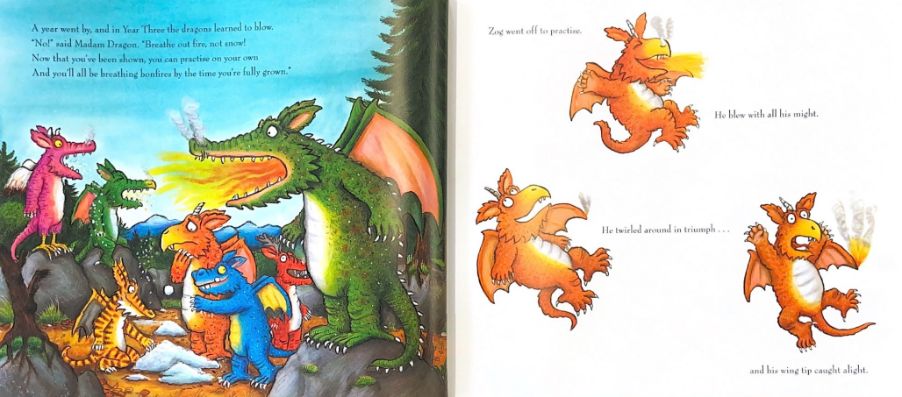

Slide 7
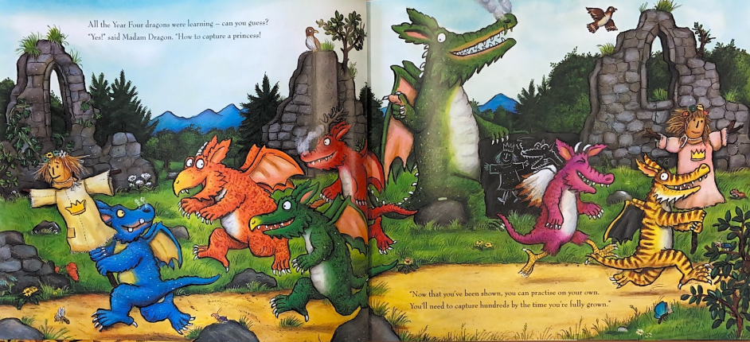

Slide 8
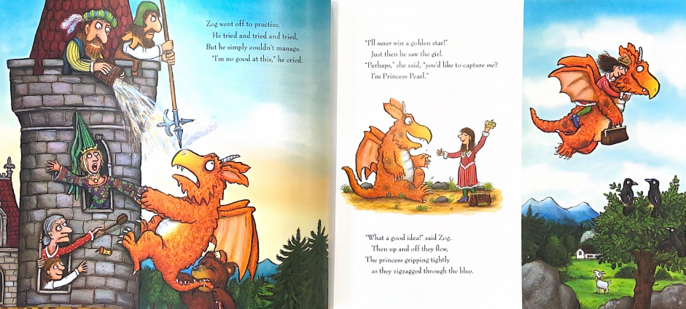

Slide 9
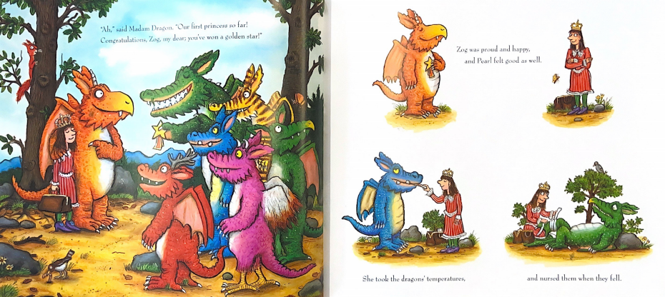

Slide 10
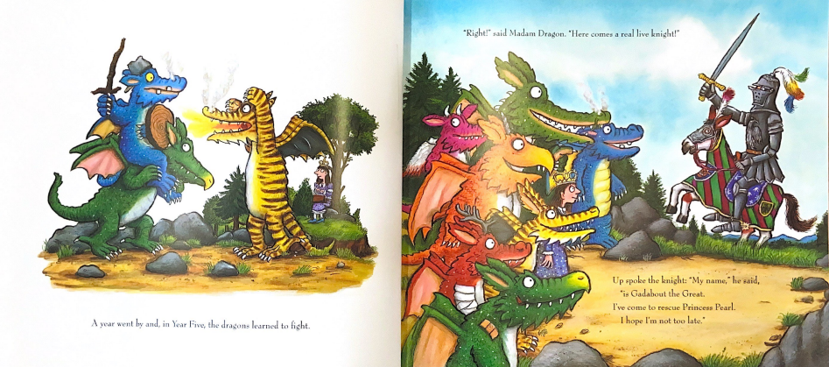

Slide 11
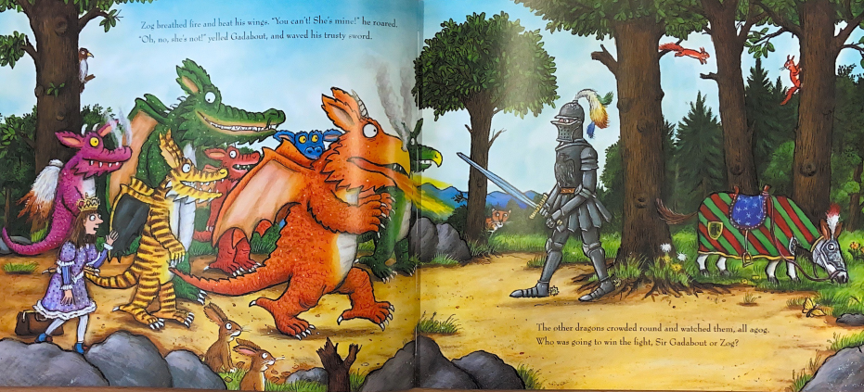

Slide 12
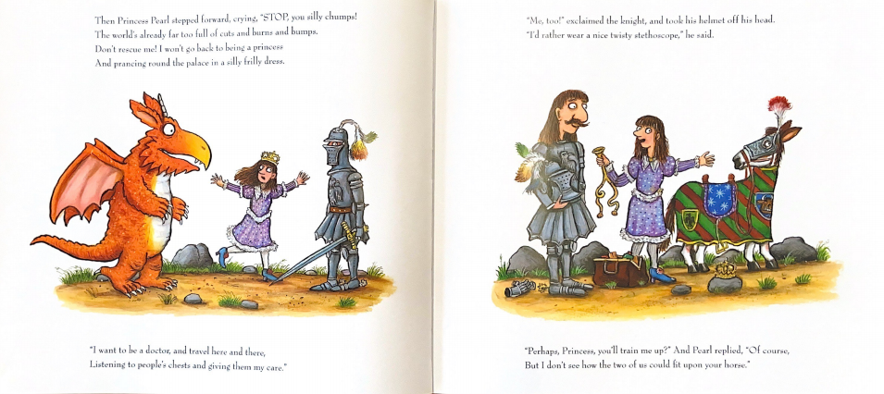

Slide 13
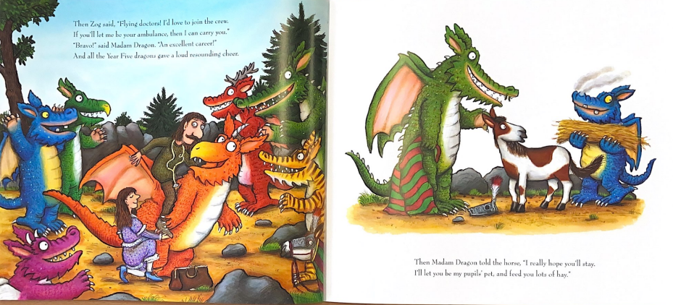

Slide 14
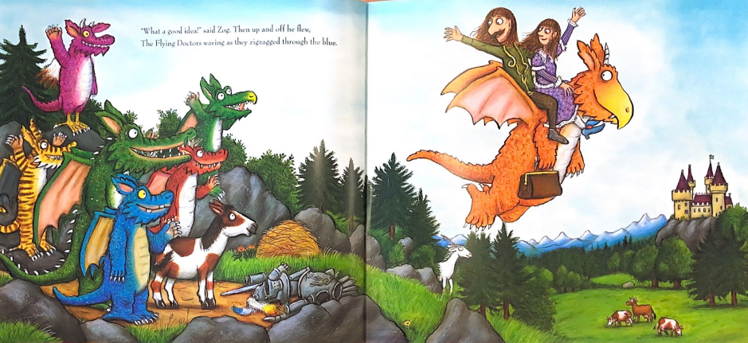

Slide 15
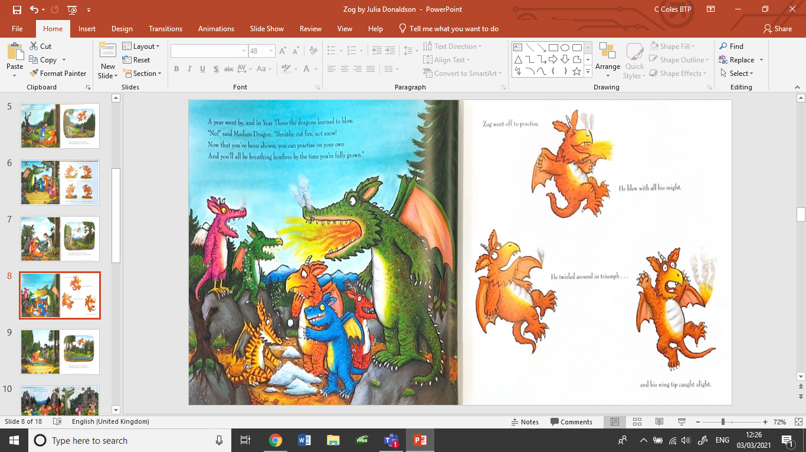
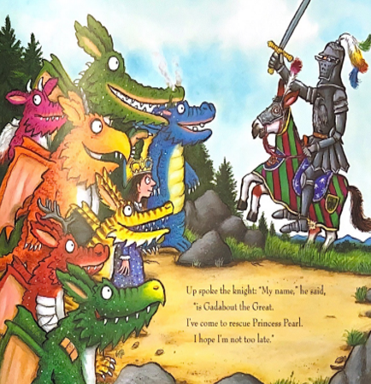
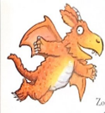
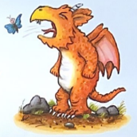
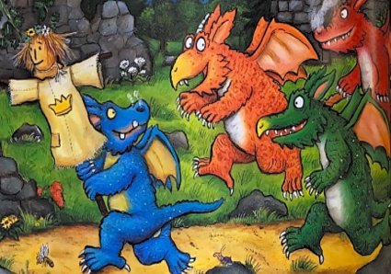
During Zog’s time at school he learns lots of new skills. Can you remember any?
Breathing
fire
Fight the
knight
Flying
Capture the
princess
Roaring

Slide 16
Your Task
Write a school report for Zog based on how well he did learning each new skill.
It should include an overview of Zog as a pupil, what he acts like, if he has friends, behaviour etc
You should give Zog a grade based on how well he preformed during each lesson e.g. 1 being worst 5 being the best.
You should also give Zog targets that he can work on to improve his dragon skills

Slide 17
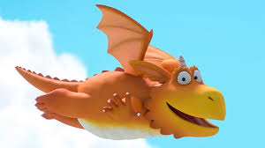
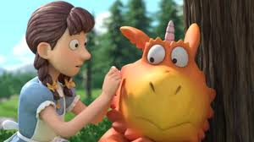
What do you think Zog did well in school?
I think although Zog was not always the best at doing all the set activities that he never gave up and he always tried his hardest even when he found it tricky.
Zog was also kind and made friends with Princess Pearl.

Slide 18
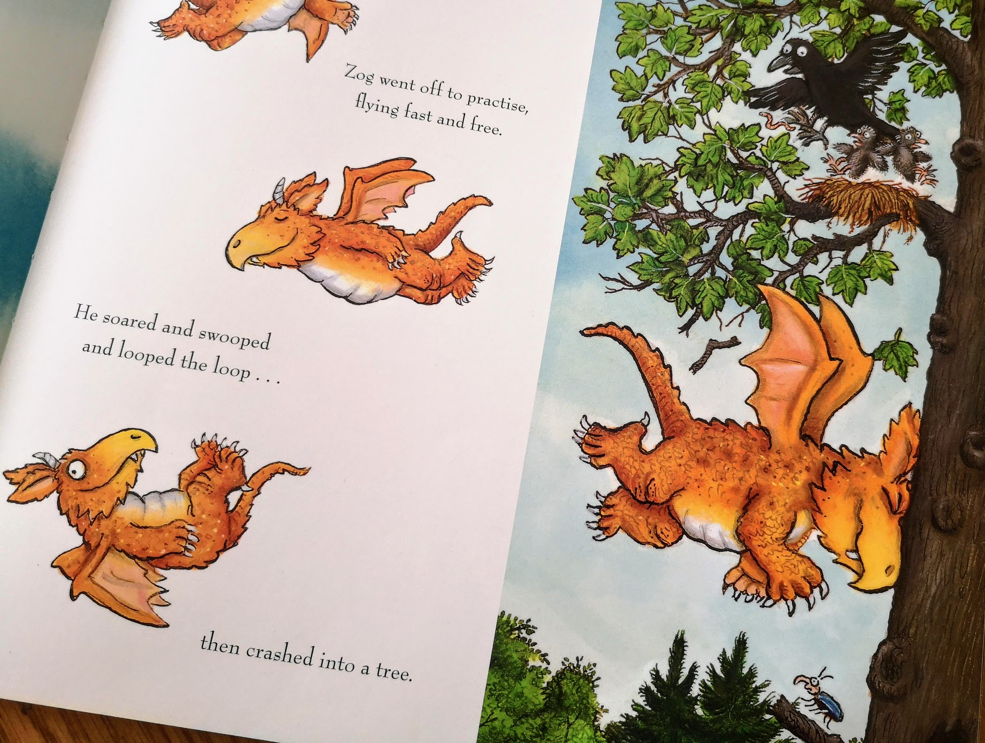
What do you think Zog might need to practise more?
I think Zog needs to practise his flying to make sure he doesn’t fly into any more trees.

Slide 19
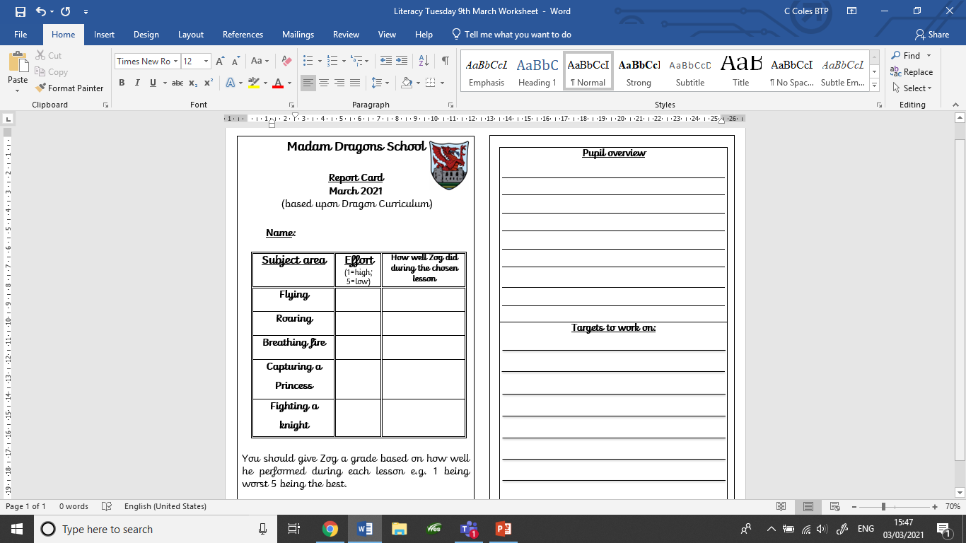
In this part you write about
how Zog was in class.
Was he sensible?
Was he kind to others?
Did he try his best?
Targets mean things Zog
needs to improve
What do you thing he needs
to practice more?

