Slide 1
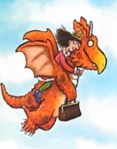
Can you read
then match up
my rhyming
words? **
own
might
luck
grown
far
blue
tried
snow
star
alight
suck
flew
cried
blow

Slide 2
Can you read
then match
up my
rhyming
words? *
own
far
luck
grown
tried
star
suck
blow
cried
snow

