Slide 1
LO: To write the first two sections of a travel journey from the viewpoint of the snail.
Monday 14th June 2021

Slide 2
Your Task
When the snail and the whale go on their adventures, they see some fantastic places.
Today you will be writing a travel journal about what the snail experiences.

Slide 3
Your Task
The first two main places they visit are the incredible tropical islands with volcanoes.
They then journey on to the freezing Antarctic, where she experiences a whole new environment.

Slide 4
Let’s watch
Their adventure begins…
What do you think the snail will see, hear, feel and smell, while she travels through these amazing places.

Slide 5
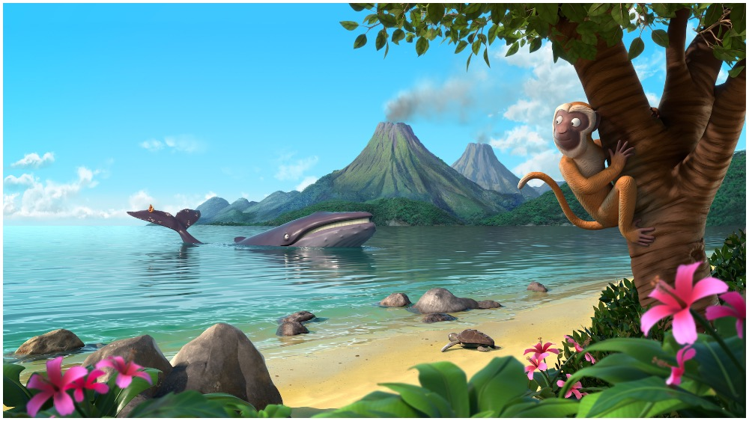
Here is the incredible tropical island.
smoking volcanoes
cheeky chattering monkeys
crystal clear water
soft yellow sand
fantastic pink flowers

Slide 6
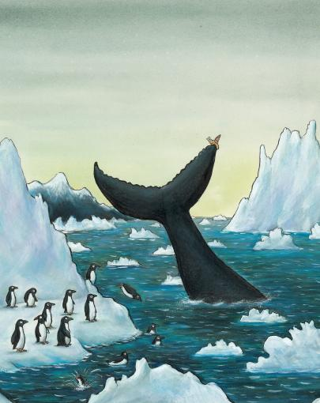
Here is the incredible tropical island.
cold crisp air
towering white cliffs
cold dark seas
squawking sliding penguins
soft shivery snow

Slide 7
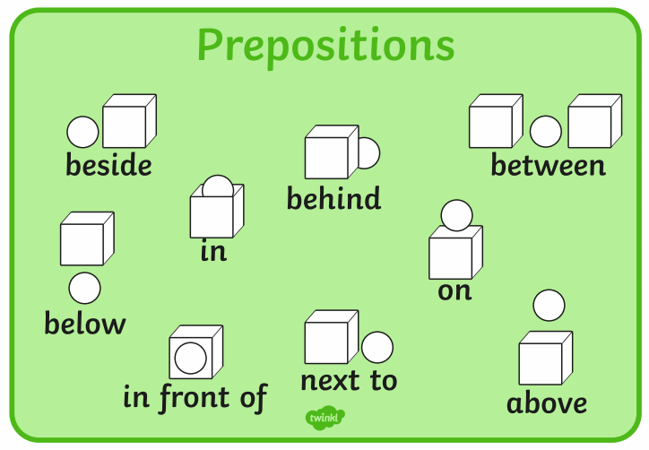
What might the snail write about her journey so far?
Remember to use the PAST tense…
  there was
  there were
  I saw
  I looked
  I smelled
  I heard
Harder!
Where were things that the snail could see?
  Use prepositions…

Slide 8
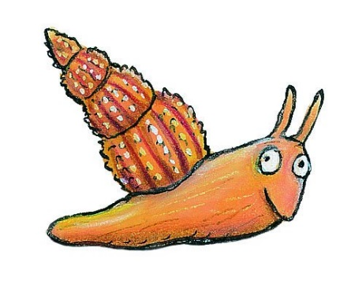
Look at this example
Easy:
I saw the lovely island and I heard a chatty monkey in a tree. I saw lovely flowers and soft sand.
Harder:
We arrived at a wonderful tropical island. Around me, the water was warm and clear. In front of me, I saw a chatty monkey in a palm tree and soft sand. Between the rocks, were lovely pink flowers with butterflies on them.

Slide 9
Your Task:
Option 1 – To write complete sentences using adjectives (describing words).
- Use the conjunctions ‘and’
Option 2 - To write compound sentences.
Use the conjunctions ‘and’
Use adjectives (describing words) for effect.
Use prepositions for location.

