Slide 1

Monday 14th June 2021

Slide 2
This week’s Red words
would
should
they
there
when

Slide 3
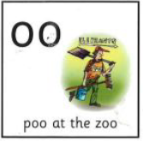
Today’s sound is
oo

Slide 4
oo words
racoon
moon
broom
food
spoon
scoop

Slide 5
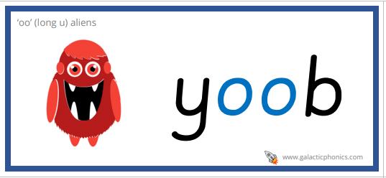
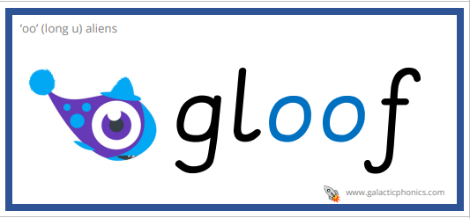
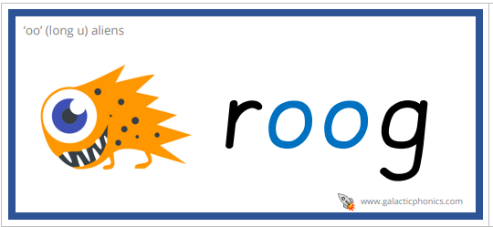
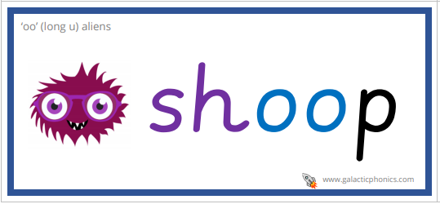
oo alien words

Slide 6
oo sentences
What is your favourite food?
We saw a racoon look at the moon.
I used a spoon to scoop ice-cream.

Slide 7
Tuesday 15th June 2021

Slide 8
This week’s Red words
would
should
they
there
when

Slide 9

Today’s sound is
oo

Slide 10
oo words
look
crook
stood
good
wooden
cook

Slide 11
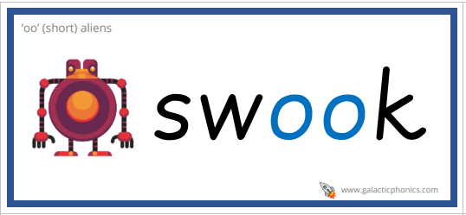
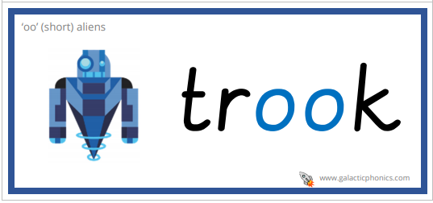
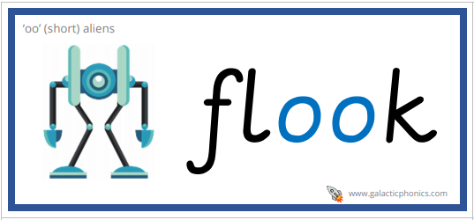
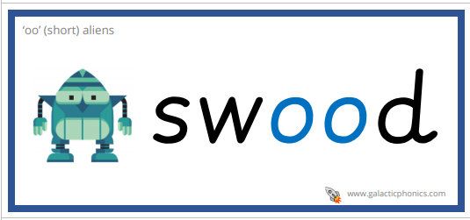
oo alien words

Slide 12
oo sentences
There is so much food to cook.
What are you looking at?
We all stood still and looked at the clouds.

Slide 13
Wednesday 16th June 2021

Slide 14
This week’s Red words
would
should
they
there
when

Slide 15
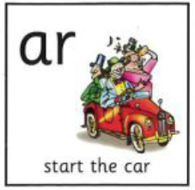
Today’s sound is
ar

Slide 16
ar words
starfish
sharp
charm
dark
March

Slide 17
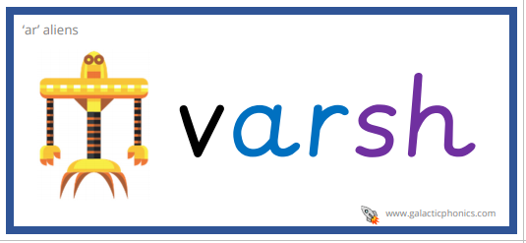
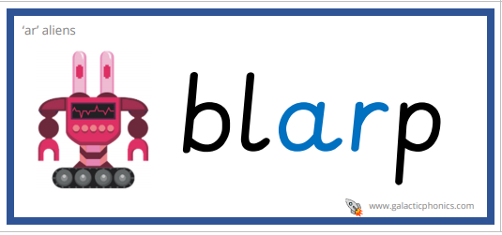
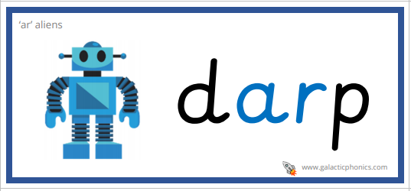
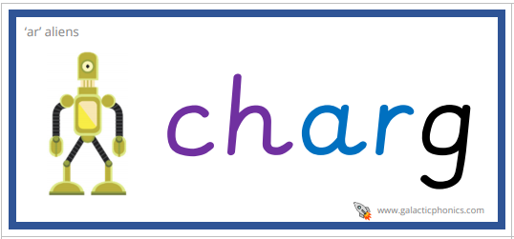
ar alien words

Slide 18
ar sentences
Charlie was born in March.
The starfish was on the sandy beach.
I could see the stars because it was so dark.

Slide 19
Thursday 17th June 2021

Slide 20
This week’s Red words
would
should
they
there
when

Slide 21
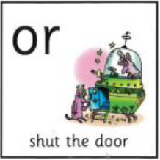
Today’s sound is
or

Slide 22
or words
door
mirror
sport
North
doctor

Slide 23
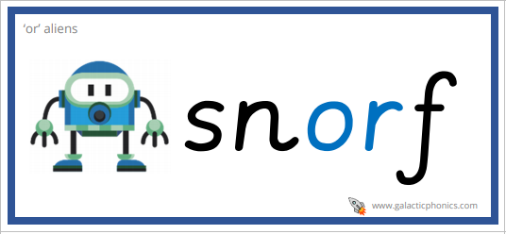
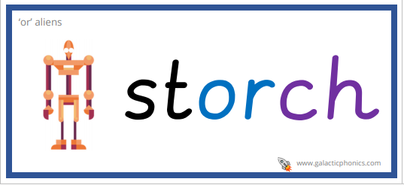
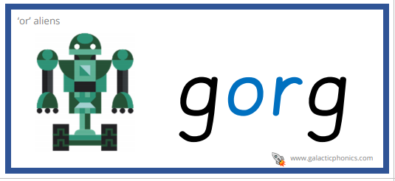
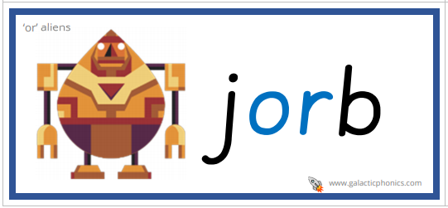
or alien words

Slide 24
or sentences
We were all playing different sports.
What can you see in the mirror?
There was a big storm in North America.

Slide 25
Friday 18th June 2021

Slide 26
This week’s Red words
would
should
they
there
when

Slide 27
This weeks sounds

