Slide 1
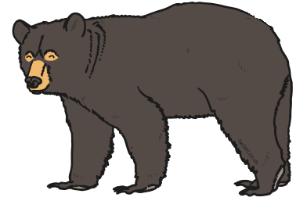
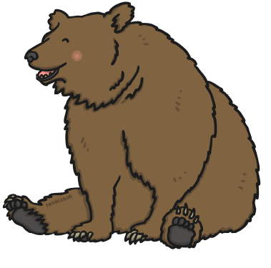
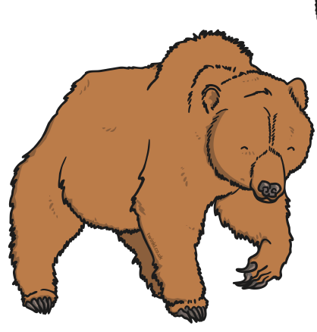
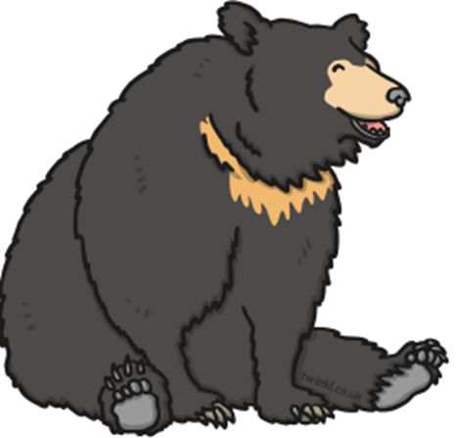
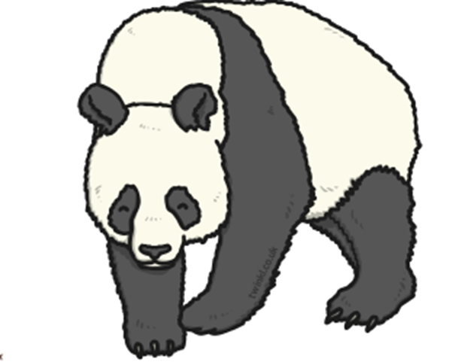
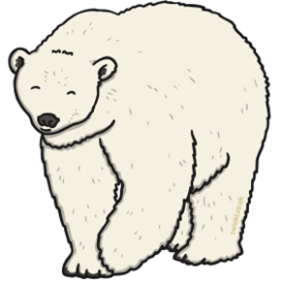
I’m going on a Bear Hunt!
 | Name | Number

Slide 2
Answers on next slide

Slide 3
I’m going on a Bear Hunt!
 | Name spectacled bear | Number 6
 | brown bear | 1
 | grizzly bear | 2
 | black bear | 3
 | panda | 4
 | polar bear | 5

