Slide 1
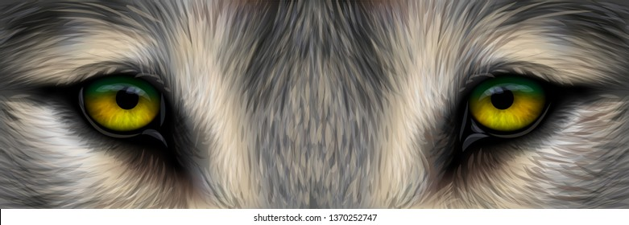
Friday 7th May
L.O. Create a non-chronological report about wolves.

Slide 2
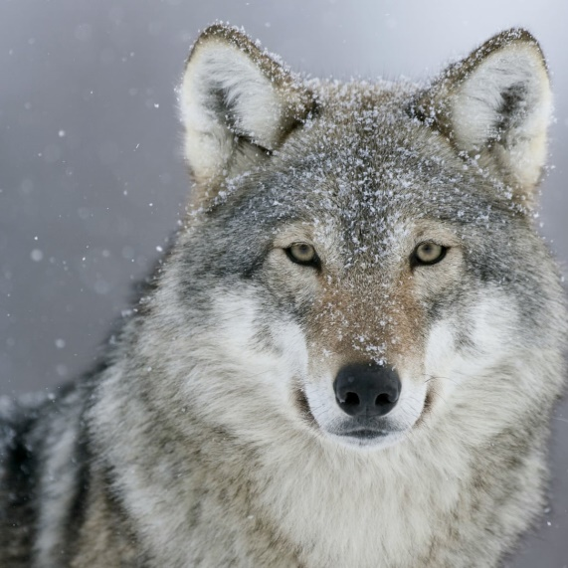
Yesterday you watched this video about wolves.
https://www.youtube.com/watch?v=bVx4vY1-0cM
Let’s take part in a quiz to see what you can remember about wolves. You can use the notes you made yesterday to help you.

Slide 3
Questions
Where do wolves live?
Do wolves often hurt humans?
What do wolves eat?
Do wolves live alone of in groups?
What are baby wolves called?
Why do wolves howl?

Slide 4
Answers
Wolves live in forests, tundras and prairies in countries such as the united states.
No wolves will only hurt humans if threatened or very, very hungry.
Wolves eat animals such as hares, bison and moose.
Wolves live in groups called a pack.
Baby wolves are called cubs.
The pack leader howls to tell the other wolves where he is and to keep the wolves together.

Slide 5
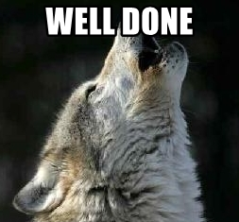
Well done you remembered lots of information.
Notes can be really useful when trying to remember facts, although your notes may not be easy for other people to understand.
Today you are going to present the information you have about wolves to teach others about what you have learnt.

Slide 6
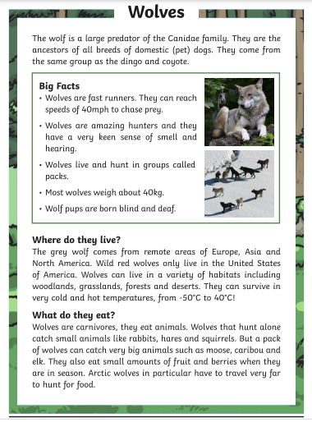
Features of a Non-Chronological Report
Title
Fact Box
Bullet points
Photographs
Sub-headings
Paragraphs

Slide 7
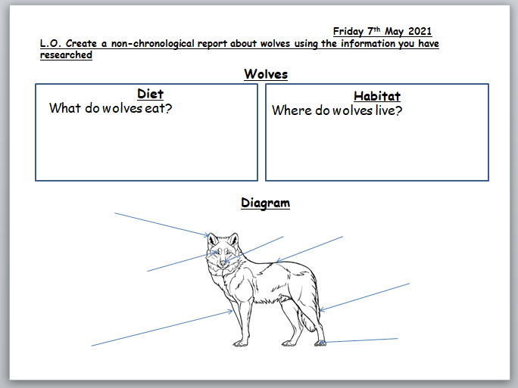
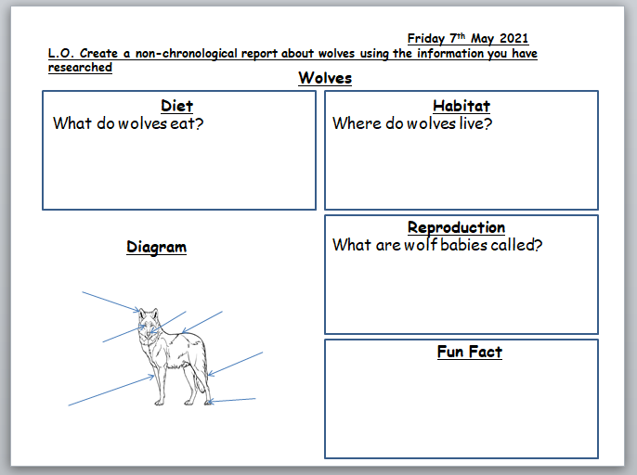
Your Task
Option 1 Option 2 Option 3
Design your own non-fiction text using the subheadings given by your teacher. You could create a book, leaflet or poster and arrange the information in any way you choose.

