Slide 1
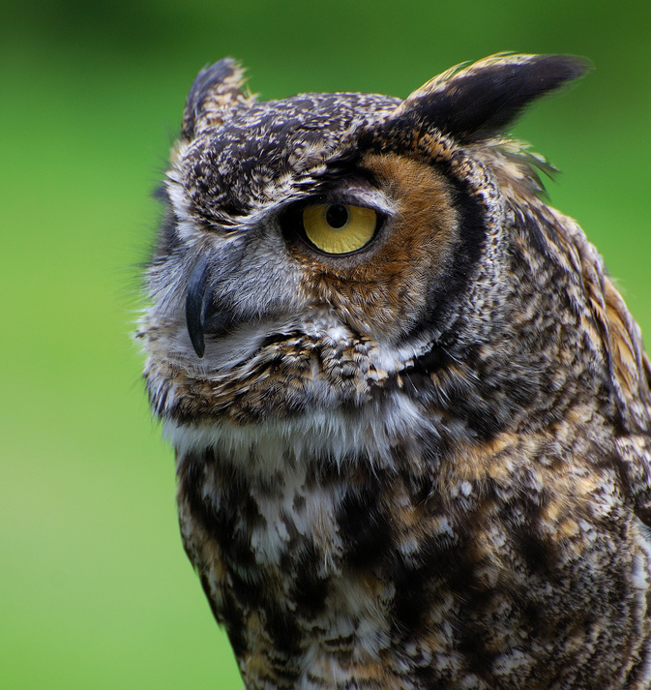
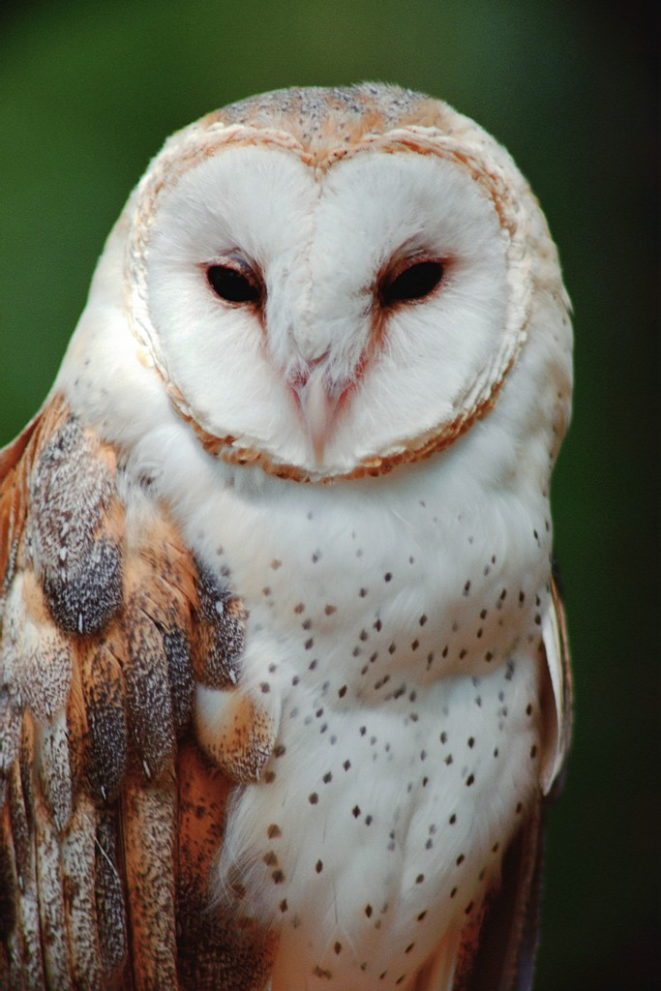
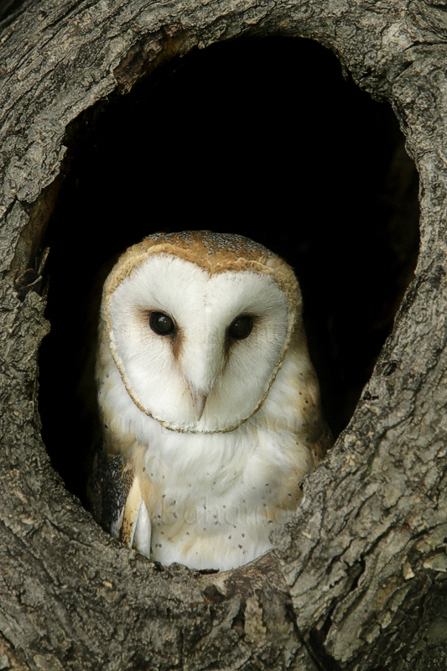
Owls:
Where do they live? What do they eat? What do they look like? What do they do?

Slide 2

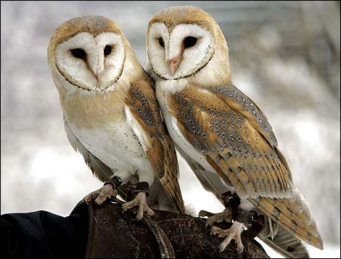
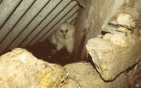
Habitat: Where do they live?
Owls don’t build nests. They look for shelter in farm buildings as well as churches, sheds and holes in trees.
Their homes have to protect the owls from the wind and rain, especially in winter.

Slide 3
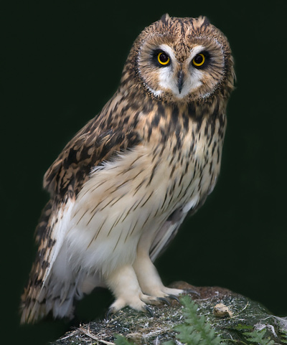
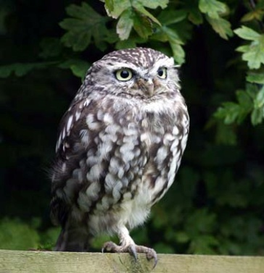
Diet: What do they eat?
Owls hunt for mice and other small animals such as rats, small birds and frogs.
Owls have brilliant eyes and ears to help them see and listen for other animals.
Owls hunt at night and have very long legs, toes and claws which help them to catch prey.

Slide 4
Appearance: What do they look like?
Owls are covered in thousands of feathers, some plain, some patterned.
They are usually brown, black, white or grey in colour.
Owls have huge, round eyes and a curved beak. They have a big body and powerful feet with sharp claws.

Slide 5

Behaviour: What do they do?
Owls are nocturnal animals which means they are active at night.
They can bob their head up and down and turn it almost all the way around.
Some owls hoot as well as screeching, hissing, snorting and whistling.

