Slide 1

Tuesday 4th May 2021

Slide 2
This week’s Red words
love
once
their
because
could

Slide 3
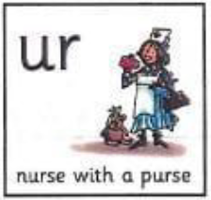
Today’s sound is
ur

Slide 4
ur words
fur
burning
turkey
hurt
nurse
church

Slide 5
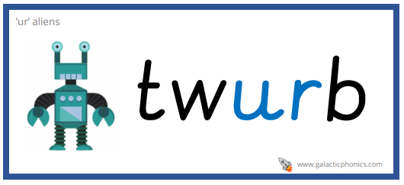
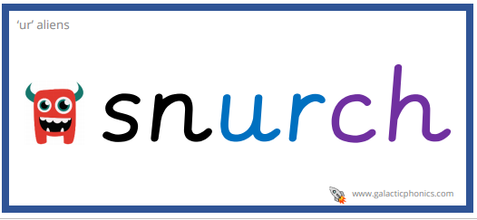
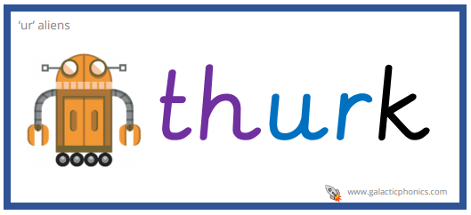
ur alien words

Slide 6
ur sentences
“I love turkey” said the nurse with a purple purse.
The dog with golden fur could not walk because it was hurt.
My friend invited me to go to their house after church.

Slide 7
Wednesday 5th
May 2021

Slide 8
This week’s Red words
love
once
their
because
could

Slide 9
Today’s sound is
ur

Slide 10
ur words
burst
turtle
curly
burger
surfing

Slide 11
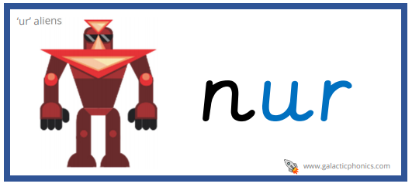
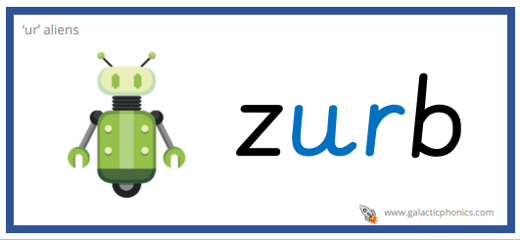
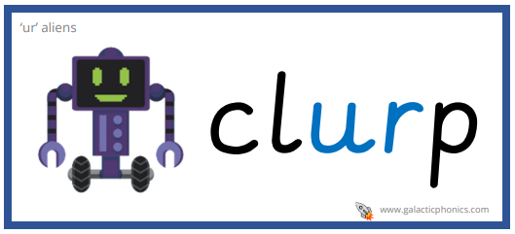
ur alien words

Slide 12
ur sentences
The balloon burst because it flew too close to the light.
“Could you teach me how to surf?” asked the girl with curly hair.
Once I saw a huge turtle swimming in the sea. I named it love.

Slide 13
Thursday 6th May 2021

Slide 14
This week’s Red words
love
once
their
because
could

Slide 15

Today’s sound is
er

Slide 16
er words
hammer
spider
person
flower
term
her

Slide 17
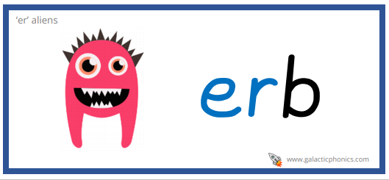
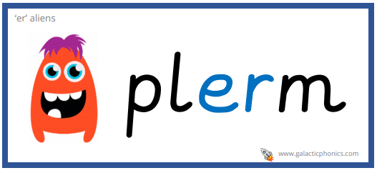
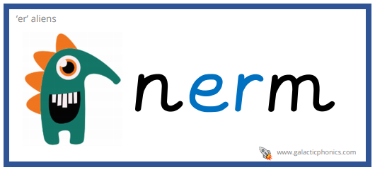
er alien words

Slide 18
er sentences
I buy my mum lilies because they are her favourite flower.
“Could you pass the hammer please?” asked the tall person.
Once a term a huge spider comes into the classroom because it is warm.

Slide 19
Friday 7th
May 2021

Slide 20
This week’s Red words
love
once
their
because
could

Slide 21
Today’s sound is
er

Slide 22
er words
tiger
nervous
herd
dinner
mermaid

Slide 23
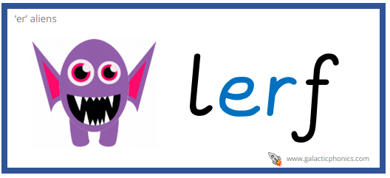
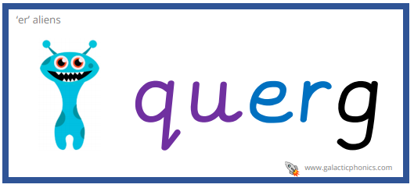
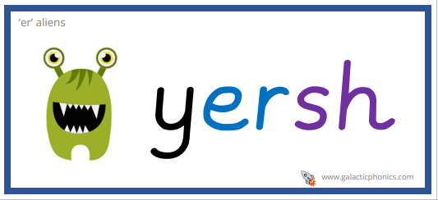
er alien words

Slide 24
er sentences
The herd of sheep ran towards the farmer because he had their dinner.
I love tigers, they are my favourite animal.
The nervous mermaid could not find her new hairbrush.

