Slide 1
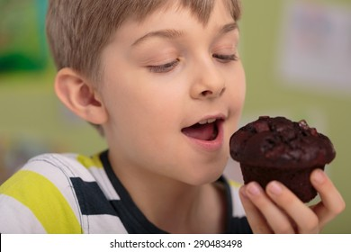
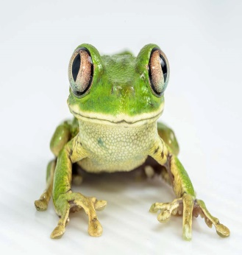
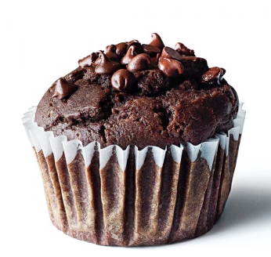
Magical Muffin Mix
Magical Muffin
Mix
Easy to follow recipe.
Turns any child into a frog.
Available in all good witch shops
Get it now before it sells out.
Price - £5.00

