Slide 1
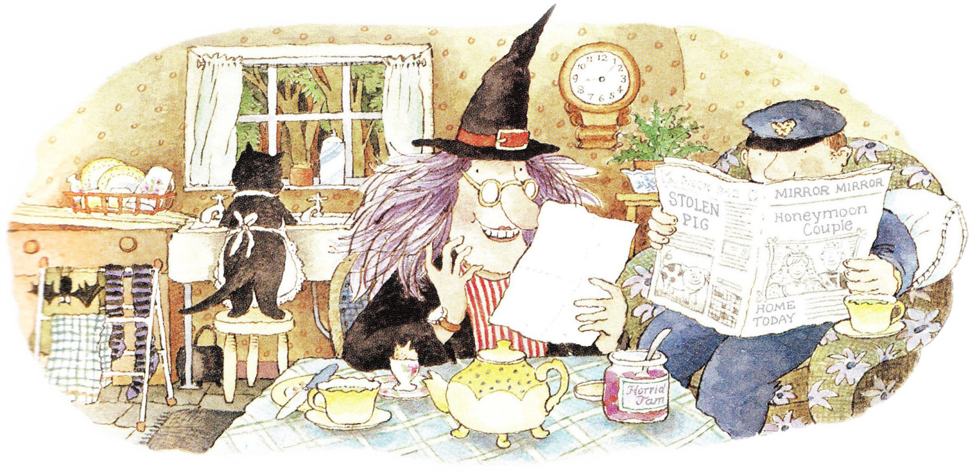
Friday 23rd April 2021
L.O. To create an advert for an original product.

Slide 2
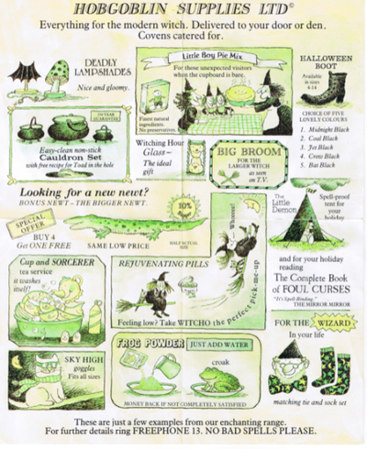
The Jolly Postman delivers a catalogue to the witch. It is full of adverts for products witches would like.

Slide 3
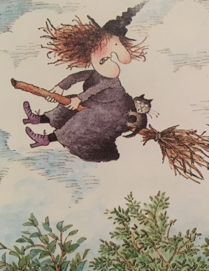
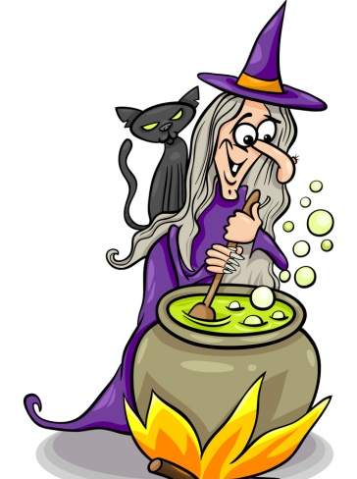
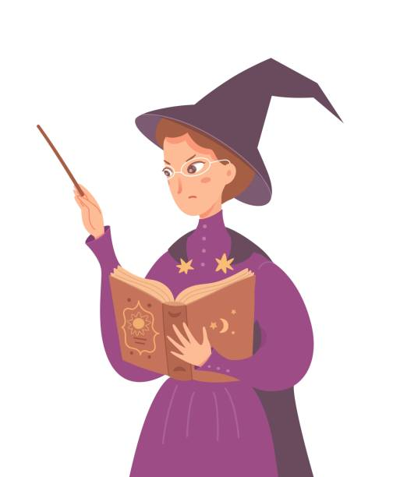
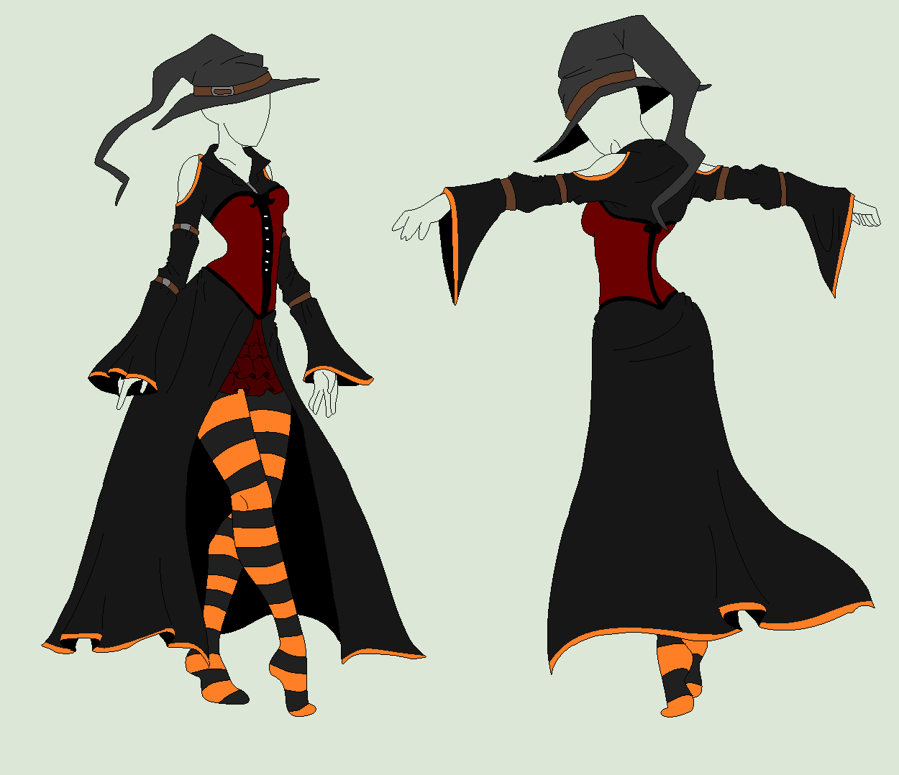
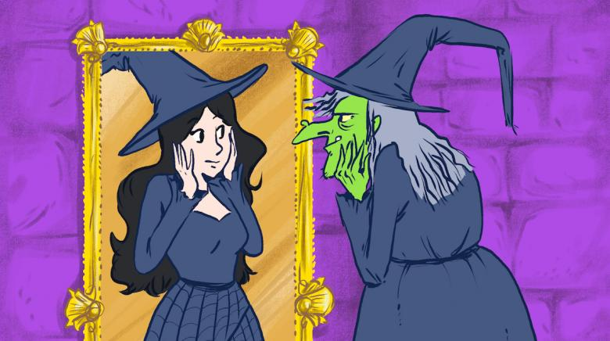
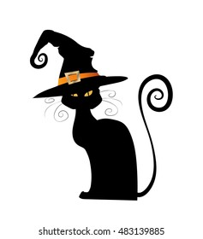
Today you are going to create an advert for a product a witch would like to buy. The product might …
be used when flying.
making potions.
be used when casting spells.
a magic mirror.
be for a cat.
be clothing.

Slide 4
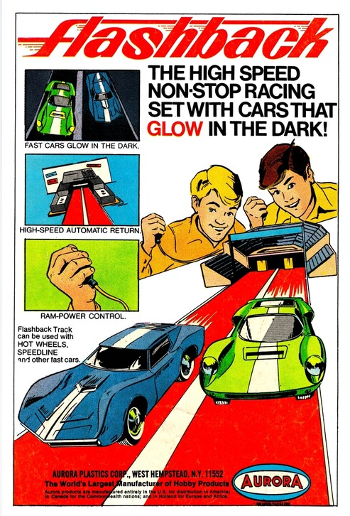
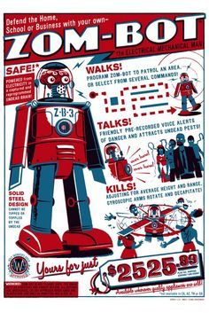
Your advert should make a witch want to buy your product. Take a look at these adverts. Try to include some of these features in your advert.
Name of product
Example of what the product does
Persuasive language like buy it now, only a few left, bargain price, limited addition, everyone should have one
Bright colours
Price

Slide 5
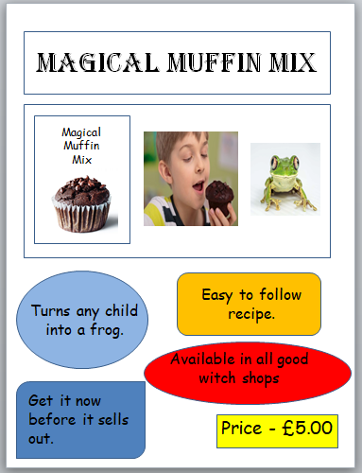
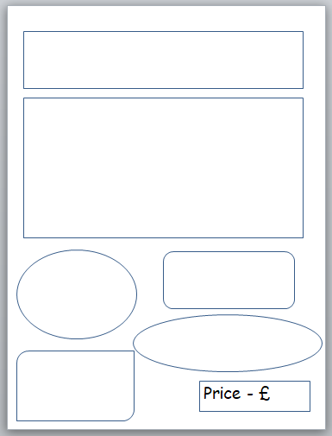
Here is an example advert.
Now it is your turn to create an advert. You can use the template or design your own.

Slide 6
Now you have created the poster for your product why not create a TV advert. Watch the video linked below for some ideas.
https://www.youtube.com/watch?v=zkXZGJdyJzs

