Slide 1

Monday 19th April 2021

Slide 2
This week’s Red words
there
come
who
what
where

Slide 3
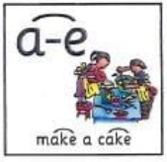
Today’s sound is
a-e

Slide 4
a-e words
brave
shape
bake
make
plane
snake

Slide 5
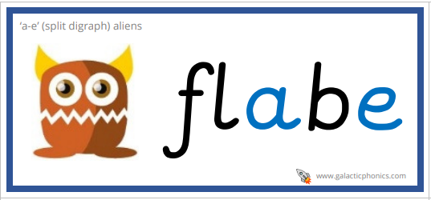

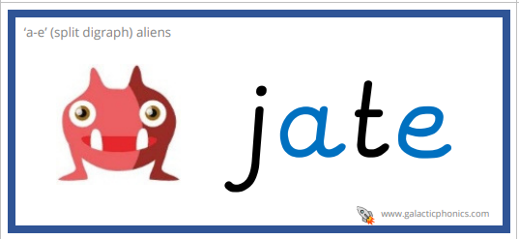
a-e alien words

Slide 6
a-e sentences
Look over there, I can see a long green snake.
I am going to bake a star shaped cake.
Who is going to be brave and get on the plane first? Asked the teacher.

Slide 7
Tuesday 20th April 2021

Slide 8
This week’s Red words
there
come
who
what
where

Slide 9
Today’s sound is
a-e

Slide 10
a-e words
arcade
shake
pancake
name
frame
maze

Slide 11
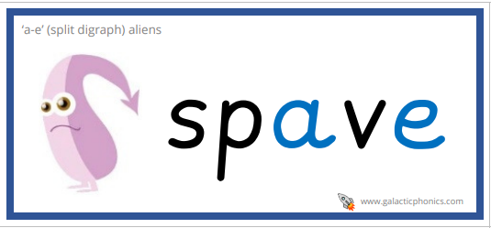


a-e alien words

Slide 12
a-e sentences
There is a big arcade, who wants to come with me?
What are your favourite milkshakes or pancakes?
What is the name of the maze that is over there?

Slide 13
Wednesday 21st April 2021

Slide 14
This week’s Red words
there
come
who
what
where

Slide 15

Today’s sound is
i-e

Slide 16
i-e words
five
smile
daytime
Mike
kite

Slide 17


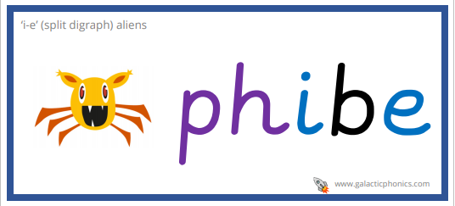
i-e alien words

Slide 18
i-e sentences
Mike who is in year five sits there.
“Wow you have a beautiful bright smile” said the little boy.
Do you want to come and fly a kite in the daytime?

Slide 19
Thursday 22nd April 2021

Slide 20
This week’s Red words
there
come
who
what
where

Slide 21
Today’s sound is
i-e

Slide 22
i-e words
beehive
ride
sunshine
nine
prize

Slide 23


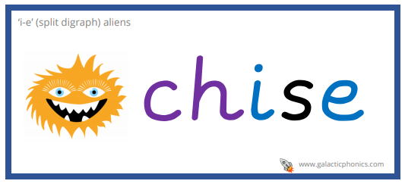
i-e alien words

Slide 24
i-e sentences
Where should we go for our bike ride today?
There are nine big beehives in the park.
I can see the beautiful prizes in the sunshine.

Slide 25
Friday 23rd April 2021

Slide 26
This week’s Red words
there
come
who
what
where

Slide 27
This weeks sounds

Slide 28
Words
bride
alive
mistakes
whale
safe
polite
grapes

