Slide 1

Monday 23rd November 2020

Slide 2
This week’s Red words
then
came
little
looked
called

Slide 3

Today’s sound is
aw

Slide 4
aw words
draw
claws
paws
straw
yawn
fawn

Slide 5
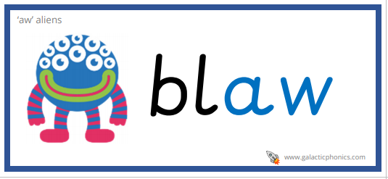
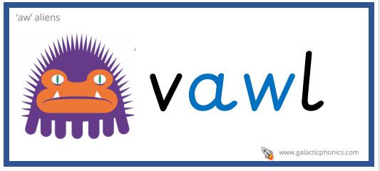
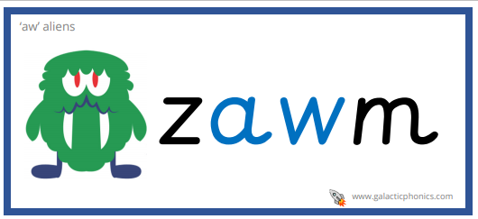
aw alien words

Slide 6
aw sentences
The little bird over there has huge claws.
When I looked outside this morning I saw a beautiful animal called a fawn.
I did a big yawn because I was tired then I came to school.

Slide 7
Tuesday 24th November 2020

Slide 8
This week’s Red words
then
came
little
looked
called

Slide 9
Today’s sound is
aw

Slide 10
aw words
crawl
seesaw
jigsaw
hawk
squawk

Slide 11
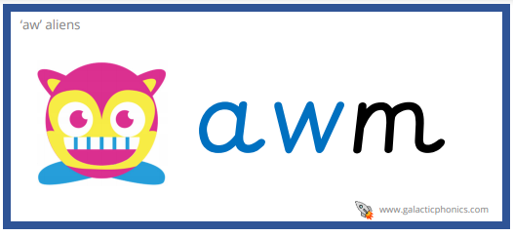
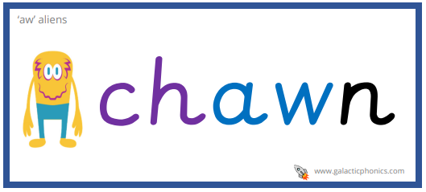
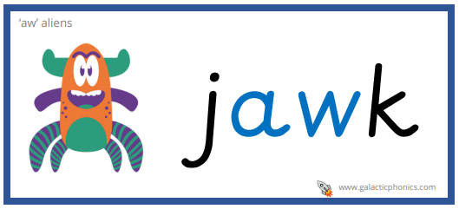
aw alien words

Slide 12
aw sentences
I looked up because I heard a loud squawk, it was a huge hawk.
When I was little I loved going on the seesaw at the park.
My favourite jigsaw is a picture of a place called New York City.

Slide 13
Wednesday 25th November 2020

Slide 14
This week’s Red words
then
came
little
looked
called

Slide 15

Today’s sound is
are

Slide 16
are words
dare
care
square
share
stare
mare

Slide 17
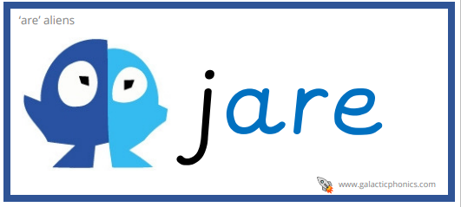
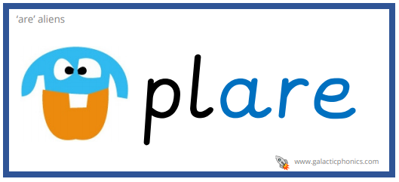
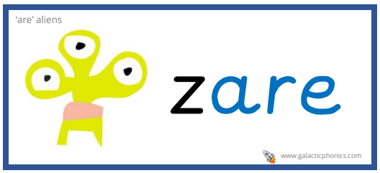
are alien words

Slide 18
are sentences
They came to the town square to stare at the shining stars.
The horse shared it’s food with it’s little mare.
All of the class took care of each other and were kind.

Slide 19
Thursday 26th November 2020

Slide 20
This week’s Red words
then
came
little
looked
called

Slide 21
Today’s sound is
are

Slide 22
are words
scarecrow
fare
bare
compare
beware

Slide 23
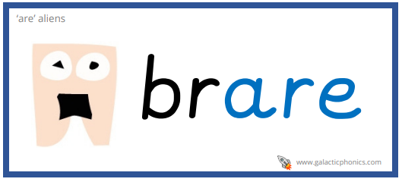
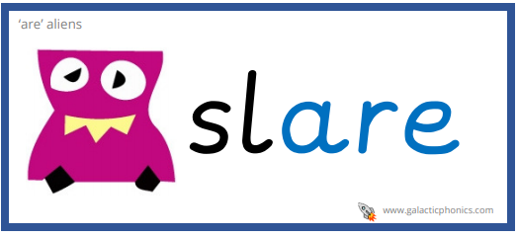
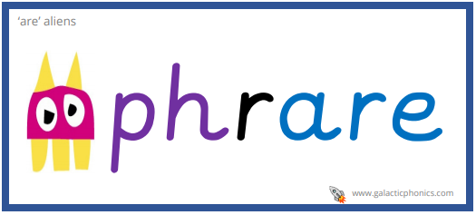
are alien words

Slide 24
are sentences
The little scarecrow with a bright red shirt was out in the bare field.
The children looked at the old crooked sign and it said beware.
A tall lady with dark hair came to compare the two cars.

Slide 25
Friday 27th November 2020

Slide 26
This week’s Red words
then
came
little
looked
called

