Slide 1
All about Badgers

Slide 2
The word badger comes from the French word ‘Becheur’ meaning digger.
A male badger is called a boar.
A female badger is called a sow.
A baby badger is called a cub.

Slide 3
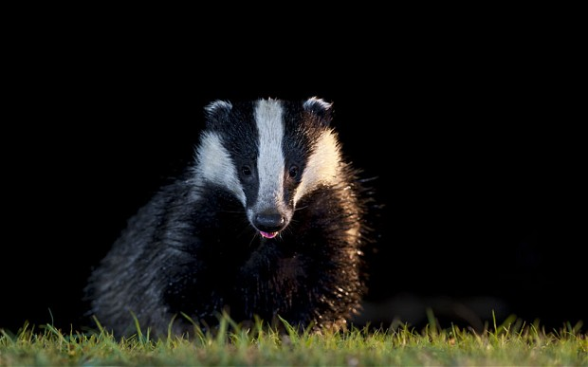
Badgers are nocturnal- they sleep through the day and are awake at night.
Badgers do not hibernate, they have a deep sleep called a torpor that last for days at a time.

Slide 4
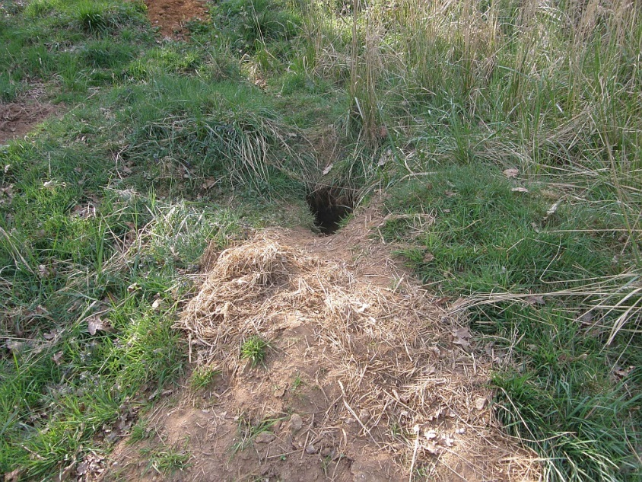
Badgers live in groups of up to 14 adults and dig systems of underground tunnels and nesting chambers called "setts", where they sleep and rear their young.
These setts can have several entrances, and grass, bracken and leaves are used to line their beds.

Slide 5
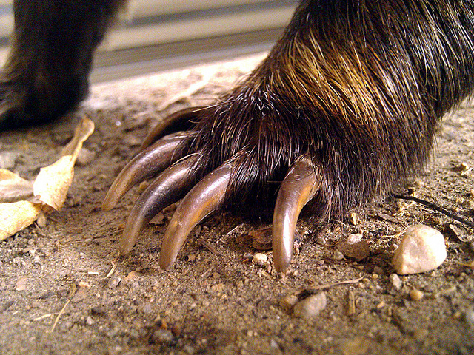
Badgers are strong and heavy for their size and have sharp clawed feet, making them the fastest-digging animal on Earth.
Badgers scratch their claws against trees near the sett to keep them sharp.

Slide 6
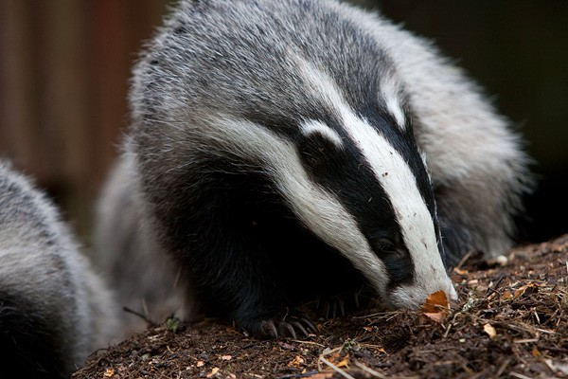
Badgers are omnivorous, which means they will eat almost anything edible. The bulk of their diet is made up of earthworms (generally about 80%), but they will also eat small rodents, frogs and slugs, fruit, nuts, wheat, sweet corn and grubs.
They use their long claws to dig up their food.

Slide 7
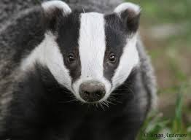
A badgers’ head has the distinctive black and white stripes - the rest of the body is grey. Badgers spend most of their lives underground or out at night, so their best developed senses are sound and smell.
Badger stripes point to a different danger zone - powerful jaws and sharp teeth, the badgers primary defence. Watch out they bite!
www.bbc.co.uk/programmes/p007xsl6

