Slide 1
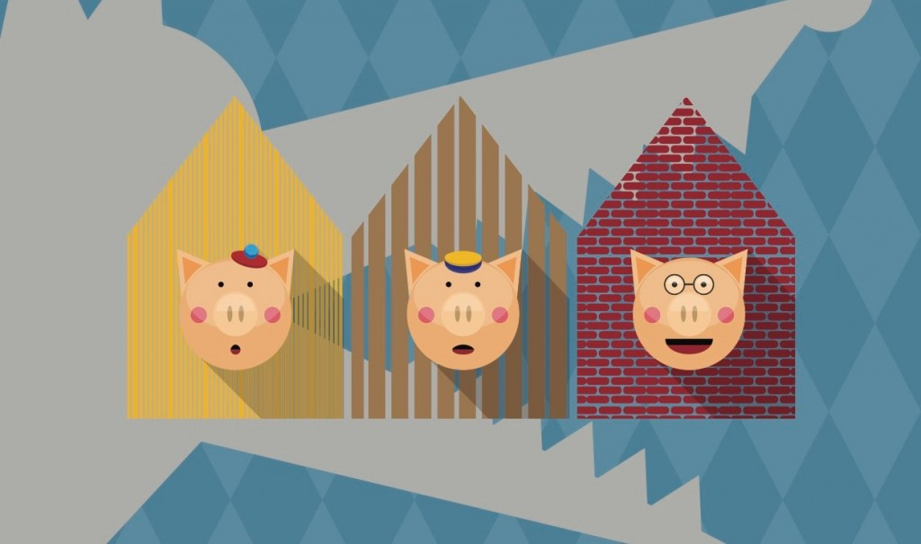
Thursday 13th May 2021
LO: To plan an alternative story based
on structure of The Three Little Pigs

Slide 2
Let’s recap the story of the
Three Little Pigs

Slide 3
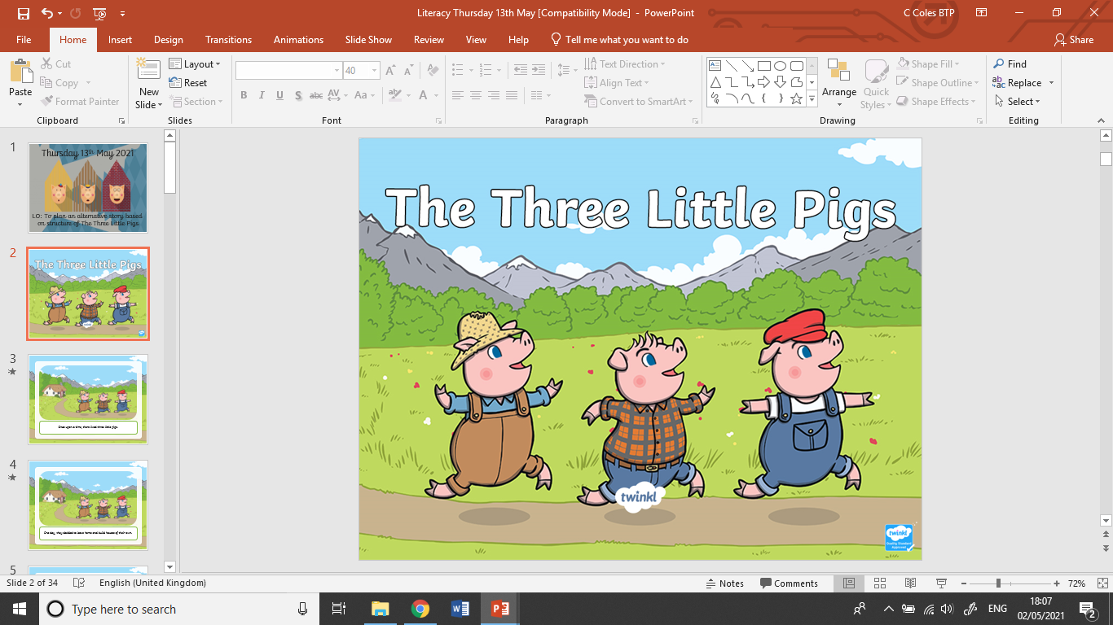

Slide 4
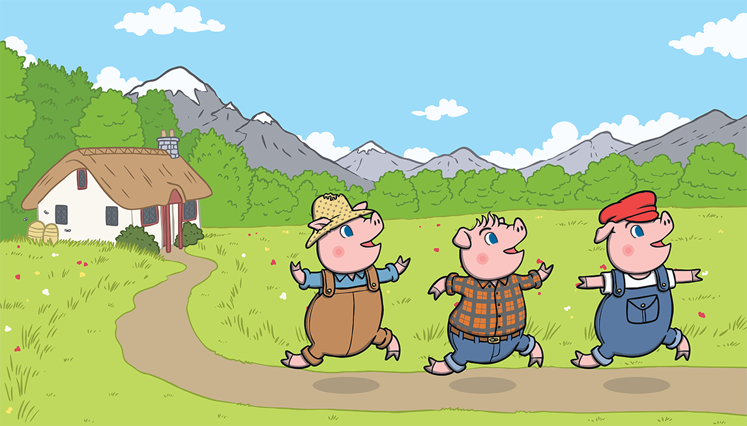
Once upon a time, there lived three little pigs.
One day, they decided to leave home and build houses of their own.

Slide 5
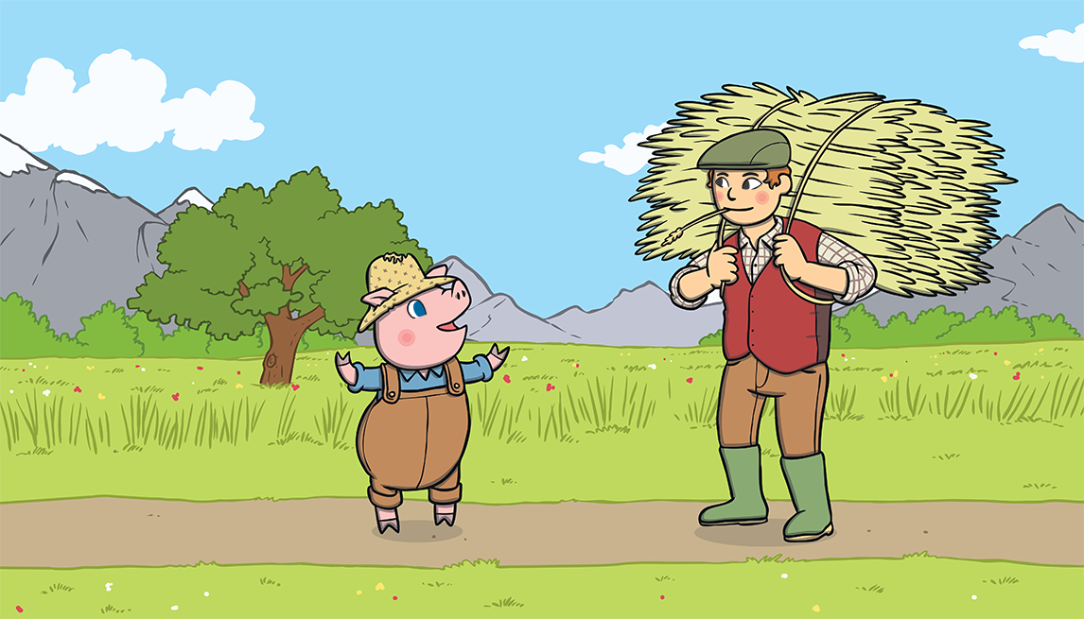
The first little pig thought that straw would make a
good house.

Slide 6
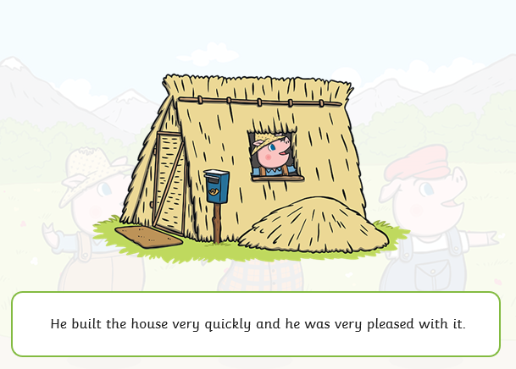

Slide 7
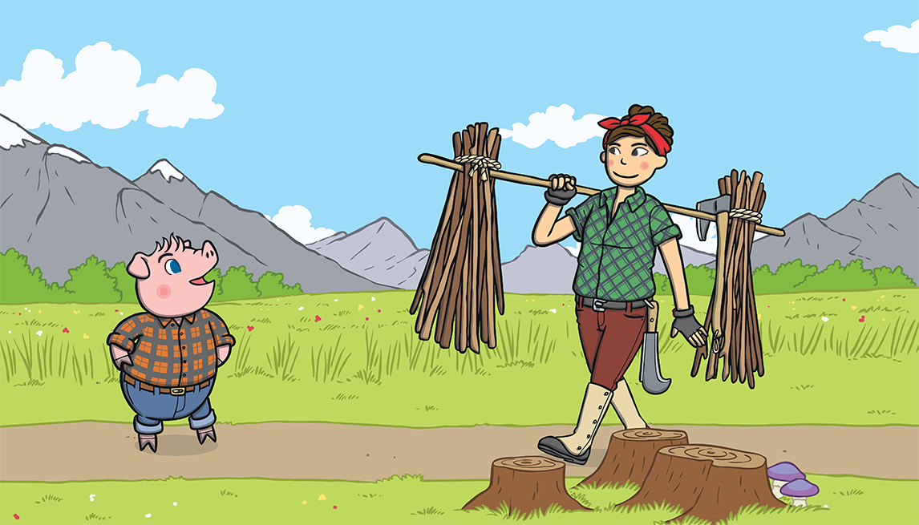
The second little pig thought that sticks would make a fine house.

Slide 8
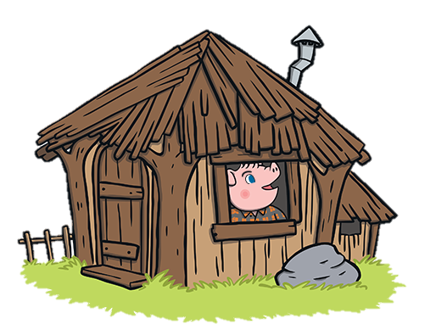
He built the house very quickly and he was very pleased with it.

Slide 9
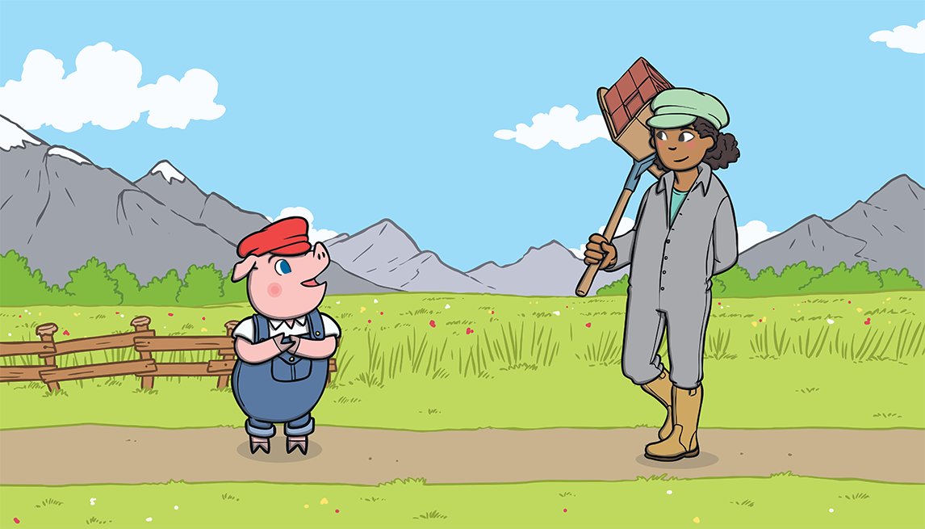
The third little pig thought that bricks would make a strong house.

Slide 10
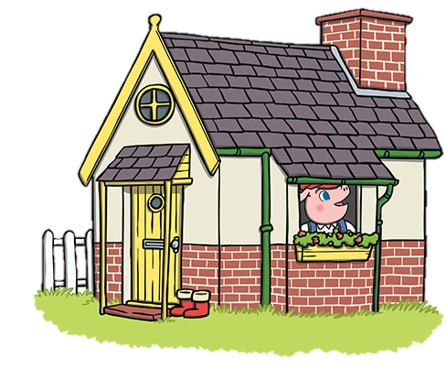
It took him a long time to build the house but he was very
pleased with it.

Slide 11
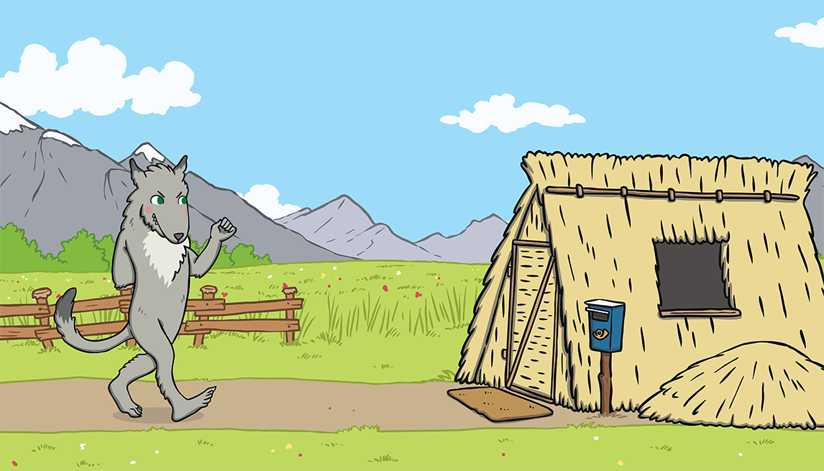
One day, a big bad wolf came along.
He saw the first little pig in his house of straw.

Slide 12
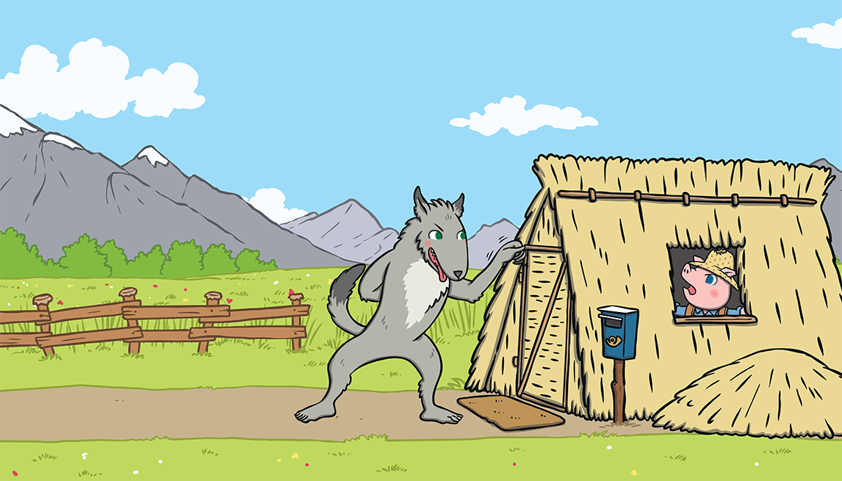
“Little pig, little pig, let me come in,” he snarled.
“Not by the hair on my chinny, chin, chin!” cried the first little pig.

Slide 13
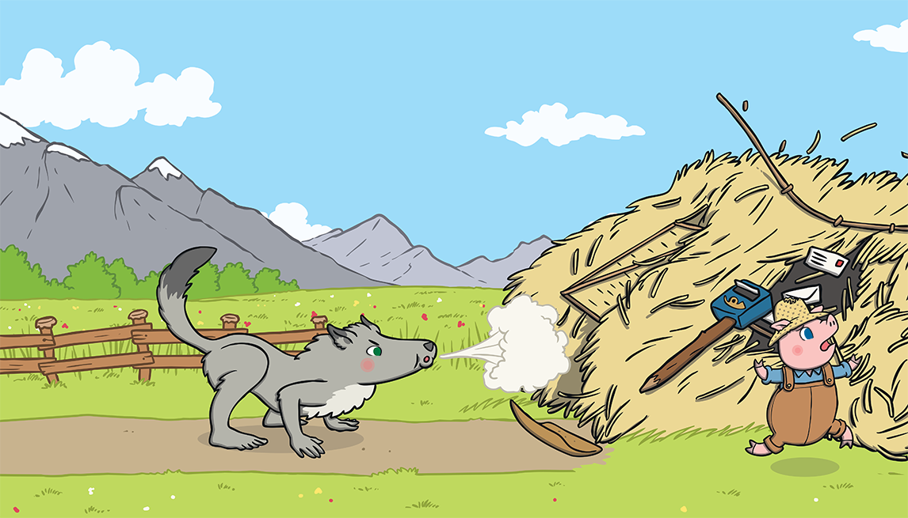
“Then I’ll huff and I’ll puff and I’ll blow your house down!” growled the big bad wolf.
So he huffed and he puffed and he blew the house down!

Slide 14
The first little pig escaped and ran to join his brother in the house made of sticks.

Slide 15
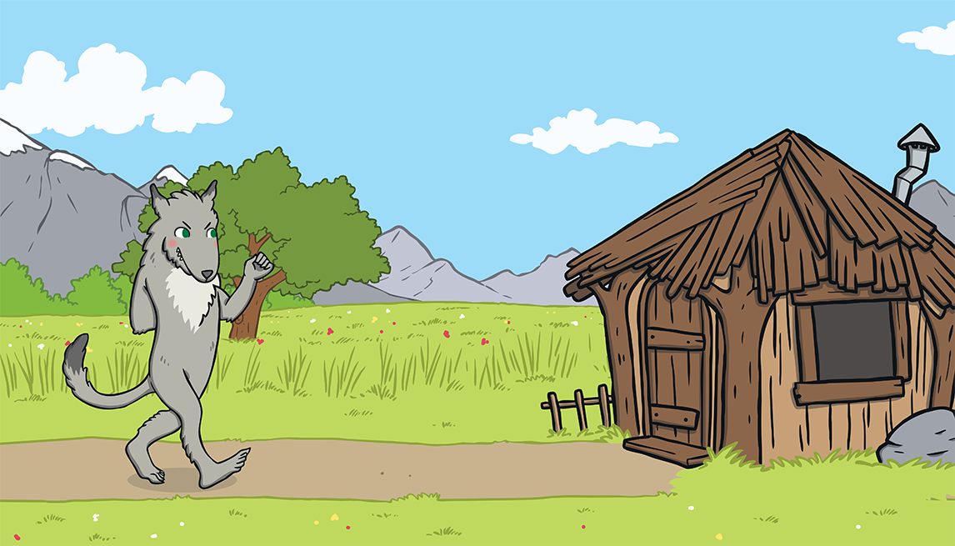
The big bad wolf followed the little pig to the house made of sticks.

Slide 16
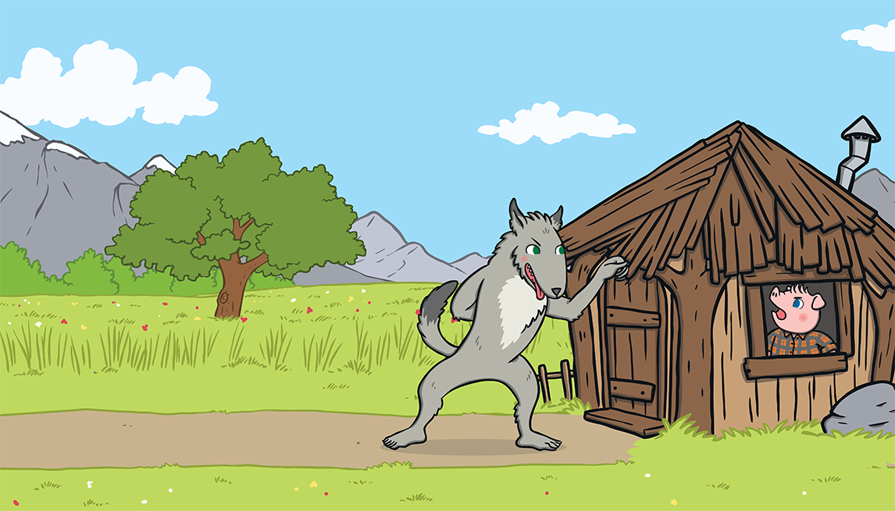
“Little pig, little pig, let me come in,” he snarled.
“Not by the hair on my chinny, chin, chin!” cried the second little pig.

Slide 17
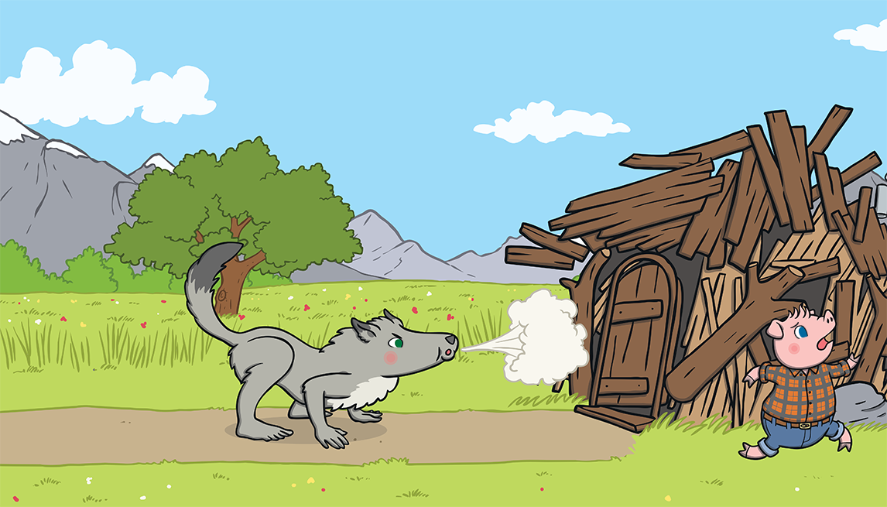
“Then I’ll huff and I’ll puff and I’ll blow your house down!” growled the big bad wolf.
So he huffed and he puffed and he blew the house down!

Slide 18
The two little pigs escaped and ran to join their brother in the house made of bricks.

Slide 19
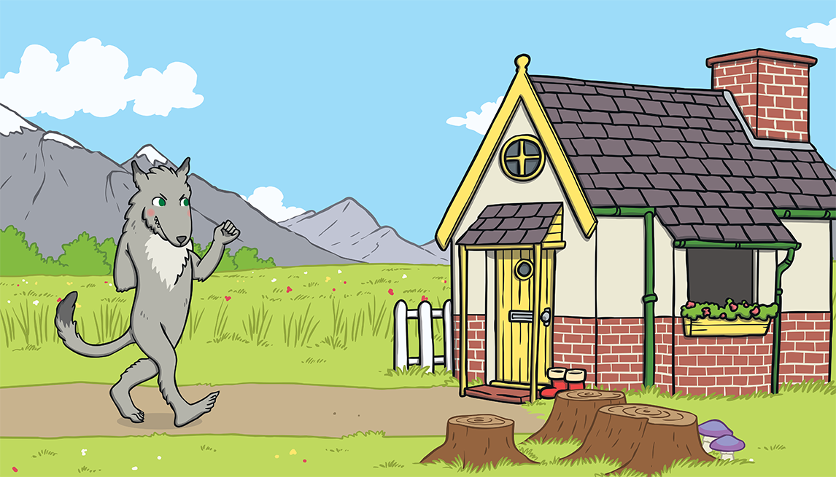
The big bad wolf followed the pigs to the house made of bricks.

Slide 20
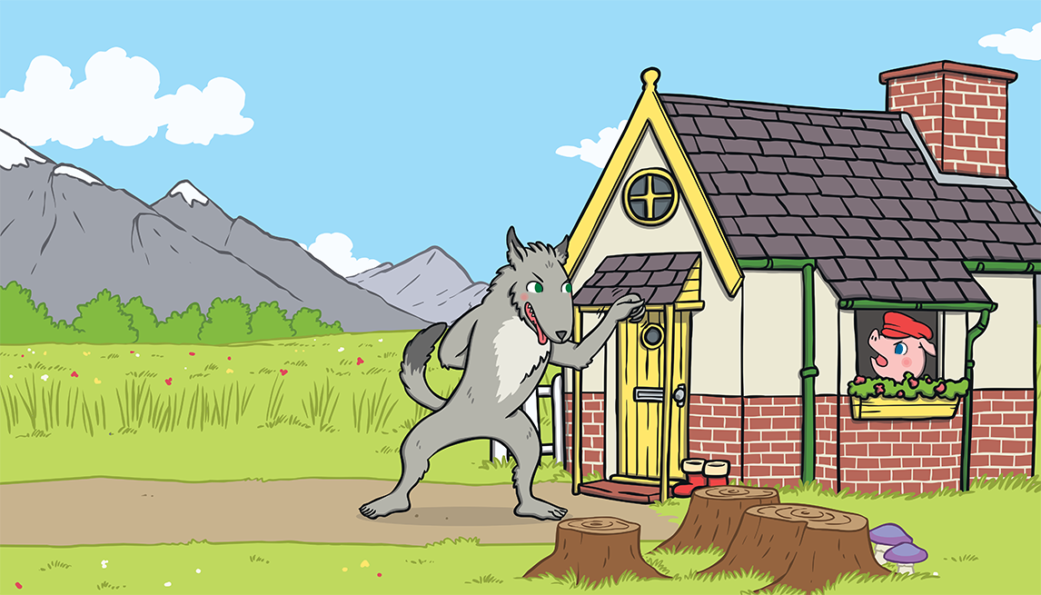
“Little pig, little pig, let me come in,” he snarled.
“Not by the hair on my chinny, chin, chin!” cried the third little pig.

Slide 21
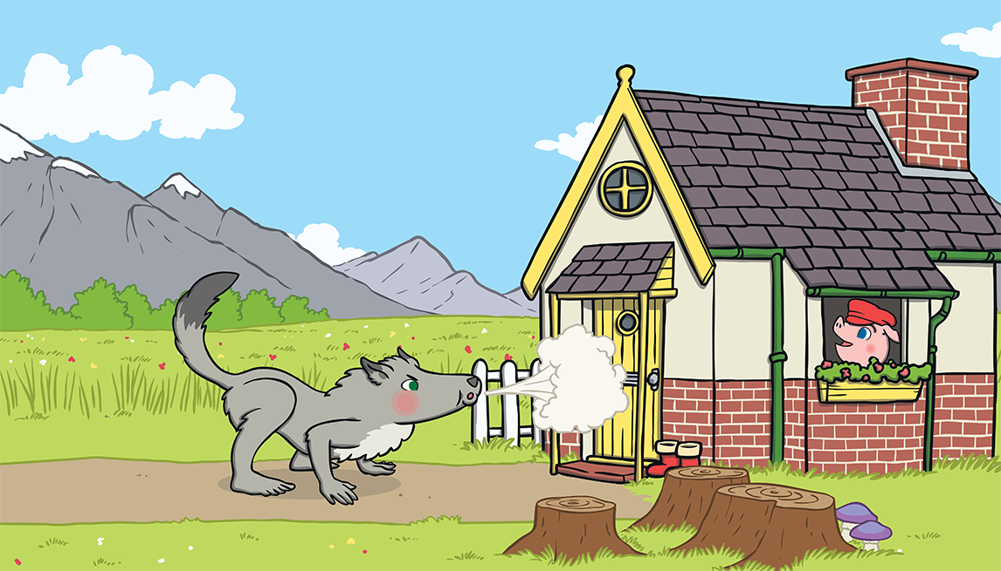
“Then I’ll huff and I’ll puff and I’ll blow your house down!” growled the big bad wolf.
He huffed and he puffed, but the house was too strong. He could not blow it down!

Slide 22
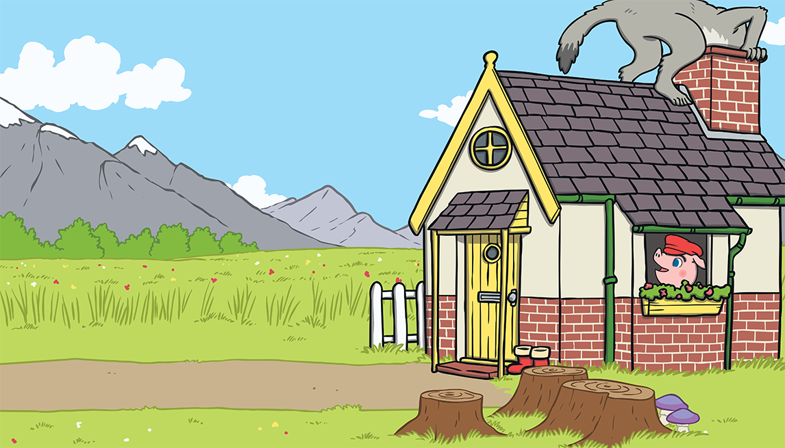
This made the big bad wolf very angry.
He climbed onto the roof of the house so he could crawl down the chimney.

Slide 23
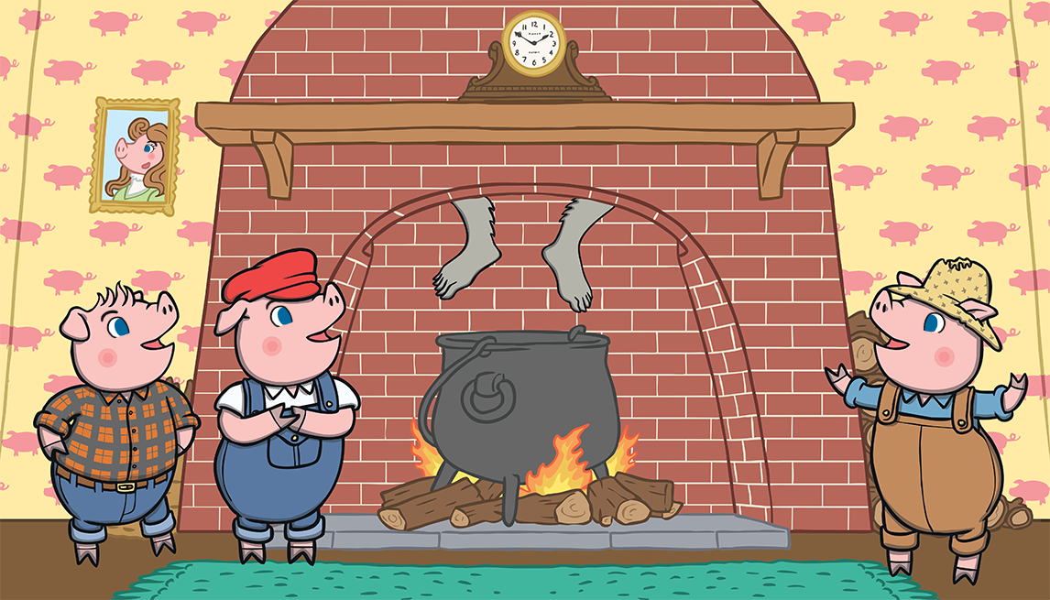
The big bad wolf was in for a big surprise!

Slide 24
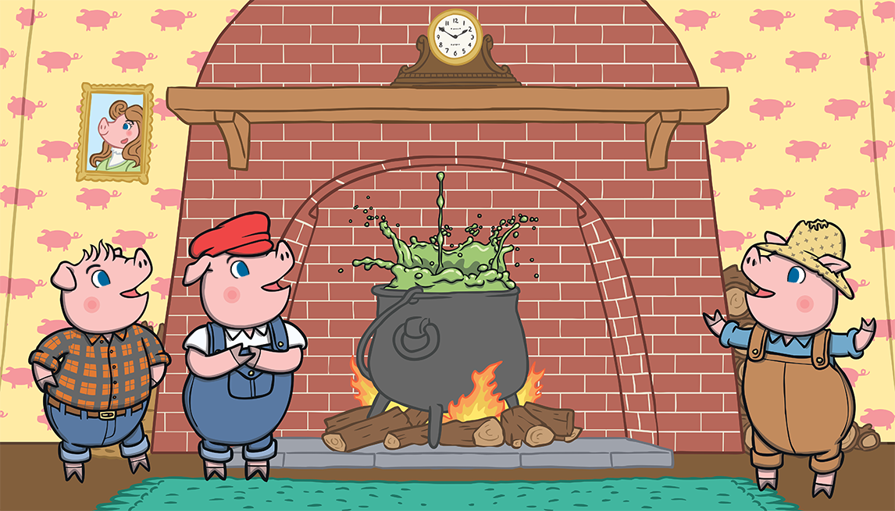
The third little pig had been cooking a big pot of stew and SPLASH! The wolf fell right into the pot!

Slide 25
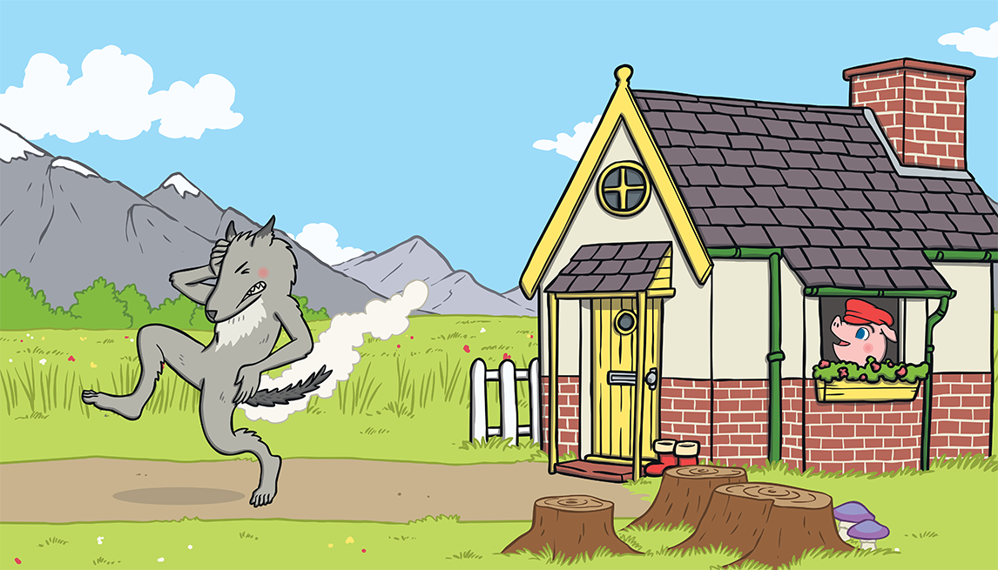
The wolf was very shocked. He jumped out of the pot and ran straight out of the house. He never came back again.

Slide 26
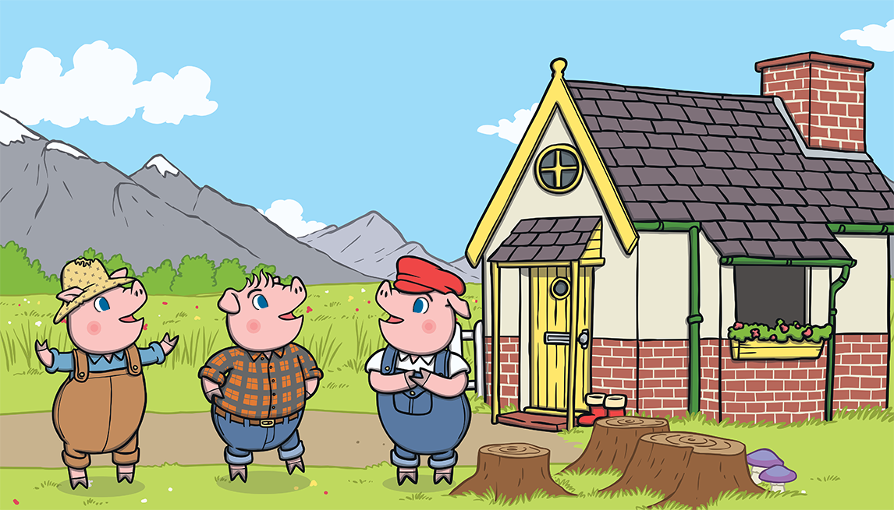
The little pigs lived happily ever after in the house made of bricks.

Slide 27
Your Task:
Is to use the ideas from the story
The Three Little Pigs but change the characters and the houses they built.
You are then going to put these ideas on to a story map to show what is going to happen in your version.

Slide 28
Here is my idea for the new story.
My characters
Three Little Kittens
The Big Barking Dog
The settings
First house is made out of plastic
Second house made of glass
Third house made out of stone.

Slide 29
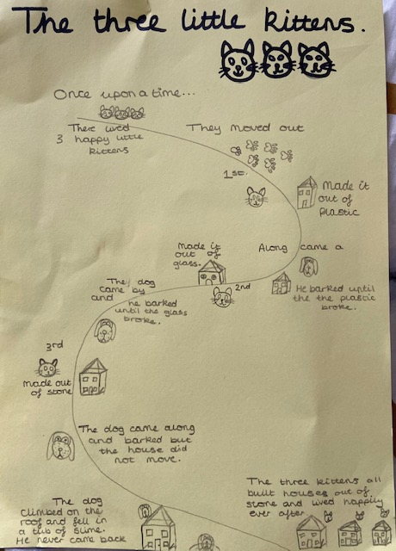
Here is my
story map.
I have drawn pictures and written short captions to help me remember what is happening in that part of the story.

Slide 30
What animals are going to be your main characters?
Remember:
You will need Three Little ……………….
A bad character (Big Bad Wolf)
What they build their houses out of.
What the bad animal does to knock then down.
What happens to the bad animal at the end e.g. falling into a pot of boiling water.

