Slide 1
A task setting PowerPoint about the Jewish synagogue for Key Stage 1.

Slide 2
Aim
To learn about what you might see and experience at a Jewish synagogue.
To learn about why it is an important place to many people.
Success Criteria
I can list the things that are the same and different about Jewish synagogues around the world.
I can name and describe special objects that can be found inside.
I understand why the synagogue is an important place by describing what happens there.

Slide 3
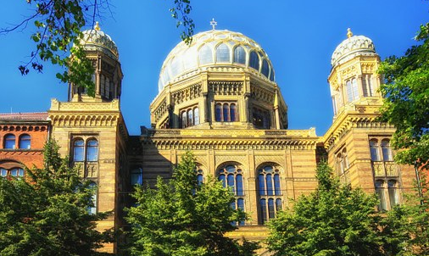
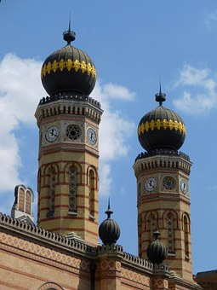
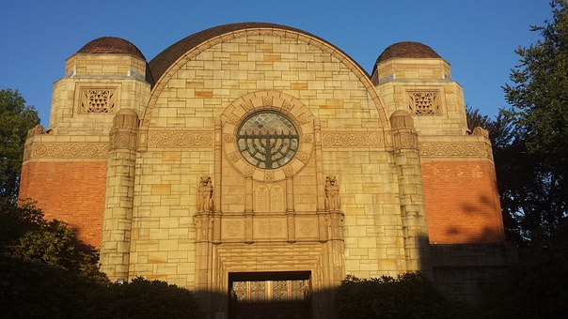
What Do All These Buildings
Have in Common?

Slide 4
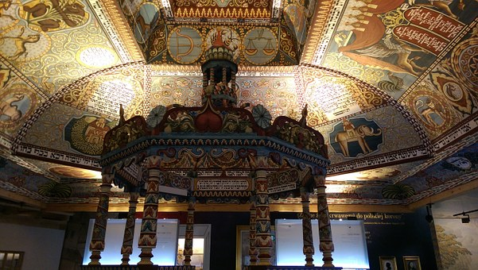
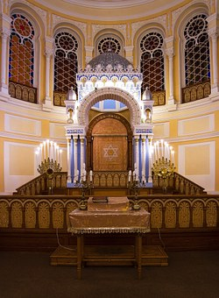
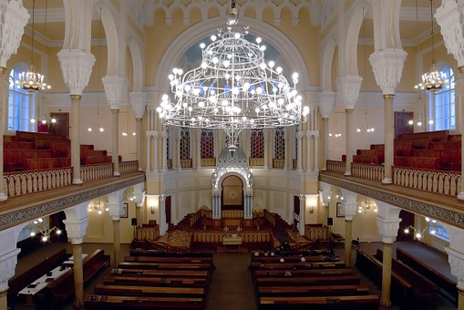
What Is It like Inside a
Jewish Synagogue?

Slide 5
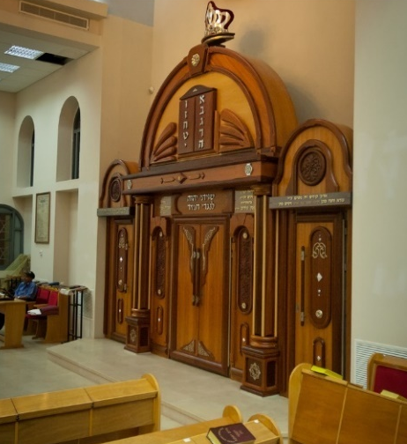

Important Features of a
Jewish Synagogue.
Bimah
A raised platform where most of the service takes place. The Torah readings happen here.
Ark
The Ark is a cupboard in which the Torah scrolls are kept.
Siddur
This is the main prayer book.
Photos courtesy of Flavio~ (@flickr.com) - granted under creative commons licence - attribution

Slide 6

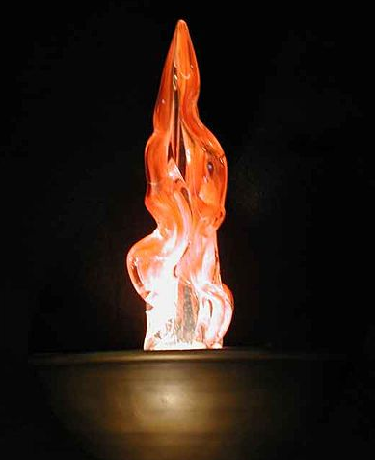
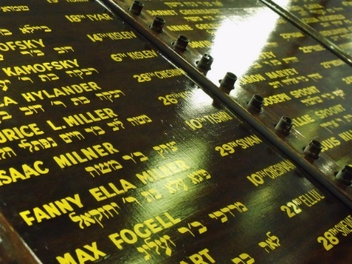
Important Features of a
Jewish Synagogue.
Torah Scrolls
The scrolls contain the words of the Hebrew Bible.
The Eternal Light
This hangs above the Ark and is always burning to remind everyone that God is always with them.
Memorial Boards
These are boards full of name plates. Each name plate remembers someone who has died.
Photos courtesy of Toksook~ (@Wikipedia.org), GlasgowAmateur (@flickr.com) - granted under creative commons licence - attribution

Slide 7
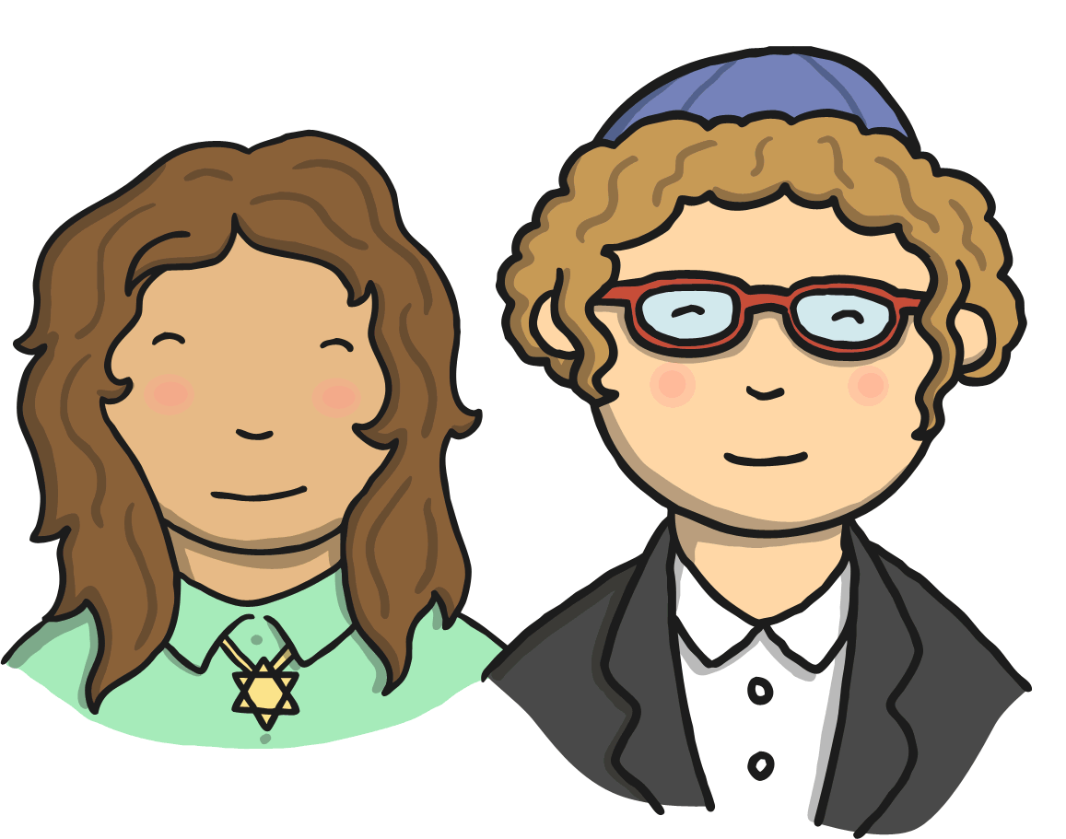
Why Do People Go to a
Jewish Synagogue?
People go to the synagogue to worship but also to study. Many synagogues are also community centres where local Jewish people can meet and take part in different activities and events..
A synagogue is a house of prayer where Jewish people can get together to feel closer to God, and each other.
The services are led by a rabbi or a worshipper.

Slide 8
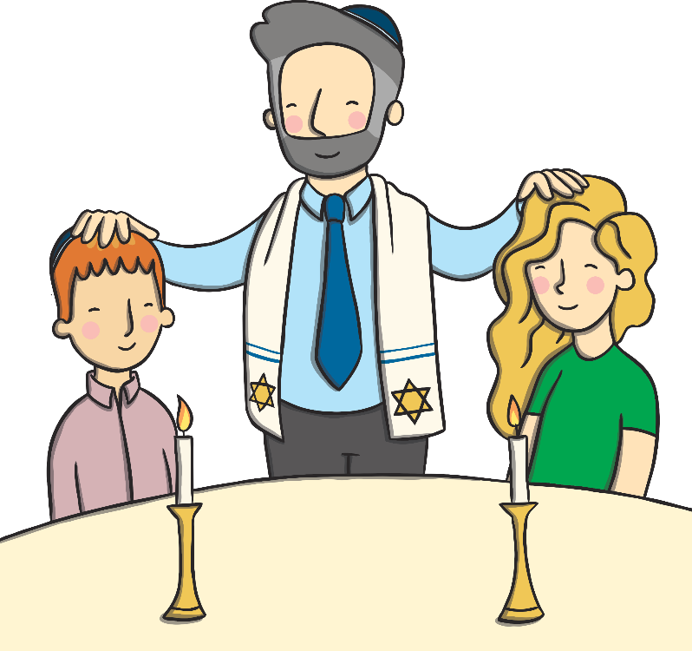
Showing Respect
During the service everyone, except women who aren’t married, must wear a hat to show respect to God; this is called a kippah.
Adult men wear a prayer shawl for morning prayer which has fringes along the edge to remind the worshipper to follow God’s way.
Men and women sit separately in the synagogue.
Once the Ark is open, nobody must enter or
leave the room as a sign of respect.

Slide 9
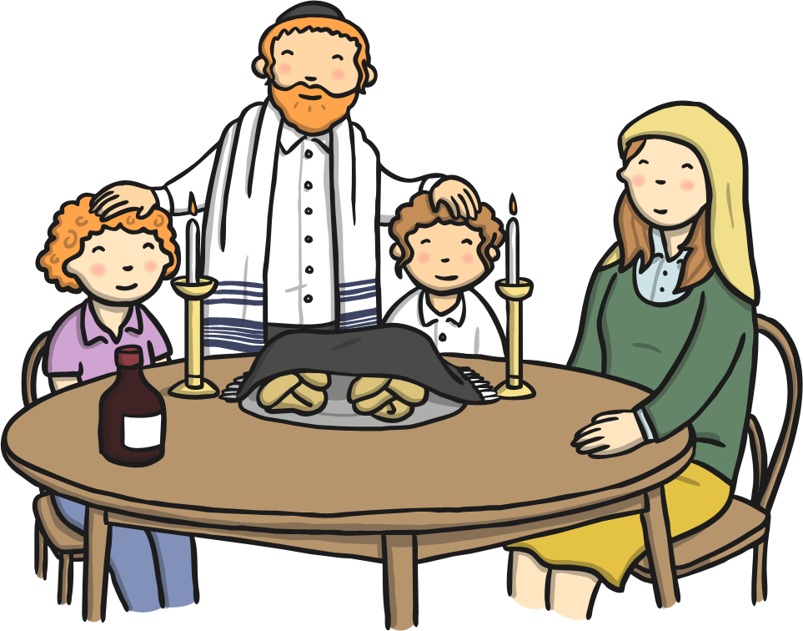
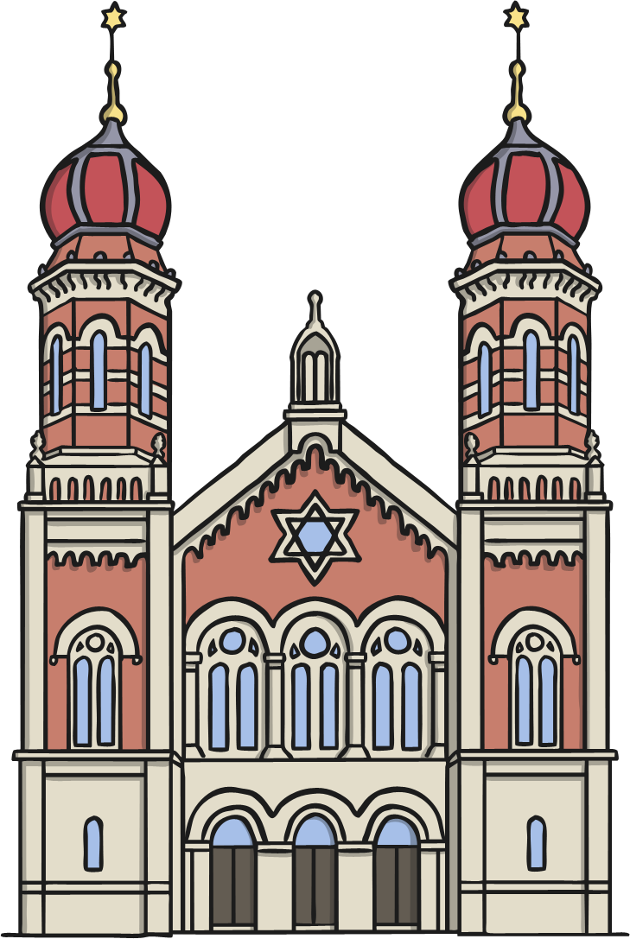
What difference do you think it makes for Jewish people to be
part of a faith family?
Do you still have any questions about synagogues?

