Slide 1
LO: To make a Bird House
Tuesday 11th May 2021

Slide 2
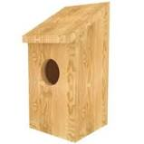
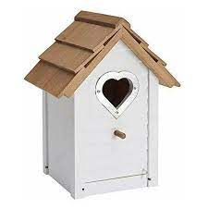
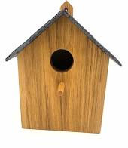
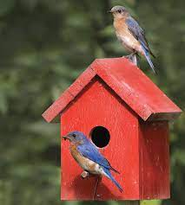
Today we will be making a bird house!
We put bird houses outside to give them spaces for new homes when they nest.

Slide 3
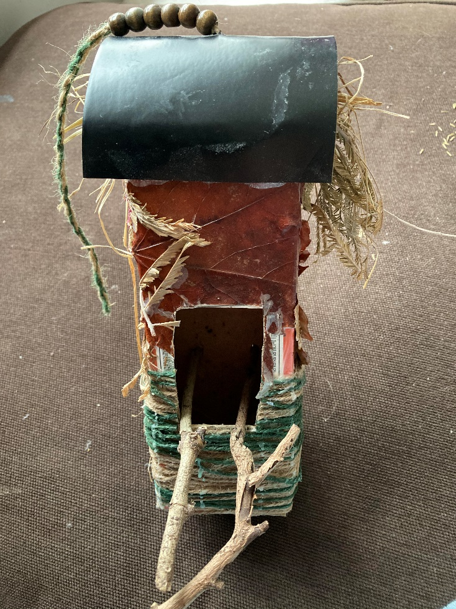
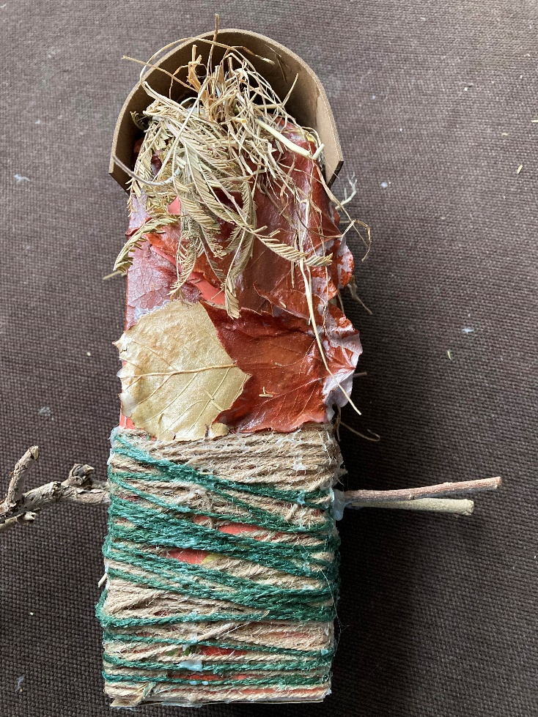
Our bird houses will be decorative but not useable outside!
This is what it will look like.

Slide 4
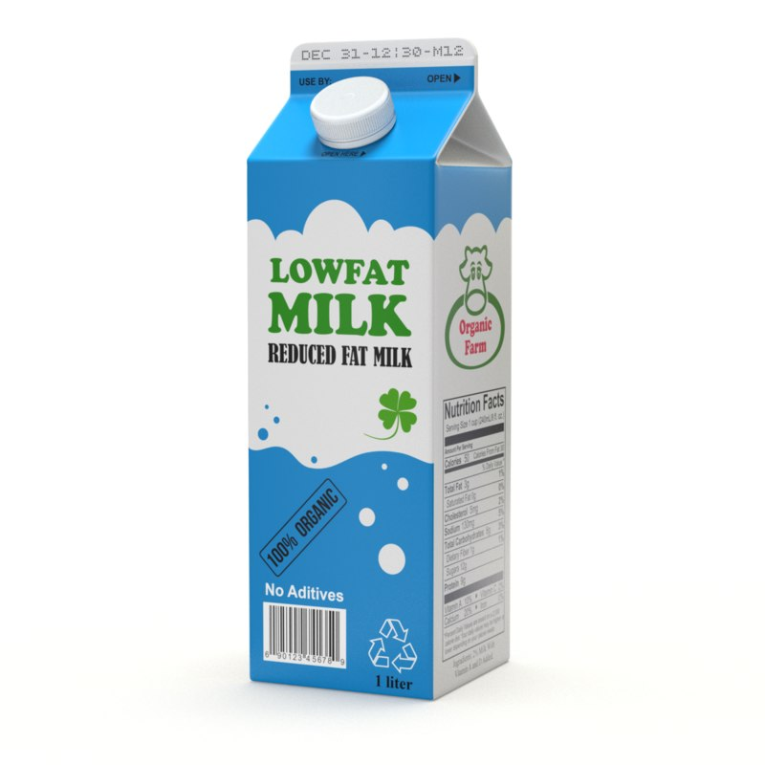
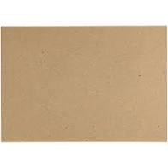
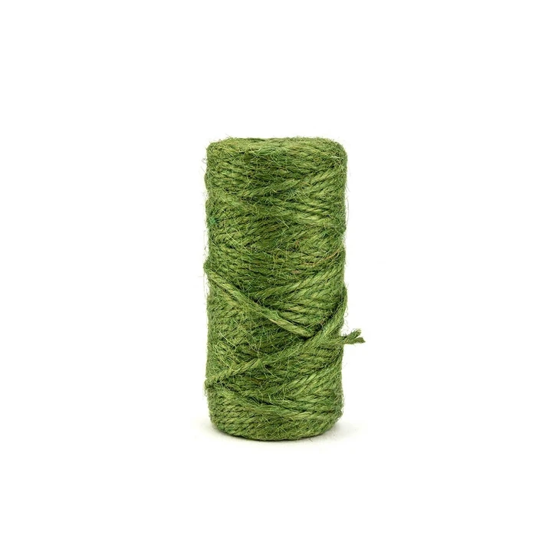
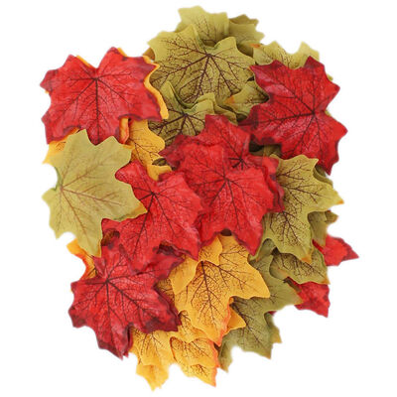
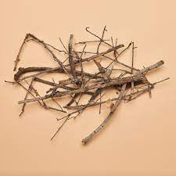
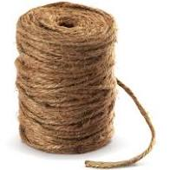
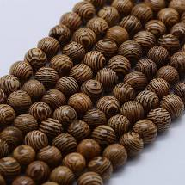
What you will need:
beads (if you want them)
a milk carton (rinsed)
two colours of garden twine
twigs
Leaves (real or fake)
card for the roof

Slide 5
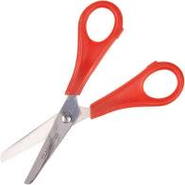
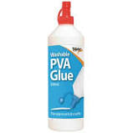
You will also need:
scissors PVA glue

Slide 6
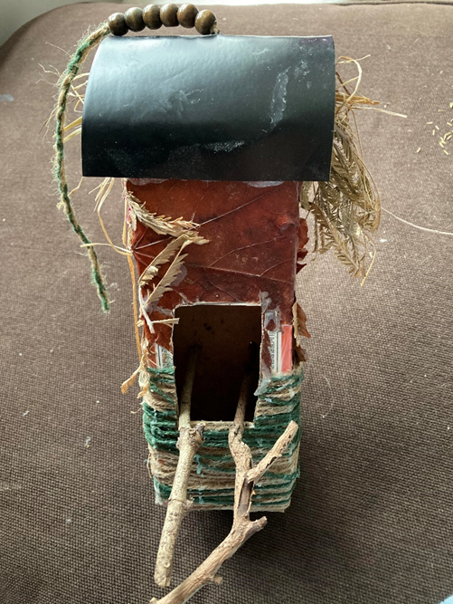
Step 1:
First, Make a hole in the middle of the card.
Second, Twist two pieces of twine together tying a knot in one end.
After that, Pull the twine through the hole with the knot under the card.
Next, Thread some beads onto the twine at the top of the card.
Finally, Tie a final knot at the other end of the twine to stop the beads falling off.

Slide 7
Step 2:
Then, cut out a rectangle in the side of your clean milk carton.
Next, create two holes in the opposite side for the twigs to go through.

Slide 8
Step 3:
After that, curve over your rectangle of card over the top of the carton so it curves front to back and glue securely.

Slide 9
Step 4:
Next, cover the bottom half of the carton with PVA and wrap twine around it and fasten securely.

Slide 10

Step 5:
Cover the top half with PVA glue and stick your natural materials (leaves etc) onto it.

Slide 11
Step 6:
After that, poke your twigs through the holes in the back through to the front rectangle. Glue to secure.

Slide 12
Step 7:
Finally, get some dried grass or hay and push it under the roof.
And your bird house is complete!

