Slide 1
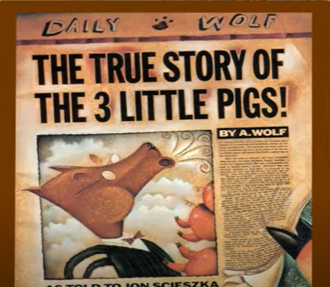
LO: To use speech bubbles to show dialogue.
Tuesday 11th May 2021

Slide 2
Let’s think about the questions that we came up with yesterday in our groups.
We will learn how to write our questions and then think about how to write clear answers.

Slide 3








What punctuation do we see at the end of a question?

Slide 4
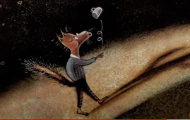
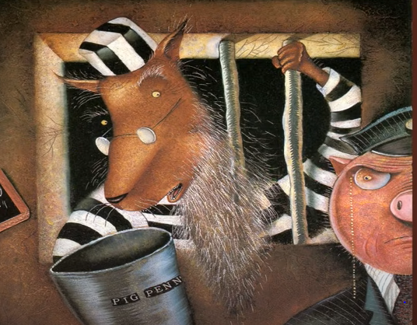
Mr. Wolf was going to get a cup of sugar for a cake he was making for his Grandma. We can find out more about if this was the truth by asking about the cake.
I was making a chocolate rabbit cake.
What sort of cake were you making?

Slide 5
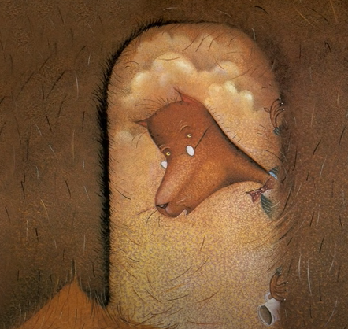
The straw house door fell down. We can find out more about if this was the truth by asking about the door.
I knocked on the door very gently.
How hard did you knock on the door?

Slide 6
Task 2 – To read the questions then write an answer using the language of the question.
Task 1 – To match question speech bubbles with the right answers.
Task 3 – To write the questions carefully then write an answer using the language of the question.

