Slide 1
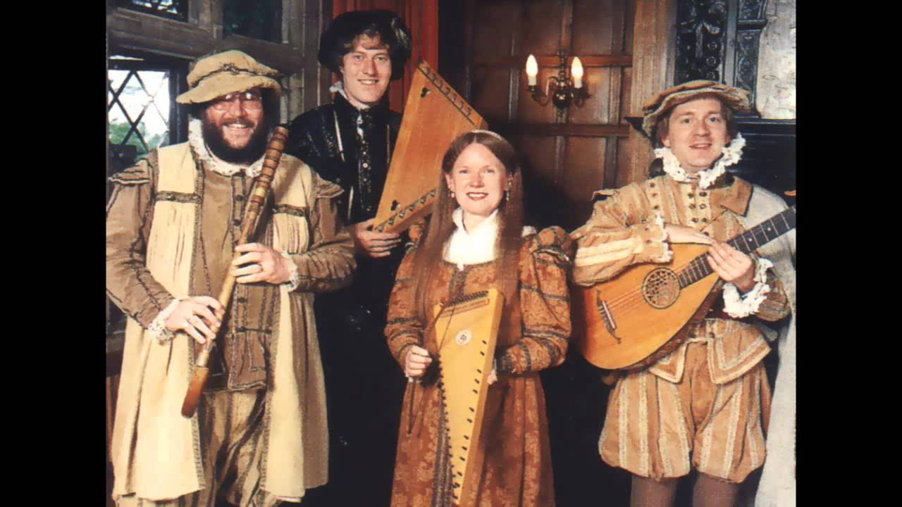
Tudor Music
L.O. Listen to and discuss Tudor music.

Slide 2
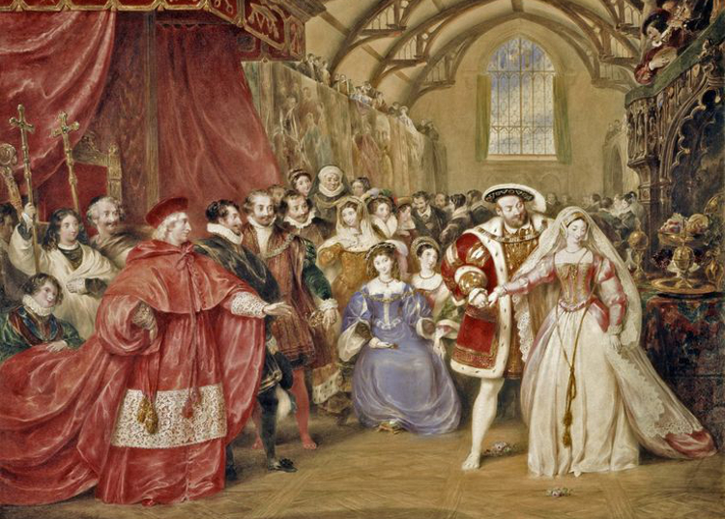
This week you have been learning about a famous Tudor monarch named King Henry VIII. He is famous for throwing lavish feasts and parties similar to the scene you can see in the painting below. During these parties, people enjoyed feasting, dancing and listening to music.

Slide 3
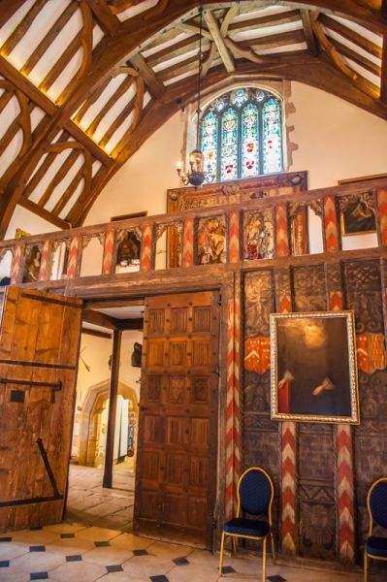
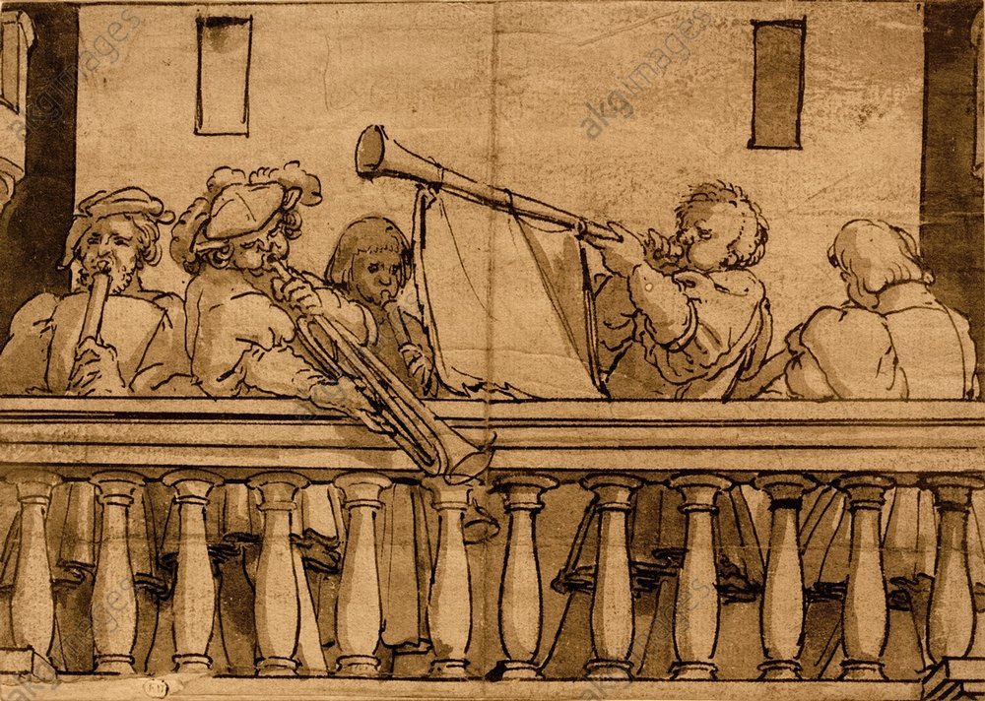
Tudor musicians and entertainers were called Minstrels and they would play on a minstrels gallery (similar to a balcony) as seen in the pictures below.

Slide 4
Listen
Follow the link below to listen to some Tudor music.
What did you like /dislike about the music? Explain your answer
What instruments could you hear?
https://www.bbc.co.uk/teach/school-radio/history-tudors-music/zm4gvk7

Slide 5
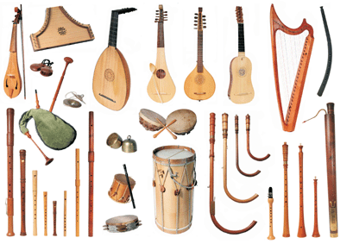
Tudor Instruments
Tudors often used different instruments to the ones that are commonly used today.
Use the link below to listen to and learn the names of Tudor instruments.
https://www.youtube.com/watch?v=-Ns14mCcFig

Slide 6
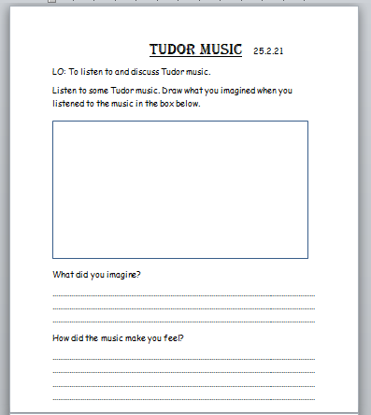
Your Task
Listen to the Tudor music. Then either complete the sheet shown here or on plain paper, draw what you imagined when you listened to the music. Think about how the music made you feel.

