Slide 1










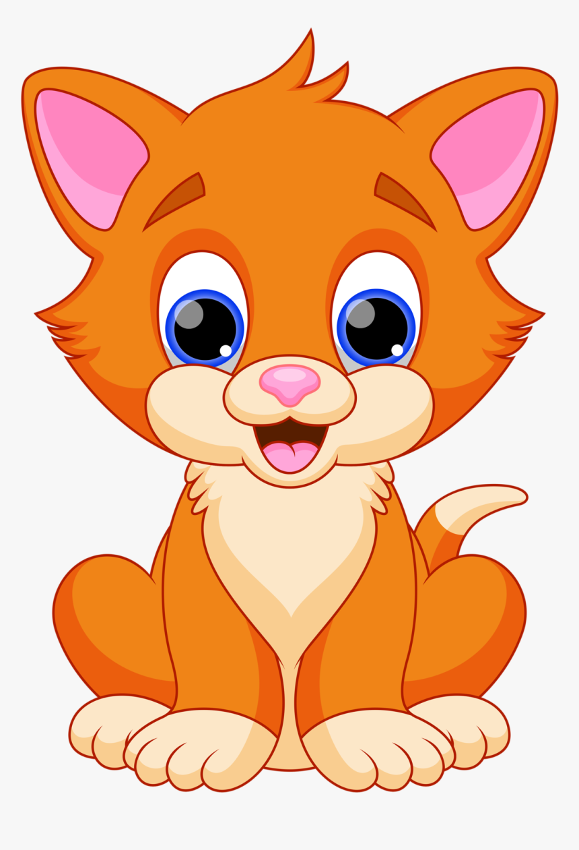





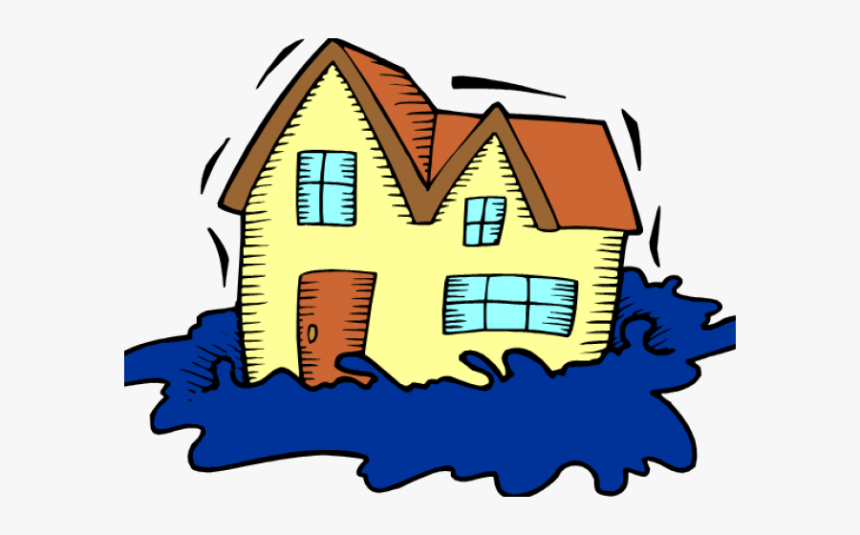
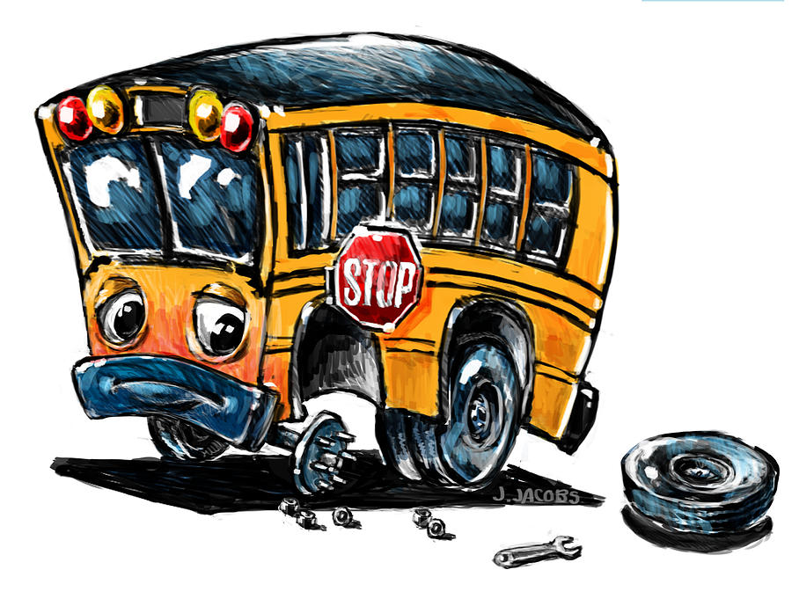
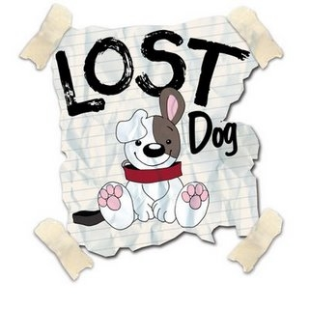
Plan a story for Egg Box Dragon
Who is in trouble?
What is the Problem
What does Egg Box Dragon do? | You choose! What would Egg Box Dragon do?
How does it end? | You choose! Will it be a happy or sad ending?
Lost dog!
Cat in a tree!

