Slide 1
LO: To Create your own story based on a dice throwing game.
Thursday 25th February 2021

Slide 2


Slide 3
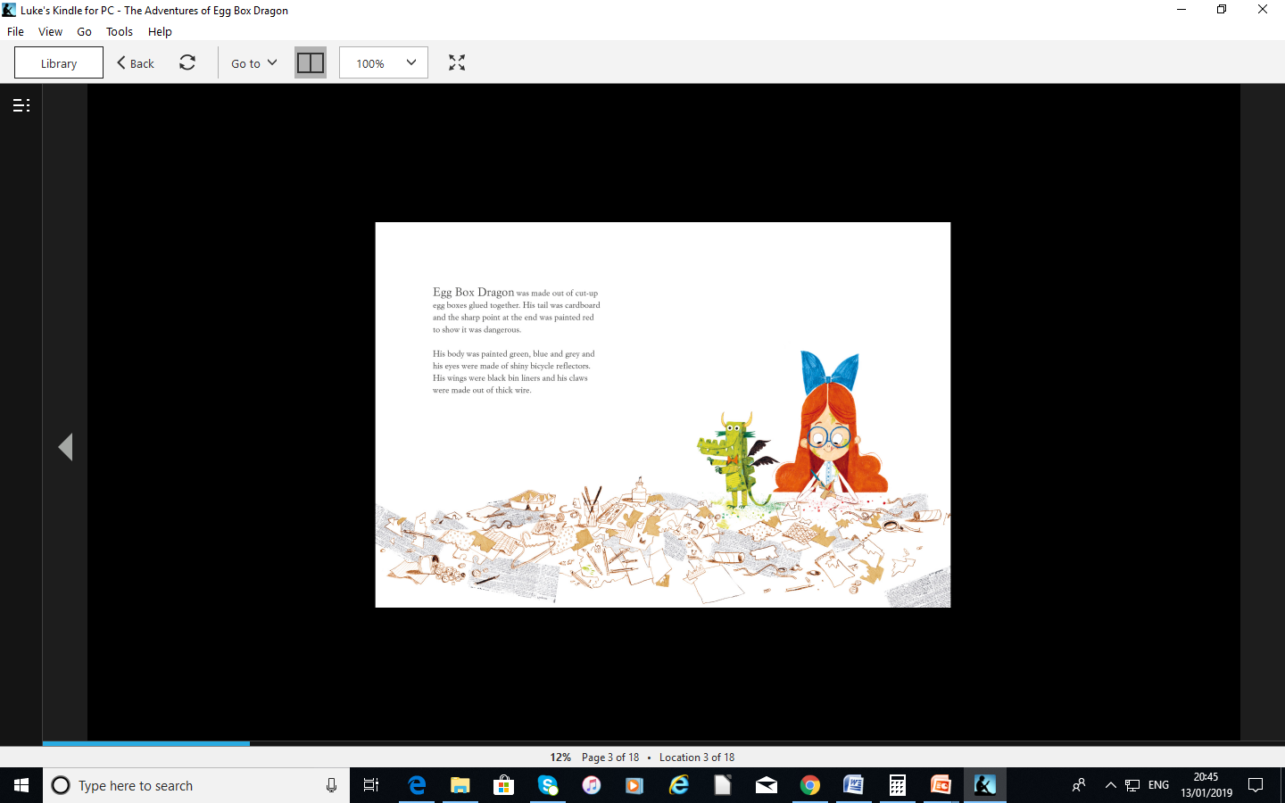

Slide 4
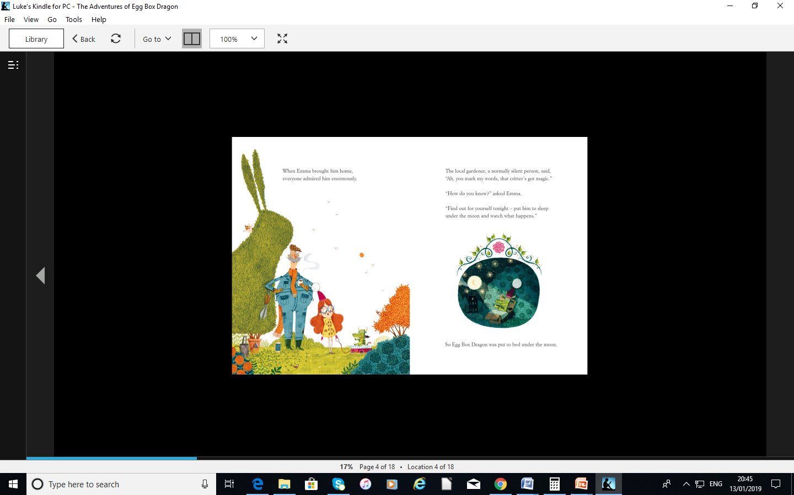

Slide 5
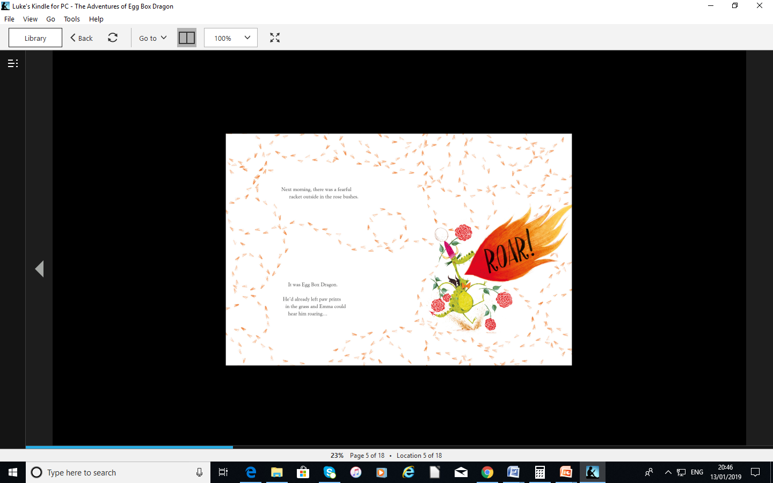

Slide 6
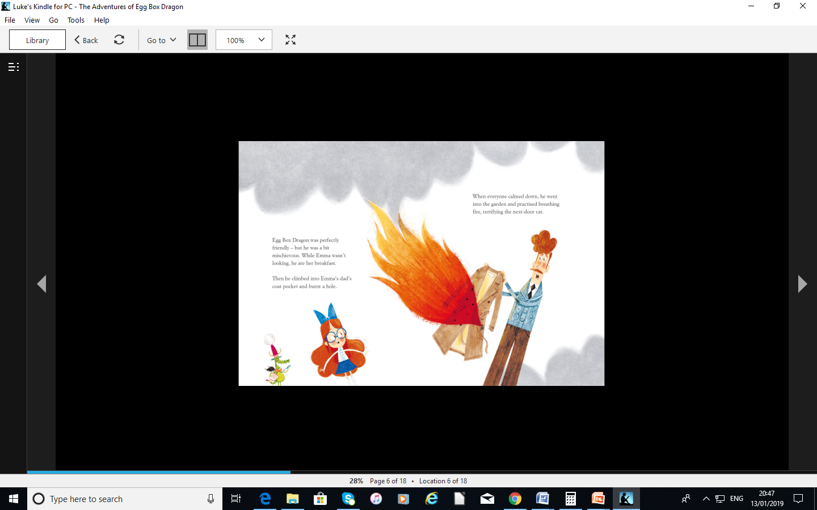

Slide 7
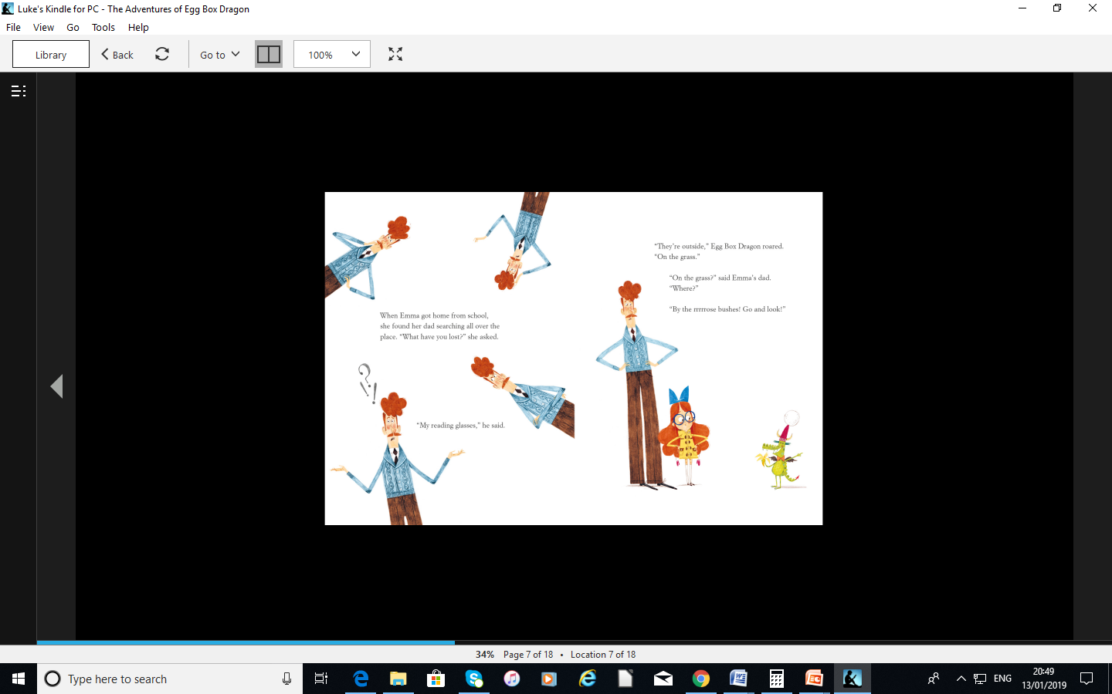

Slide 8
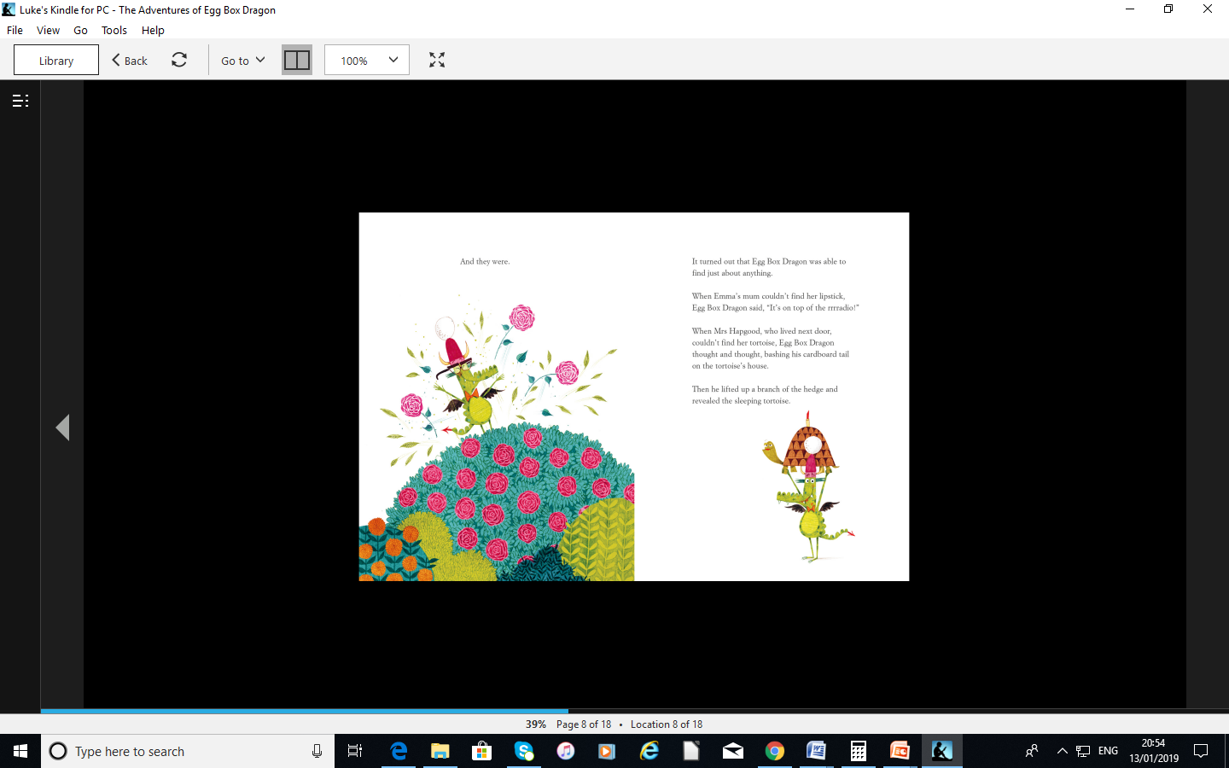

Slide 9
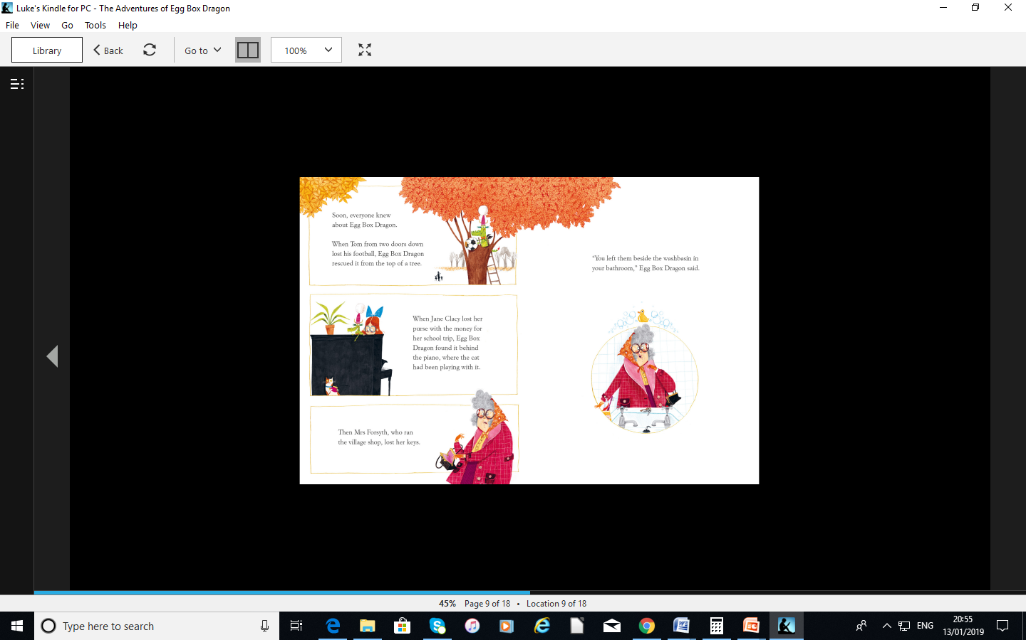

Slide 10
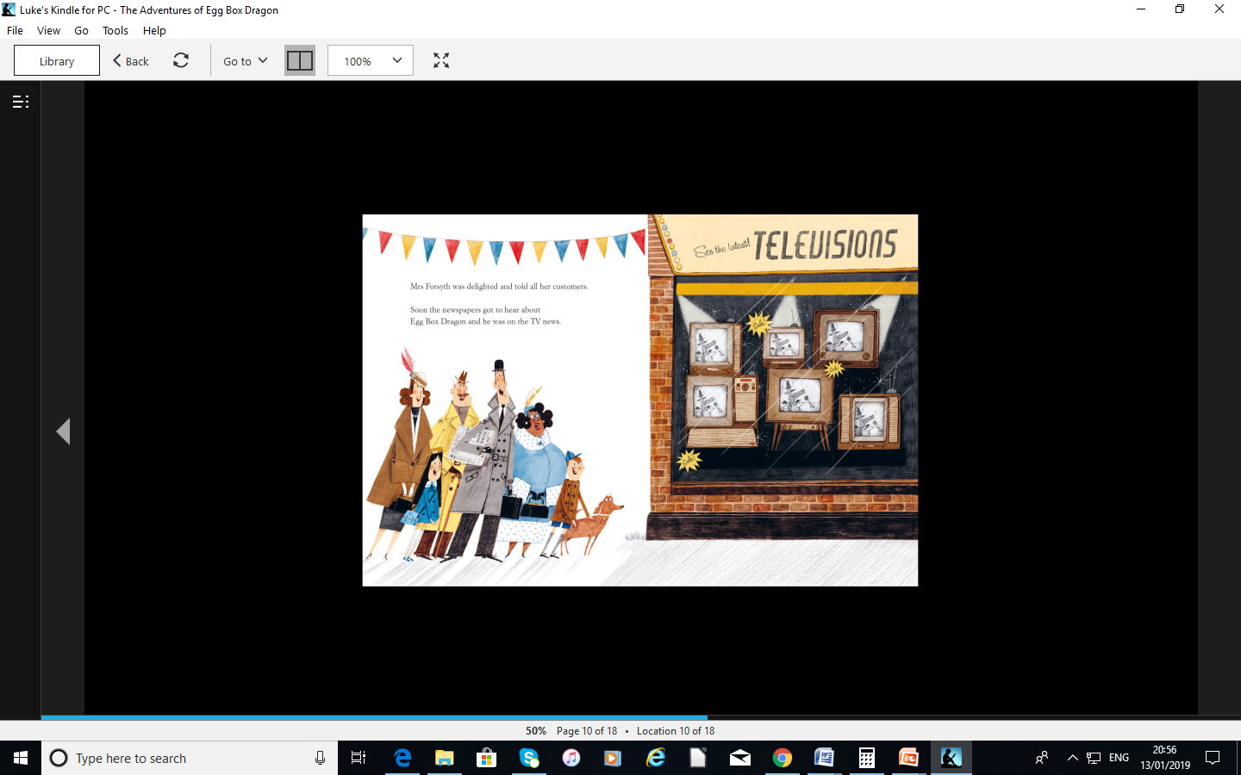

Slide 11
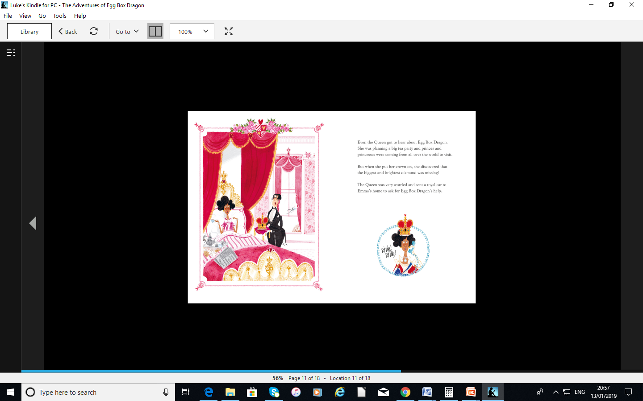

Slide 12
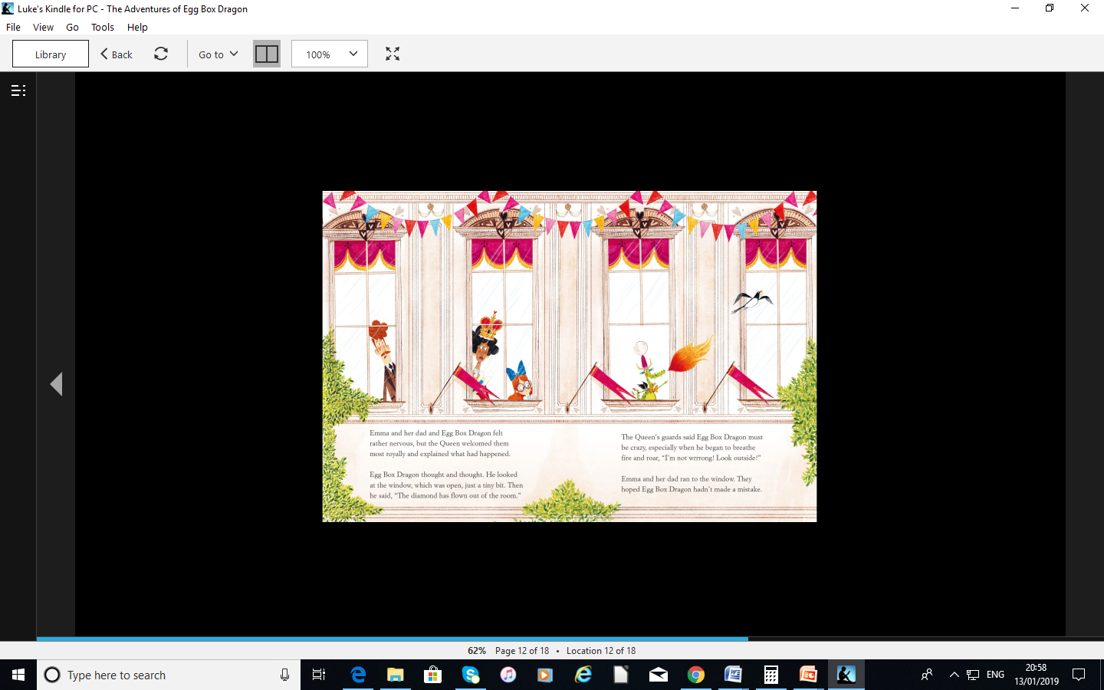

Slide 13
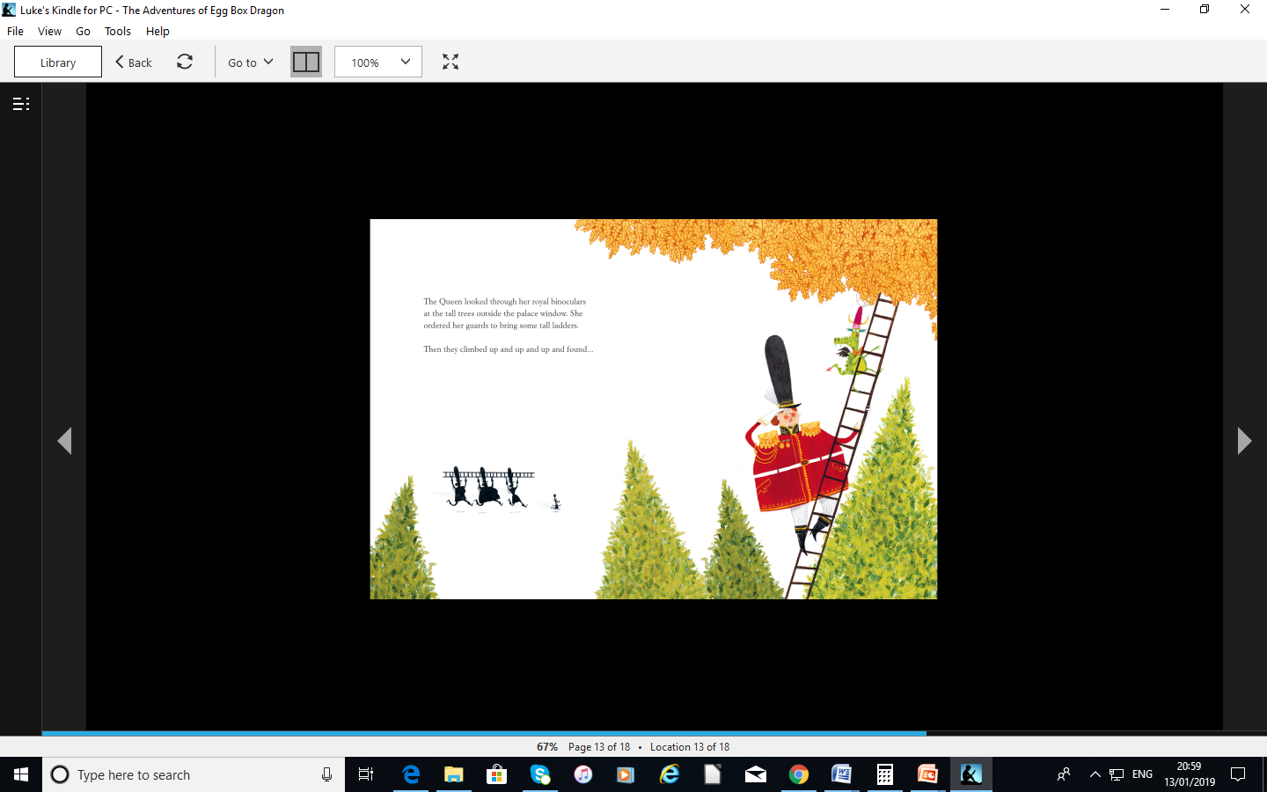

Slide 14
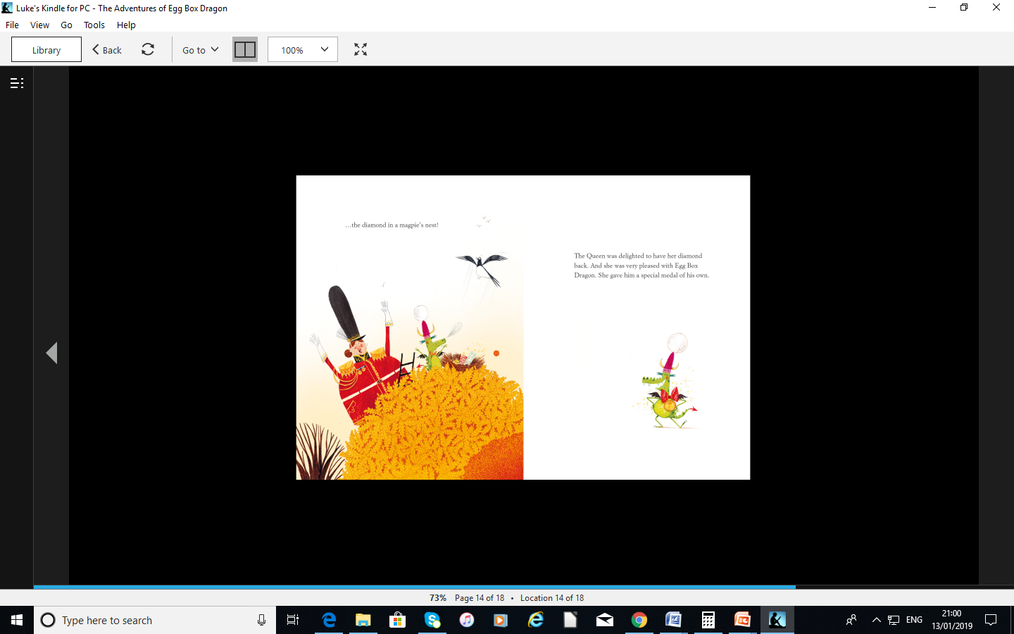

Slide 15
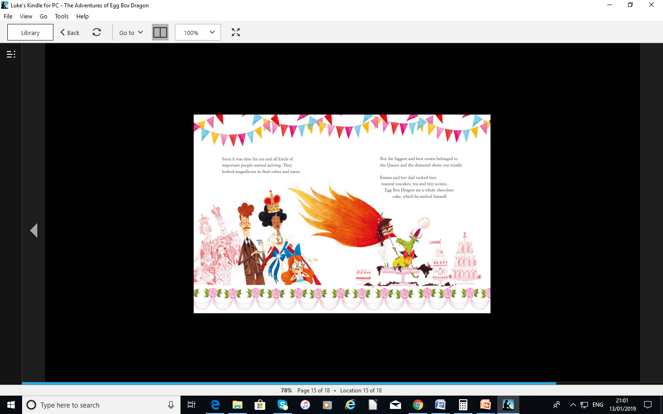

Slide 16
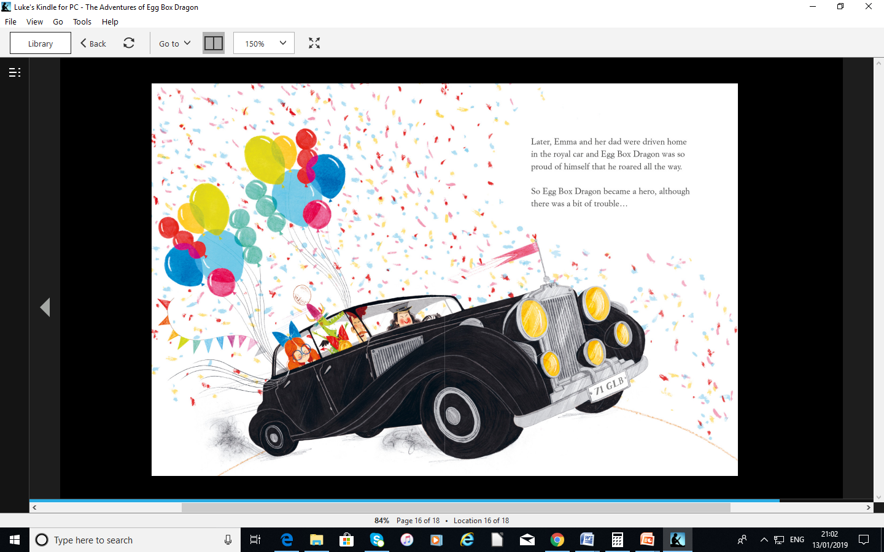

Slide 17
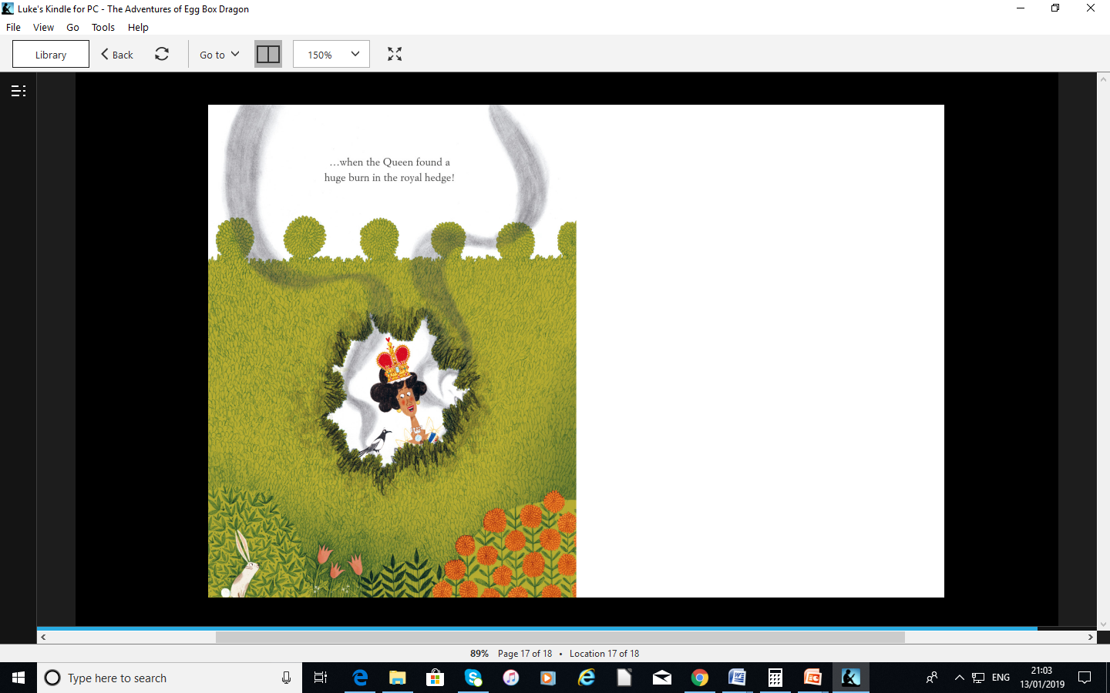

Slide 18
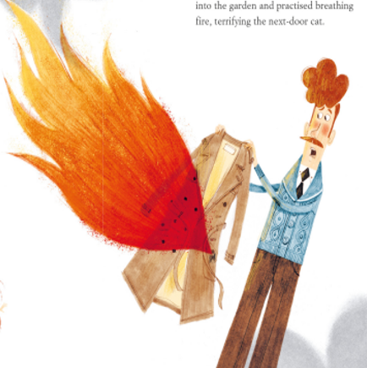




We know Egg Box Dragon had lots of adventures…
Now it’s time to come up with your own story for him!

Slide 19
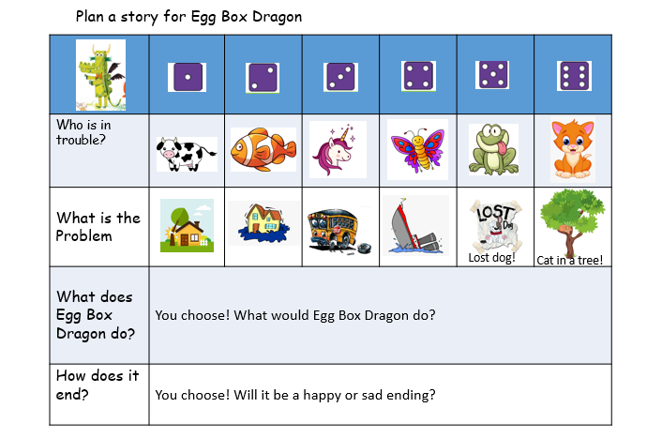

Get a dice and play this game…select your character who needs help, then select what the problem is using the dice to choose…
Write a short story about my adventure!

Slide 20
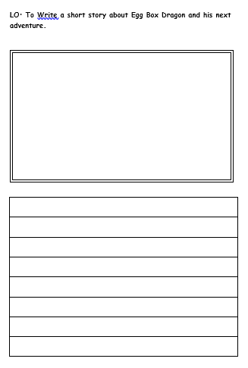
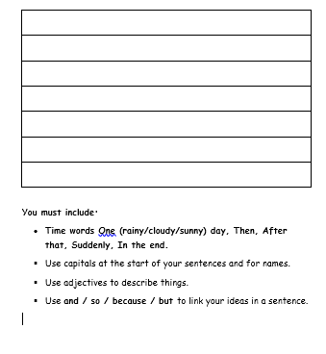
Your task today!
Task 1: Write a short story about Egg Box Dragon’s next adventure using the objectives below.
You must include:
Time words – One (rainy/cloudy/sunny) day, Then, After that, Suddenly, In the end.
Use capitals at the start of your sentences and for names.
Use adjectives to describe things.
Use and / so / because / but to link your ideas in a sentence.

