Slide 1
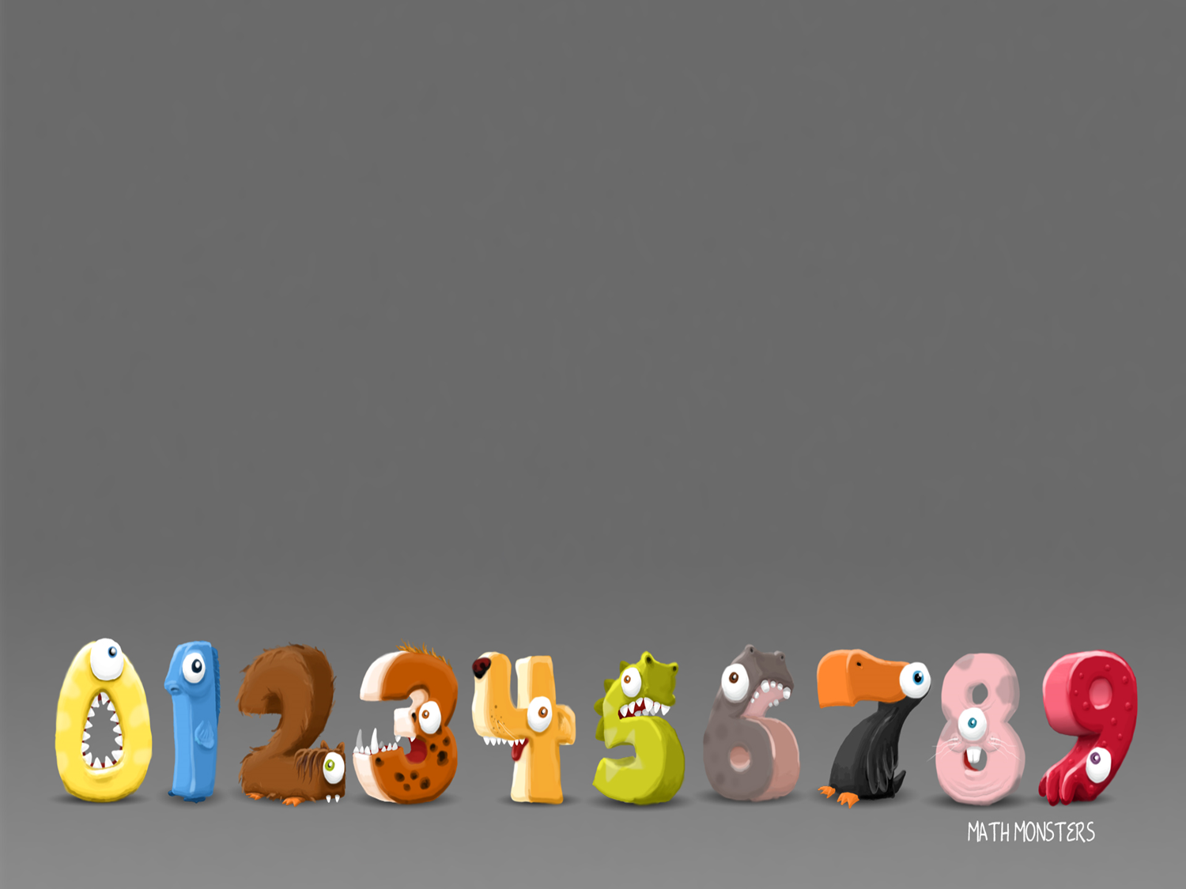
22/2/2021
LO: Recognise and name 2D Shapes

Slide 2
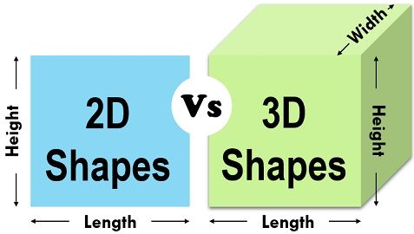
A 2D shape cannot be physically held, because it has no depth; it is completely flat. The thin plastic shapes that are sometimes used to represent 2D shapes are actually 3D because they do have depth to them – even if it’s very small.

Slide 3

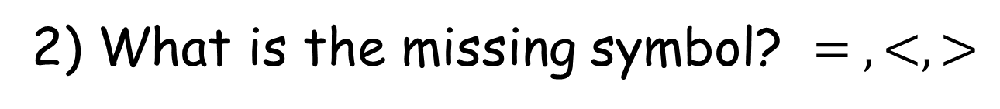
1) Which shape doesn’t belong?
2) What is the missing symbol? $= , <, >$
3) What shape is this?

Slide 4
Here are some pictures of 2-D shapes.
Can you name any?

Slide 5
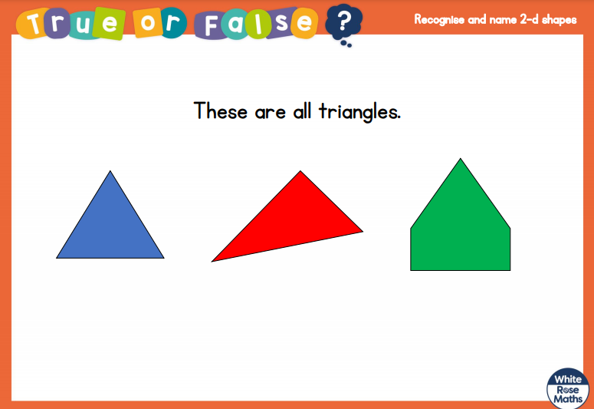

Slide 6
Two of these shapes have
5 sides, what are they called?

Slide 7
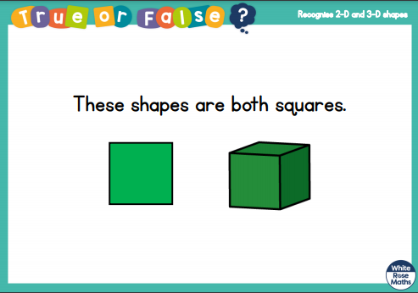

Slide 8
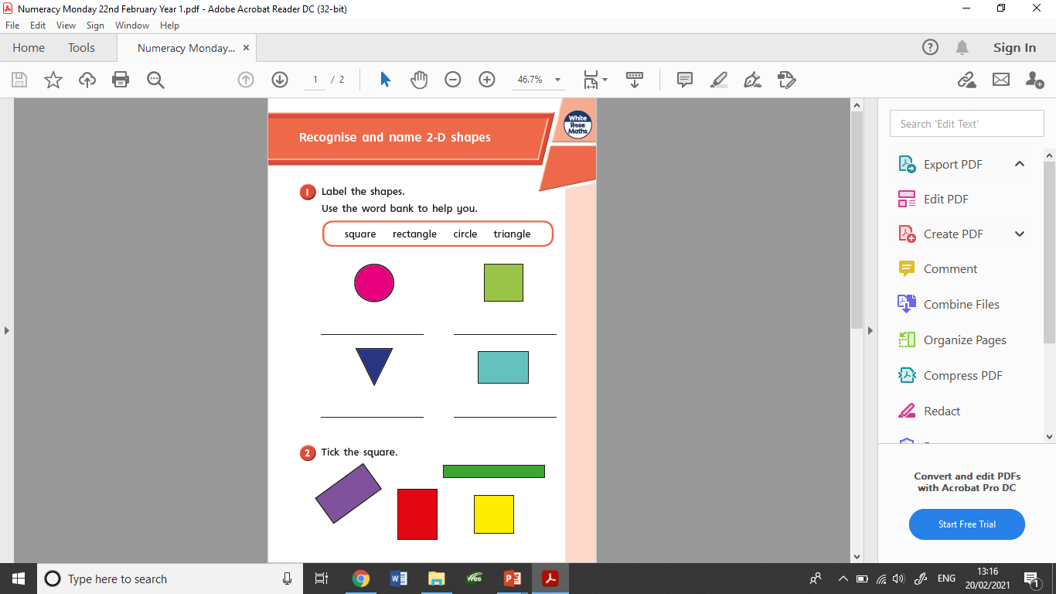
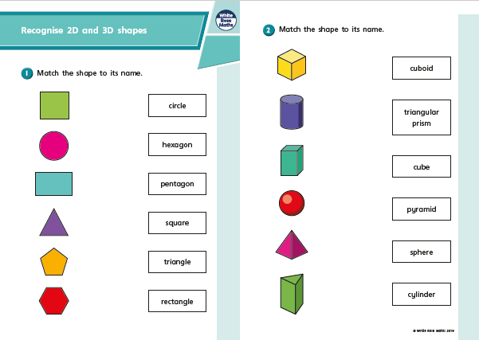
These are the worksheets set today.

Slide 9
23/2/2021
LO: Sort 2D shapes

Slide 10
1) Which shape is a triangle?
2) Which shape is a square?
3) How many sides does a square have?
4) How many circles do you see?

Slide 11
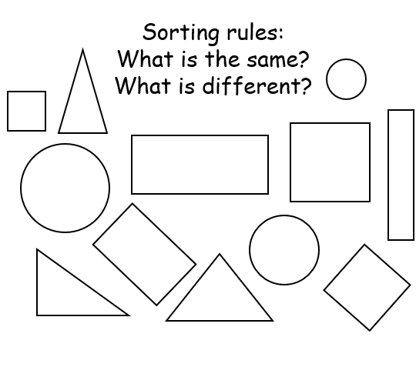
When sorting 2D shapes you can sort them in different ways.
Sort by colour
How many sides
By shape name

Slide 12
Sorting rules - Colour

Slide 13
Sorting rules - shape
Triangles
Rectangles

Slide 14
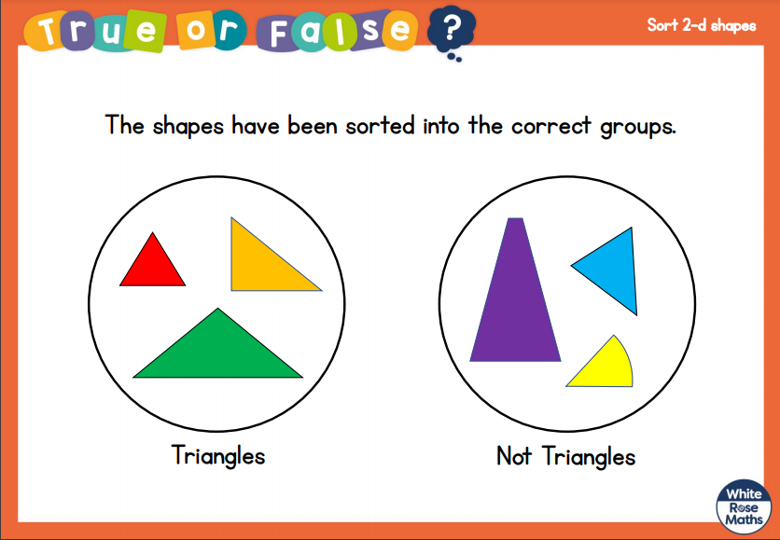

Slide 15
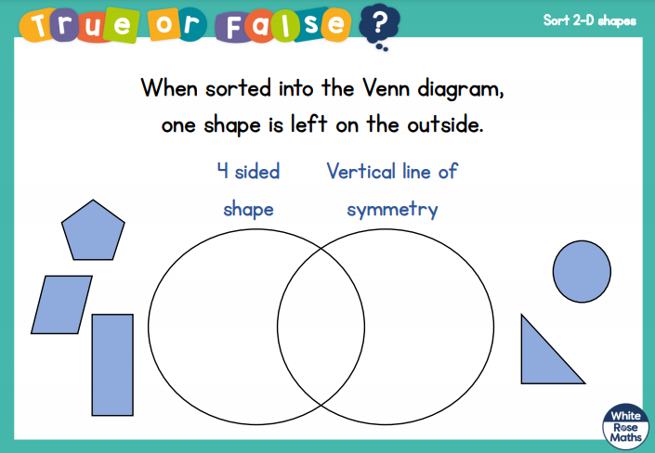

Slide 16
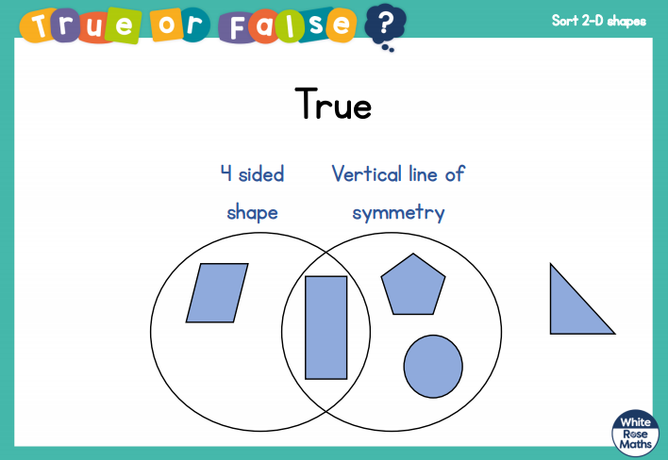

Slide 17
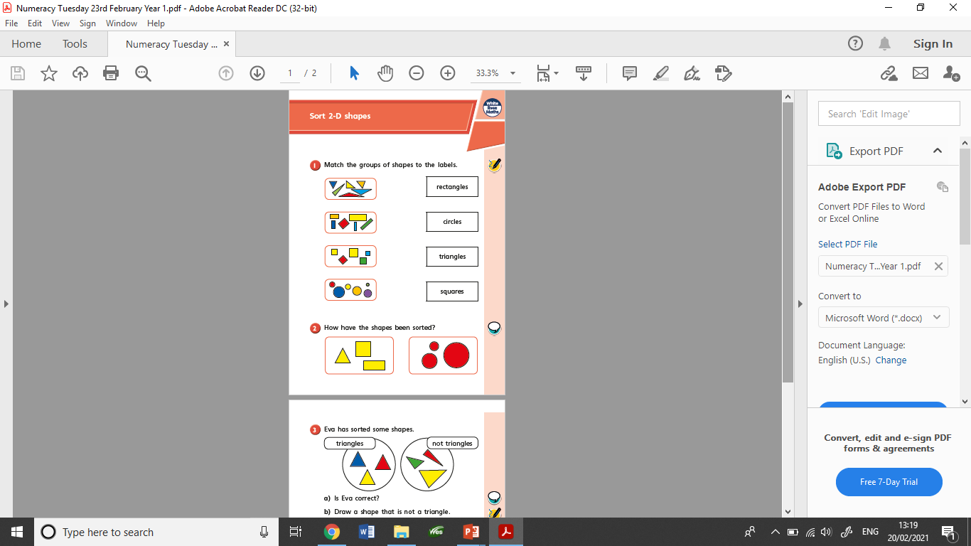
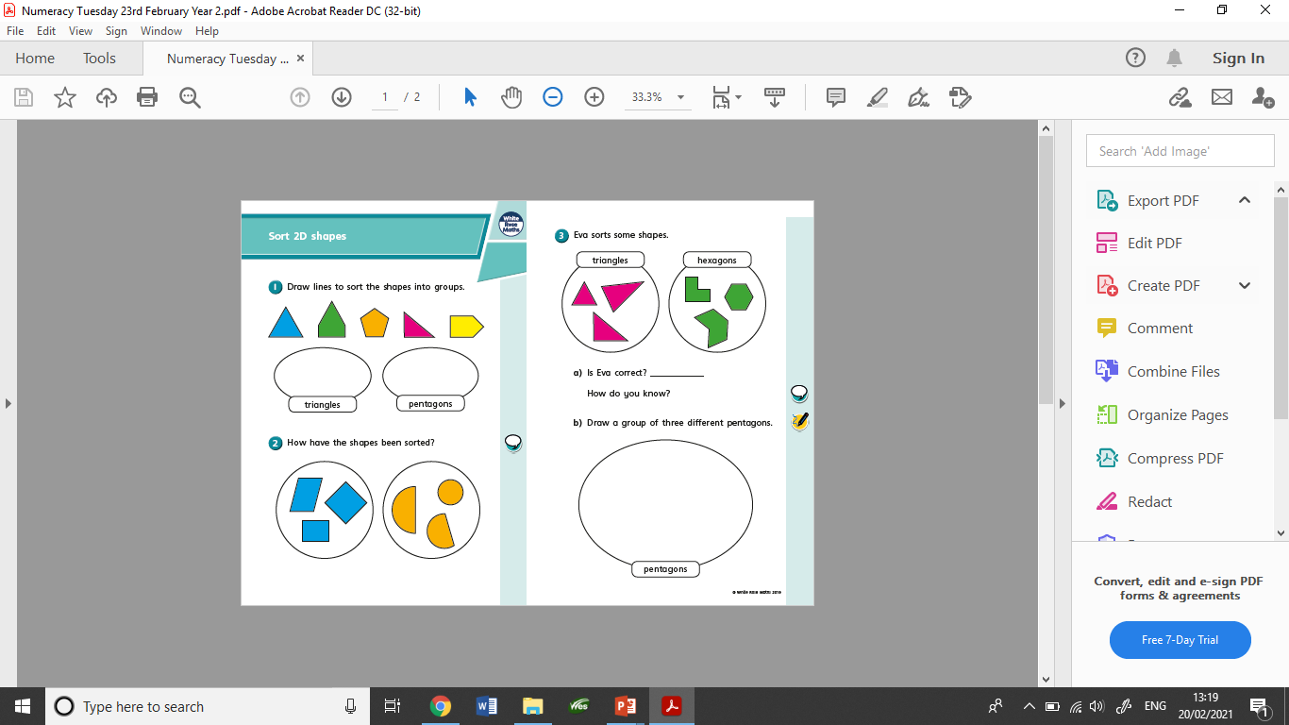
These are the worksheets set today.

Slide 18
24/2/2021
LO: Recognise and name 3D shapes- Year 1
Draw 2D shapes- Year 2

Slide 19
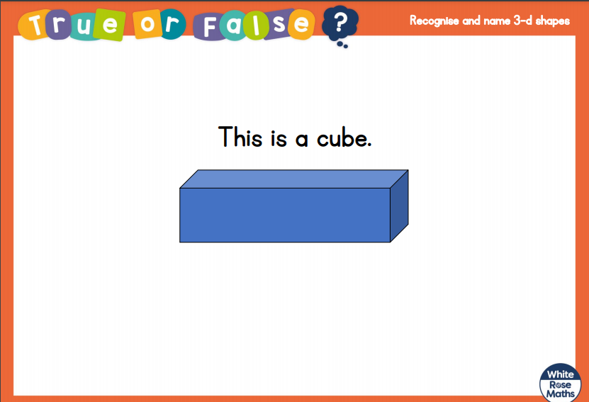

Slide 20
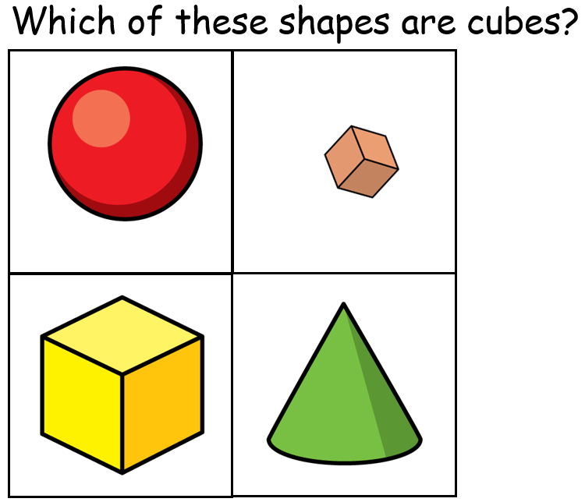

Slide 21
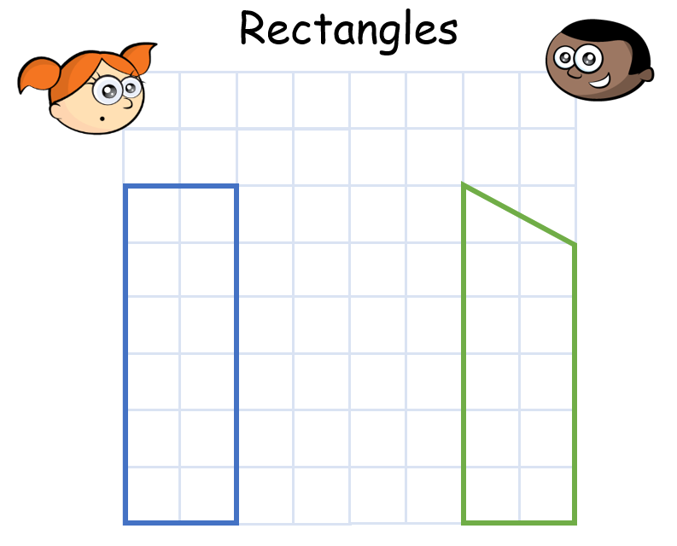

Slide 22
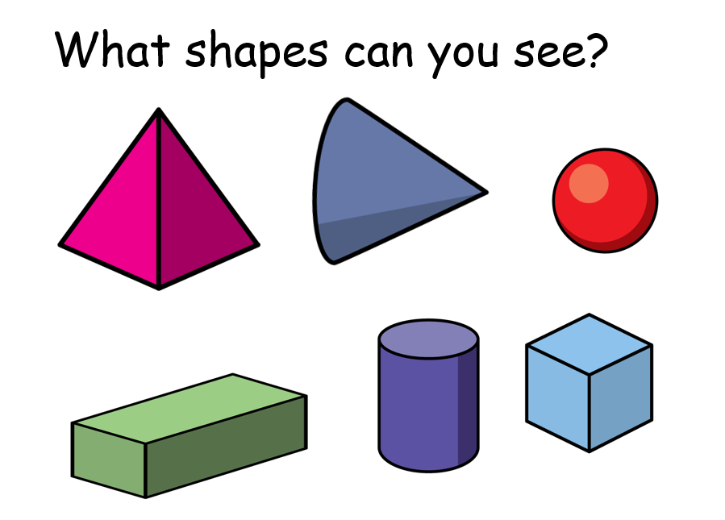

Slide 23
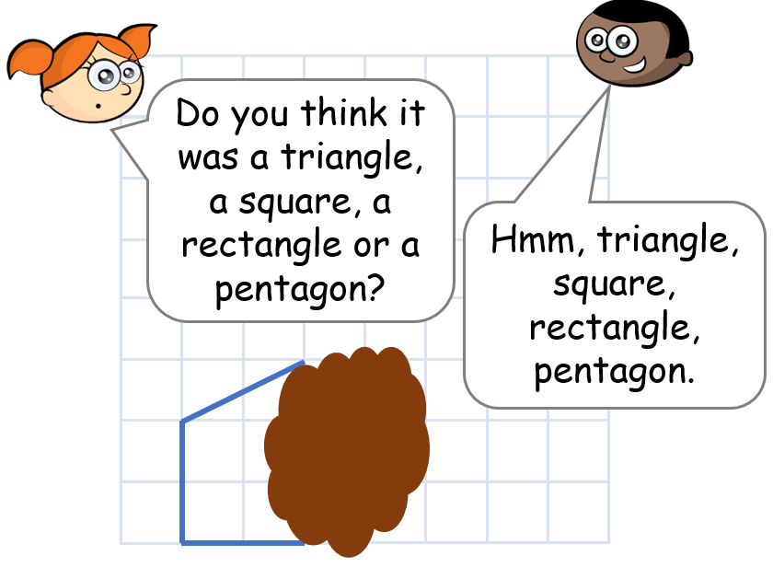

Slide 24
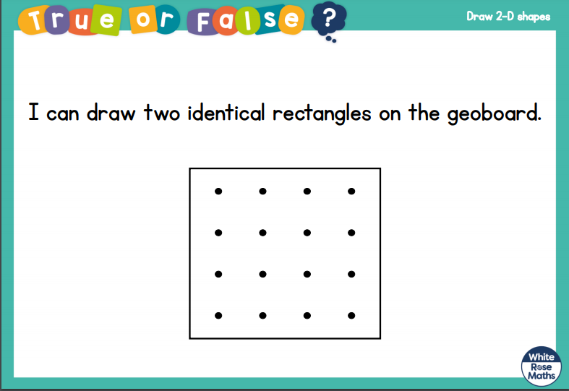

Slide 25
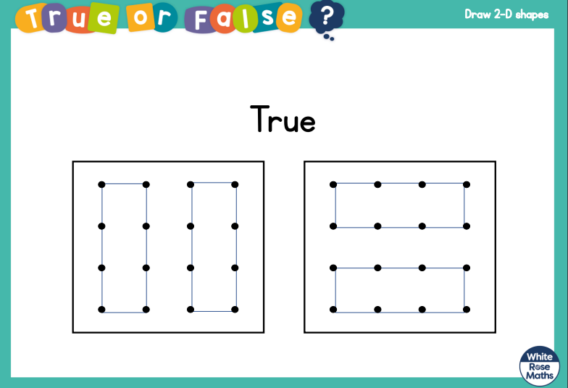

Slide 26
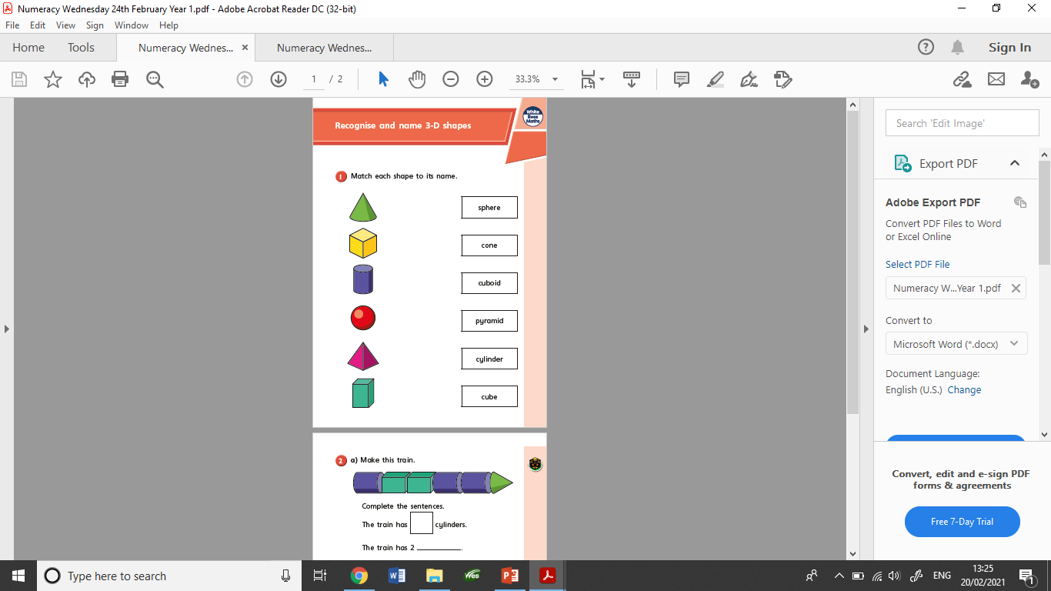

These are the worksheets set today.

Slide 27
25/2/2021
LO: Sort 3D shapes

Slide 28
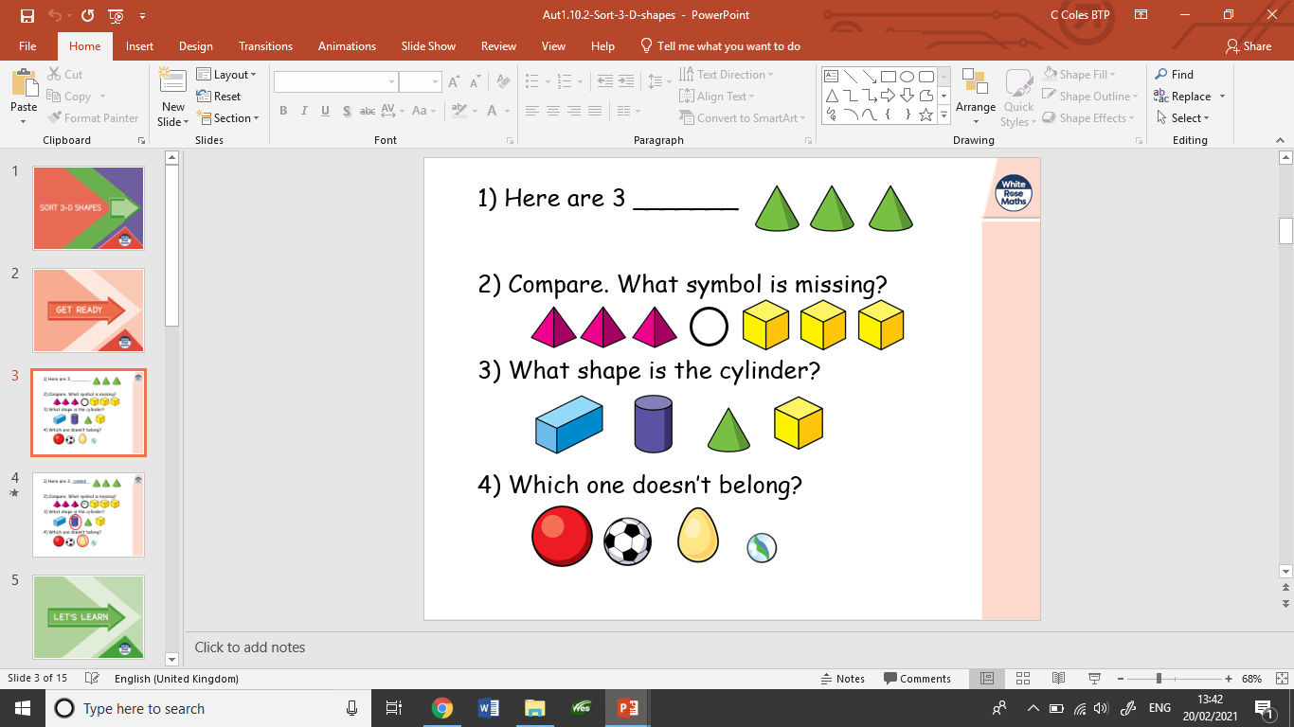

Slide 29
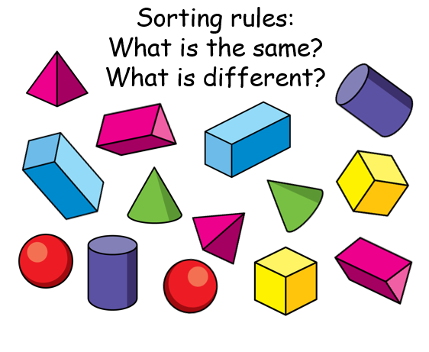
When sorting 3D shapes you can sort them in different ways.
Sort by colour
How many sides
By shape name
If they can roll
If you can stack them

Slide 30
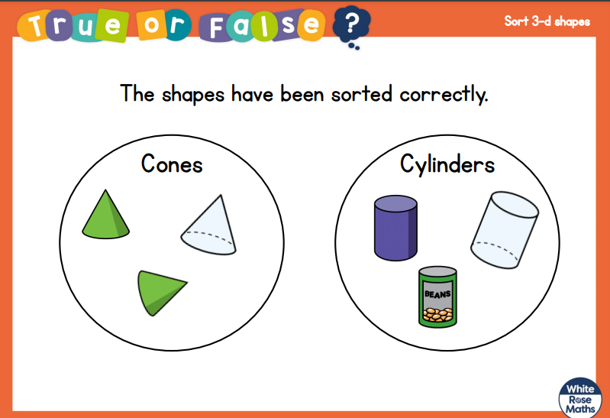

Slide 31
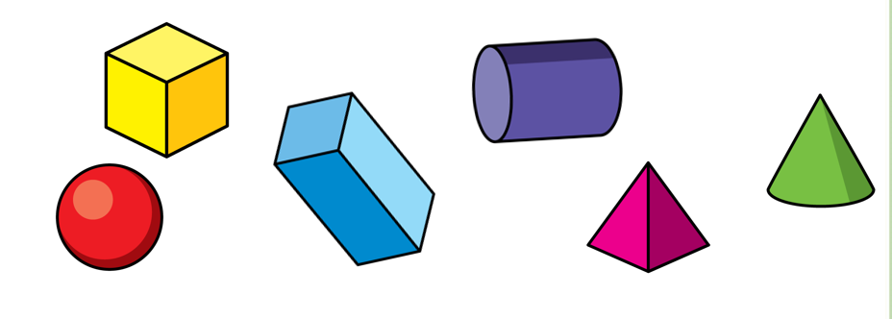
Which of these shapes could you stack?

Slide 32
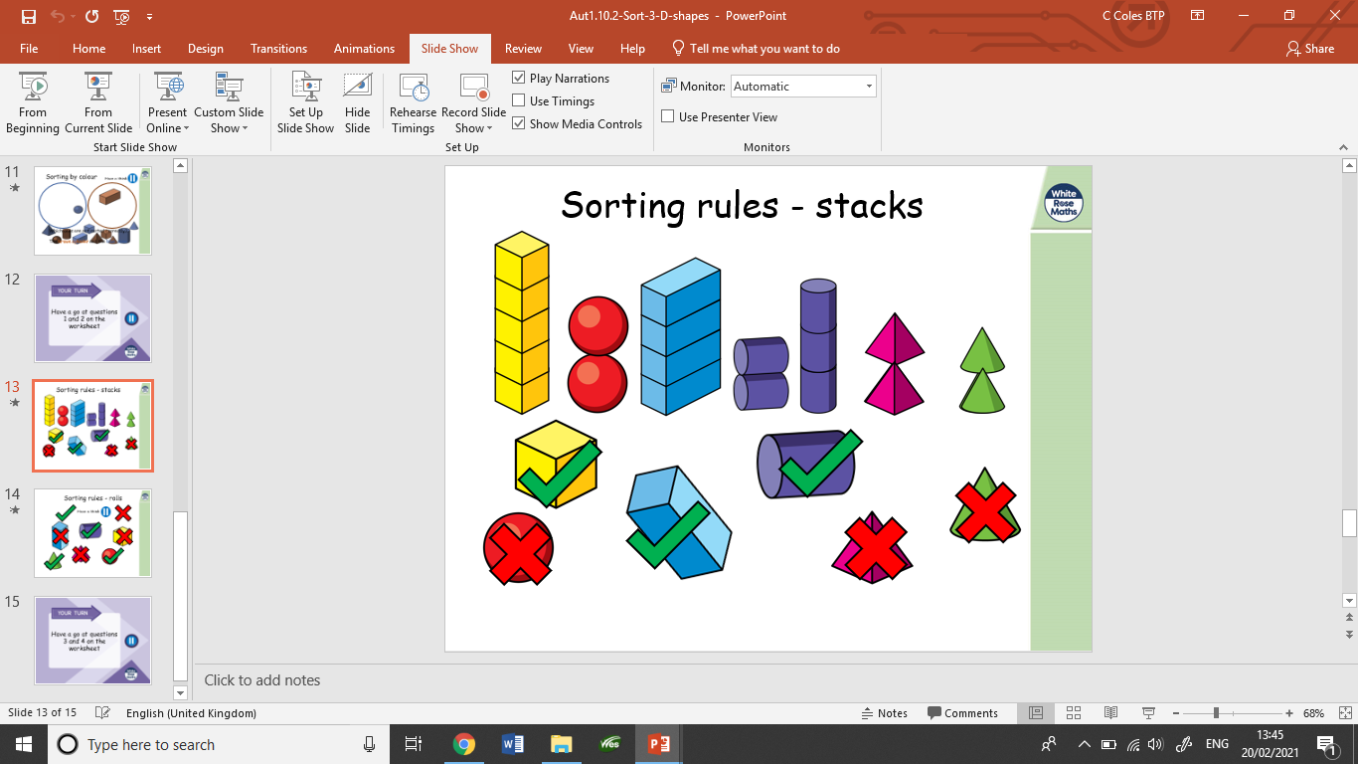

Slide 33
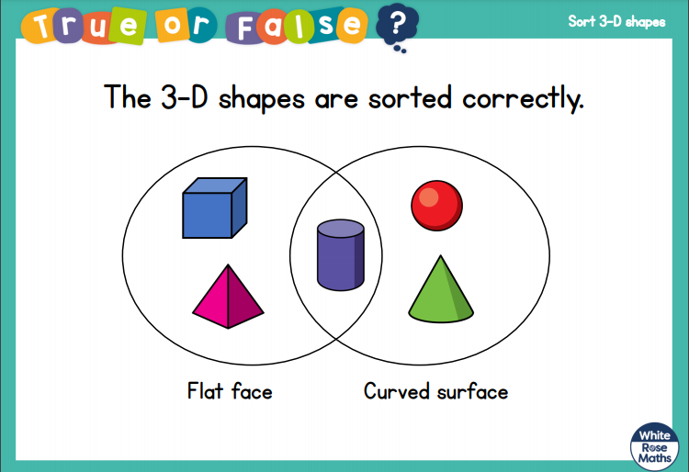

Slide 34
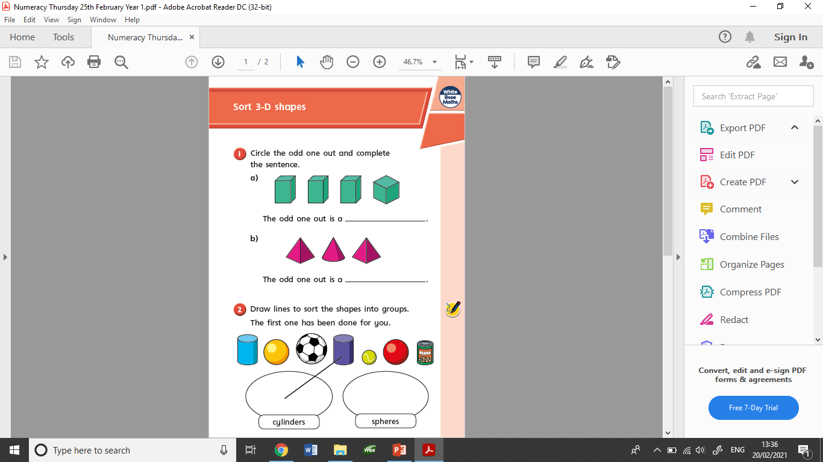
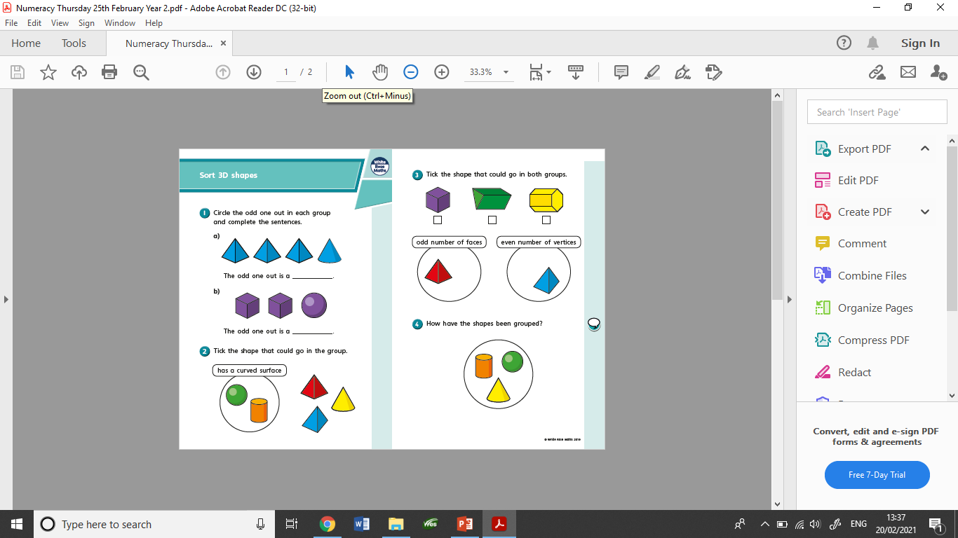
These are the worksheets set today.

Slide 35
26/2/2021
LO: Patterns using 2D shapes

Slide 36
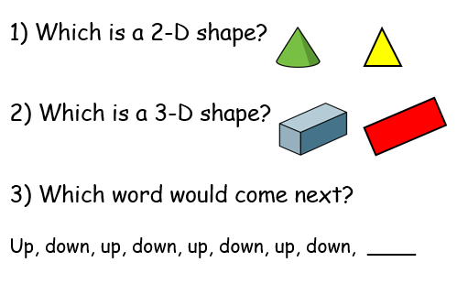

Slide 37
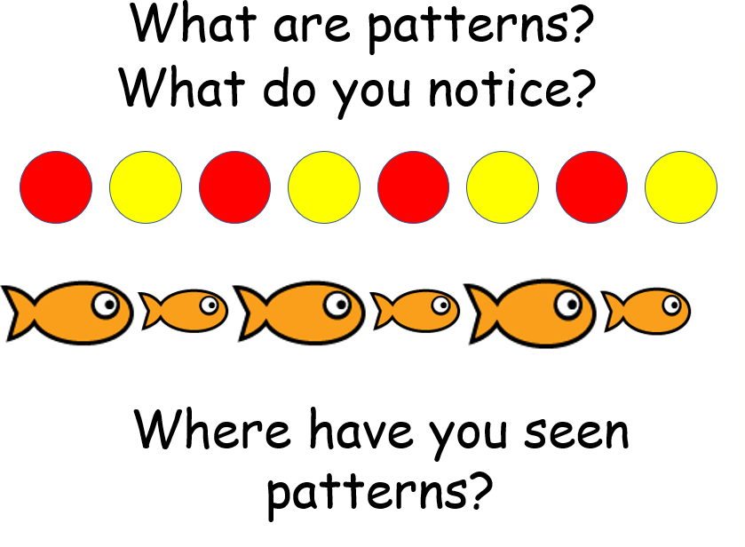
What are patterns?

Slide 38
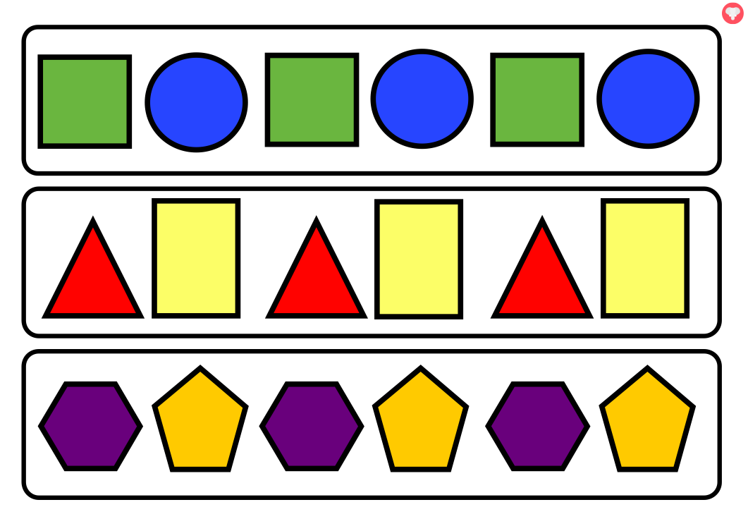
Shape patterns happen when a sequence of shapes is repeated more than two times. To find a shape pattern, you need to identify the sequence of shapes that is being repeated. To complete a shape pattern, you need to look at the last known shape and then add the next shape in the sequence.

Slide 39
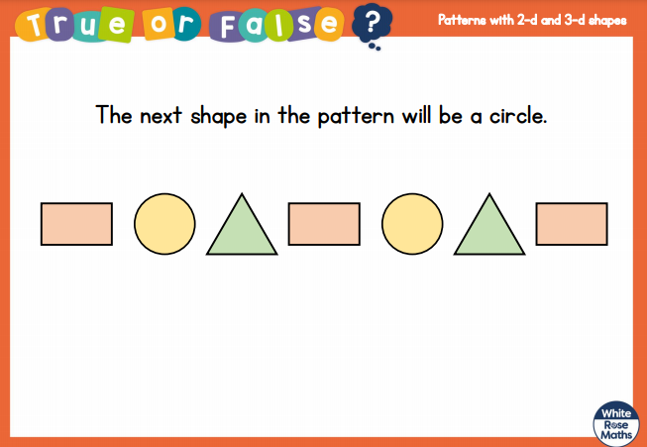

Slide 40
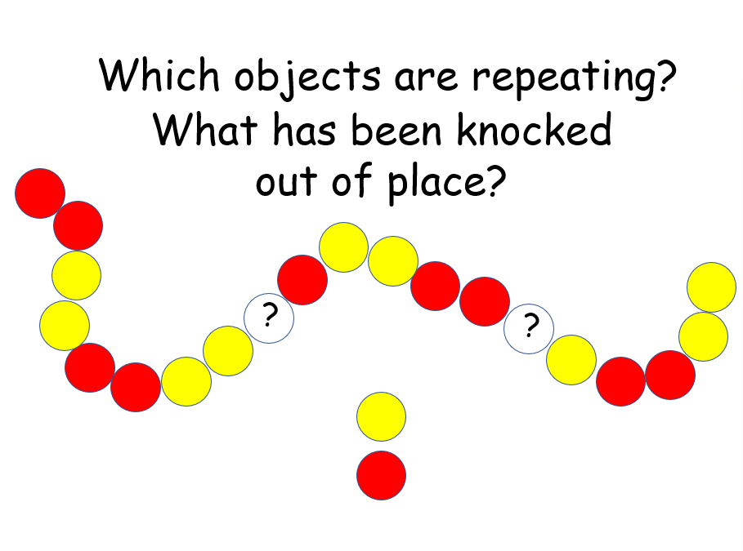

Slide 41
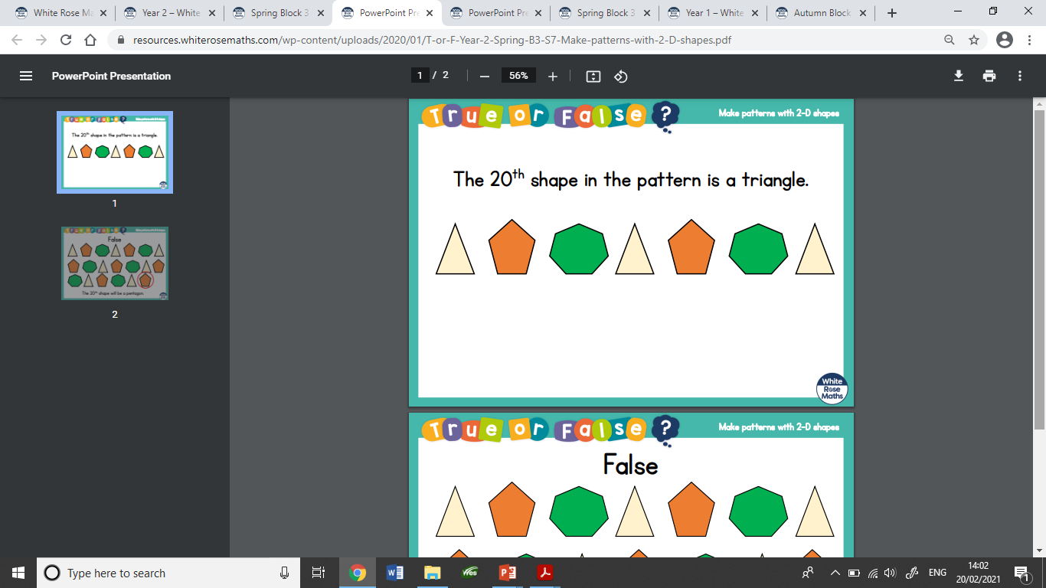

Slide 42
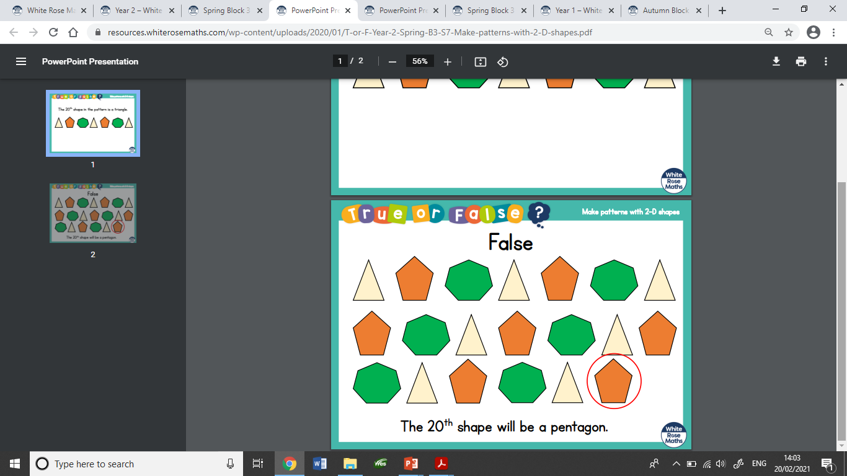

Slide 43
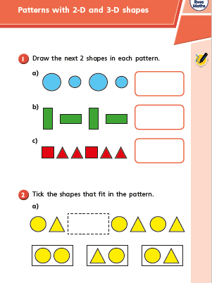
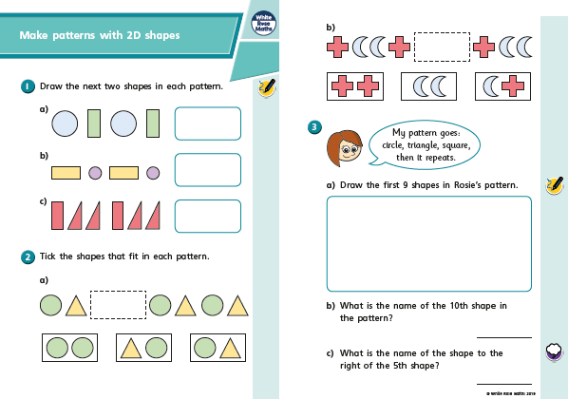
These are the worksheets set today.

