Slide 1
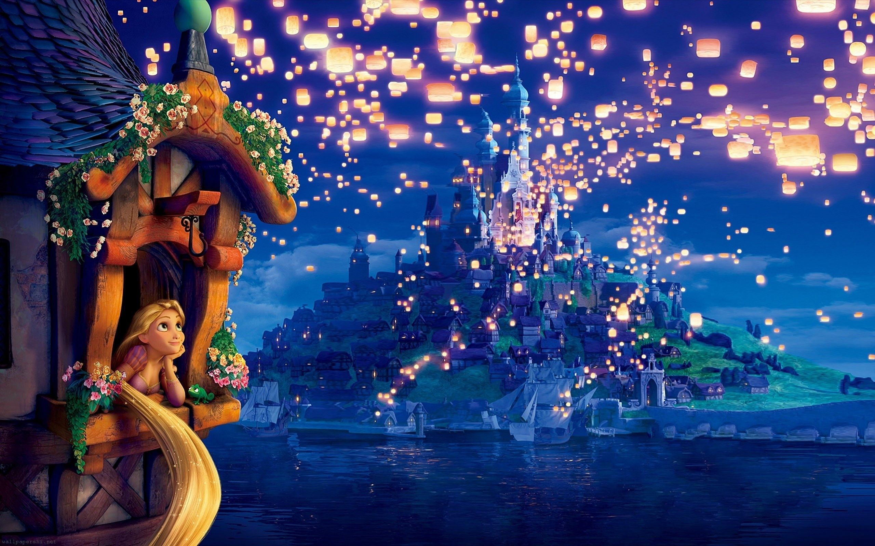
Tuesday 30th March 2021
LO: To compare Tangled and Rapunzel

Slide 2
Task: Complete a Venn diagram about Tangled / Rapunzel

Slide 3
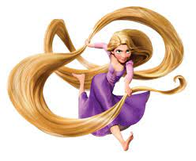
TANGLED
Rapunzel is about a lost princess whose mother was very ill and she got a healing flower that only works when Rapunzel would sing a song.
She falls for a rogue thief named Flynn Eugene Fitzherbert Rider, the kingdom's most wanted-and most charming-bandit.
Flynn Rider, hides out in a mysterious tower, he's taken hostage by Rapunzel, a beautiful and feisty teenager with 70 feet of magical, golden hair.

Slide 4
Rapunzel, wants to escape the tower where she's been locked away for years.
She makes a deal with the handsome thief, after hitting him on the head with a frying pan!
The unlikely pair set off on an adventure, complete with a super-cop horse, a colourful chameleon and a gruff gang of pub thugs.

Slide 5
Together they go on a whirlwind adventure. Near the end of the film it is revealed that Rapunzel has brown hair!
Eugene chopped her hair off using a broken mirror after he got stabbed by Mother Gothel.
She wanted to keep Rapunzel all to herself because she looks around 100 years old and as Rapunzel sings the following lyrics:
Flower, gleam and glow
Let your power shine,
Make the clock reverse, bring back what once was mine,
Heal what has been hurt,
Change the fates design,
Save what has been lost,
Bring back what once was mine,
What once was mine.

Slide 6
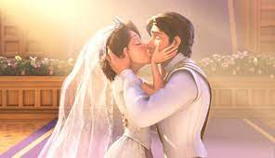
It either makes the person young again or it heals them. At the end of the film Rapunzel married Eugene.

Slide 7
RAPUNZEL- Bethan Woolvin
Rapunzel lived all lone in a tall, dark tower. She was trapped there by a witch, who visited everyday.
“Rapunzel, Rapunzel let down your hair” called the witch. Then, using Rapunzel’s hair as a rope, up she climbed, because that was the only way in to the tower.
Everyday the witch brushed Rapunzel’s hair. Then she stole some golden locks to sell for riches.
As she left with her treasure, the witch cackled, “You can never escape, Rapunzel! Leave the tower and I will put a terrible curse on you!”

Slide 8
But was Rapunzel frightened? Oh no not she!
If the witch could use her hair to get in, Rapunzel could use it to get out. So one day, she did.
After climbing down from the tower, Rapunzel pulled her hair free, and looked around. The she started to explore.
The thought of returning to the tower made her sad. It’s a shame about that witch she thought to herself.
So Rapunzel made a plan she worked on it secretly everyday. And with some help from a new friend she made from the forest, she was always safely back to the tower before the witch came.
The witch never suspected a thing.
Until one day…

Slide 9
“RAPUNZEL!”
The witch found a leaf in Rapunzel’s hair.
But was Rapunzel frightened? Oh no, not she!
“The wind must have blown it through the window” she said boldly.
“Well remember” snarled the witch, “if you ever leave the tower, I will put a TERRIBLE curse on you.”
And with that, she grabbed the end of Rapunzel’s hair and climbed out of the window.
But the witch didn’t get far before SNIP SNIP she was sent tumbling to the ground.
The witch’s cursing days were done.
So Rapunzel climbed down out the tower for the last time, down into the forest where her friend was waiting.
And were the other witches frightened? Oh yes indeed!

Slide 10
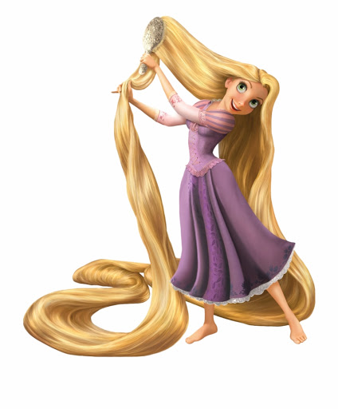
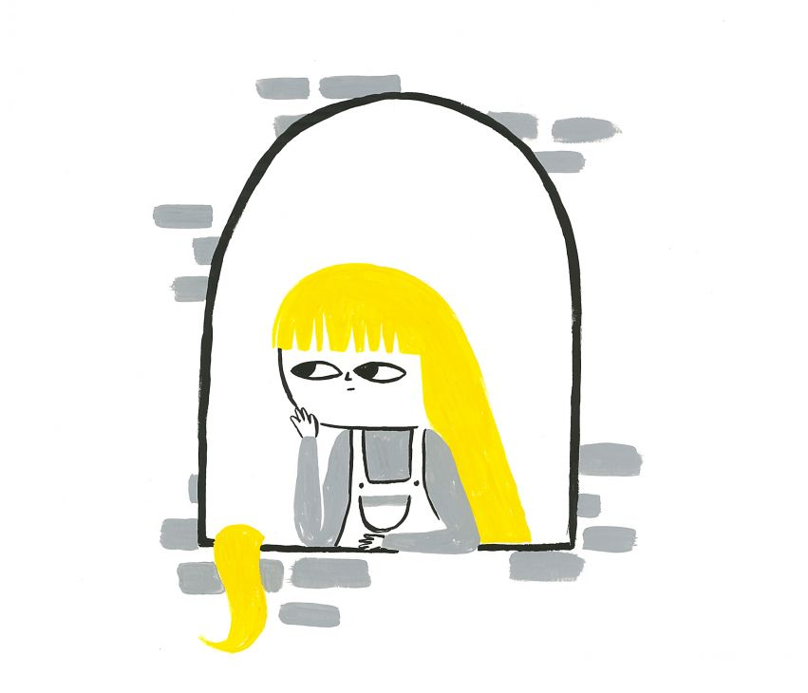
What differences do you notice in the stories?

Slide 11
What similarities do you notice in the stories?

Slide 12
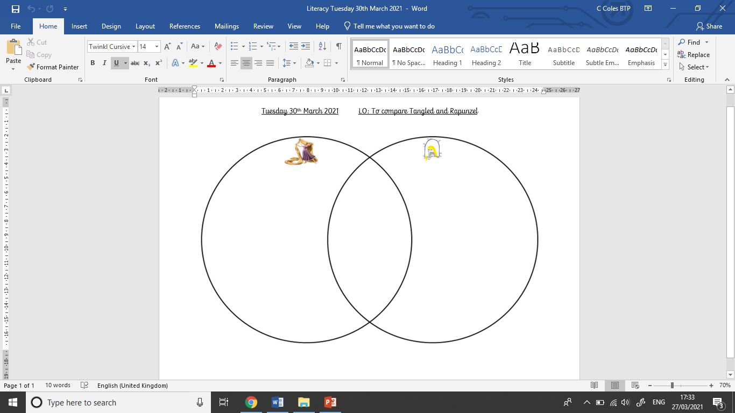
Has long
golden hair.
Wanted to get revenge
on the witch
who trapped
her in the tower.
Meets a thief and they
go on an adventure.
Sort then sentences into the
correct space.

Slide 13
Your task

