Slide 1
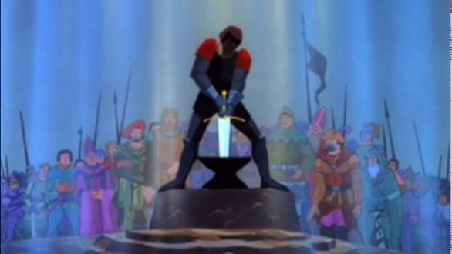
Literacy
Friday 5th March
L.O. To write questions to ask King Arthur.
To think of responses to those questions.

Slide 2

What are Questions?
A question is a type of sentence.
We ask a question to find out about something.
Questions begin with a capital letter and end with a question mark.

Slide 3
We use different question words to find out different information.
Can you think of any question words?
A lot of question words begin with the same letter.
Do you know what letter this is?
Let’s have a look at some different question words.

Slide 4
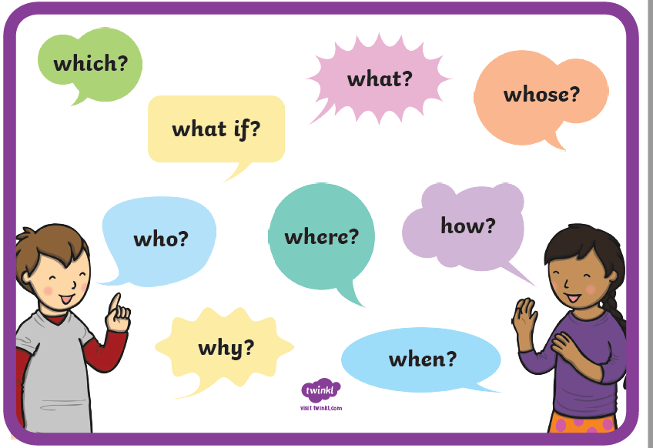

Slide 5
Let’s play a game
Is a question or not?
If the sentence is a question it will need a question mark at the end.
If the sentence is not a question it will need a full stop at the end.
Can we decide?

Slide 6
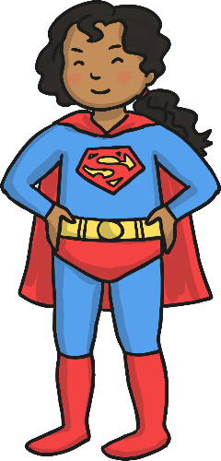
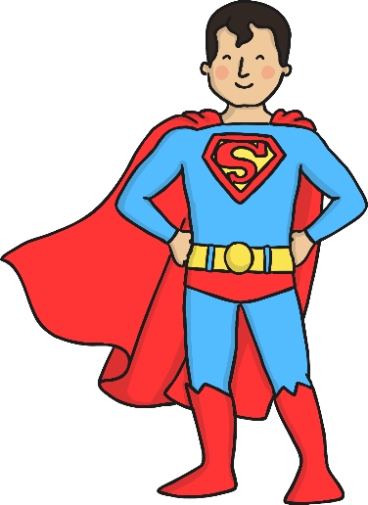
These superheroes are here to help make these sentences super!
If the sentence needs a full stop adding, you need Full Stop Girl!
If the sentence needs a question mark adding, you need Captain Question Mark!
Click on the superhero needed for each sentence.
Where did mum put the cheese
Where did mum put the cheese?
Full Stop Girl
Captain Question Mark
Correct!
Try again!

Slide 7
These superheroes are here to help make these sentences super!
If the sentence needs a full stop adding, you need Full Stop Girl!
If the sentence needs a question mark adding, you need Captain Question Mark!
Click on the superhero needed for each sentence.
I like to play football with my friends
I like to play football with my friends.
Full Stop Girl
Captain Question Mark
Correct!
Try again!

Slide 8
These superheroes are here to help make these sentences super!
If the sentence needs a full stop adding, you need Full Stop Girl!
If the sentence needs a question mark adding, you need Captain Question Mark!
Click on the superhero needed for each sentence.
I can’t decide what to wear
I can’t decide what to wear.
Full Stop Girl
Captain Question Mark
Correct!
Try again!

Slide 9
These superheroes are here to help make these sentences super!
If the sentence needs a full stop adding, you need Full Stop Girl!
If the sentence needs a question mark adding, you need Captain Question Mark!
Click on the superhero needed for each sentence.
Who is going to wash the dishes
Who is going to wash the dishes?
Full Stop Girl
Captain Question Mark
Correct!
Try again!

Slide 10
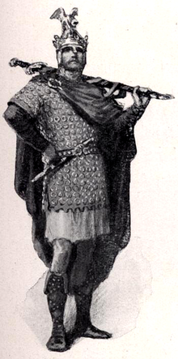
Your Task
Imagine that you have met King Arthur. Think of a few questions to ask him.
These questions can link with our story or they can be your own ideas.
Can you also think of how King Arthur would answer your questions?
Remember to use:
Capital letters for all of your sentences.
Question marks at the end of your question sentences.
Full stops at the end of your answer sentences.
Can you use a different sentence word for each of your questions?
Options for recording the task
Handwrite your questions and responses. This is always helpful handwriting practice.
Type up your questions and responses into Word or on a ppt slide.
Here are some examples on the next slide.

Slide 11
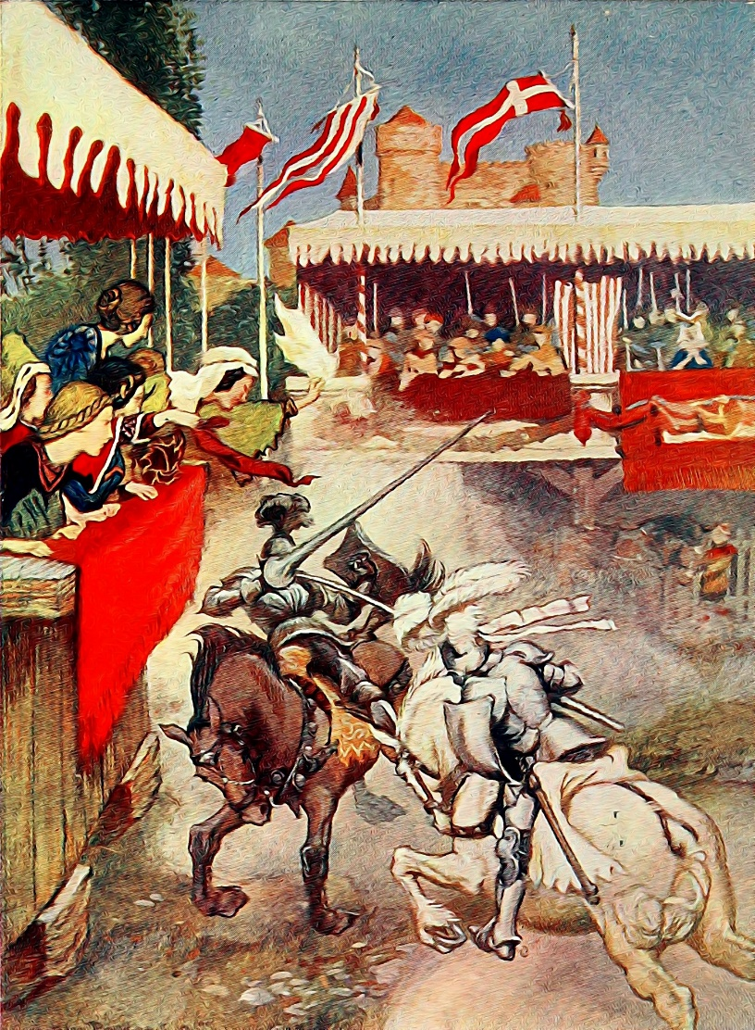
Examples of Questions for King Arthur and his Responses
Do you remember being taken away by Merlin when you were a baby?
I have a faint memory of being carried in a cloak on a winding mountain path.
How did you pull the sword from the stone?
The sword came out of the stone very easily in my hand.
What did it feel like to become the King of England?
I felt so excited and also full of hope to rule my country the best that I can.

