Slide 1


Slide 2
LO: World Book Day Activities
- Cartoon strip
- Record a video of the dialogue.
- Create a scene from your favourite book.
Thursday 4th March 2021

Slide 3
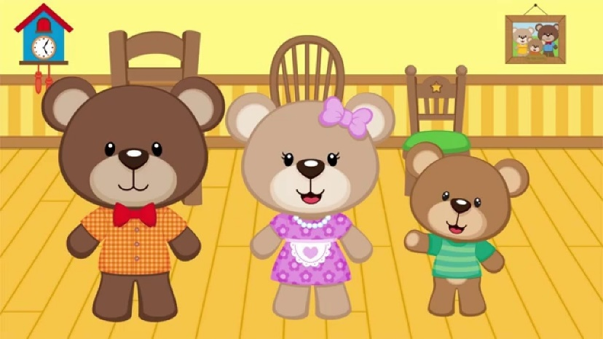
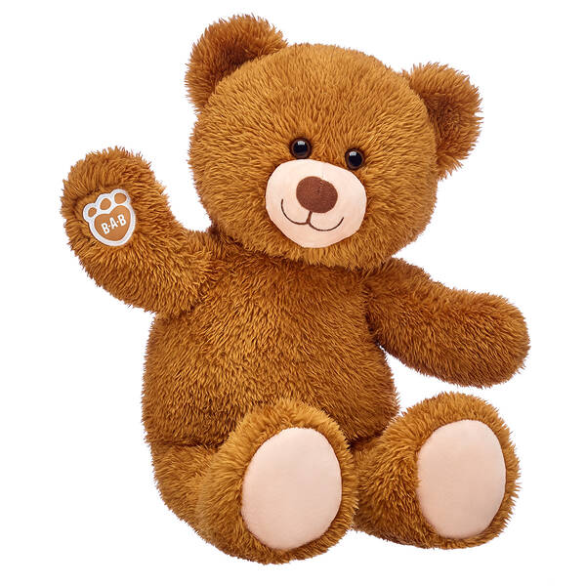
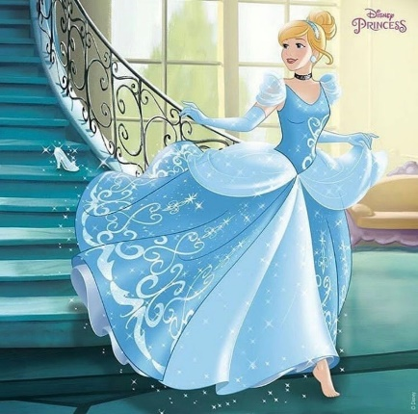
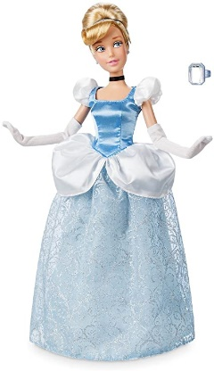
Today you will be creating your own cartoon strip to show a conversation between two characters!
Firstly, think about what toys you have in your house! These two characters will be having a ‘dialogue’ or a ‘conversation. They can talk about anything, but don’t forget to think about what they might say or think!
Think about two characters that have been in a book… perhaps a princess doll and a bear (Cinderella and one of the Three Bears!)
Or a dragon and a pig… (Zog and one of the Three Little Pigs!)

Slide 4

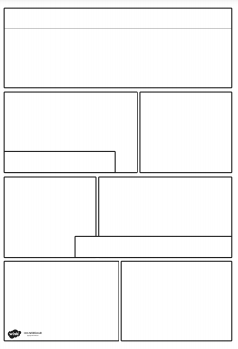
Your First Task
Once you have decided which two characters
you want to use in your conversation, create
a cartoon strip showing what they might do.
Will they go on a picnic or visit each other’s
Homes.
What will they say to each other?
When we show speech in a cartoon strip it is
in the form of a speech bubble.

Slide 5

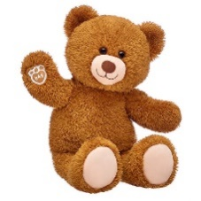
A conversation between Cinderella and Daddy Bear
Hello. I am Cinderella. Who are you?
I am Daddy Bear. I live in a cottage in the wood.
Do you want to come for tea?
I love porridge!
That would be lovely. Will there be cake?
No. We only eat porridge I’m afraid.

Slide 6
Cartoon Strip Advice
Opt. 1 – Print out a template of your choice and create your cartoon strip.
Opt. 2 – Write up your cartoon strip on a piece of paper.
Don’t forget to make sure you draw your characters first.
Write your dialogue (using punctuation such as ? for questions and ! for exclamations or surprise)
Then draw your speech bubble around the words.
Fill in the scenery after you have done your writing and speech bubbles.

Slide 7
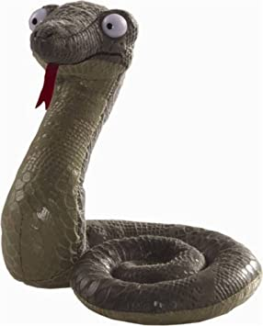
Your second task! Create a video!
Once you have created your cartoon strip, you can then think about how you will present your dialogue (conversation) using the toy characters you chose.
You can record a video like the one on the website (only better!) and send it to us! Try and add characterisation, changing your voice to be the different characters.

Slide 8
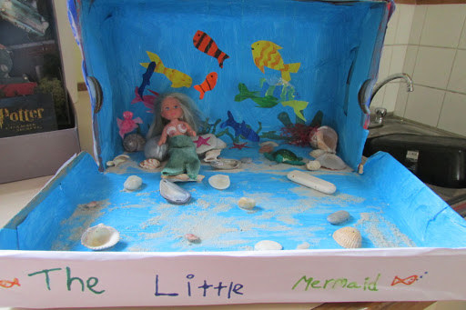
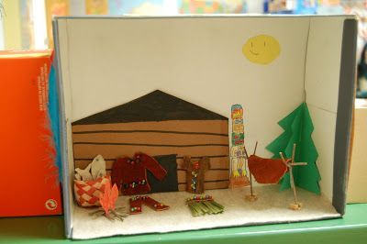
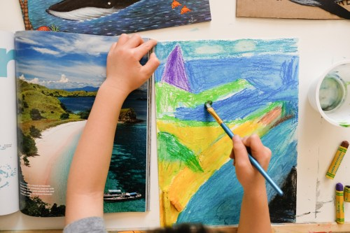
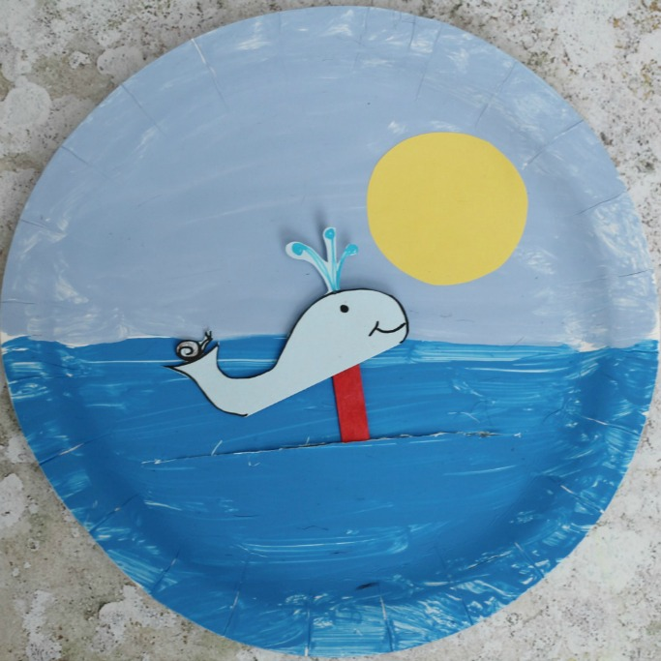
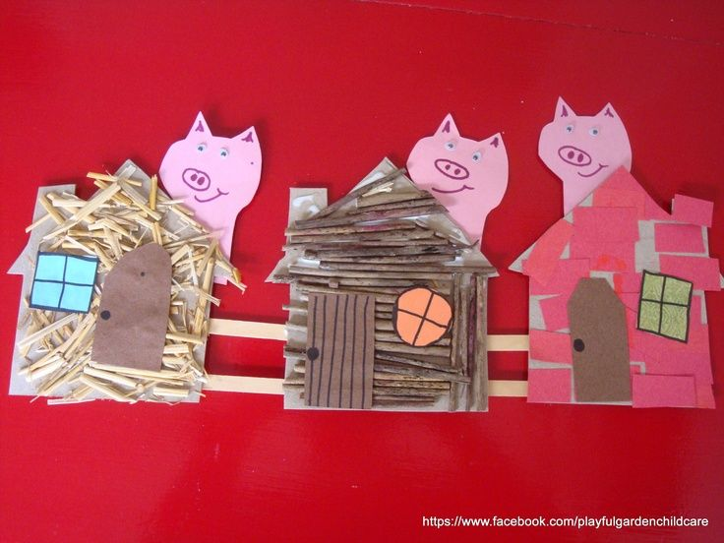
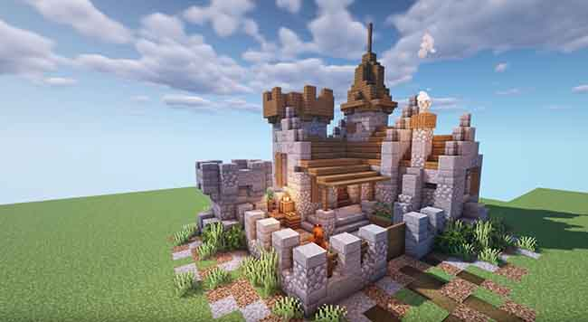
Your third task! Create a scene from a book!
During the afternoon, you can create a scene from your favourite book. When you think about scenes, you need to think where the story is set. It could be in a castle, wood or even under the sea!
You can show your scene in ANY way you choose. It could be a shoebox scene, painted on the inside or you could use your skills in Minecraft to create your scene using different blocks. You could paint a picture or create a collage. You could build part of the scene using junk modelling and paint it.
Be creative and send us pictures of your scenes for us to guess which book the scene is from.

Slide 9

We hope you will enjoy these tasks and that you have a wonderful World Book Day!

