Slide 2
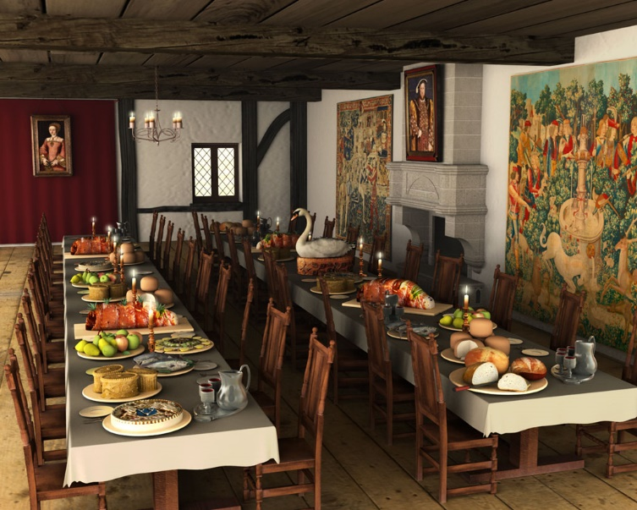
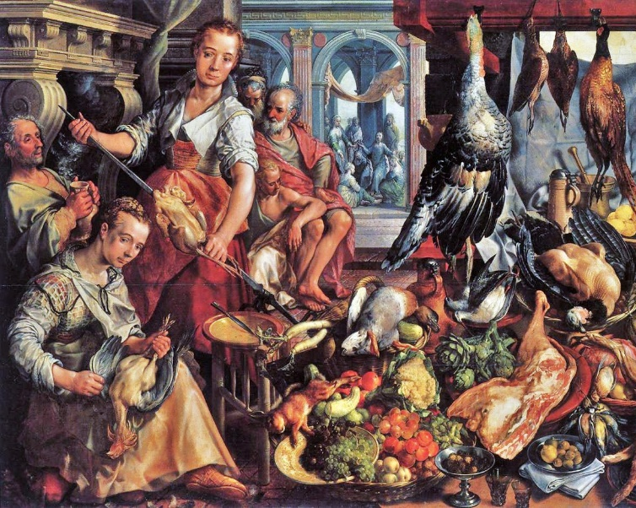
The Tudor Era
The Tudor era began in 1485 when Henry Tudor defeated Richard III at the Battle of Bosworth Field. After the battle, he was crowned King Henry VII. It ended in 1603 when Queen Elizabeth I died.
Food was seen as a sign of status and wealth. Meals in the Tudor Court were very lavish and rich. If visiting nobles were not served more than twenty different meat dishes, they would feel insulted.

Slide 3
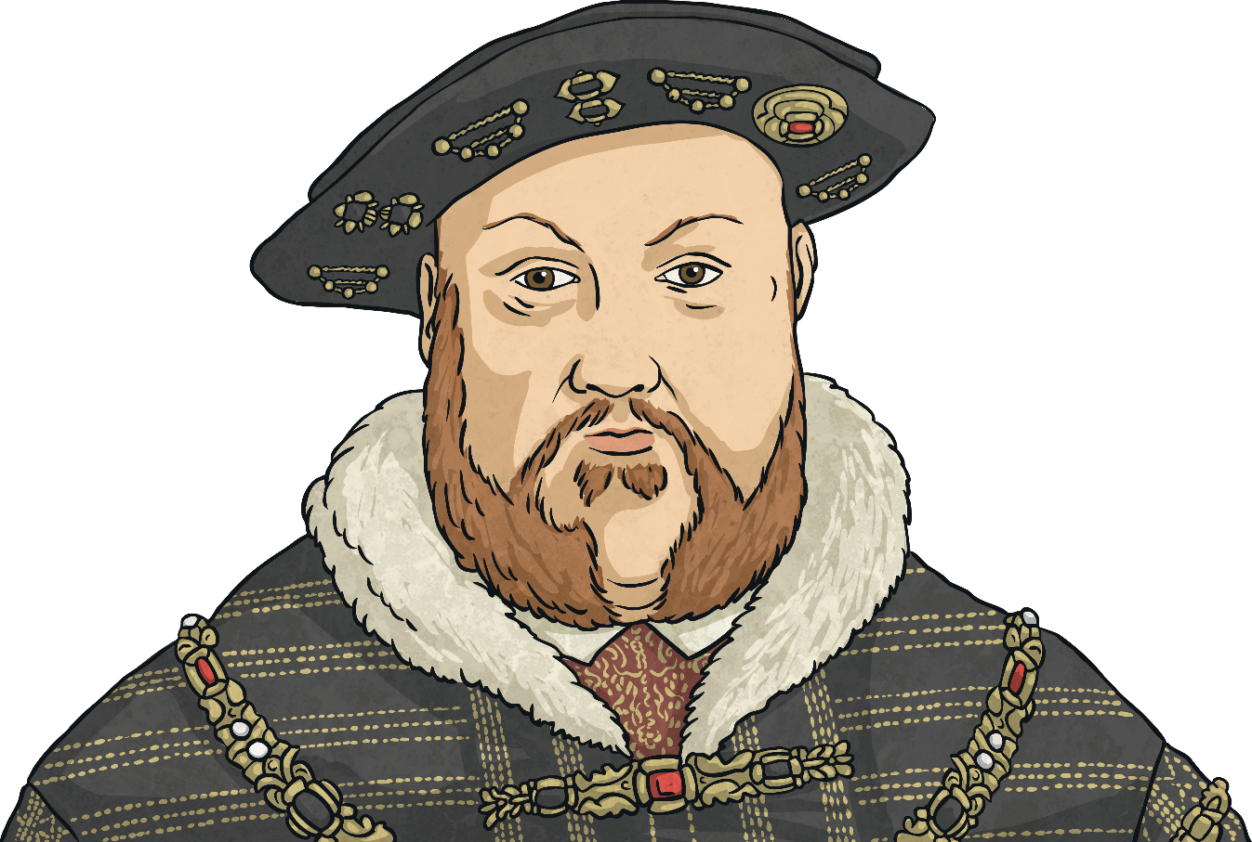
The Court of Henry VIII
There were approximately four hundred people at King Henry VIII’s Court, who were allowed two meals a day. When they dined, they were seated according to their rank.
The King would normally eat in his private rooms; however, at special times, he would eat in his Presence Chamber.

Slide 4
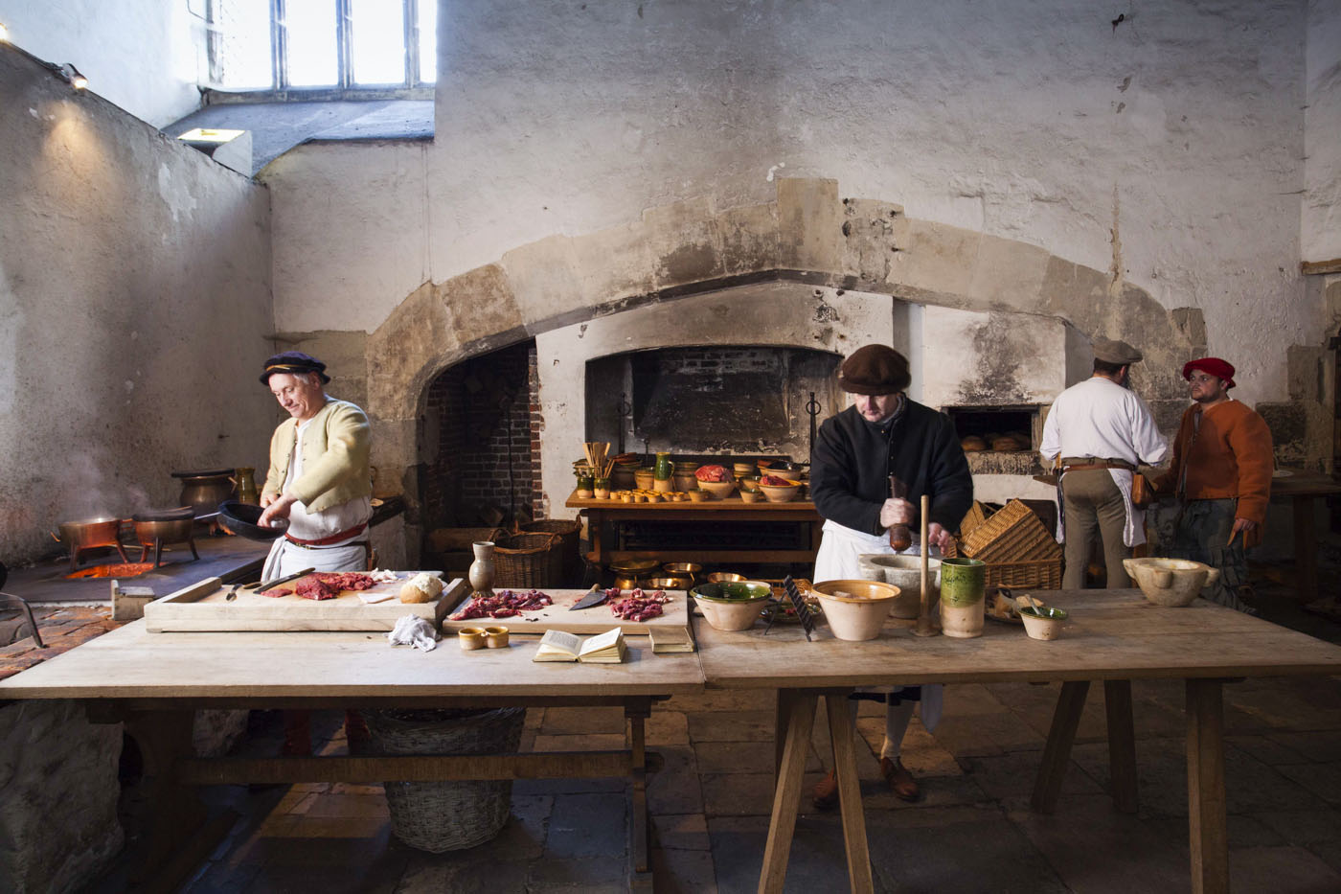
The Royal Kitchens
The royal Tudor kitchens would make around 1000 meals a day.
The meat would be cooked on a spit in a huge fireplace. However, the food Henry VIII ate was prepared in a private kitchen by the
Privy Master Cook, John Bricket.

Slide 5
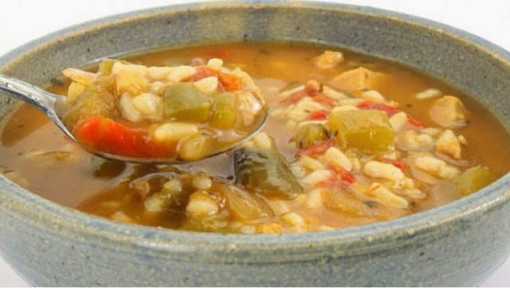
What Did Poor People
Eat in Tudor England?
Most people in the Tudor era lived on a diet of bread, butter, cheese and eggs. They would often eat a food called potage
(a vegetable broth thickened with oats).

Slide 6
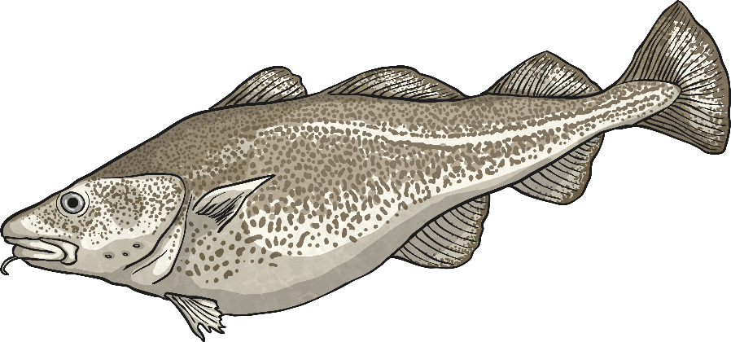
Fish
During the Tudor times, fish was mainly eaten in places near rivers and the coast. However, due to religious rules, people had to eat fish on Fridays and during Lent. Eels, pike, perch, trout, sturgeon and salmon were a part of the Tudor diet.

Slide 7
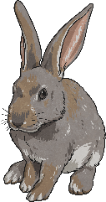
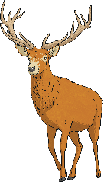
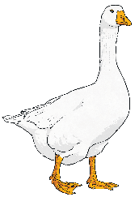
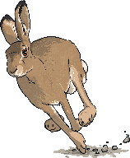
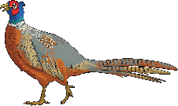
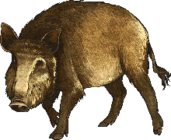
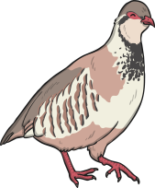
Meat
Meat made up three-quarters of the Tudor diet. Many other types of meat were eaten during the Tudor era.
rabbit
pheasant
deer
goose
hare
wild
boar
partridge
Henry VIII ate swan and seagull at Court.
The Tudor Court

Slide 8
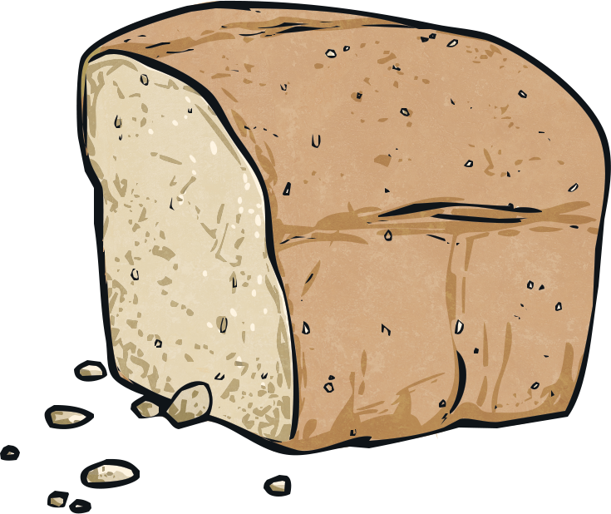
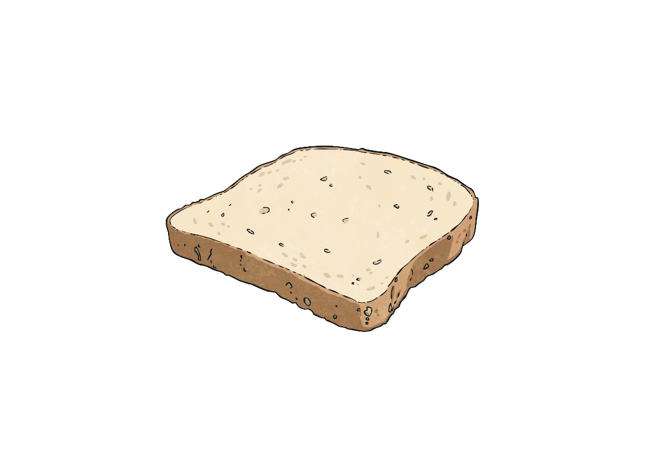
Bread
The type of bread you ate in Tudor times, largely depended on how wealthy you were. The rich would eat white bread; however, the poor would eat bread made from rye.

Slide 9
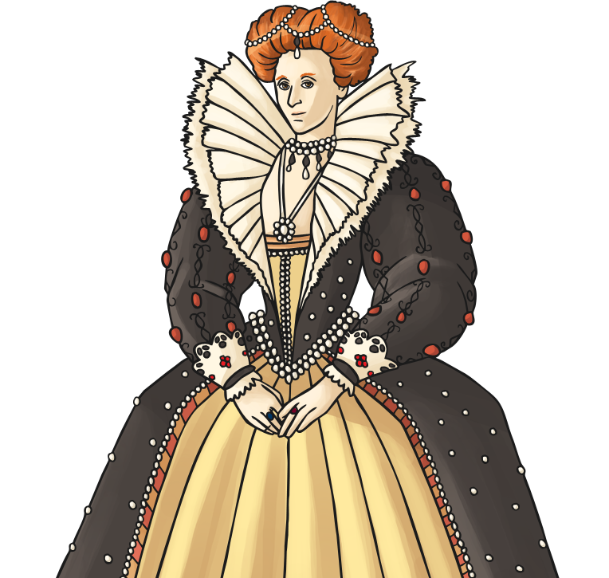
Sweet Foods
Sugar was brought from Cyprus. It became very popular during Queen Elizabeth I’s reign. Marzipan was used to make models of castles and animals, which would then be the centrepiece of the Tudor dining table.
Poorer people would use honey to sweeten their food, which was cheaper and easier to find.
Did you know?
Wealthy Tudors loved sugar so much that they would even eat rose petals covered in sugar.

Slide 10
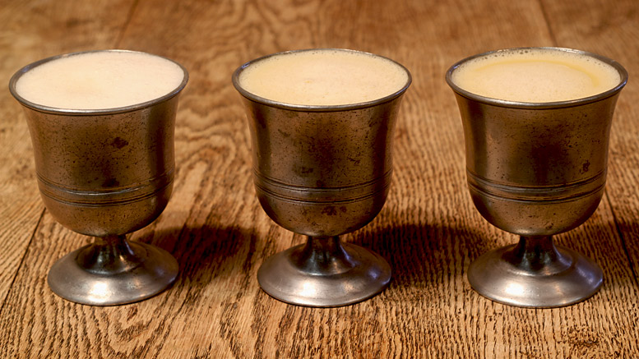
Drink
Water was not used as a drink as it was often unsafe due to sewerage. Instead, poorer people drank weak ale – even the children –
and the wealthy drank wine.

Slide 11
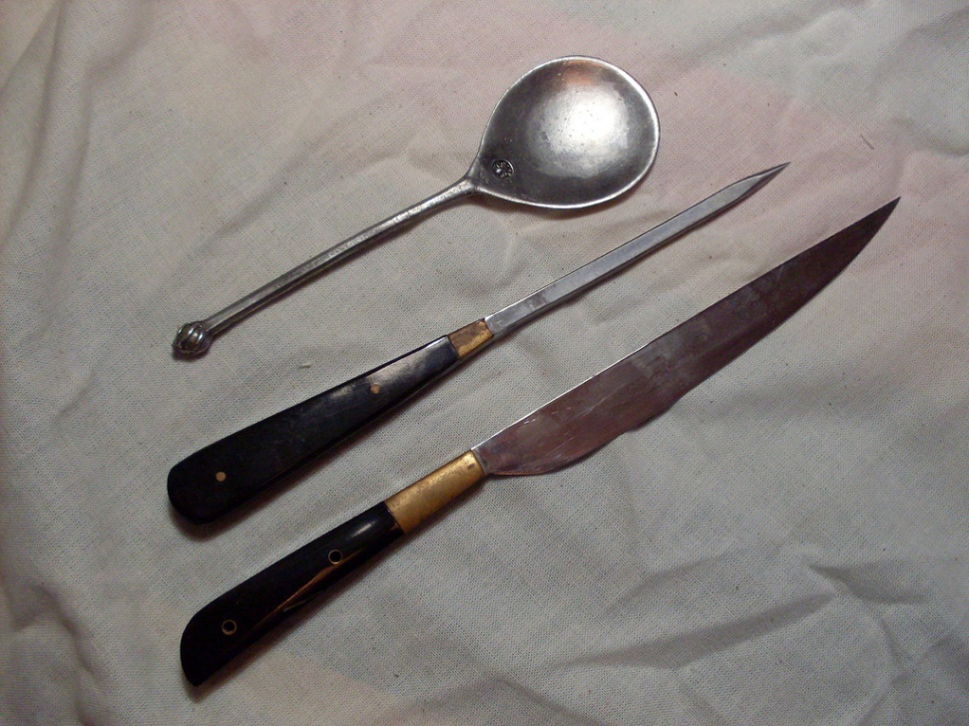
Cutlery
People in the Tudor times would use knives, fingers and spoons to eat their meals. At the Court of Henry VIII, only the King was given a fork, which he used to eat sweet food. In Tudor times, forks were only used to serve, cook and carve food.

Slide 12
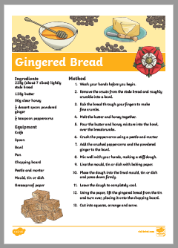
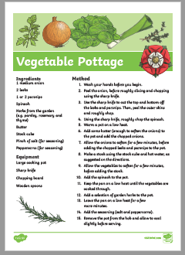
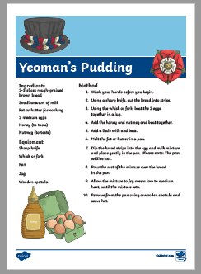
Your Task
Learn more about Tudor food using the video link below.
https://www.youtube.com/watch?v=i1cW6sVbUBg
Why not try cooking some Tudor food using the recipes on the class page.

