Slide 1
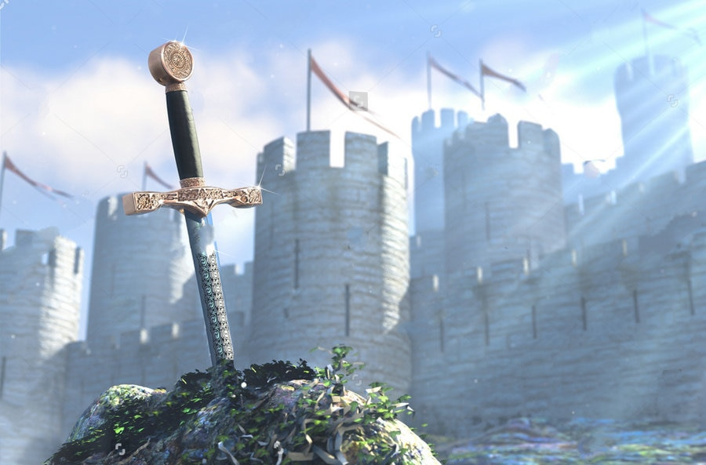
Tuesday 2nd March 2021
LO: To create a poster to publicise the hunt for the new king of England.

Slide 2
This week we are looking at the story of King Arthur.
King Arthur is a medieval, mythological figure who was the head of the kingdom Camelot and the Knights of the Round Table. Although it is unknown if Arthur was real it is thought that he lived during the 1100’s.

Slide 3
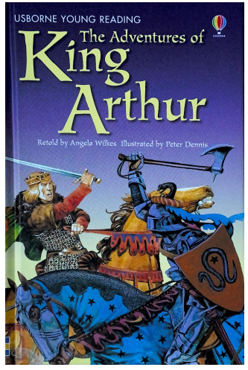

Slide 4
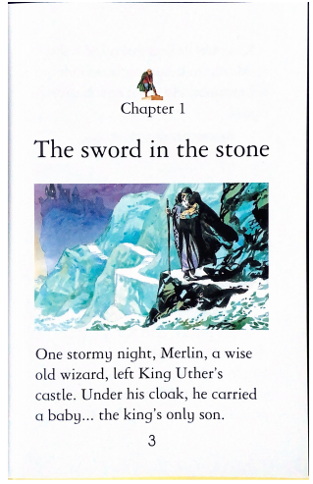

Slide 5
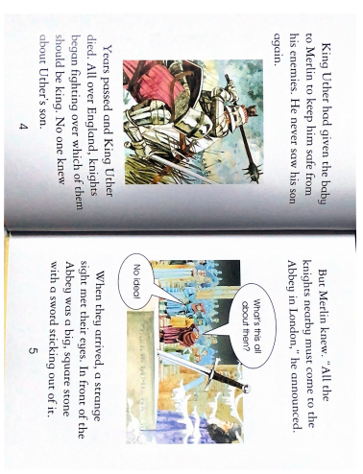

Slide 6
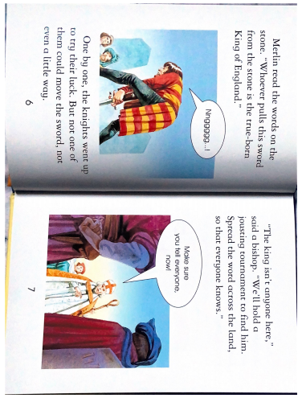

Slide 7
Your task
Create a poster to publicise the tournament being held to find the next “True-born King of England.
You should include:
The date and time
Where it is taking place (The Abbey)
What they will have to do in the tournament.
What qualities the true King should have.

Slide 8
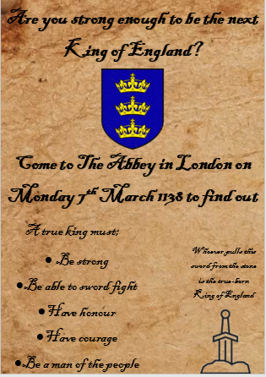

Slide 9
Opt. 1 –Create your own poster using PowerPoint, Word or Publisher etc.
Opt. 2 – Create your own poster on a blank piece of paper.
You could make it look old by adding tea stains to it and ripping the edges. To make it look like it is from the 1100’s

