Slide 1
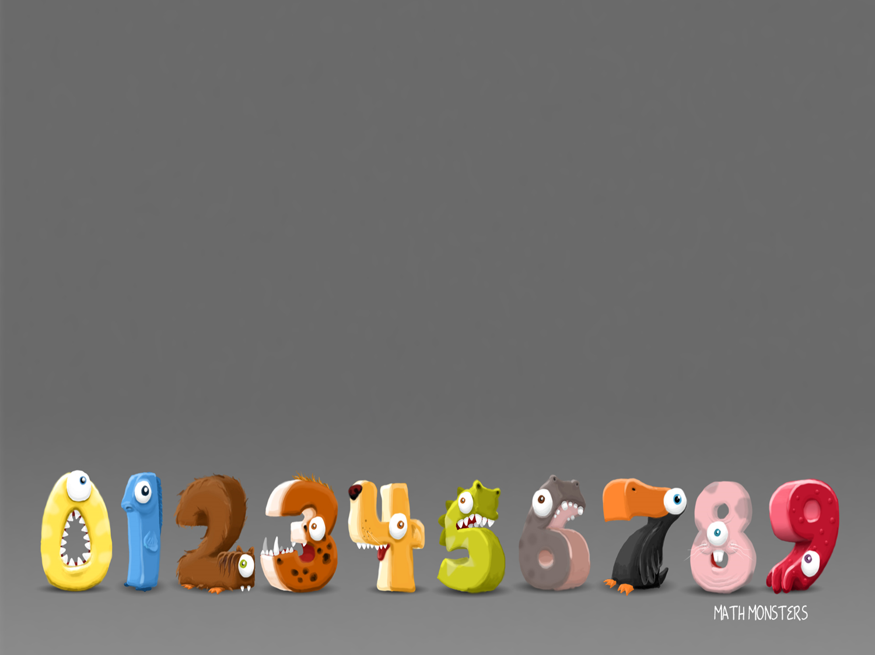
1/3/2021
LO: Count sides on 2D shapes

Slide 2
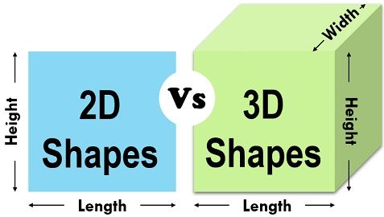
A 2D shape cannot be physically held, because it has no depth; it is completely flat. The thin plastic shapes that are sometimes used to represent 2D shapes are actually 3D because they do have depth to them – even if it’s very small.

Slide 3
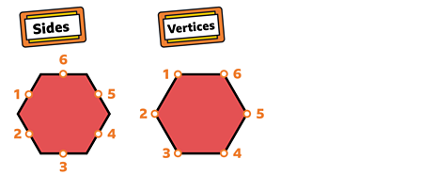

Slide 4
Which one of these is the odd one out?

Slide 5
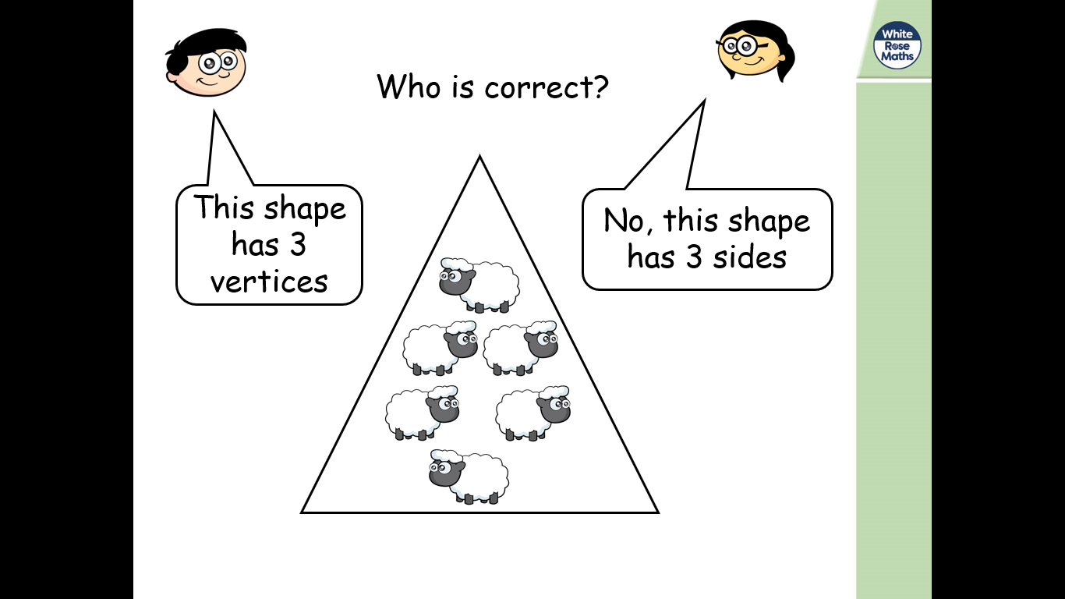

Slide 6
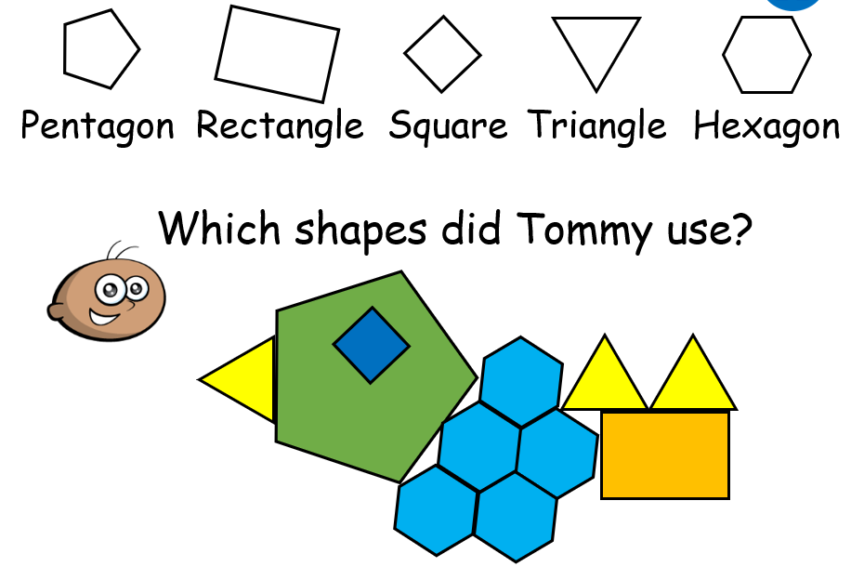

Slide 7
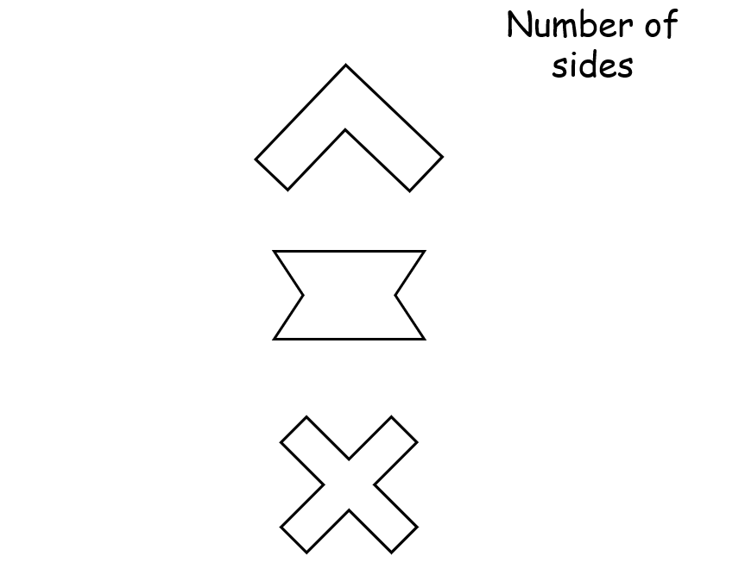

Slide 8
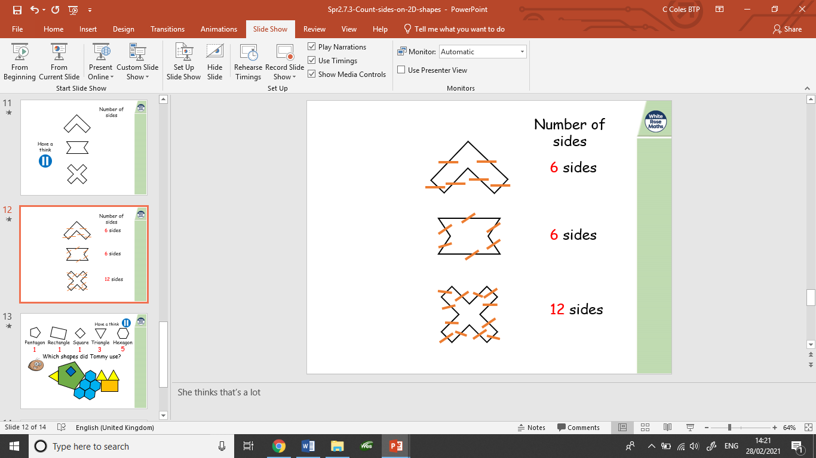

Slide 9
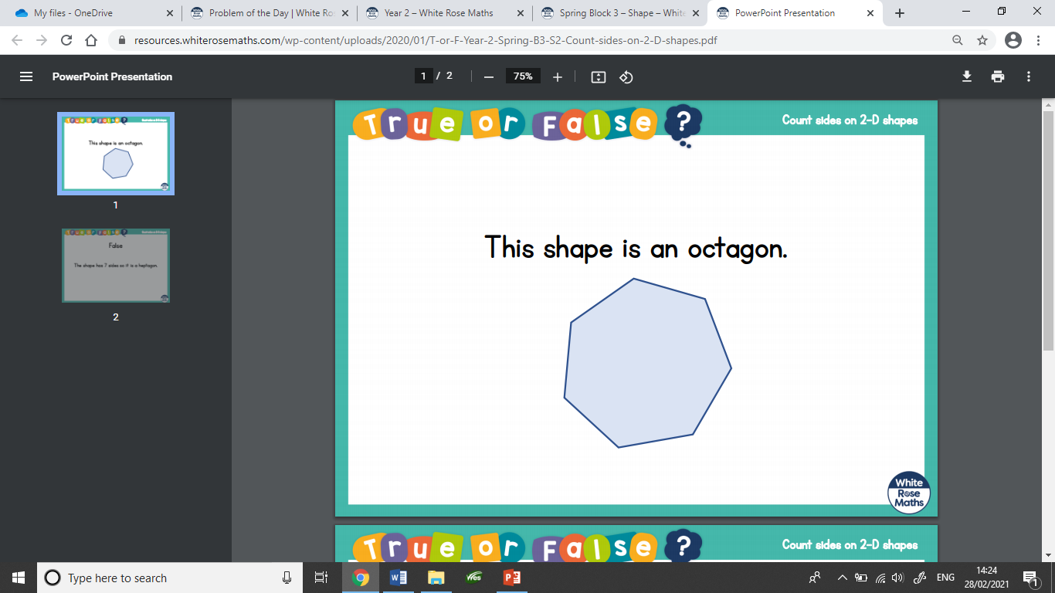

Slide 10
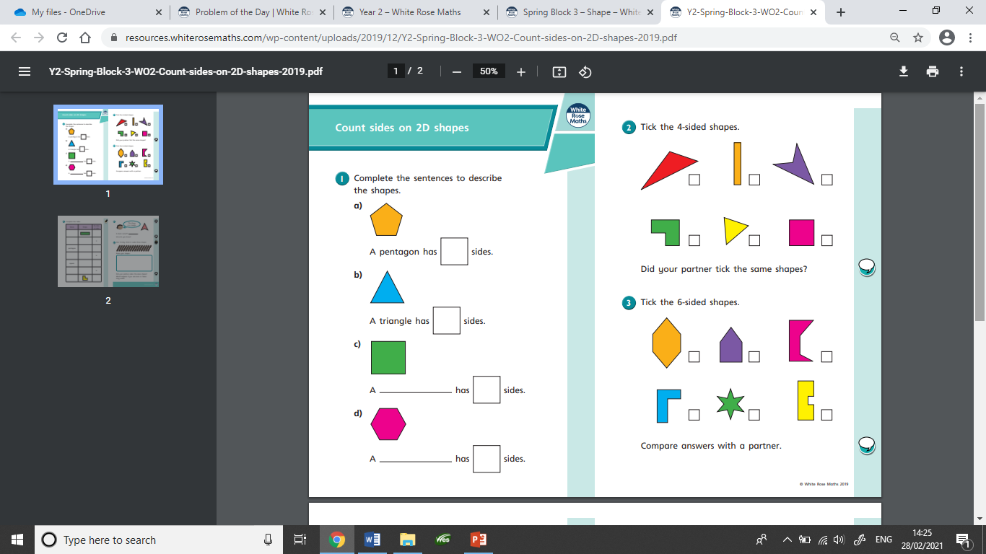
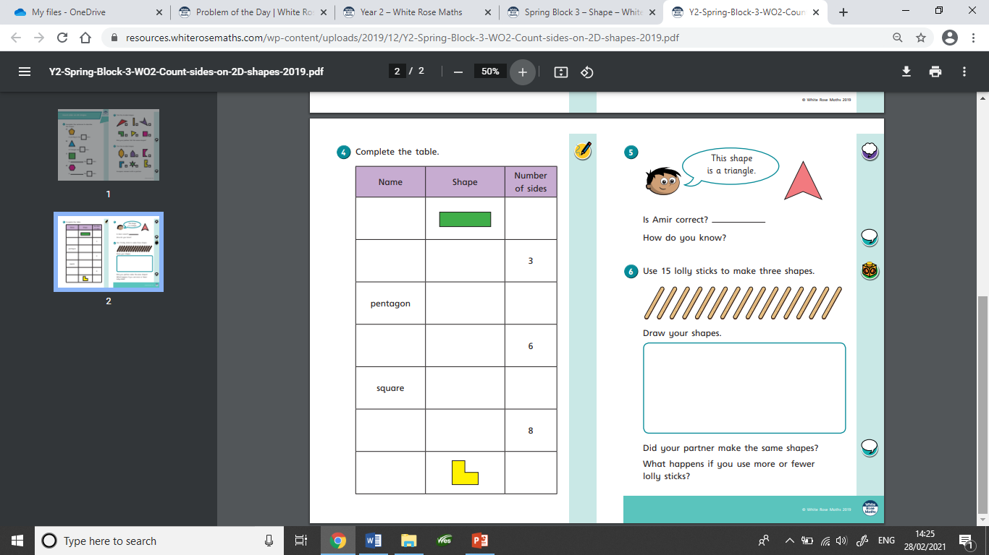
These are the worksheets set today.

Slide 11
2/3/2021
LO: Count vertices 2D shapes

Slide 13
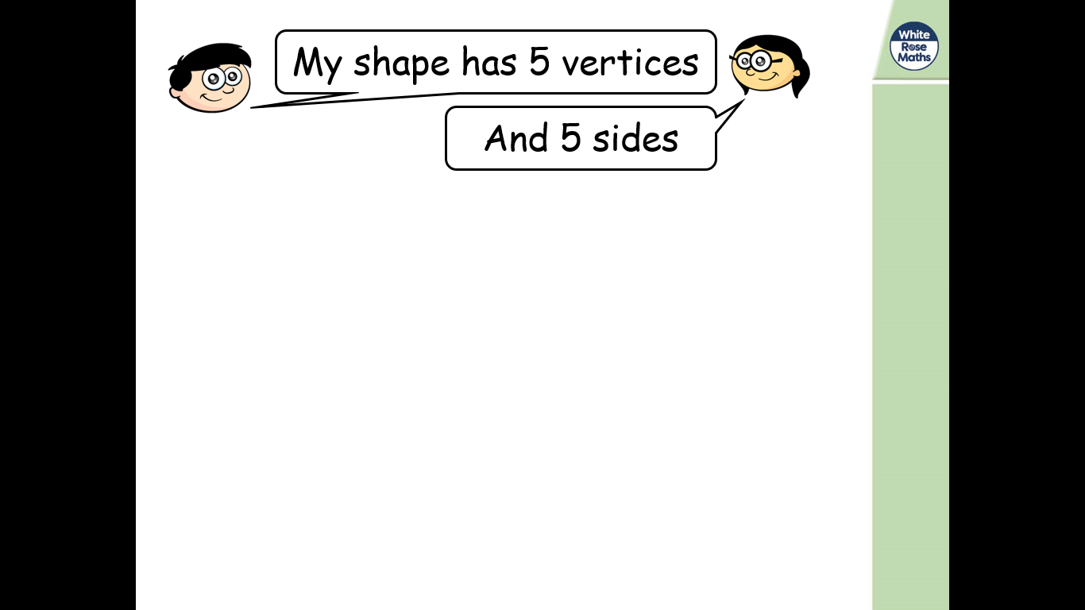
What shape could it be?

Slide 14
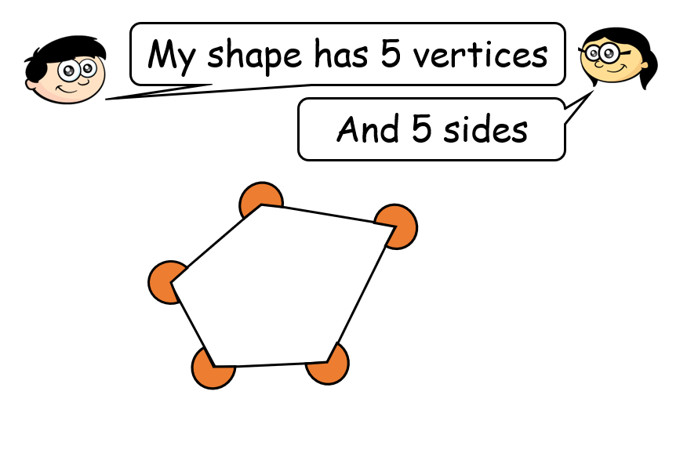
A pentagon

Slide 15
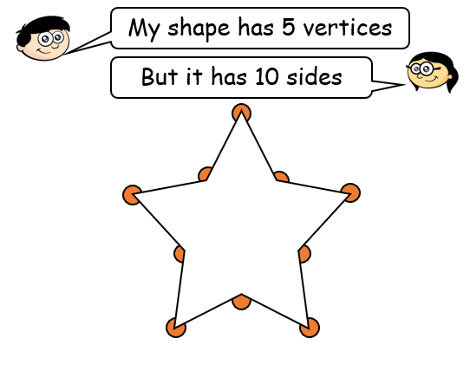
Is this correct?

Slide 16
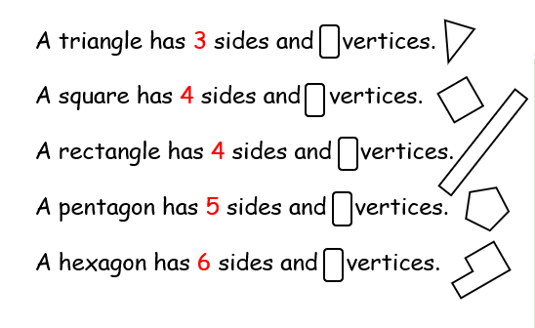

Slide 17
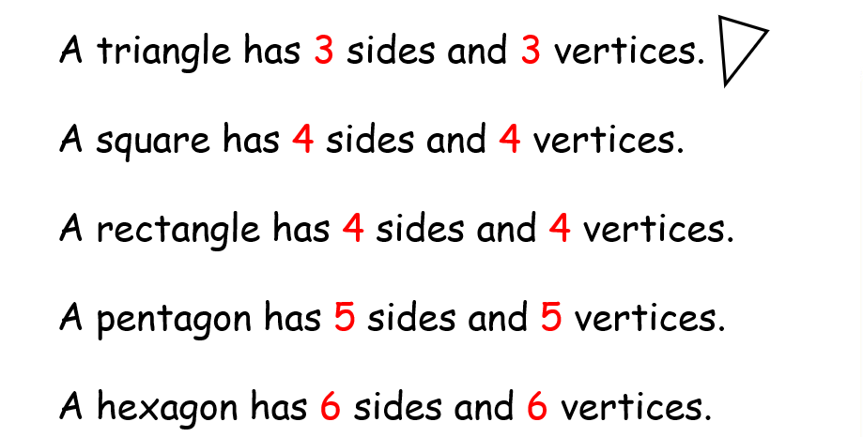

Slide 18
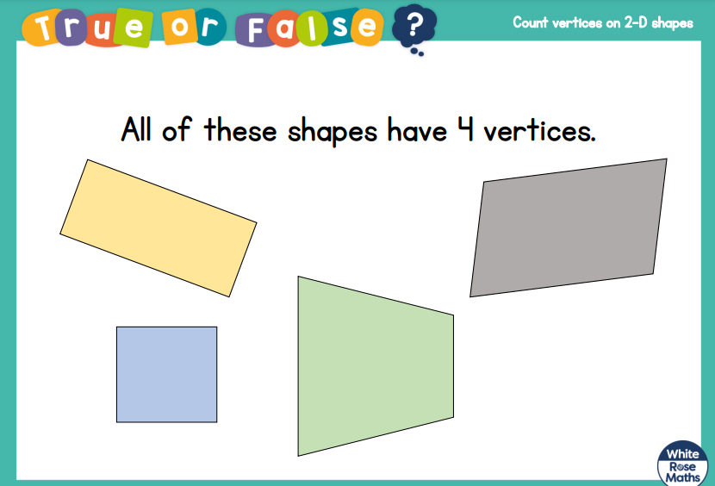

Slide 19
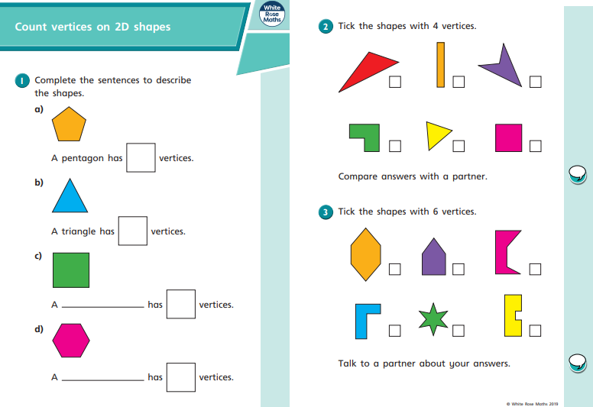
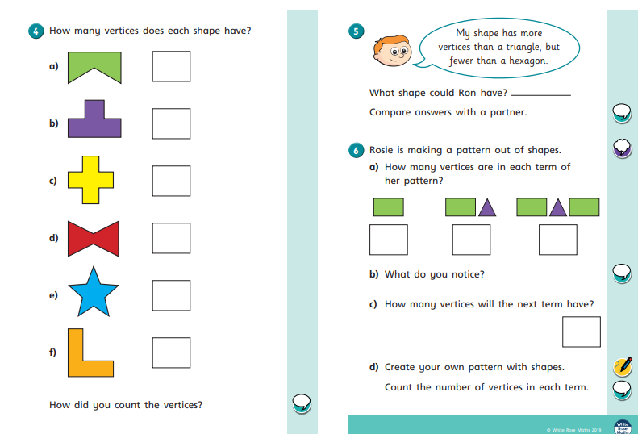
These are the worksheets set today.

Slide 20
3/3/2021
LO: Lines of symmetry

Slide 21
What is symmetry?
Something is symmetrical when it is the same on both sides. A shape has symmetry if a central dividing line (a mirror line) can be drawn on it, to show that both sides of the shape are exactly the same.

Slide 22
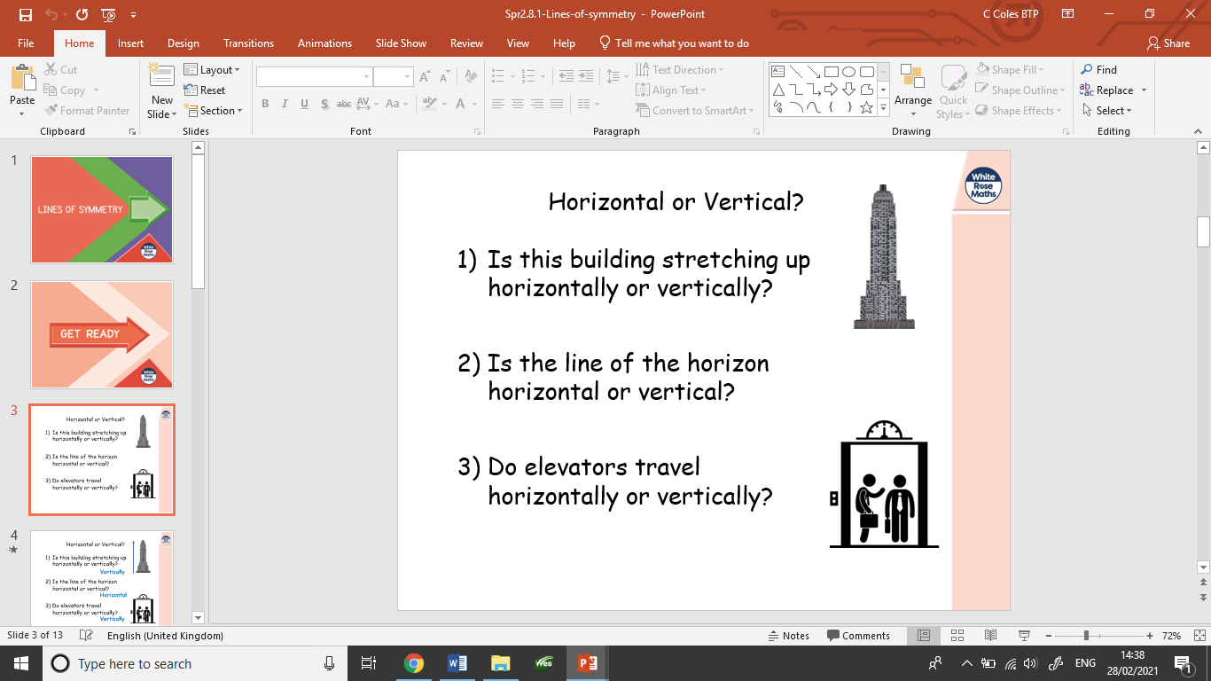

Slide 23
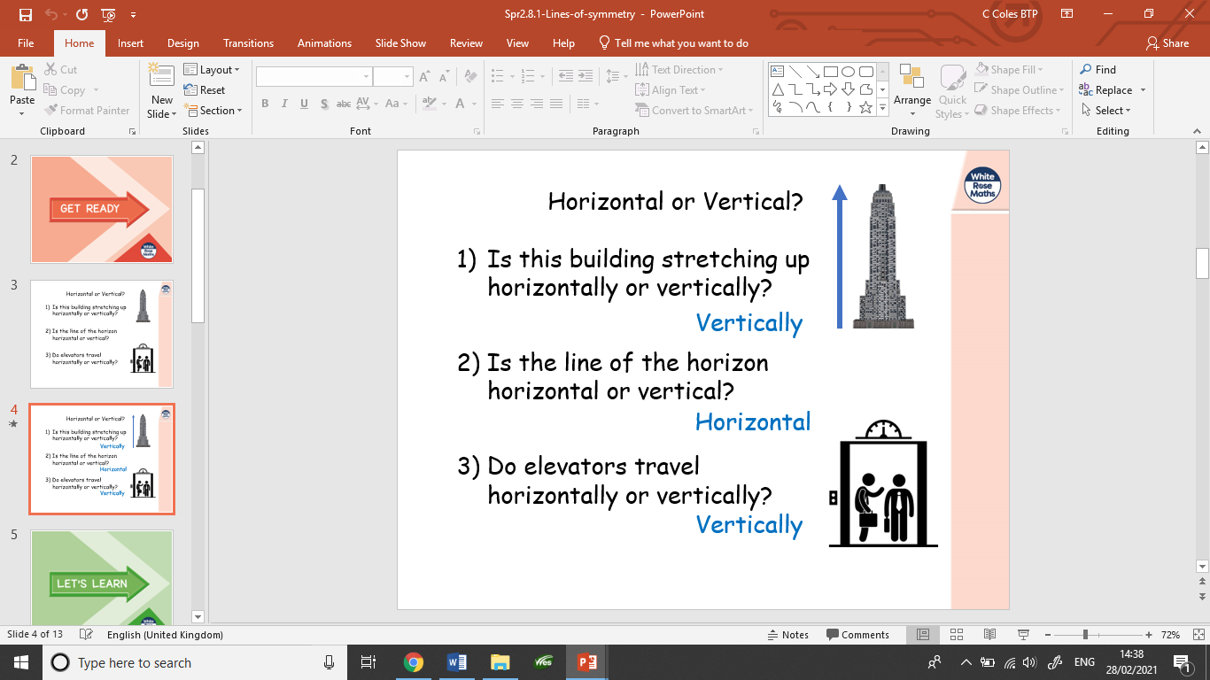

Slide 24
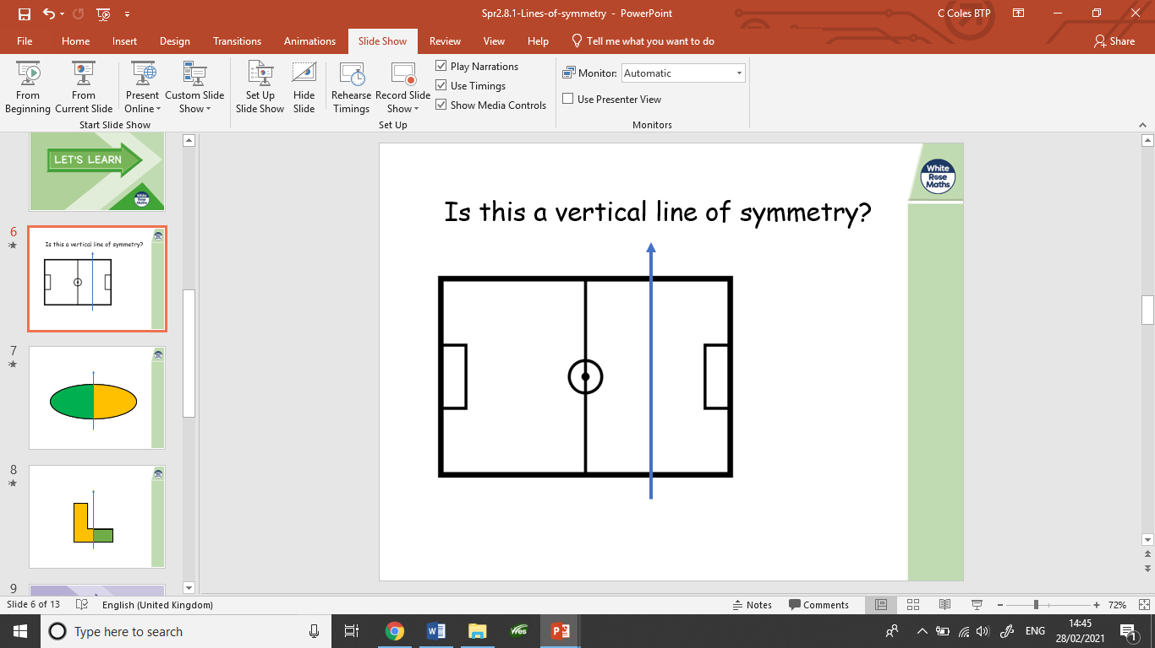

Slide 25
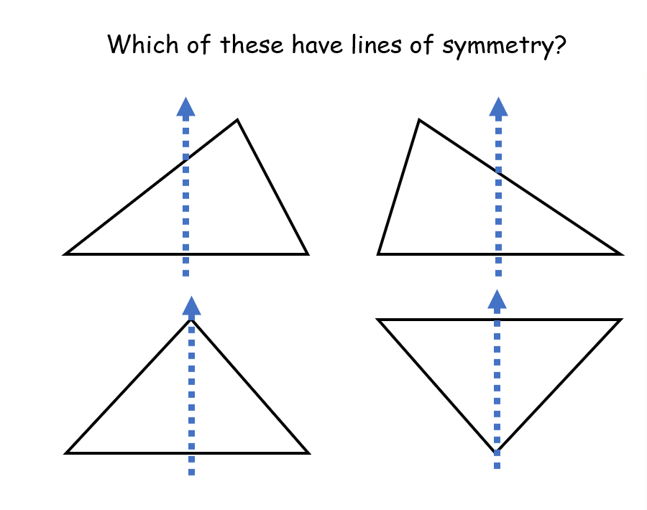

Slide 26
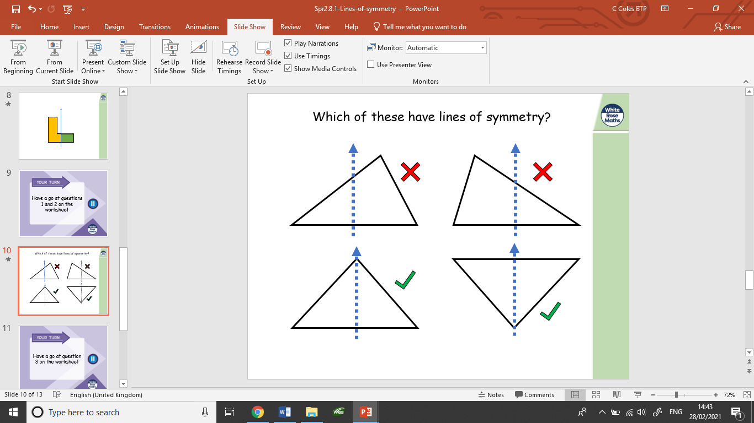

Slide 27
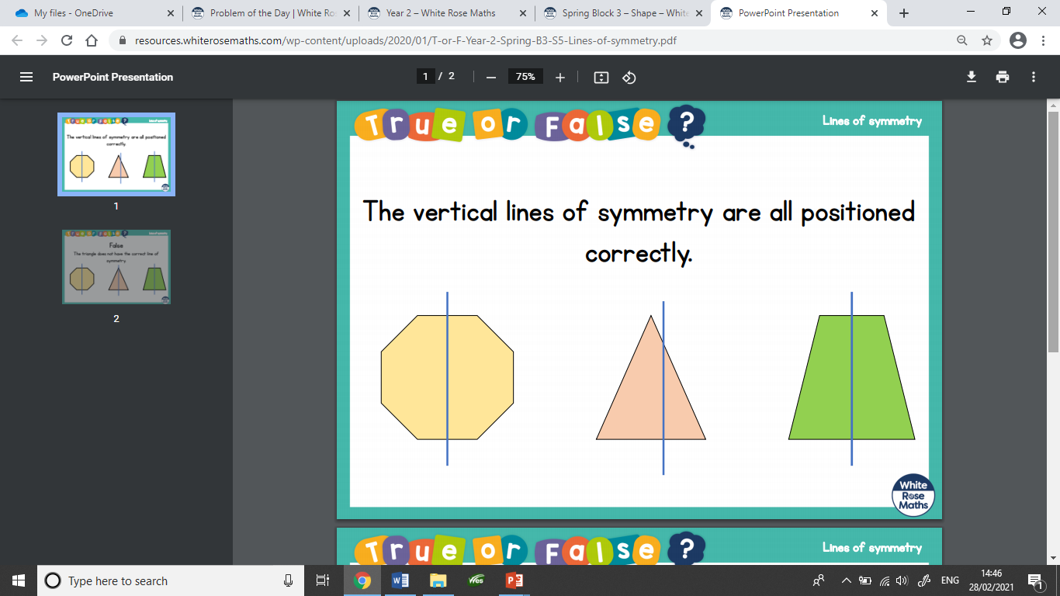

Slide 28
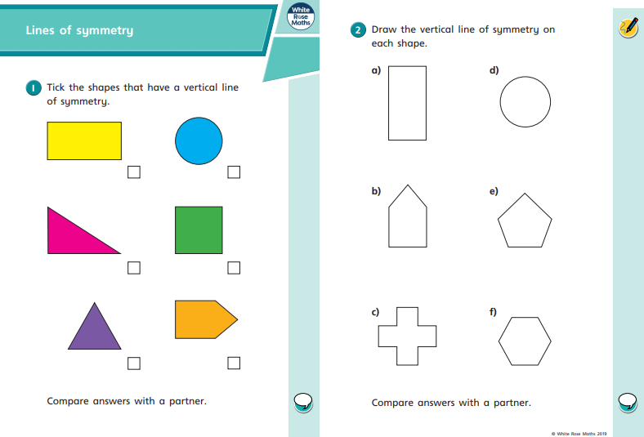
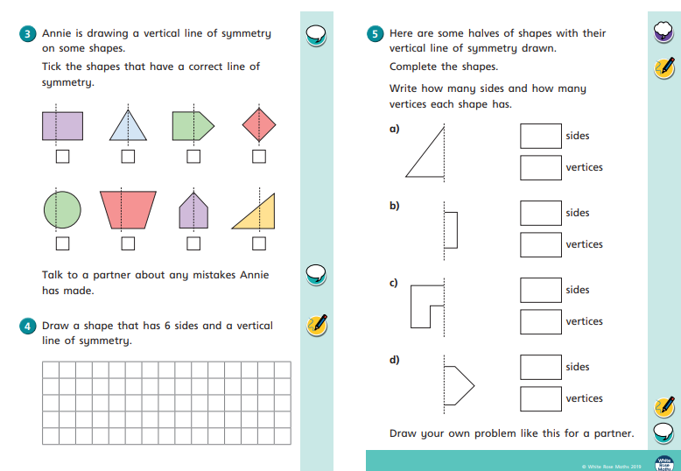
These are the worksheets set today.

Slide 29
4/3/2021
LO: Lines of symmetry - draw the whole

Slide 30
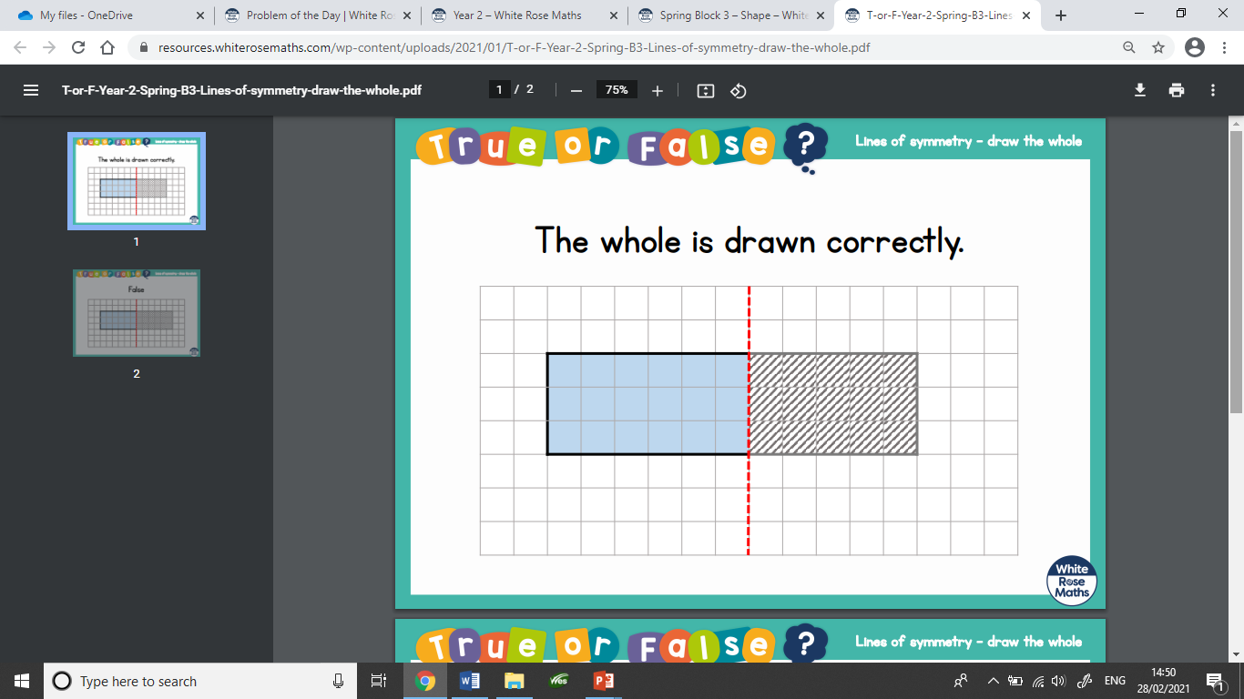

Slide 31
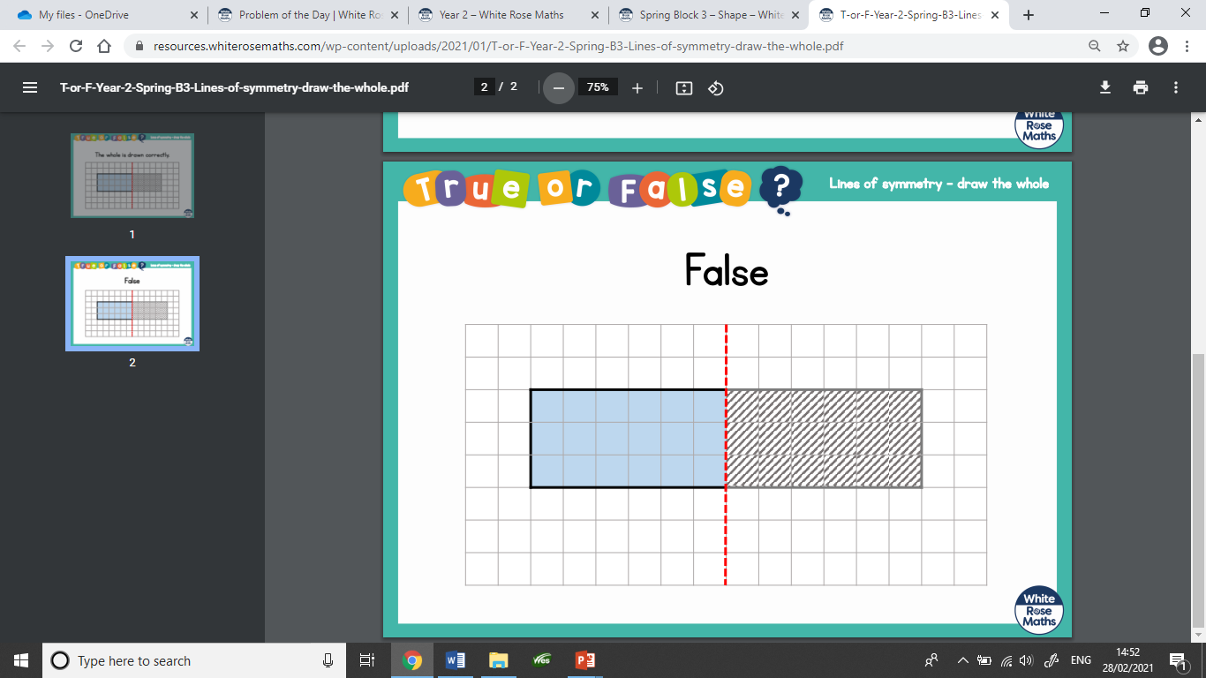

Slide 32
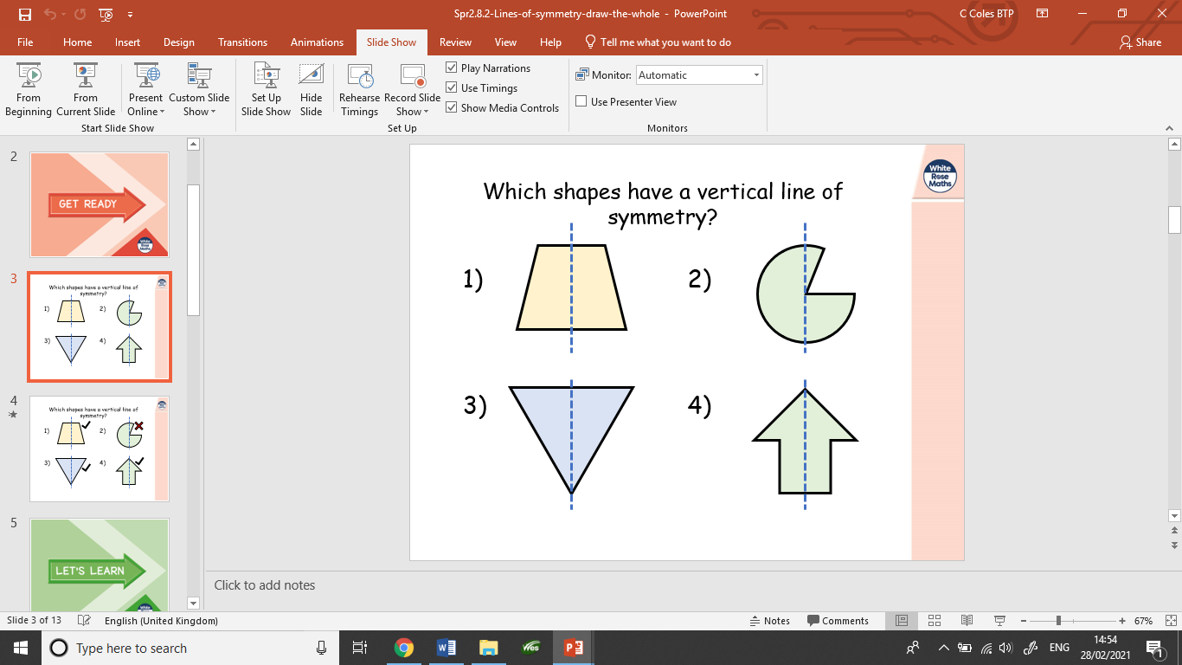

Slide 33
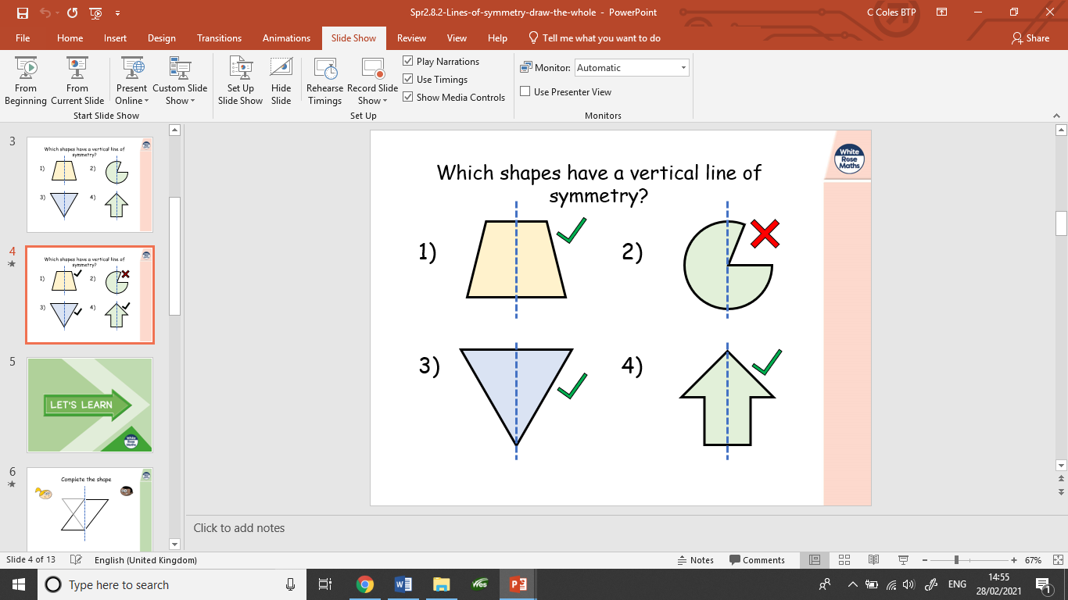

Slide 34
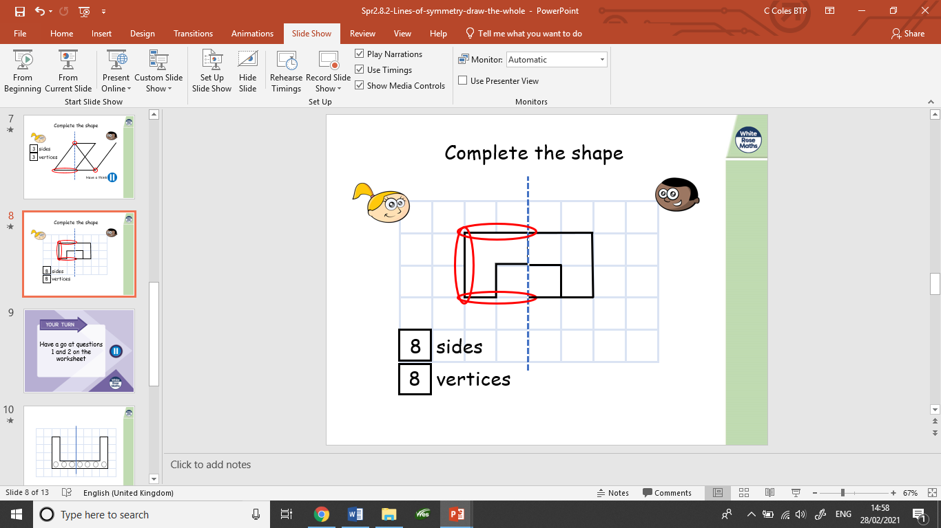

Slide 35
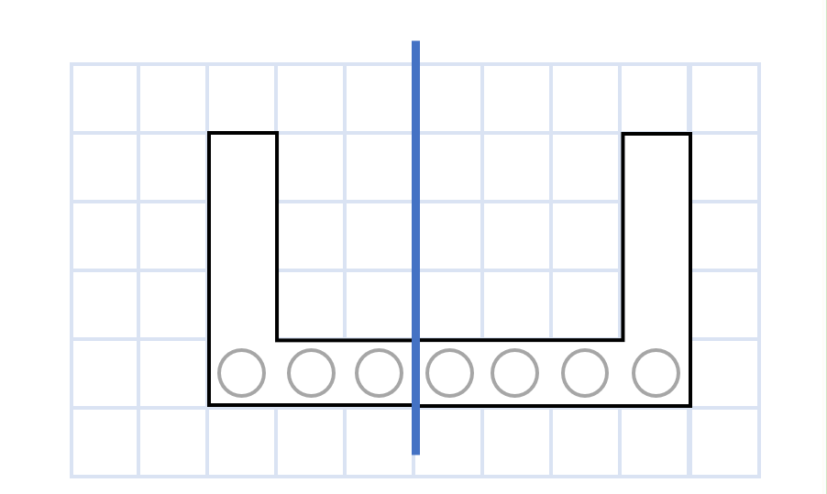
Has this shape been drawn correctly?

Slide 36
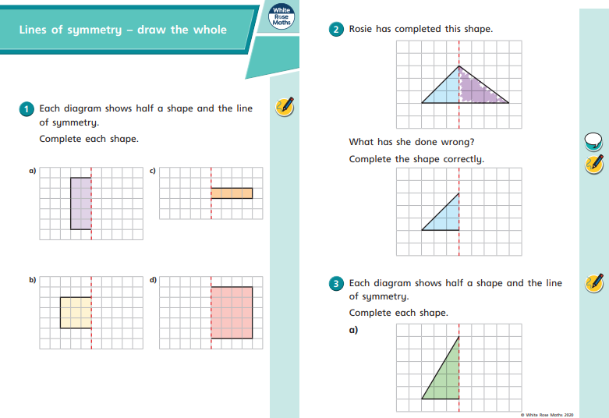
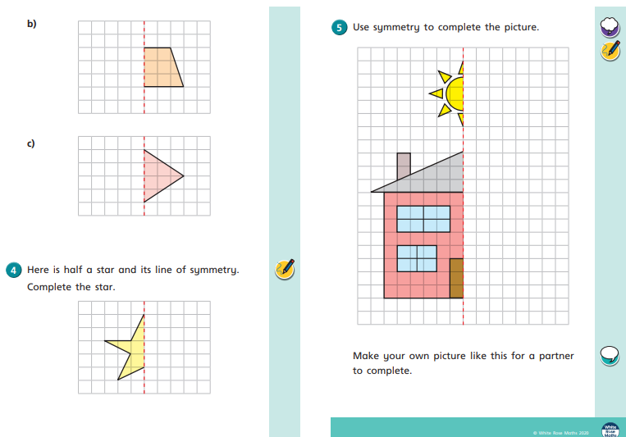
These are the worksheets set today.

Slide 37
5/3/2021
LO: Symmetry

Slide 38
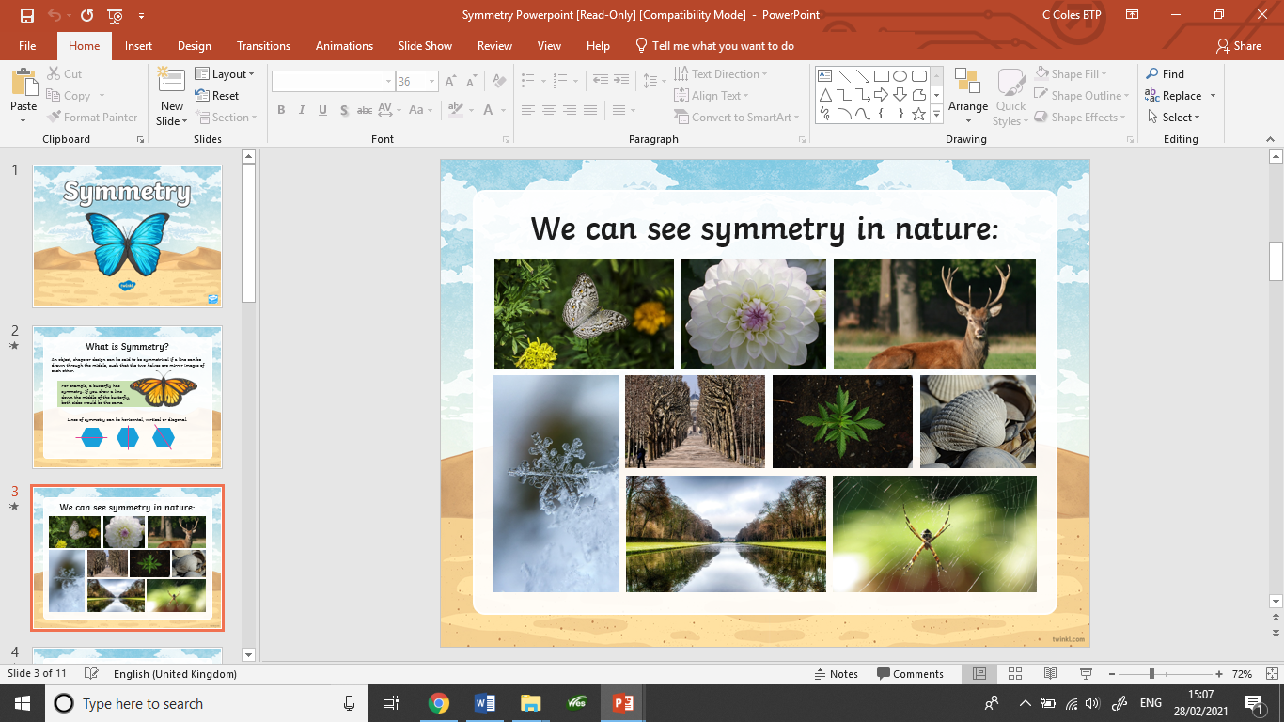

Slide 39
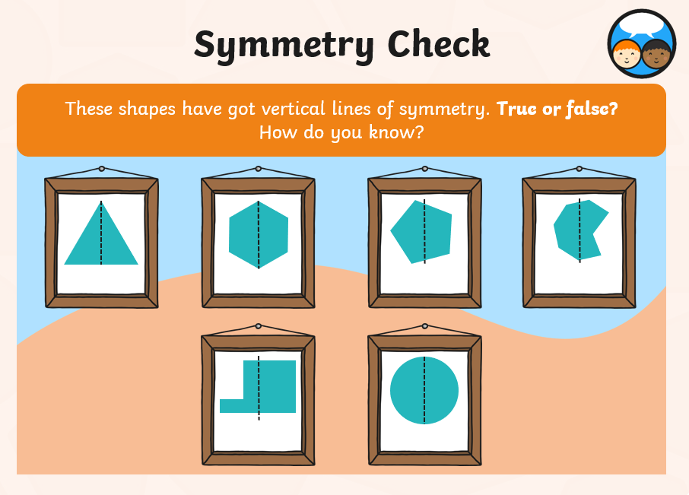

Slide 40
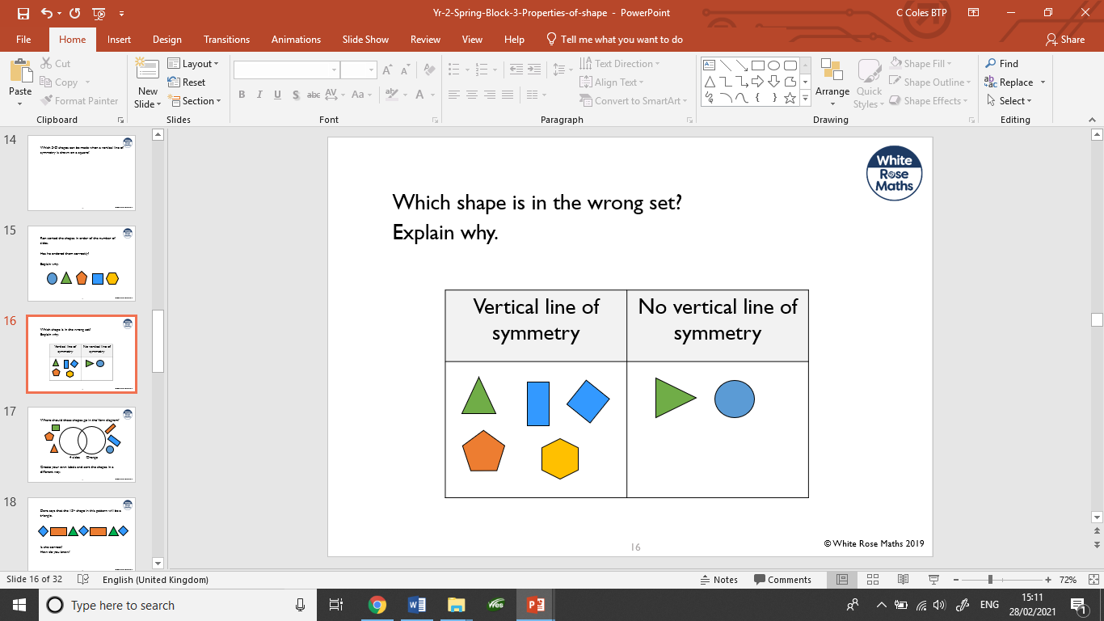

Slide 41
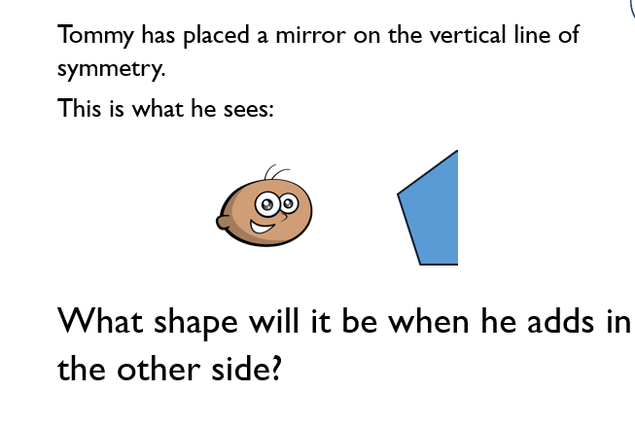

Slide 42
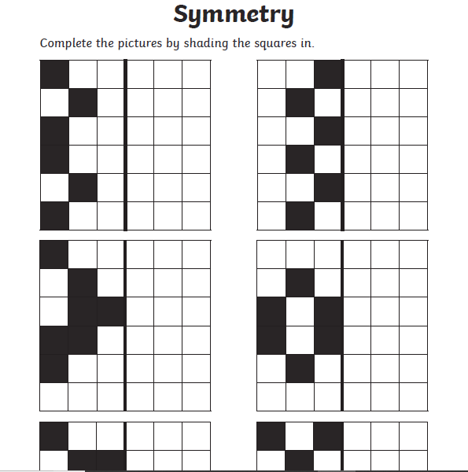
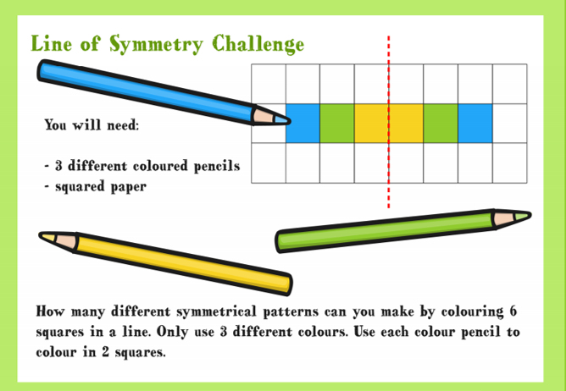
These are the tasks set for today.

Slide 43
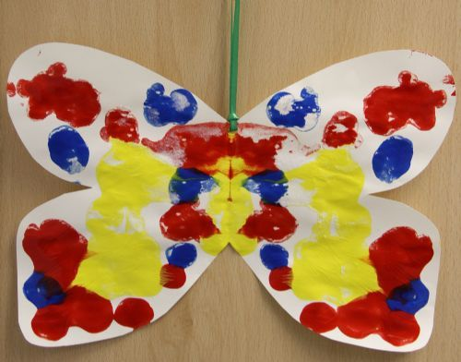
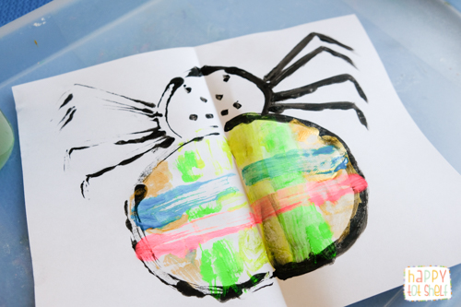
Additional task you may want to do
Create a symmetry painting.
Paint on one half of the paper and fold over to create a symmetrical painting.

