Slide 2
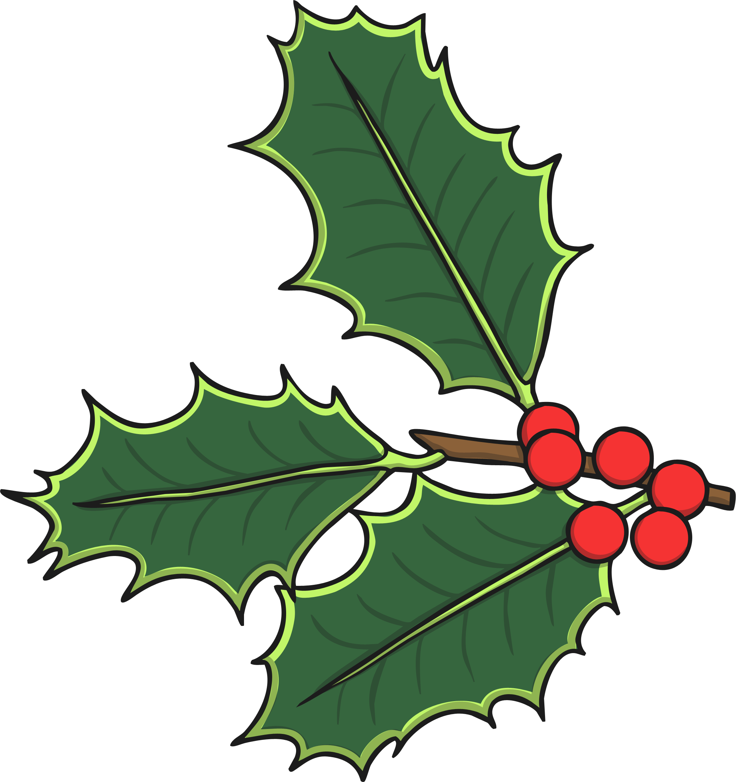

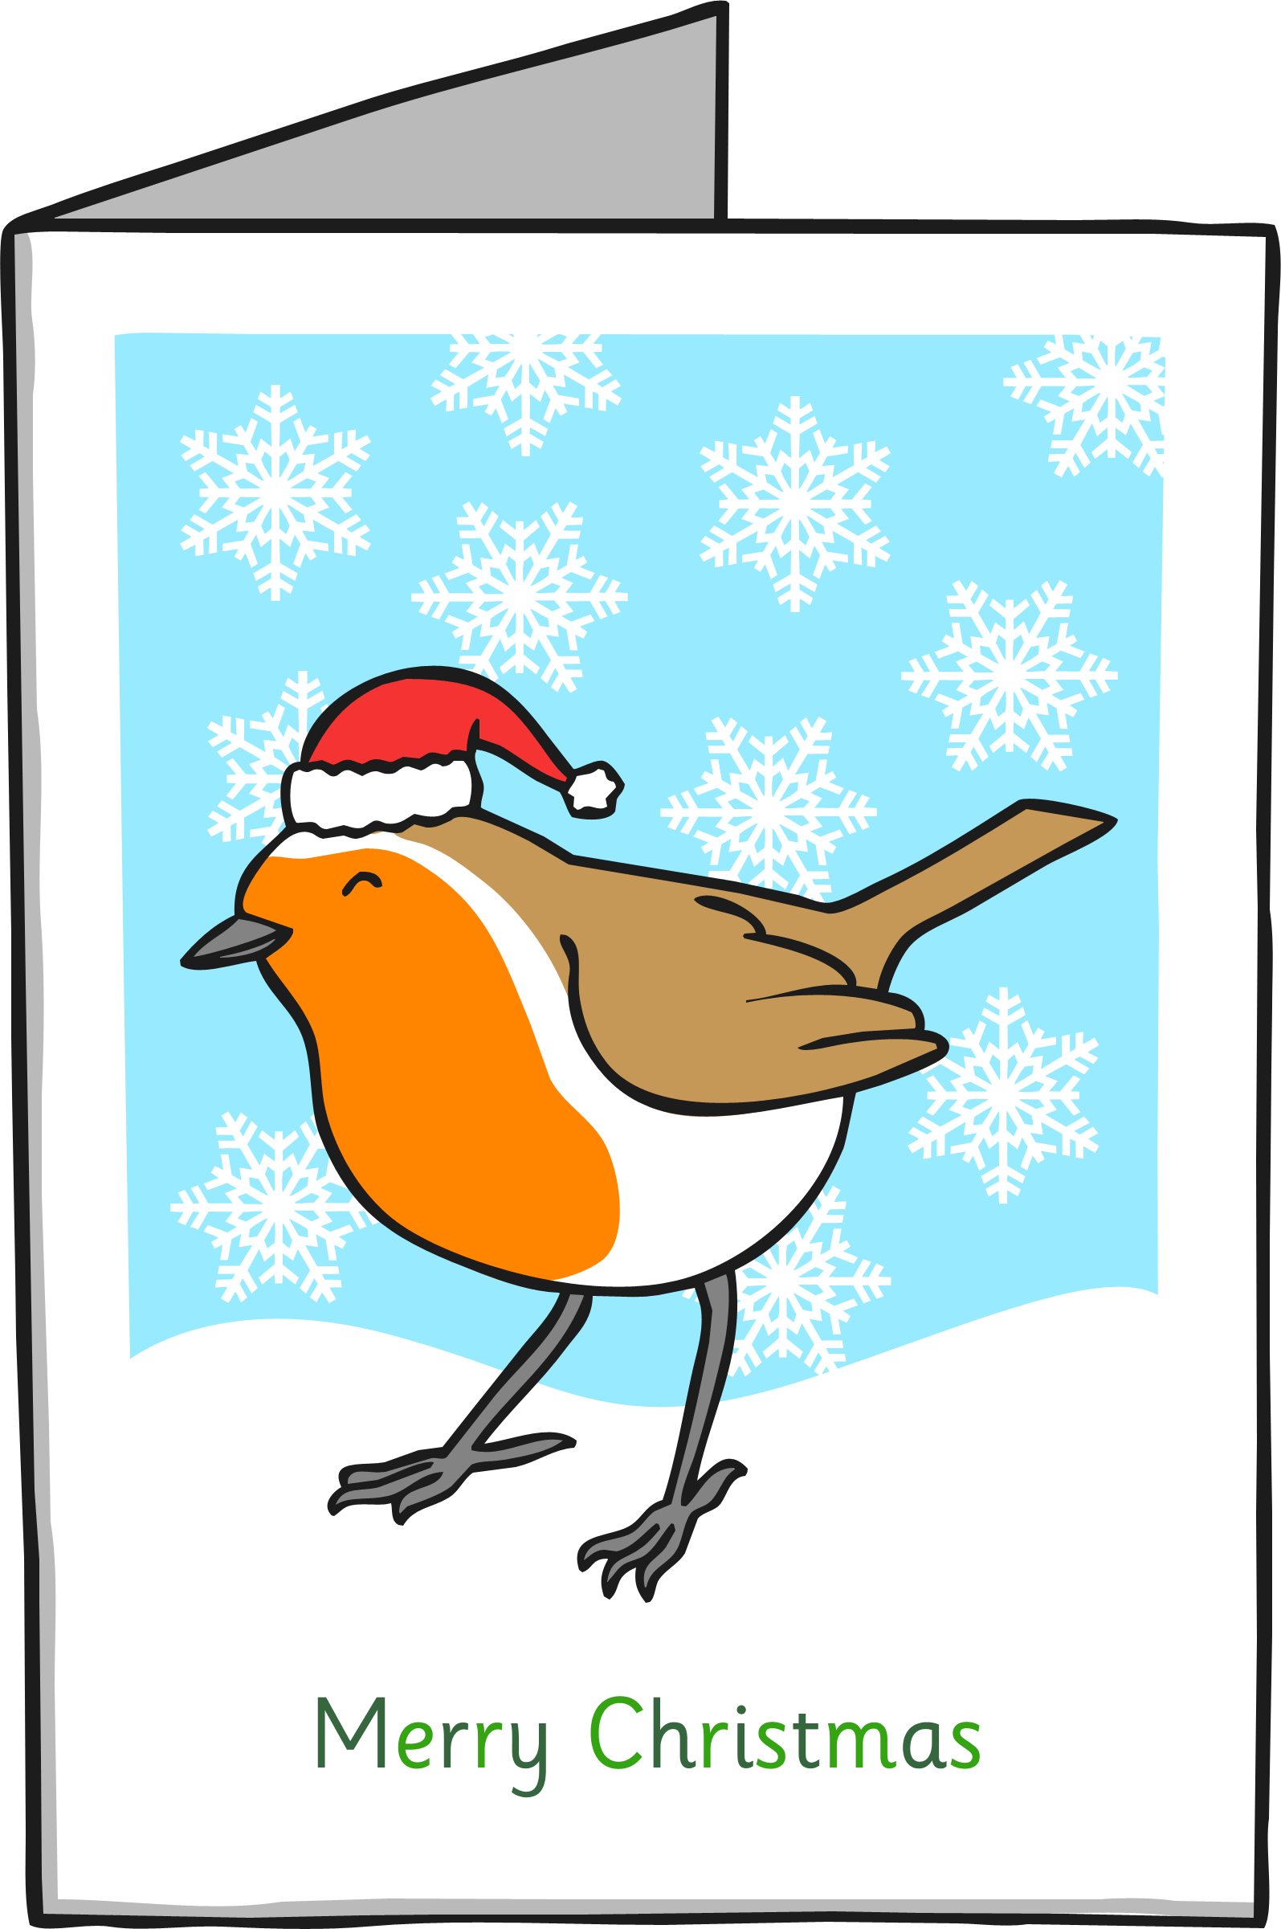





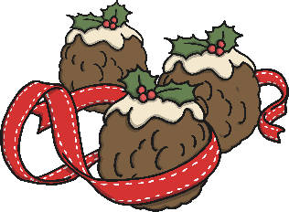
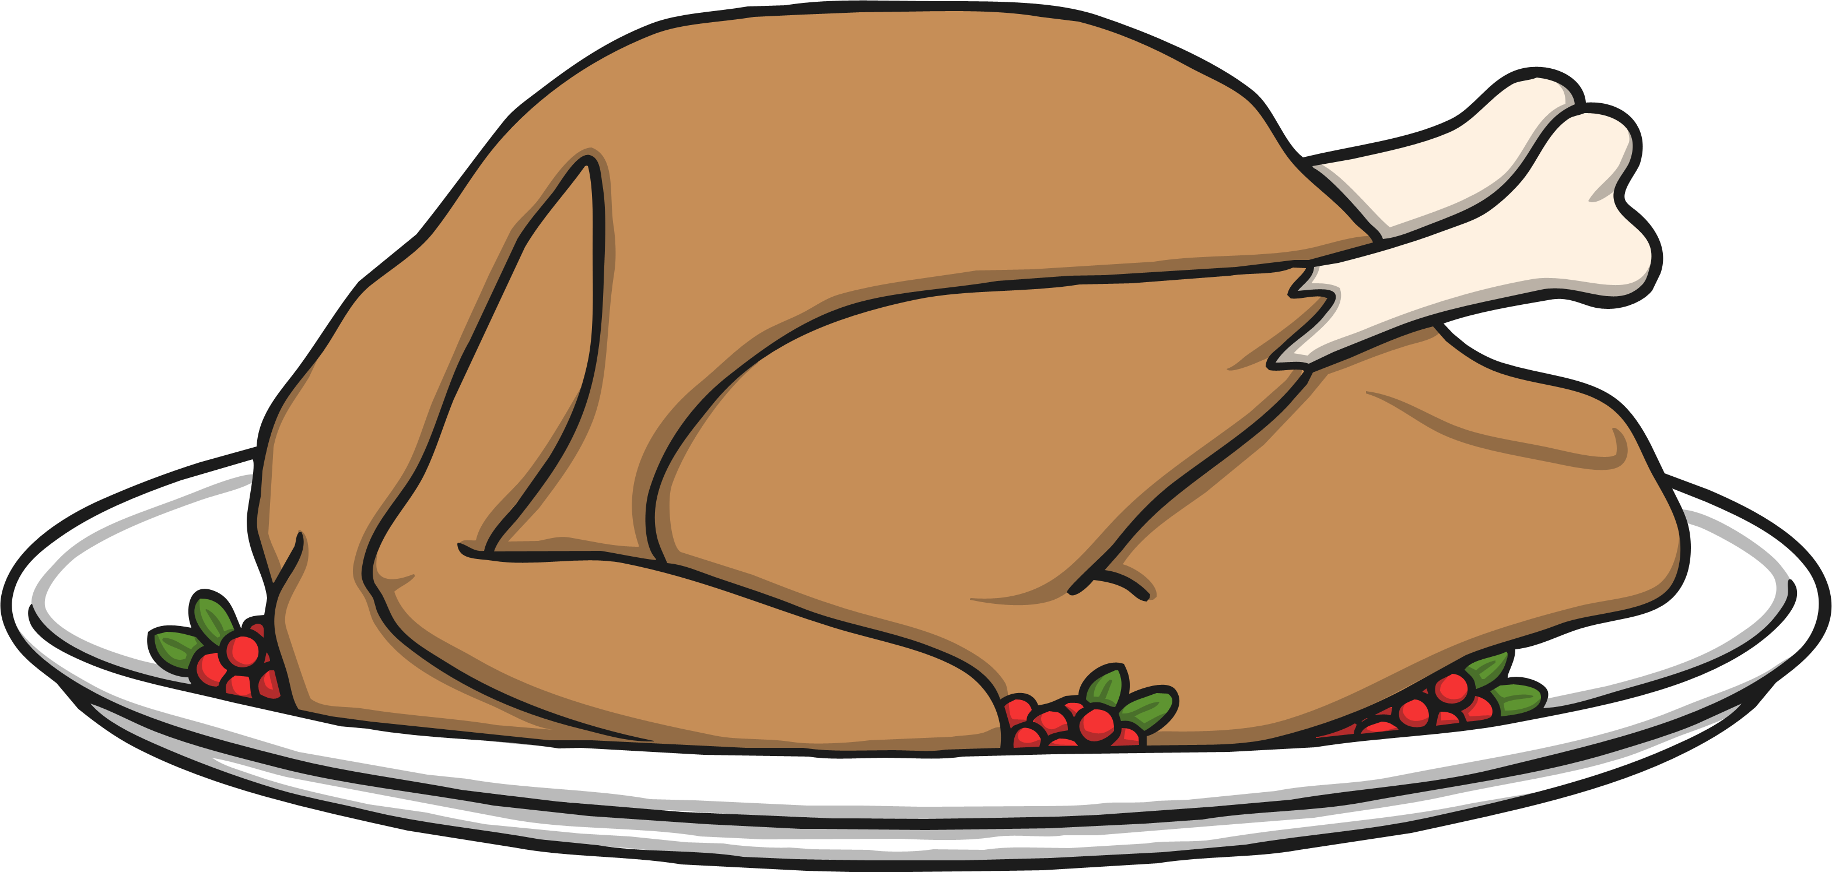
Christmas Traditions
Christmas tree
Christmas cards
Mistletoe
Christmas crackers
Father Christmas
Decorations
Turkey dinner
Carol singing
Christmas pudding

Slide 3
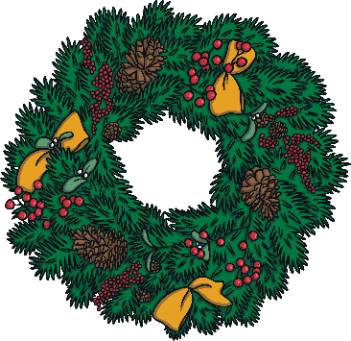
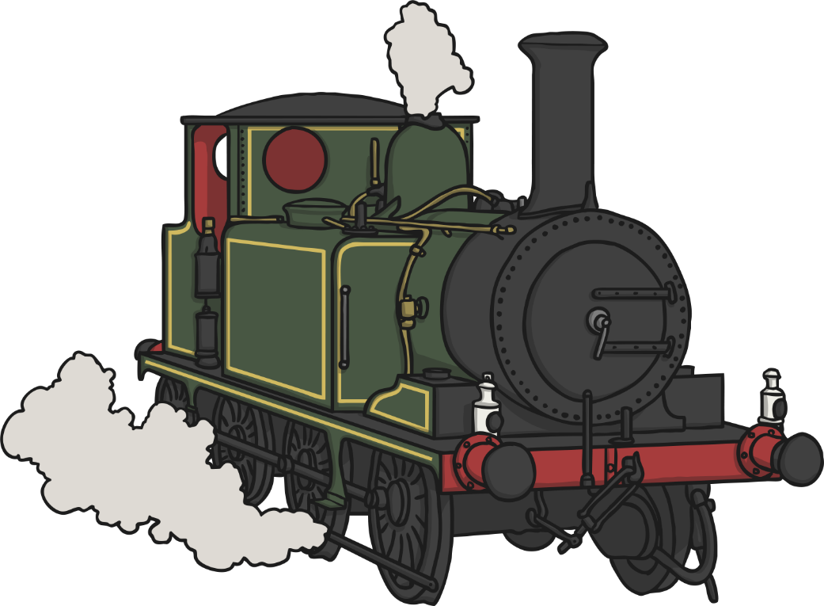
Holidays
Because lots of people were a lot wealthier in the Victorian era, some people could take time off work to celebrate for two days - Christmas day and Boxing day.
Boxing day is called boxing day because servants and working people in Victorian times collected boxes from the wealthy containing gifts of money.
People who lived far away from their families were able to return home for the holidays because they could go by train.

Slide 4
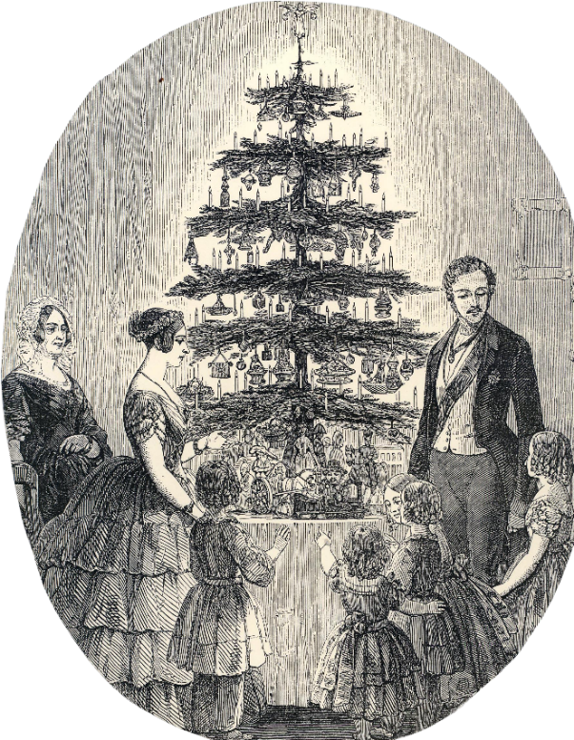
The Christmas Tree
Queen Victoria’s husband, Prince Albert introduced the Christmas tree to the UK. Their Christmas tree was illustrated in the newspaper, The London News in 1848 and because they were very popular, having a Christmas tree became very fashionable and everybody wanted one.
Decorations were homemade and included sewn snowflakes and pouches, paper baskets containing sugared almonds, bead decorations, tinsel, candles, fruit and an angel on top of the tree.
Later on glass ornaments, toys, glitter and lots of other decorations were introduced. Trees were very over decorated. It was seen as a sign of class.
Just like today, gifts were placed
underneath the tree.

Slide 5
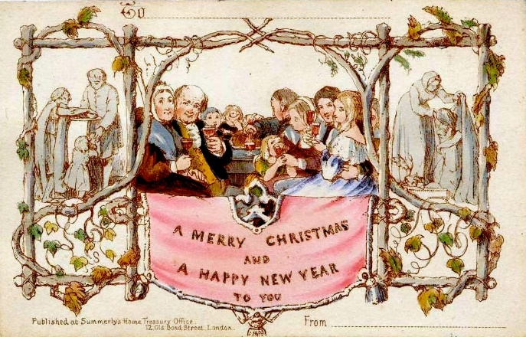
Christmas Cards
The first ever Christmas card was created in 1843 by a man named John Calcott Horsley for his friend Sir Henry Cole who had given him the idea.
Sir Henry Cole wanted a card he could send to friends and colleagues that wished them a ‘Merry Christmas’. The card had an illustration of a family enjoying Christmas and being charitable which he believed was an important part of the Christmas spirit.
1000 copies of the card were printed and sold for one shilling.

Slide 6

Christmas Parlour Games
There was no TV to watch on a Victorian Christmas day so they had to come up with fun games to entertain the family on Christmas day.
Click on a game to read the rules.
Choose one player to be the sculptor.
All other players stand in a still position.
The sculptor moves the other players into positions that are difficult to hold.
The other players must not laugh, break pose or move.
The sculptor can distract the players and try to make them laugh and
move but cannot touch them.
The first player to move or laugh becomes the sculptor.
One player thinks of an object.
The other players try to discover what it is by asking four questions:
How do you like it?
Why do you like it?
When do you like it?
Where do you like it?
Player 1 must answer the questions.
The person who guesses correctly wins and takes the place of player 1.
The Sculptor
All players sit in a circle
Each player takes it in turns to say ‘ha’, ‘ho’ or ‘hee’.
The first player to start laughing loses and is out of the game.
Continue until everyone is out of the game.
The person who doesn’t laugh for the longest wins.
The Laughing Game
How? What? Where? When?

Slide 7


The Christmas Cracker
Invented in 1848 by Tom Smith.
They were created as a way to sell sweets.
A simple package was filled with the sweets which snapped when pulled apart to reveal the sweets.
Later in the Victorian period the sweets were replaced with gifts and paper hats.
Christmas crackers are still popular at Christmas time today.

Slide 8
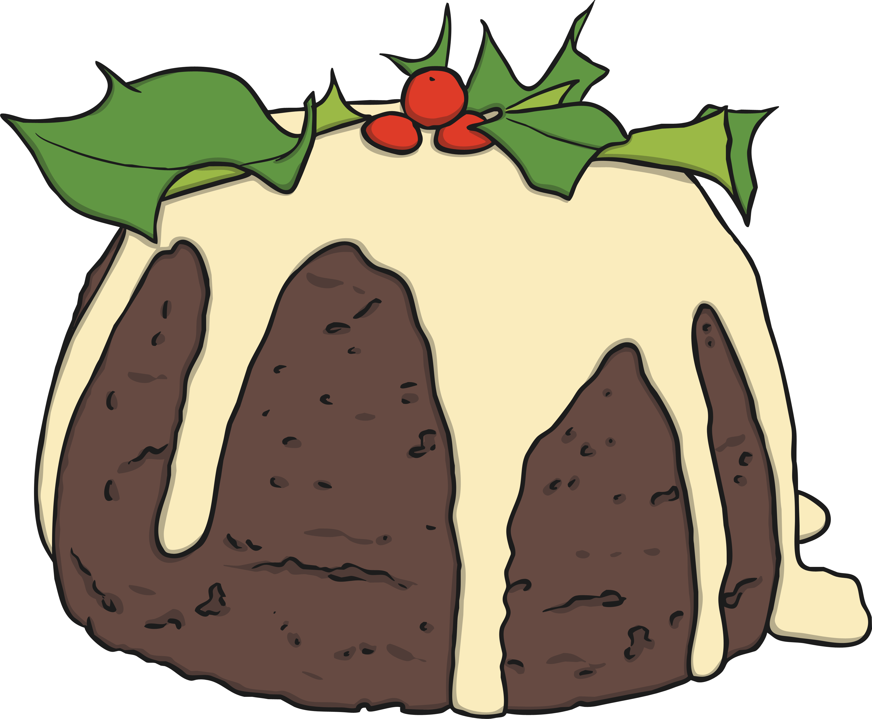
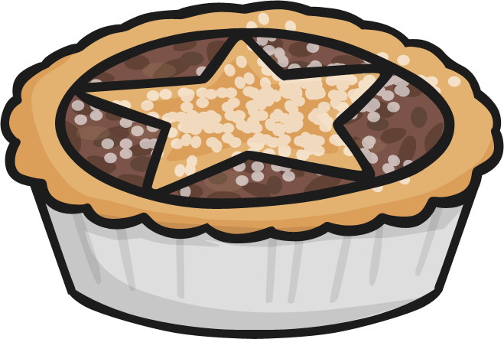
Christmas Dinner
The Christmas turkey was the perfect size for a middle class family although only wealthy families could afford turkey until the 20th century. Before that they usually ate rabbit.
Mince pies used to contain meat instead of fruit.
The Christmas pudding was
homemade and sometimes
sprinkled with brandy and set
on fire before serving.

Slide 9
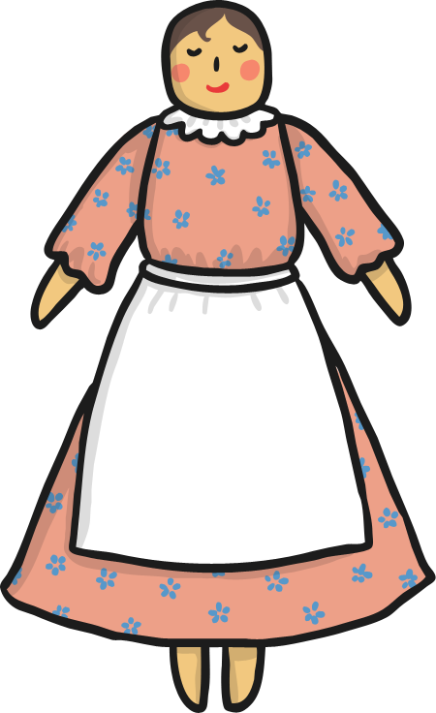




Christmas Gifts
In early Victorian times toys were handmade so only wealthy people could afford them. Later on, when lots of factories opened, games, dolls, books and clockwork toys were a lot more affordable to the middle class.
In a poor child’s Christmas stocking only an apple, an orange and a few nuts would be found and if they were really lucky, a small gift such as a book or a pair of gloves.

Slide 10
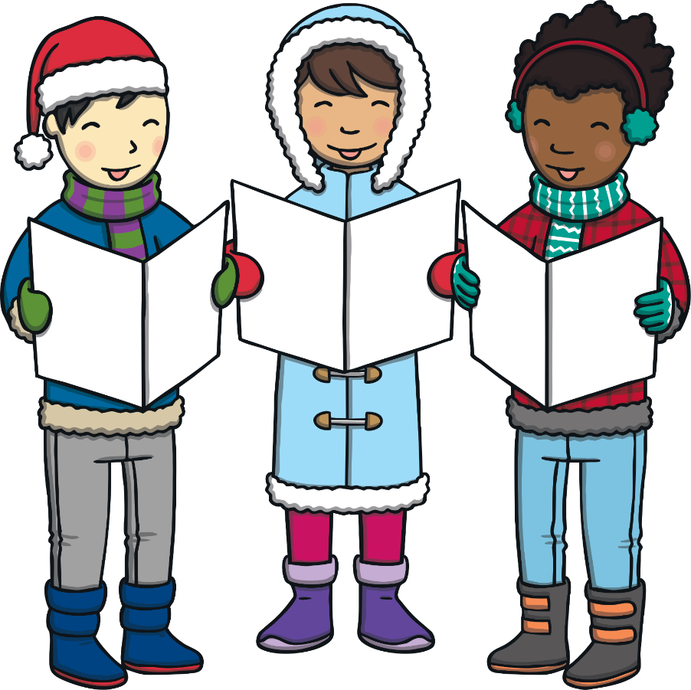
Christmas Carols
Carol singers and musicians sang a lot of carols that are still sung today:
O Come all ye Faithful
Once in Royal David’s City
O Little Town of Bethlehem
Away in a Manger

