Slide 2



Diving into Mastery Guidance for Educators
Each activity sheet is split into three sections, diving, deeper and deepest, which are represented by the following icons:
These carefully designed activities take your children through a learning journey, initially ensuring they are fluent with the key concept being taught; then applying this to a range of reasoning and problem-solving activities.
These sheets might not necessarily be used in a linear way. Some children might begin at the ‘Deeper’ section and in fact, others may ‘dive straight in’ to the ‘Deepest’ section if they have already mastered the skill and are applying this to show their depth of understanding.
Diving
Deeper
Deepest

Slide 3
Aim
Identify 3D shapes, including cubes and cuboids, from
2D representations.

Slide 4
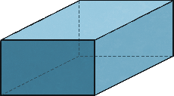
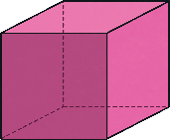
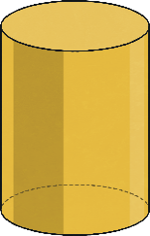
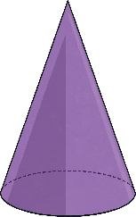
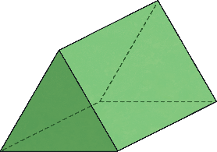
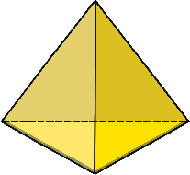
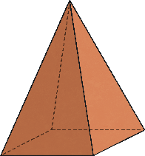
Reasoning about 3D Shapes (1)
Diving
Name a 3D shape that has at least one of these 2D shapes as a face:
A square
A circle
An equilateral triangle
Did you come up with any different suggestions to these?
A square
This could be a
cuboid, a cube or a
square-based pyramid.
A circle
An equilateral triangle
This could be a triangular prism or
a tetrahedron.
This could be a cylinder or a cone.

Slide 5
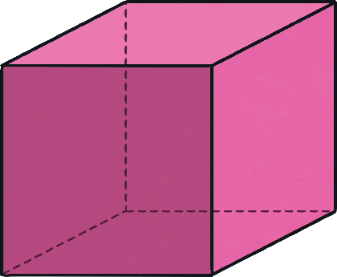
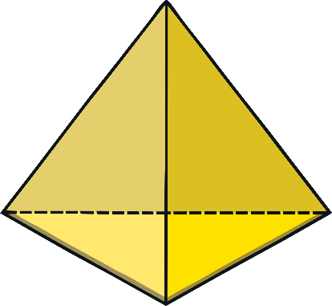
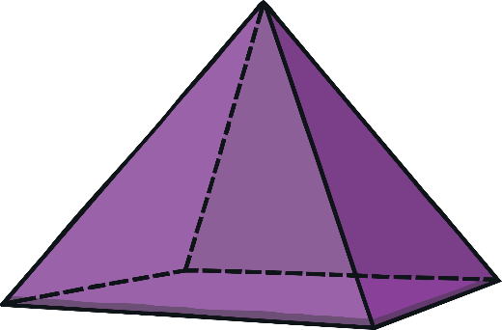
Reasoning about 3D Shapes (1)
Diving
What is the name of each 3D shape shown below?
square-based pyramid
cube
tetrahedron
Which could be the odd one out and why?
The cube could be the odd one out because it is not a pyramid; it does not have any triangular faces; it does not have an apex.
The tetrahedron could be the odd one out because it has the fewest number of faces; it does not have any square faces.
The square-based pyramid could be the odd one out because its faces are not all the same 2D shape; it has an odd number of vertices.

Slide 6

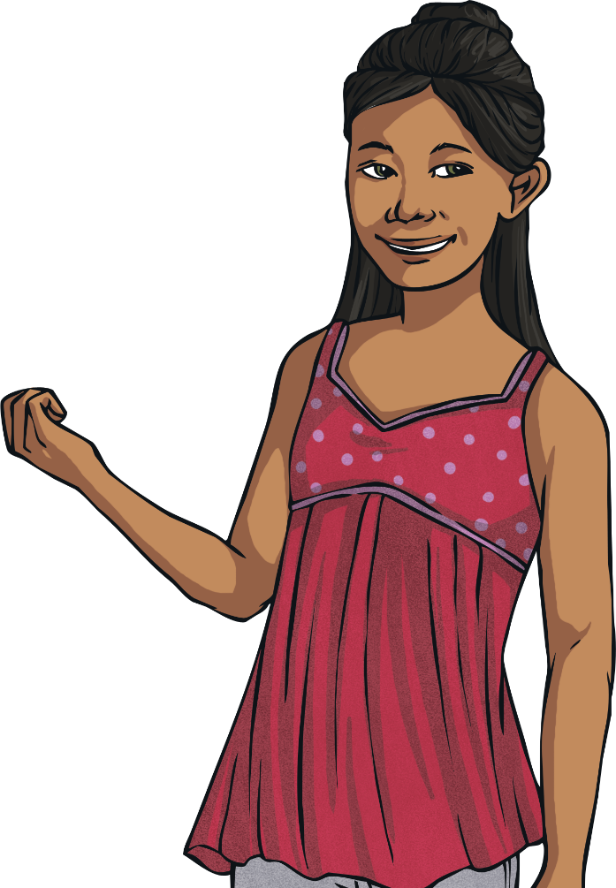
Reasoning about 3D Shapes (1)
Deeper
True or False?
A cube is the only 3D shape
to have square faces.
False
A cuboid can have two square faces at opposite
ends to each other.
Prisms can have square faces joining the
opposite ends.

Slide 7

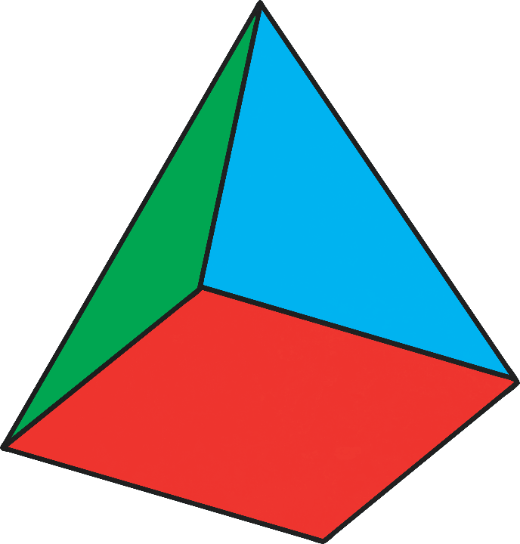
Reasoning about 3D Shapes (1)
Deepest
If you were to colour the net for this square-based pyramid, what would it look like? Is there more than one possibility?

Slide 8


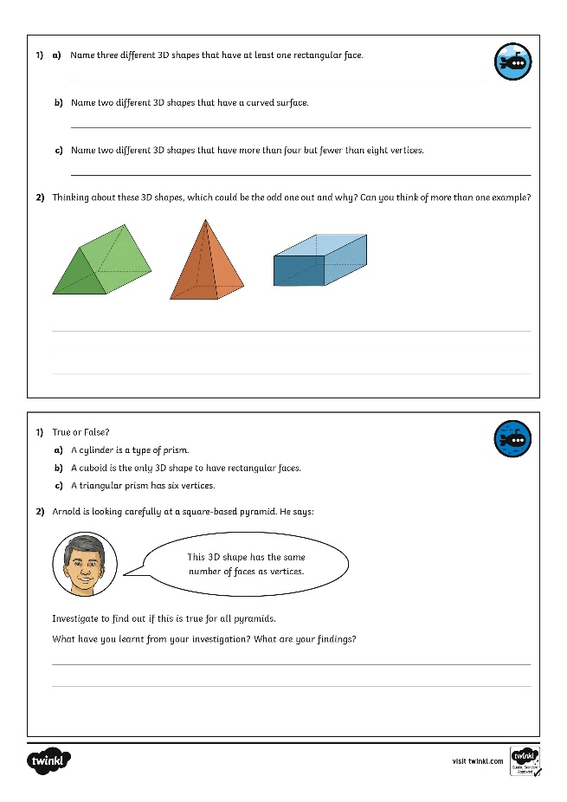
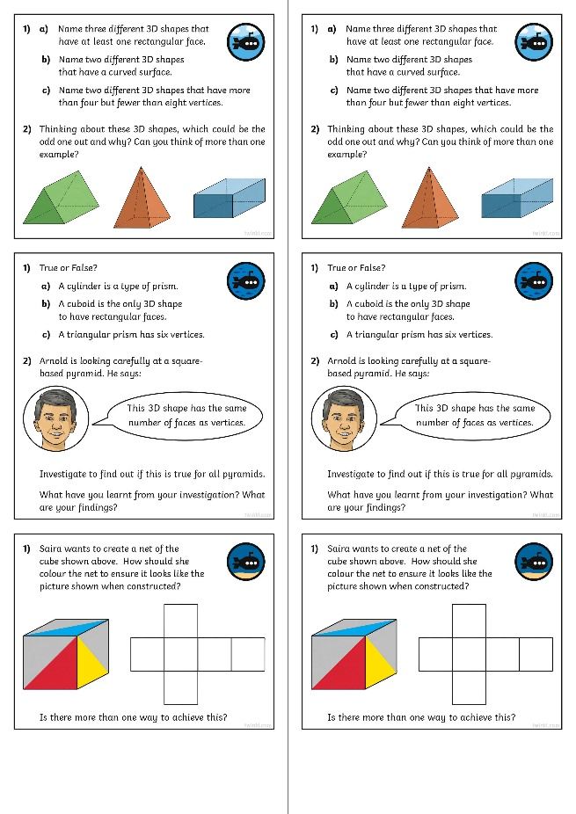
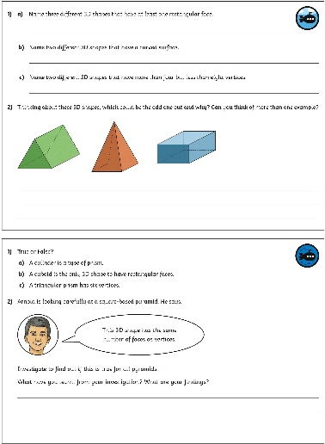
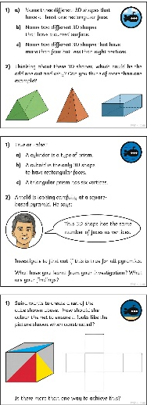
Reasoning about 3D Shapes (1)
Dive in by completing your own activity!

Slide 9
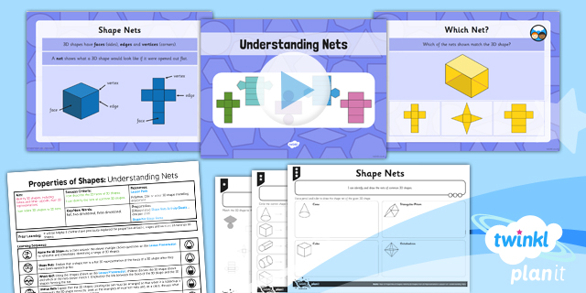
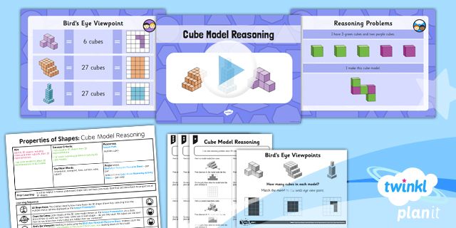
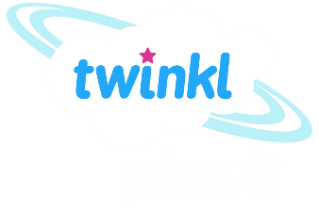
Need Planning to Complement this Resource?
National Curriculum Aim
Identify 3D shapes, including cubes and cuboids,
from 2D representations.
For more planning resources to support this aim, click here.
Twinkl PlanIt is our award-winning scheme of work
with over 4000 resources.

