Slide 1
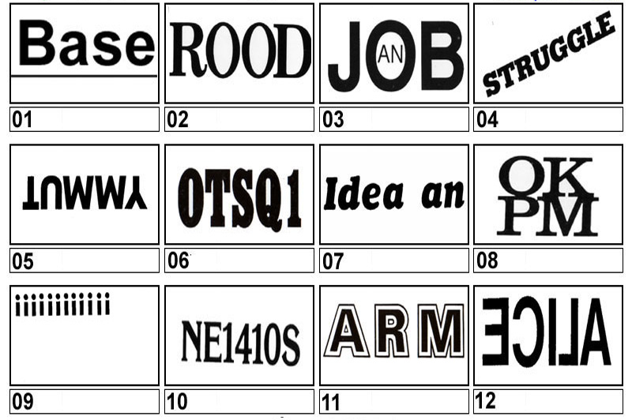
Starter – 5 mins
Say what you see…
How Many Can you get?
Notes:
01 – Baseline, 02 – Back Door, 03 – An inside Job, 04- Uphill Struggle, 05 – Upset Tummy, 06 – Back to Square 1, 07 – An after thought, 08 – Alright on the night, 09 – A High IQ, 10– Any one for tennis, 11- Arm in Arm, 12 – Alice through the looking glass.

Slide 2
Class 1
Monday, 11 June 2018
Topic: Problem Solving
Lesson Title:
Code Breaking
What are you going to learn today:
Learning Intentions for the class
Keywords:
Encode
Decode
Cipher
Key

Slide 3
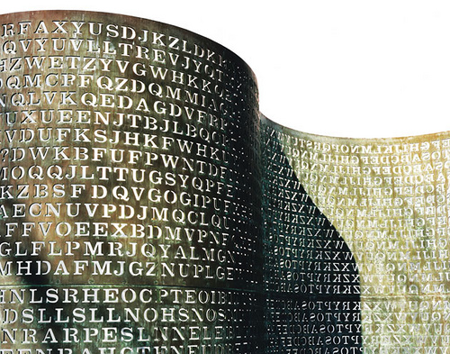

Codes appear for many reasons.
They are usually used to hide information.
One of the biggest places for codes is on the internet.
Everything you send on the internet is encoded so that hackers do not have access to everyone's private information.

Slide 4

Ancient Runes
The Vikings communicated in writing by making simple scratching on wood or stones called runes.
Sometimes they were written in a secret or coded way.
Here is ‘WAS’ written in coded runes:

Slide 5
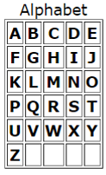
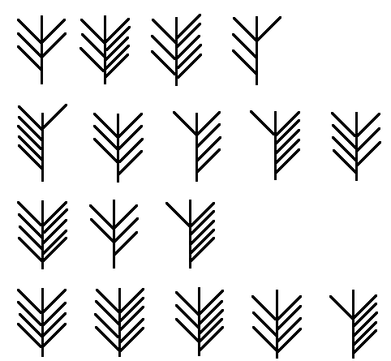
Ancient Runes
This is the Key..
Does this help?
Can you figure out what this says?
L
O
O
K
U
N
D
E
R
T
H
E
S
T
O
N
E
Notes:
This should take about 5 minutes in total. Show the first picture and asked the students to try and figure out what it says. Give them about 30 seconds. Then provide them with the key, explain this is what is needed to decode the message. Give the students about 1 minute to work on it. Next reveal the first two letters and give them some time to try and figure out how the symbol used the key to get the letter. Once someone has identified the correct method, give the students another minute to decode the rest of the message.
*** The strokes on the left indicate how many rows down, the strokes on the right indicate how many columns to the right***

Slide 6
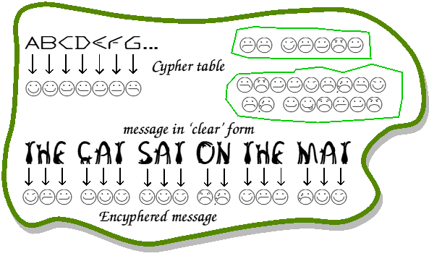
The ancient coded runes are an example of a substitution code
These are where letters are changed to make things harder to read.
During one of Sherlock Holmes’s adventures, he comes across
“The Dancing Men Cipher”

Slide 7
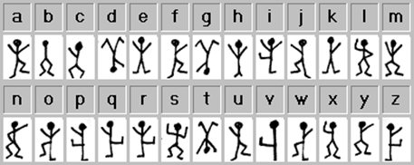
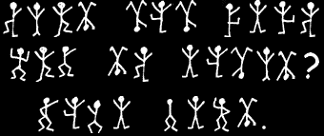
In groups of 2/3 (10 Mins)
On the sheet you have been given, can you use the cipher key to decode the message:
Cipher key
Try to work out the following message…
Message

Slide 8
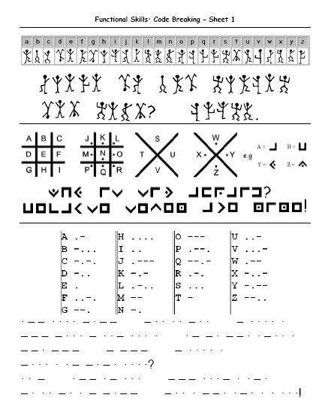
In groups (10 Mins)
Once you have decoded “The Dancing Men Cipher” let me check your solution, and then move on to the next two codes.
Above each encoded message the cipher key is also included.

Slide 9

Another way to make a cipher code is to mix up the letters instead of using symbols.
For example suppose I change the letters around so…
E becomes H
H becomes K
L becomes O
O becomes S
…then the word HELLO becomes…
KHOOS

Slide 10
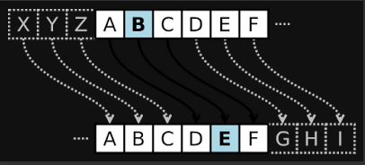
Caesar Cipher
A Caesar cipher is one of the simplest (and easiest cracked) encryption methods.
It is a Substitution Cipher that involves replacing each letter of the secret message with a different letter of the alphabet which is a fixed number of positions further in the alphabet.

Slide 11
Keyword Cipher
The Keyword cipher is identical to the Caesar Cipher with the exception that the substitution alphabet used can be represented with a keyword.
To create a substitution alphabet from a keyword, you first write down the alphabet. Below this you write down the keyword (omitting duplicate letters) followed by the remaining unused letters of the alphabet.
ABCDEFGHIJKLMNOPQRSTUVWXYZ KEYWORDABCFGHIJLMNPQSTUVXZ
To encipher a plaintext message, you convert all letters from the top row to their corresponding letter on the bottom row (A to K, B to E, etc)

Slide 12
Atbash Cipher
The Atbash cipher is a very specific case of a substitution cipher where the letters of the alphabet are reversed. In other words, all As are replaced with Zs, all Bs are replaced with Ys, and so on.
Because reversing the alphabet twice will get you actual alphabet, you can encipher and decipher a message using the exact same algorithm.

Slide 13
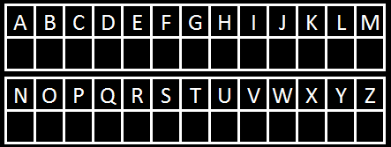
Suppose I change the letters around so…
E becomes L
H becomes X
L becomes P
O becomes E
…then the word HELLO becomes…
XLPPE

Slide 14

The reason why this is a good way to make a code is that there are lots of ways of mixing up the alphabet.
How many ways do you think we could mix up all the letters?
Over 400, 000, 000, 000, 000, 000, 000, 000, 000!
To say that number out loud it is:
Four Hundred Septillion
Interesting fact: If you read that number in Britain before 1974 the correct way to say it would have been four hundred quadrillion. In European countries you would still use the old way, but since 1974 most English speaking countries now use what is called the short system (which was previously referred to as the American System).

Slide 15

However!
Mathematicians can crack the code using something called frequency analysis.

Slide 16
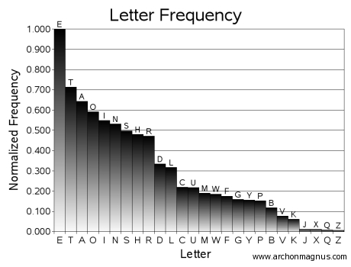
What does this graph show us?
How could we use this to work out what a coded message says?

Slide 17
By Counting the number of times each coded letter appears in the passage you can identify what the coded letter stands for using the above graph.
We are going to see if we can work out a coded sheet as a class.
For example, the letter which appears the most would stand for “e”, the next most frequent letter would stand for “t” and so on.

Slide 18
Extension Task:
On the back of the worksheet there is a coded passage.
Using letter frequency analysis can you decode it?

Slide 19
Time to Reflect
Fill Into Your Folder
Give on example of a code that you learned today and explain how it works:
Have you anything else to add?

Slide 20

Don’t forget….
WORK DUE
Manga High Exercises
Due ???

