Slide 2



Diving into Mastery Guidance for Educators
Each activity sheet is split into three sections, diving, deeper and deepest, which are represented by the following icons:
These carefully designed activities take your children through a learning journey, initially ensuring they are fluent with the key concept being taught; then applying this to a range of reasoning and problem-solving activities.
These sheets might not necessarily be used in a linear way. Some children might begin at the ‘Deeper’ section and in fact, others may ‘dive straight in’ to the ‘Deepest’ section if they have already mastered the skill and are applying this to show their depth of understanding.
Diving
Deeper
Deepest

Slide 3
Aim
Draw and translate simple shapes on the coordinate plane, and reflect them in the axes.

Slide 4
Reflections
Diving
y-axis
5
Shape A is reflected in the y-axis.
Give the coordinates of the reflected shape.
The original shape
is now reflected in
the x-axis.
Give the coordinates of the reflected shape.
4
A
3
A’
2
(2,2) (3,3) (3,4) (5,4) (5,2)
1
0
x-axis
-5
-4
-3
-2
-1
1
2
3
4
5
-1
-2
A’
-3
(-5,-2) (-2,-2) (-3,-3) (-3,-4) (-5,-4)
-4
-5

Slide 5

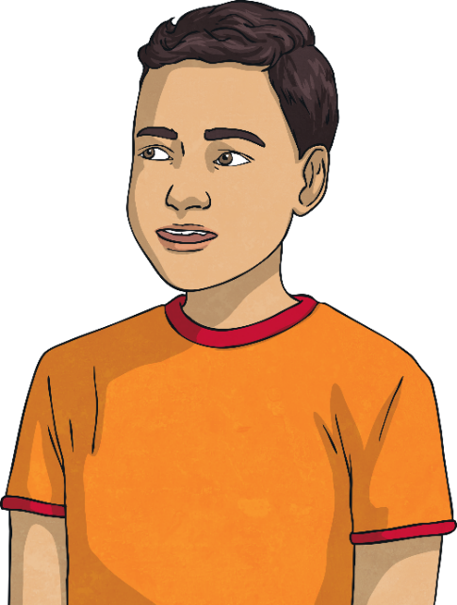
Reflections
Deeper
y-axis
5
Dylan reflects his shape in the y-axis and draws vertex A in its new position. He then reflects the new shape in the x-axis and draws vertex A in its final position.
Is Dylan correct? Explain your answer.
Dylan is incorrect. He has given the coordinate for the wrong vertex. Vertex A is now at (-3,4) after the reflection in the x-axis.
A”
4
3
2
1
0
x-axis
-5
-4
-3
-2
-1
1
2
3
4
5
-1
-2
After both reflections vertex A has now moved to (-3,2)
-3
A’
-4
A
-5

Slide 6


Reflections
Deepest
y-axis
5
A
Ellie has drawn shape A onto this coordinate grid. She has labelled one of the vertices as A.
She reflects this shape in the x-axis. Give the coordinates of vertex A after the reflection.
4
3
2
1
0
x-axis
(3,-5)
-5
-4
-3
-2
-1
1
2
3
4
5
-1
-2
-3
-4
-5
A’

Slide 7
Reflections
Deepest
Ellie now reflects her original shape in the y-axis. Give the coordinates of point A, after the reflection?
What do you notice about the coordinates of vertex A after each reflection?
y-axis
A”
5
A
4
(-3,5)
3
2
1
0
When you reflect the shape in the x-axis, the coordinates of vertex A still have the same digits, but the positive and negative signs of the y coordinate are reversed. When you reflect the shape in the y-axis, the coordinates of vertex A still have the same digits, but the positive and negative signs of the x coordinate are reversed.
3
x-axis
-5
-4
-3
-2
-1
1
2
4
5
-1
-2
-3
-4
-5
A’

Slide 8


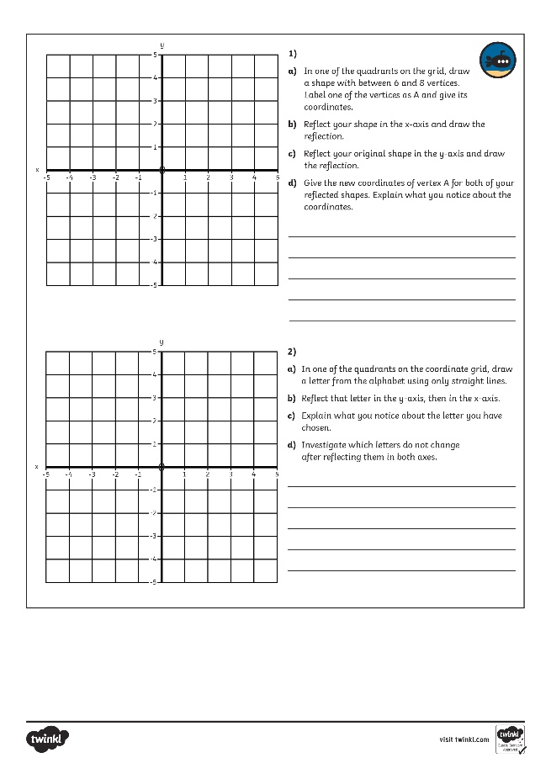
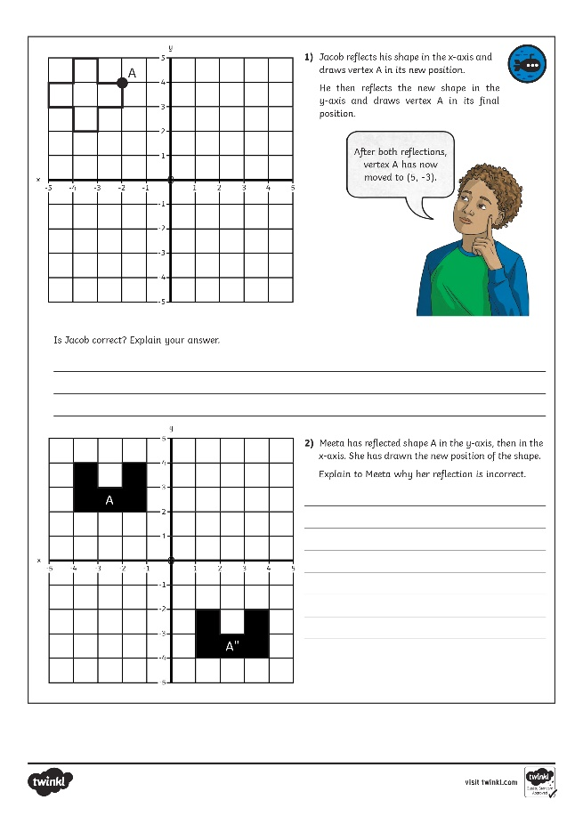
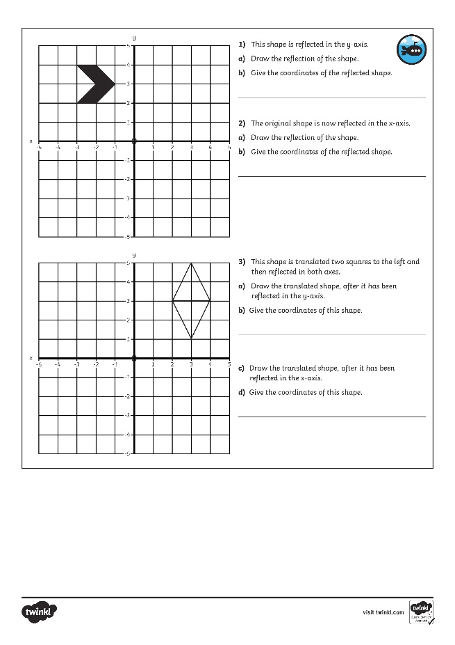
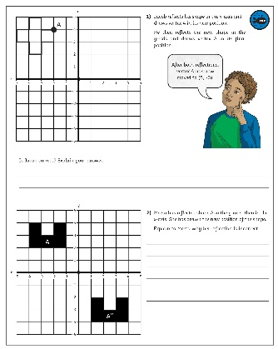
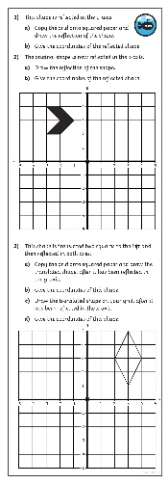
Reflections
Dive in by completing your own activity!

Slide 9
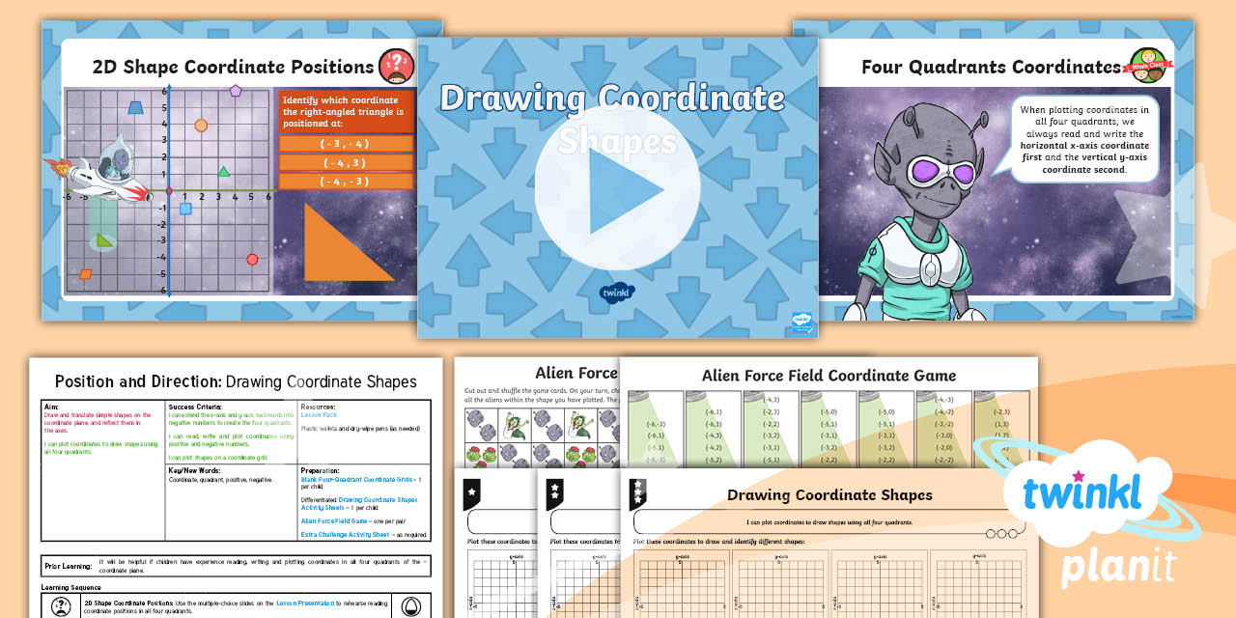
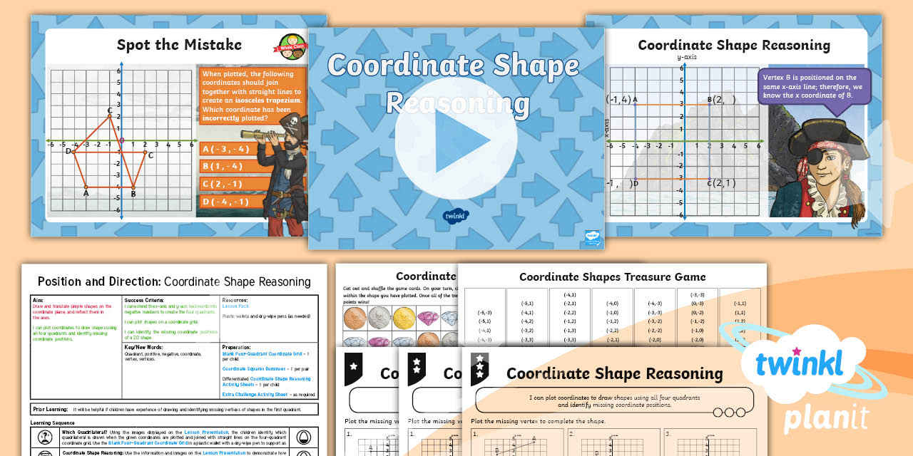

Need Planning to Complement this Resource?
National Curriculum Aim
Draw and translate simple shapes on the coordinate plane,
and reflect them in the axes.
For more planning resources to support this aim, click here.
Twinkl PlanIt is our award-winning scheme of work
with over 4000 resources.

