Slide 2



Diving into Mastery Guidance for Educators
Each activity sheet is split into three sections, diving, deeper and deepest, which are represented by the following icons:
These carefully designed activities take your children through a learning journey, initially ensuring they are fluent with the key concept being taught; then applying this to a range of reasoning and problem-solving activities.
These sheets might not necessarily be used in a linear way. Some children might begin at the ‘Deeper’ section and in fact, others may ‘dive straight in’ to the ‘Deepest’ section if they have already mastered the skill and are applying this to show their depth of understanding.
Diving
Deeper
Deepest

Slide 3
National Curriculum Objective
Identify, describe and represent the position of a shape following a reflection or translation, using the appropriate language, and know that the shape has not changed.

Slide 4

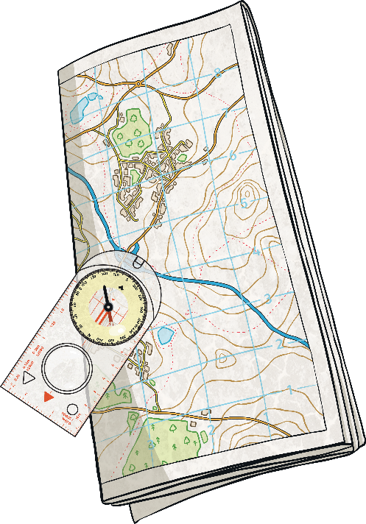
Position in The First Quadrant
Diving
Working with your learning partner, write an explanation of how to plot the coordinates (2,4).
To plot coordinates, you need to know that the first digit is an x coordinate and then second digit is a y coordinate. You need to follow the x axis along to 2 and then read up the y axis to 4, plotting a point where these would meet.
5
4
3
2
1
0
1
2
3
4
5

Slide 5

Position in The First Quadrant
Diving
Jenni has plotted two vertices of a rectangle. What are coordinates of vertices A and B?
Now plot the final two vertices to complete the rectangle.
5
B
4
3
2
A
1
Vertex A (1,2)
Vertex B (4,4)
0
1
2
3
4
5

Slide 6


Position in The First Quadrant
Deeper
Jemimah and Paul are plotting the vertices of a square.
Jemimah says the final vertex should be plotted at (6,1).
Paul says it should be plotted at (1,6).
Who do you agree with and why?
What mistake has been made?
8
7
6
5
Paul is correct.
4
3
Jemimah has read the y coordinate first. She should read the x coordinate and then the y coordinate.
2
1
0
1
2
3
4
5
6
7
8

Slide 7

Position in The First Quadrant
Deeper
What could the coordinates of the other two vertices be?
Here are two vertices of a rectangle.
What coordinates could they not be?
8
7
6
5
4
3
2
1
0
1
2
3
4
5
6
7
8
There are a few possible answers. The other two vertices could be at (6,4) and (6,6).
There are many possible answers, for example (3,2) and (3,8) as this makes a trapezium and not a rectangle.

Slide 8


Position in The First Quadrant
Deepest
Celia has drawn a square in the first quadrant but has hidden the grid.
She reveals the coordinates of two vertices. What are the coordinates of vertices A and B?
A
(7,6)
Vertex A (5,6)
Vertex B (7,4)
(5,4)
B

Slide 9


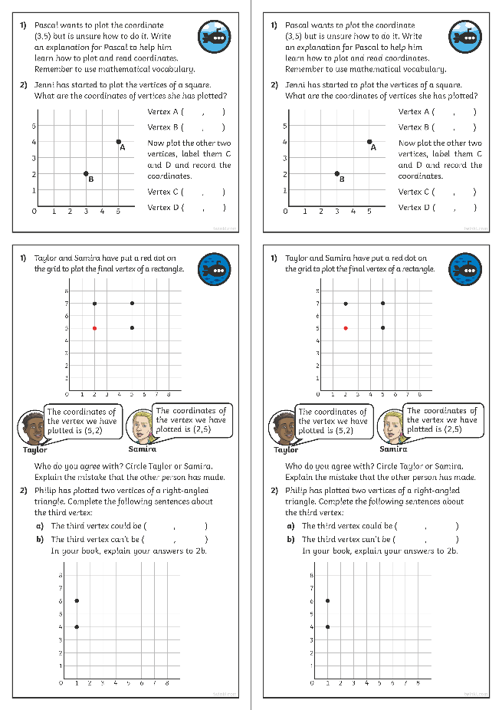
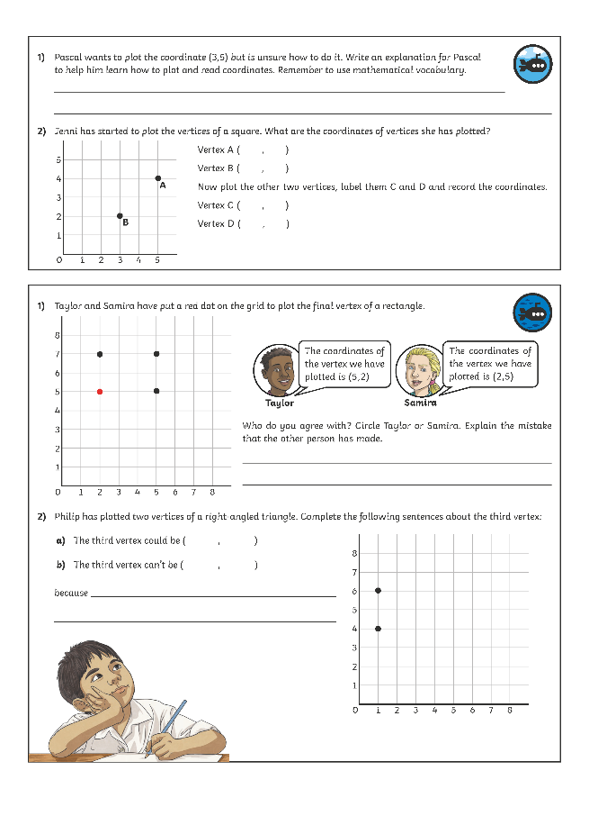

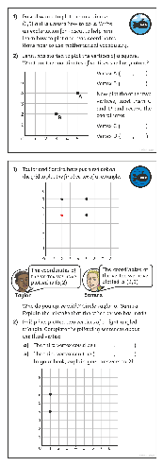
Position in The First Quadrant
Dive in by completing your own activity!

Slide 10
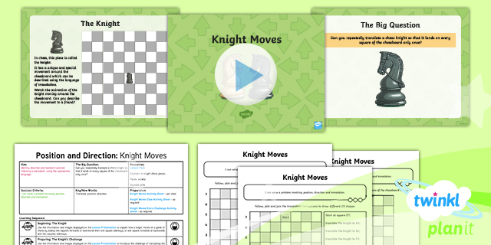
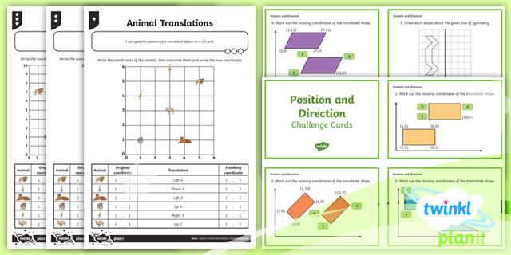

Need Planning to Complement this Resource?
National Curriculum Aim
Identify, describe and represent the position of a shape following a reflection or translation, using the appropriate language, and know that the shape has not changed.
For more planning resources to support this aim, click here.
Twinkl PlanIt is our award-winning scheme of work
with over 4000 resources.

