Slide 1


Slide 3
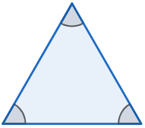
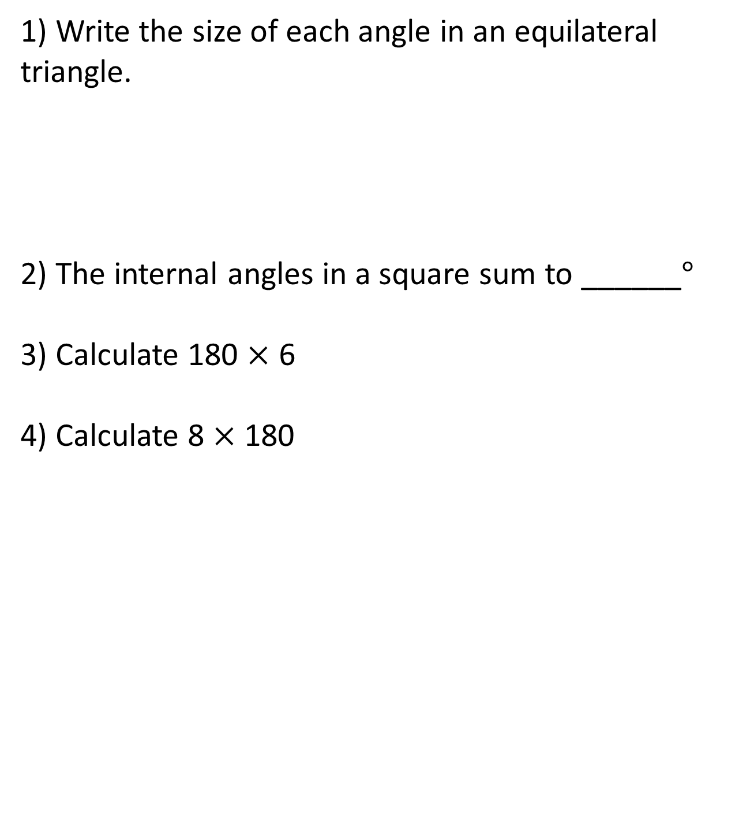
1) Write the size of each angle in an equilateral triangle.
2) The internal angles in a square sum to ______$°$
3) Calculate 180 $×$ 6
4) Calculate 8 $×$ 180

Slide 4
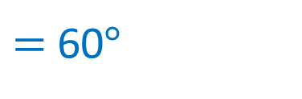

1) Write the size of each angle in an equilateral triangle.
2) The internal angles in a square sum to ______$°$
3) Calculate 180 $×$ 6
4) Calculate 8 $×$ 180
180$°$ $÷$ 3
$=$ 60$°$
360
1,080
1,440

Slide 6

Let’s review
The internal angles in a triangle sum to 180$°$
The internal angles in a quadrilateral sum to 360 $°$

Slide 7
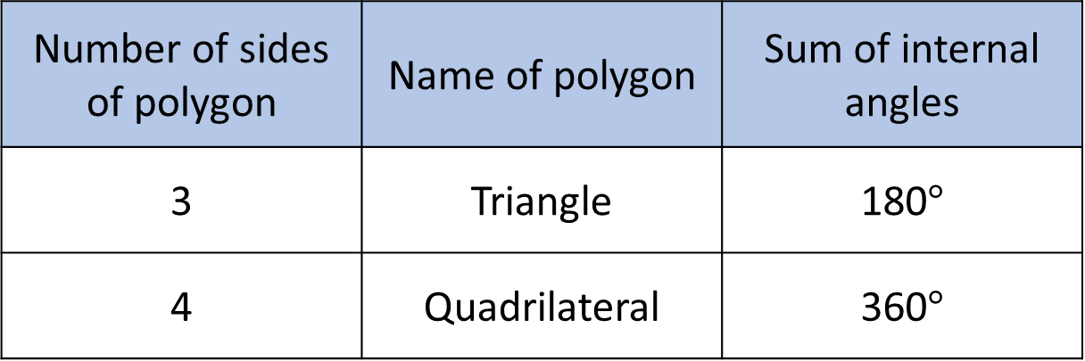
Number of sides of polygon | Name of polygon | Sum of internal angles
3 | Triangle | 180$°$
4 | Quadrilateral | 360$°$
5 | Pentagon
5

Slide 8

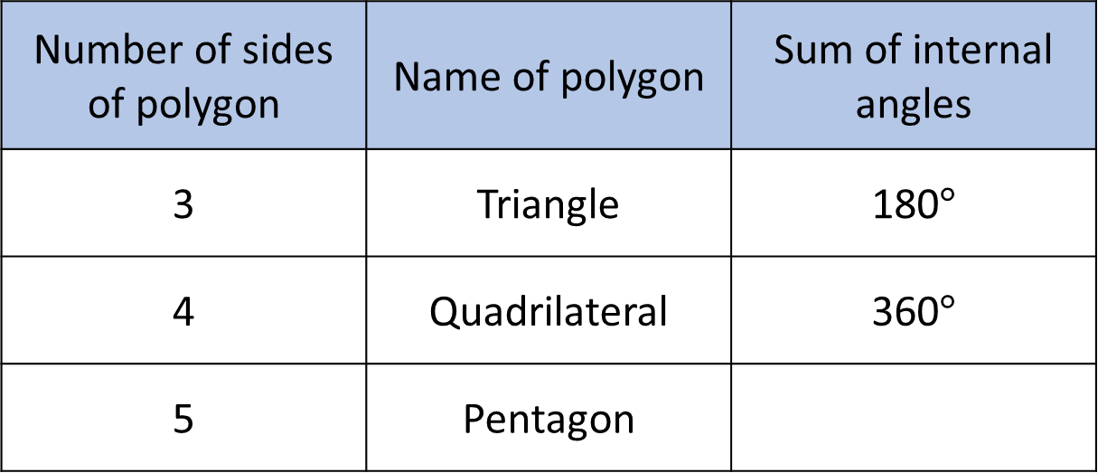
Have a think
Number of sides of polygon | Name of polygon | Sum of internal angles
3 | Triangle | 180$°$
4 | Quadrilateral | 360$°$
5 | Pentagon
What do you predict will be the sum of the internal angles of a pentagon? Why?

Slide 9
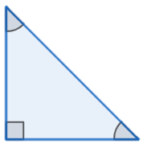
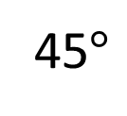

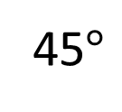
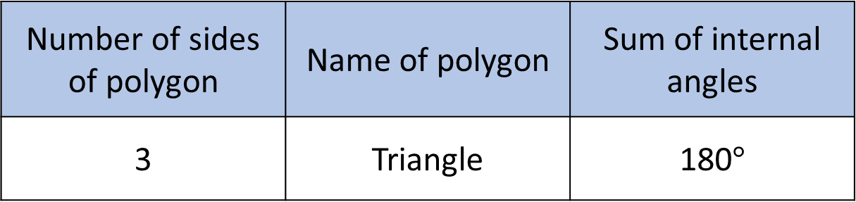
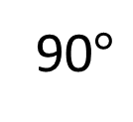
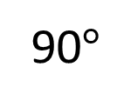
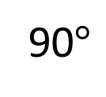
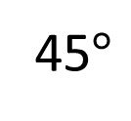
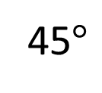
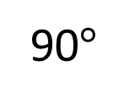
Number of sides of polygon | Name of polygon | Sum of internal angles
3 | Triangle | 180$°$
4 | Quadrilateral | 360$°$
45$°$
90$°$
90$°$
45$°$
45$°$
90$°$
90$°$
45$°$

Slide 10


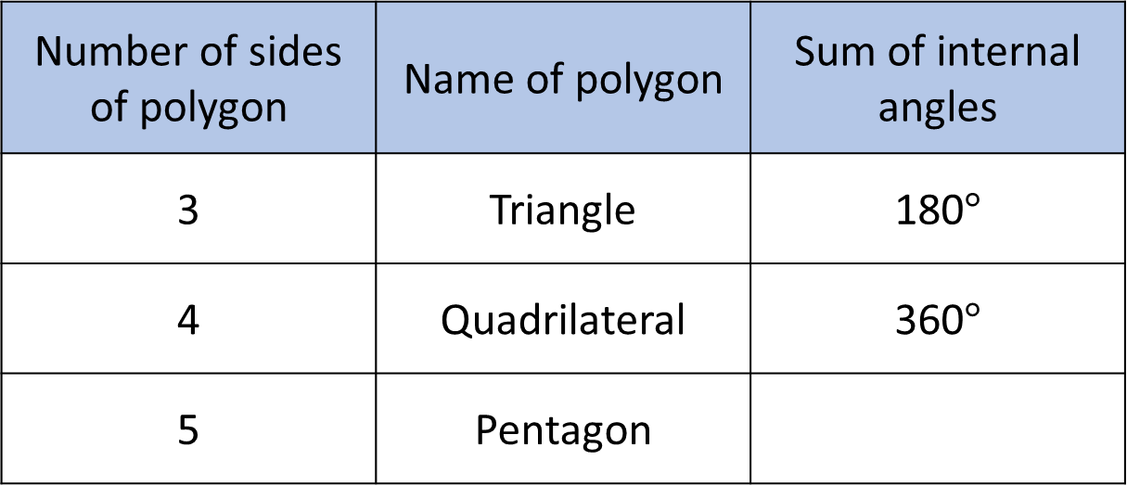
Number of sides of polygon | Name of polygon | Sum of internal angles
3 | Triangle | 180$°$
4 | Quadrilateral | 360$°$
5 | Pentagon
 |  | 540$°$
3 triangles
180$°×$ 3 $=$ 540$°$

Slide 11


Have a think
I can split the pentagon into 5 triangles, so it must be 180$°×$ 5
Whitney
Do you agree with Whitney?

Slide 12
These angles are extra

Slide 13
Have a think
How can we split the hexagon into triangles without overlapping any lines?

Slide 14
Overlap
A hexagon can be divided into 4 triangles

Slide 15
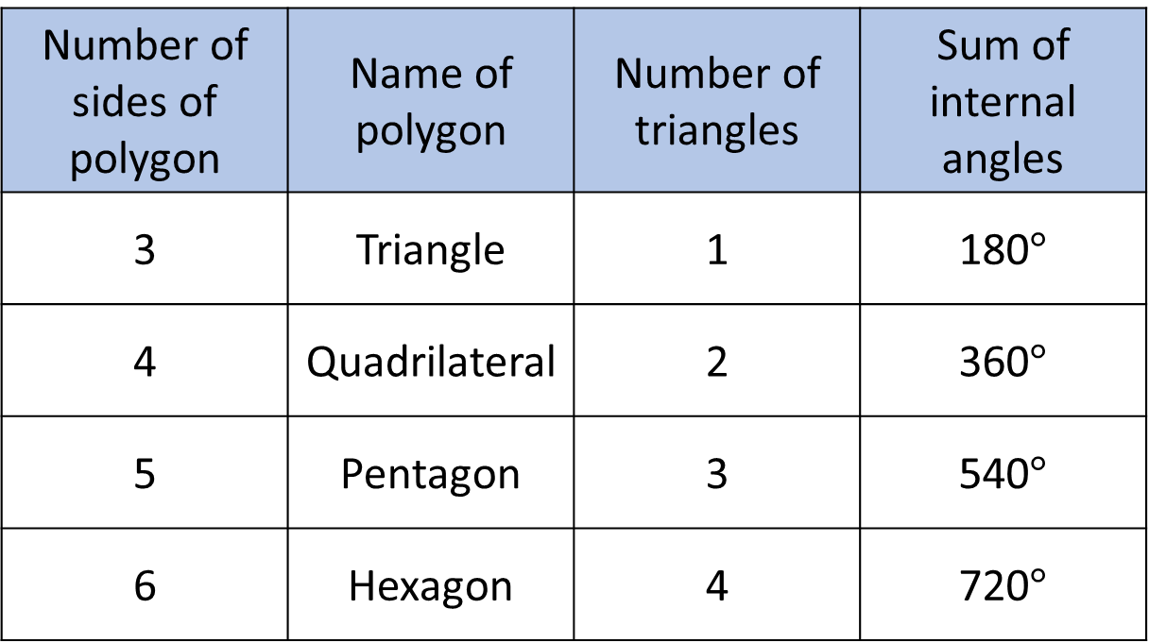
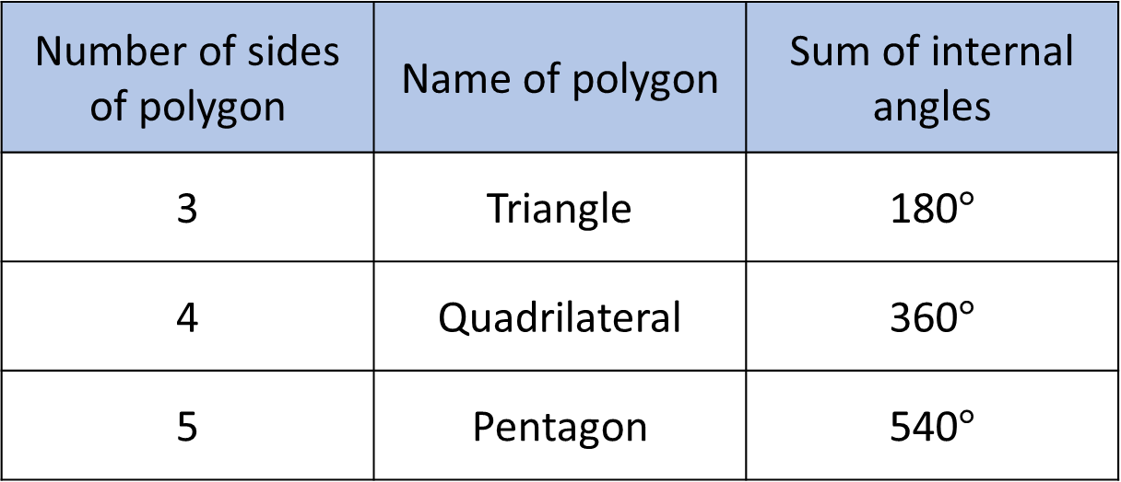
Number of sides of polygon | Name of polygon | Sum of internal angles
3 | Triangle | 180$°$
4 | Quadrilateral | 360$°$
5 | Pentagon | 540$°$
Number of sides of polygon | Name of polygon | Number of triangles | Sum of internal angles
3 | Triangle | 1 | 180$°$
4 | Quadrilateral | 2 | 360$°$
5 | Pentagon | 3 | 540$°$
6 | Hexagon | 4 | 720$°$

Slide 16

Have a think
Dodecagon
I think it is going to be tricky splitting this into triangles

Slide 17
Have a go at questions
1 - 4 on the worksheet

Slide 18
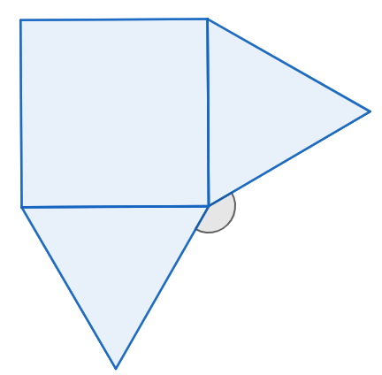


Have a think
$$x$$
The shape is made of regular polygons. Calculate the size of angle $x$

Slide 19
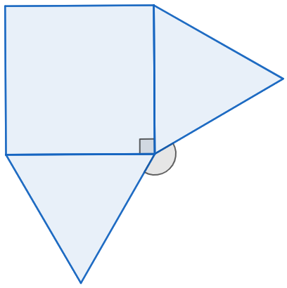
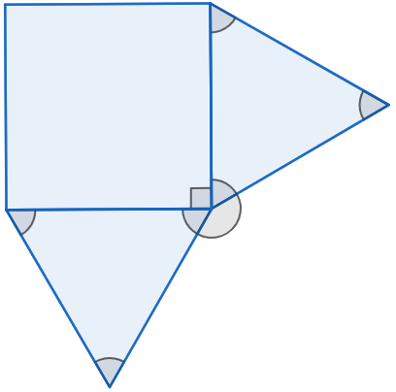



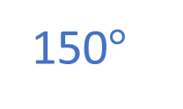

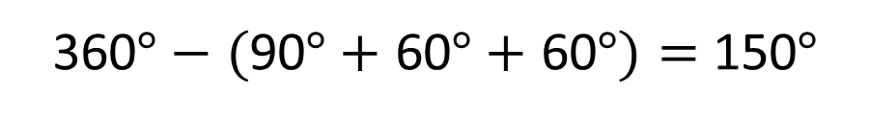
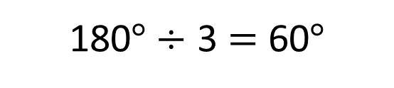
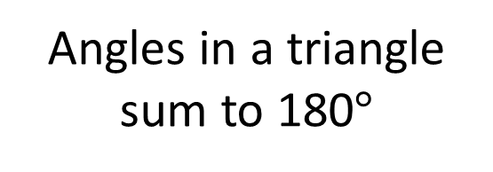

90$°$
60$°$
60$°$
$$x$$
150$°$
Angles in a triangle sum to 180$°$
Angles around a point sum to 360$°$
180$°÷$ 3 $=$ 60$°$
360$°−$ $($90$°+$ 60$°+$ 60$°)=$ 150$°$

Slide 20
Have a go at the rest of the questions on the worksheet

