Slide 1
Regular and Irregular Polygons

Slide 2




What is a polygon?
A shape with 3 or more sides | All sides must be straight
No gaps in the shape | No sides can intersect
3
4
5
Etc…

Slide 3
What is the difference between a regular polygon and an irregular polygon?

Slide 4
A regular polygon has all sides equal length and all angles equal in size
An irregular polygon has some sides that are different lengths and/or angles which are different sizes

Slide 5
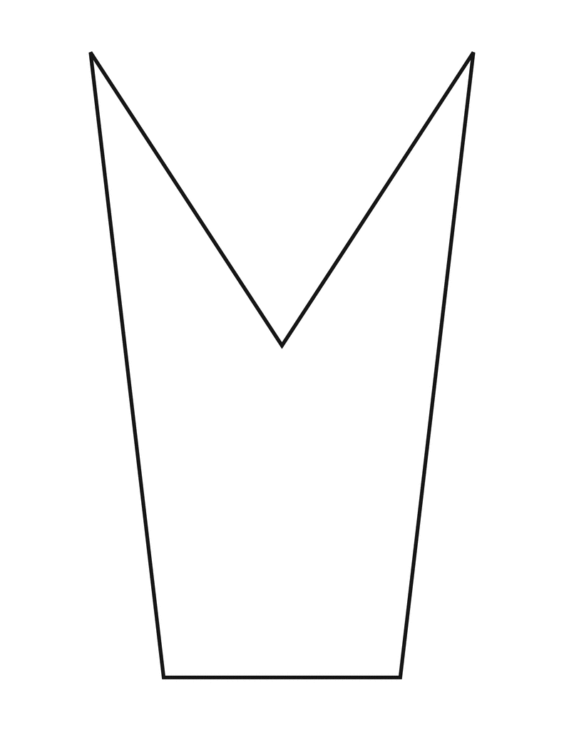
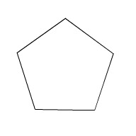
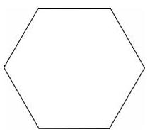
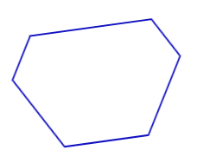

Slide 6
Is your shape a polygon?
3 or more sides
All sides equal length
No gaps
No intersecting sides
No
Not a Polygon
Yes
Are all of its sides equal in length and angles equal in size?
No
Irregular Polygon
Yes
Regular Polygon

