Slide 2
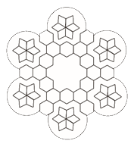
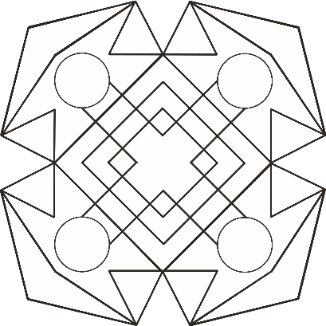
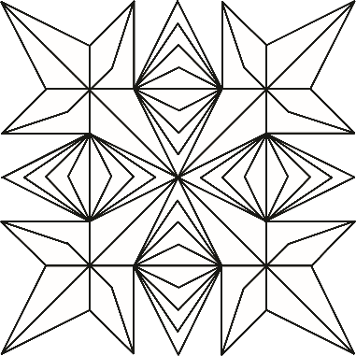
What Are Rangoli Patterns?
Do you know what these patterns are?
Do you know what these
patterns are used for?

Slide 3
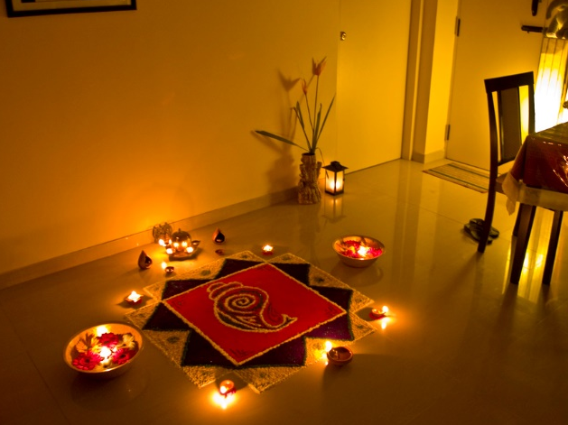
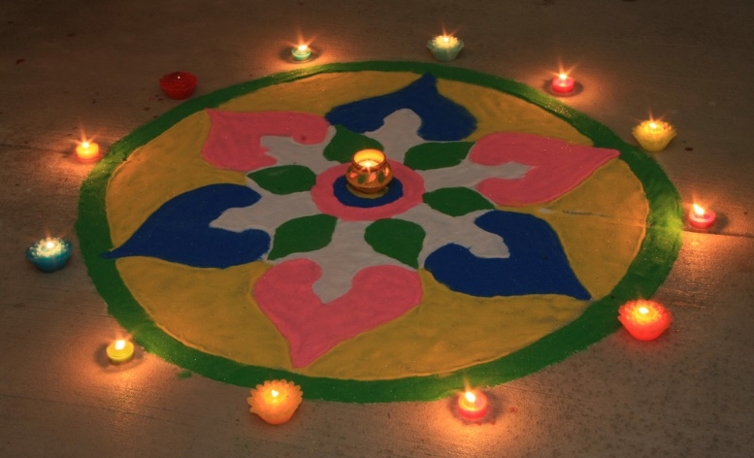
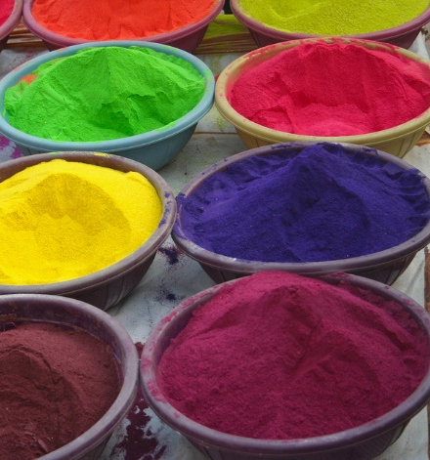
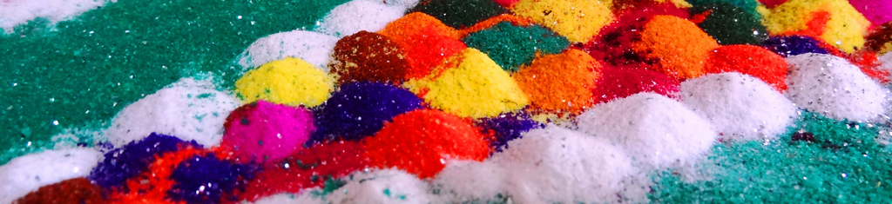
Where Might You See Rangoli Patterns?
Rangoli patterns are bright patterns on the floor by the door
to welcome visitors into homes during Diwali.

Slide 4
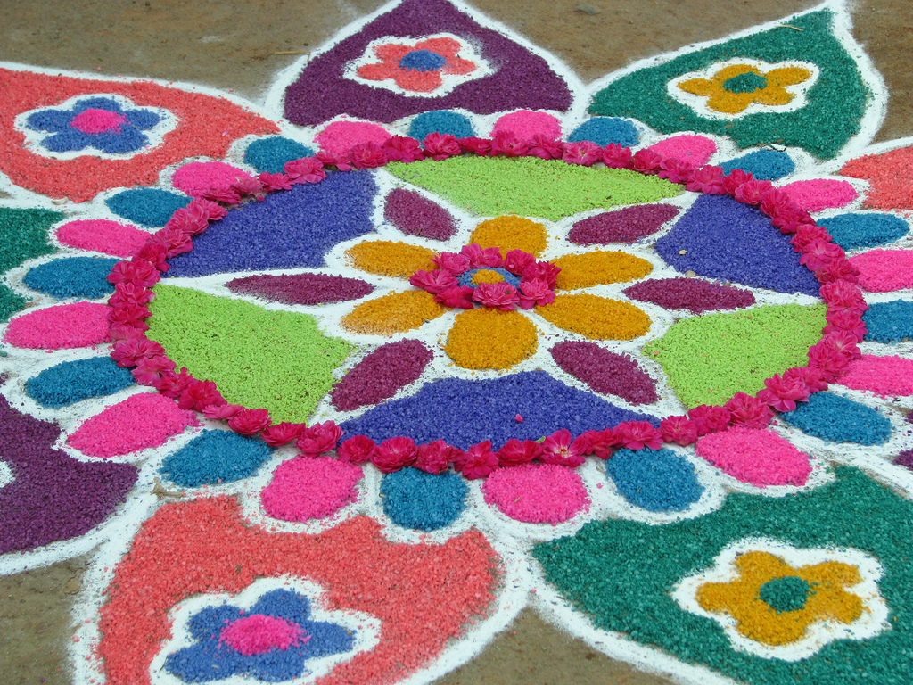
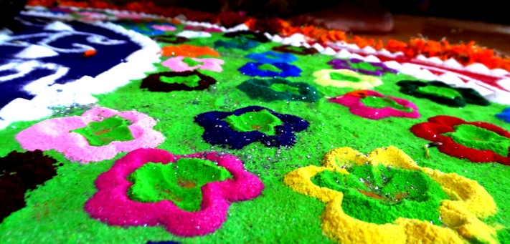
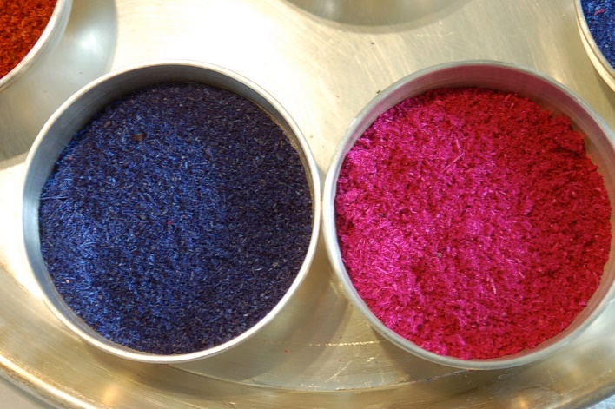
Traditional Rangoli Patterns
During the festival of Diwali, bright patterns are drawn on the floor to encourage the goddess Lakshmi to enter homes.
Traditionally, they are made using rice, grains, flour, sand, or chalk.

Slide 5
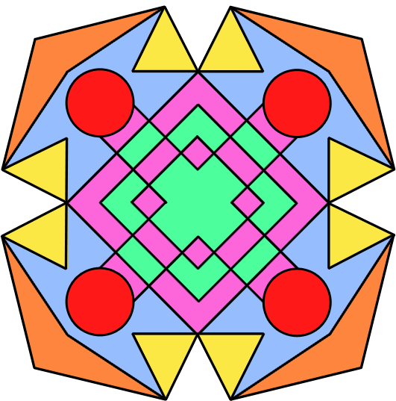
Which Shapes Are Used?
They are often square, rectangular, or circular.
Which shapes can you see in this pattern?

Slide 6
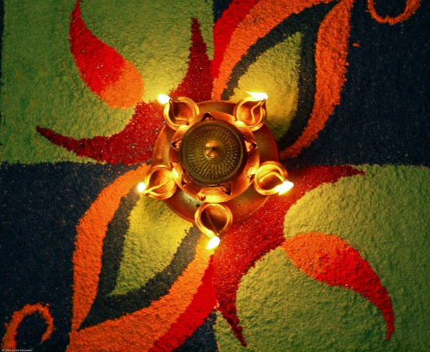
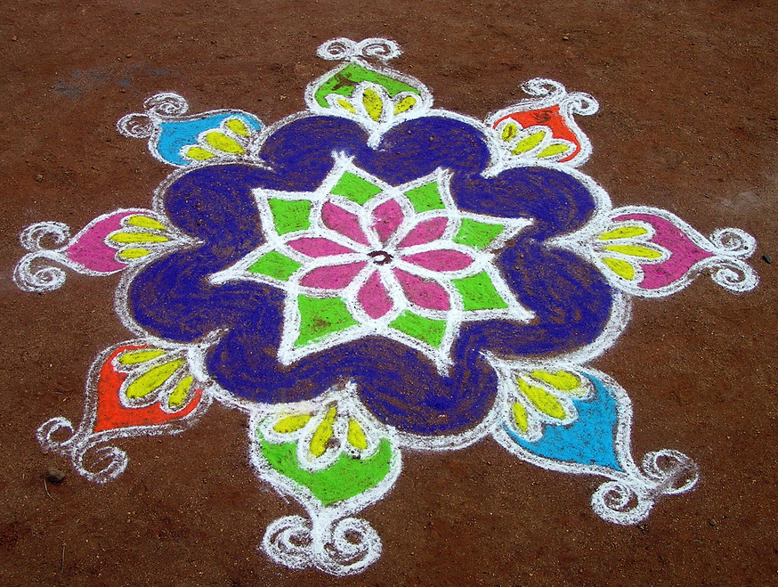
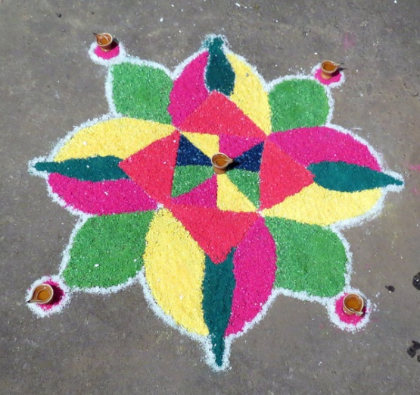
A Range Of Rangoli Patterns
They come in all shapes and sizes.

Slide 7
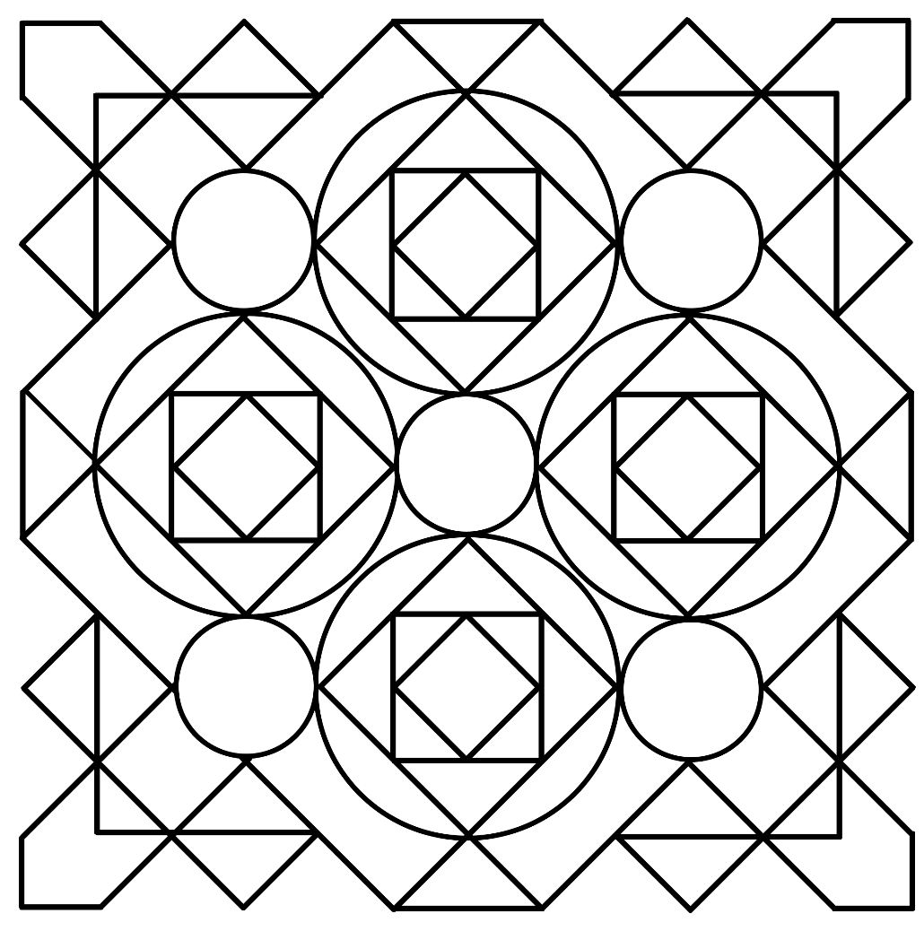
How Are They Created?
Shapes have at least one line of symmetry.
They are made of geometric patterns.

Slide 8
Glossary
symmetry | Symmetry is where one side of the shape looks exactly the same when it is flipped. You can check symmetry in a mirror.
geometric patterns | A pattern using shapes such as lines, rectangles, circles, and squares.

