Slide 2



Diving into Mastery Guidance for Educators
Each activity sheet is split into three sections, diving, deeper and deepest, which are represented by the following icons:
These carefully designed activities take your children through a learning journey, initially ensuring they are fluent with the key concept being taught; then applying this to a range of reasoning and problem-solving activities.
These sheets might not necessarily be used in a linear way. Some children might begin at the ‘Deeper’ section and in fact, others may ‘dive straight in’ to the ‘Deepest’ section if they have already mastered the skill and are applying this to show their depth of understanding.
Diving
Deeper
Deepest

Slide 3
National Curriculum Objective
Identify, describe and represent the position of a shape following a reflection or translation, using the appropriate language, and know that the shape has not changed.

Slide 4
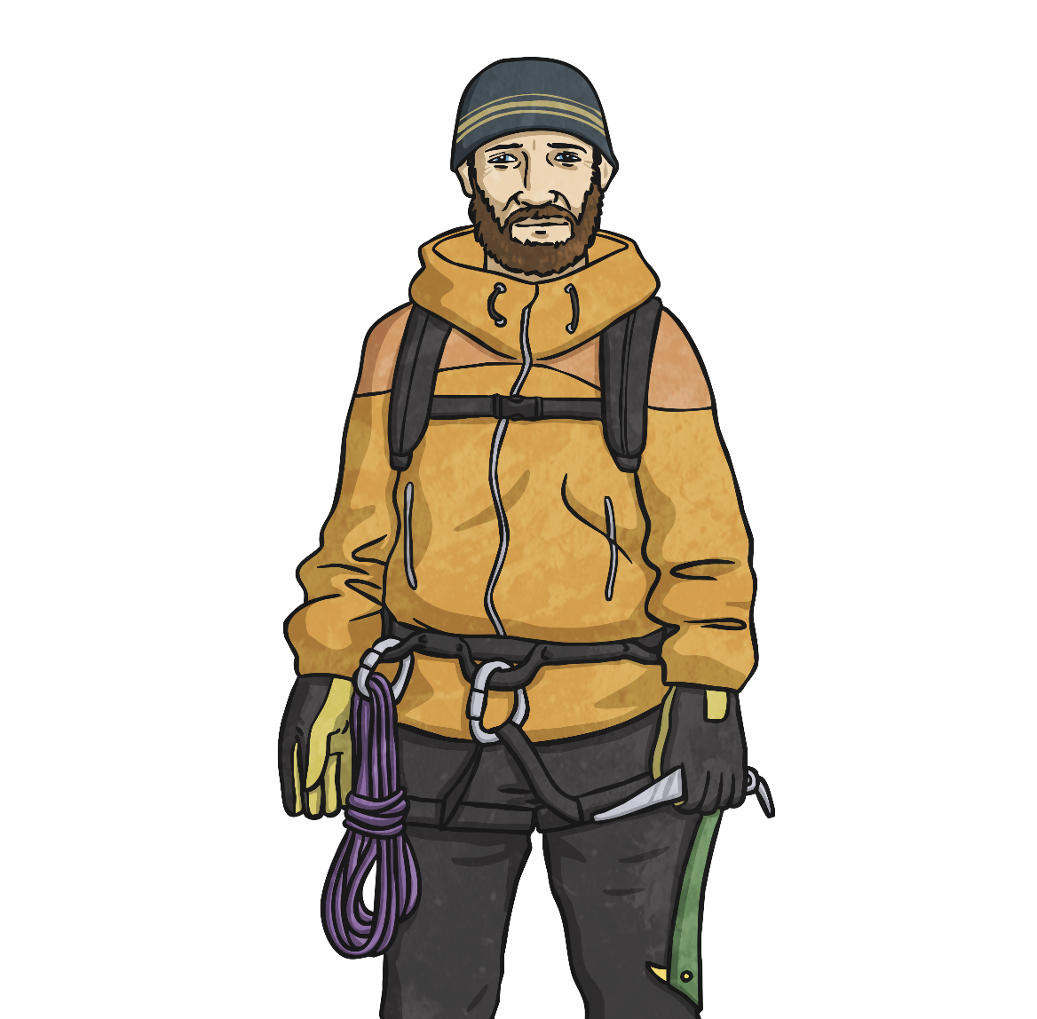
Translation with Coordinates
Diving
If it were to move to the right, which digit would change?
If it were to move upwards, which digit would change?
What are the coordinates of the plotted point?
The second digit would change: the y coordinate.
The first digit would change: the x coordinate.
(2,1)
5
4
3
2
1
0
1
2
3
4
5

Slide 5
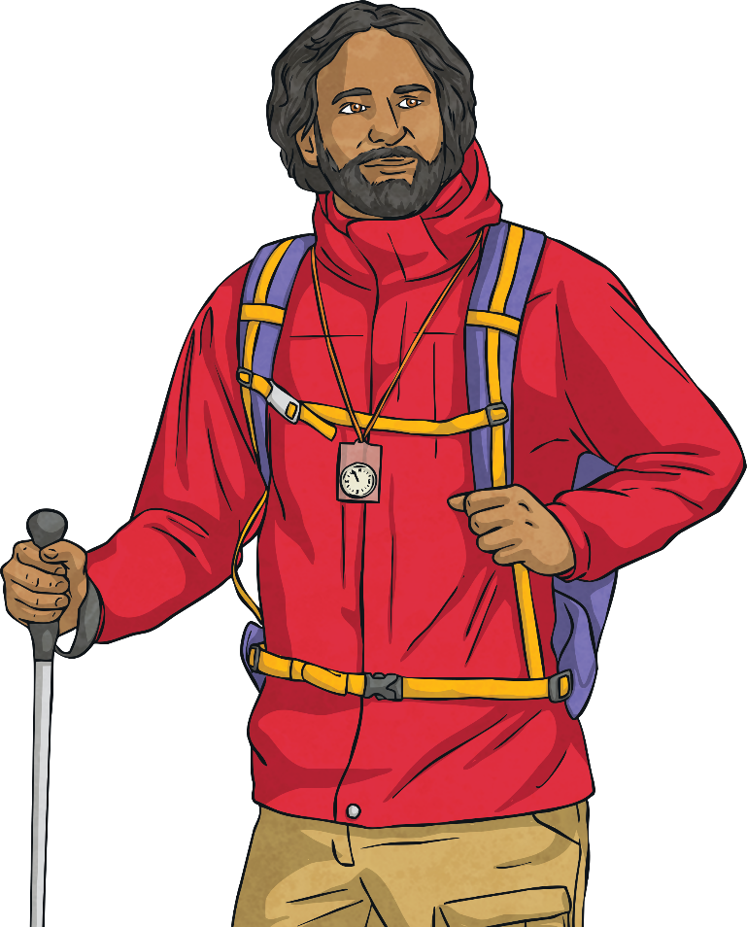
Translation with Coordinates
Diving
James has translated triangle A to its new position, B.
2 right, 2 up.
Describe the translation to your learning partner.
(5,3)
What are the coordinates of the missing vertex?
5
4
B
3
2
A
1
0
1
2
3
4
5

Slide 6

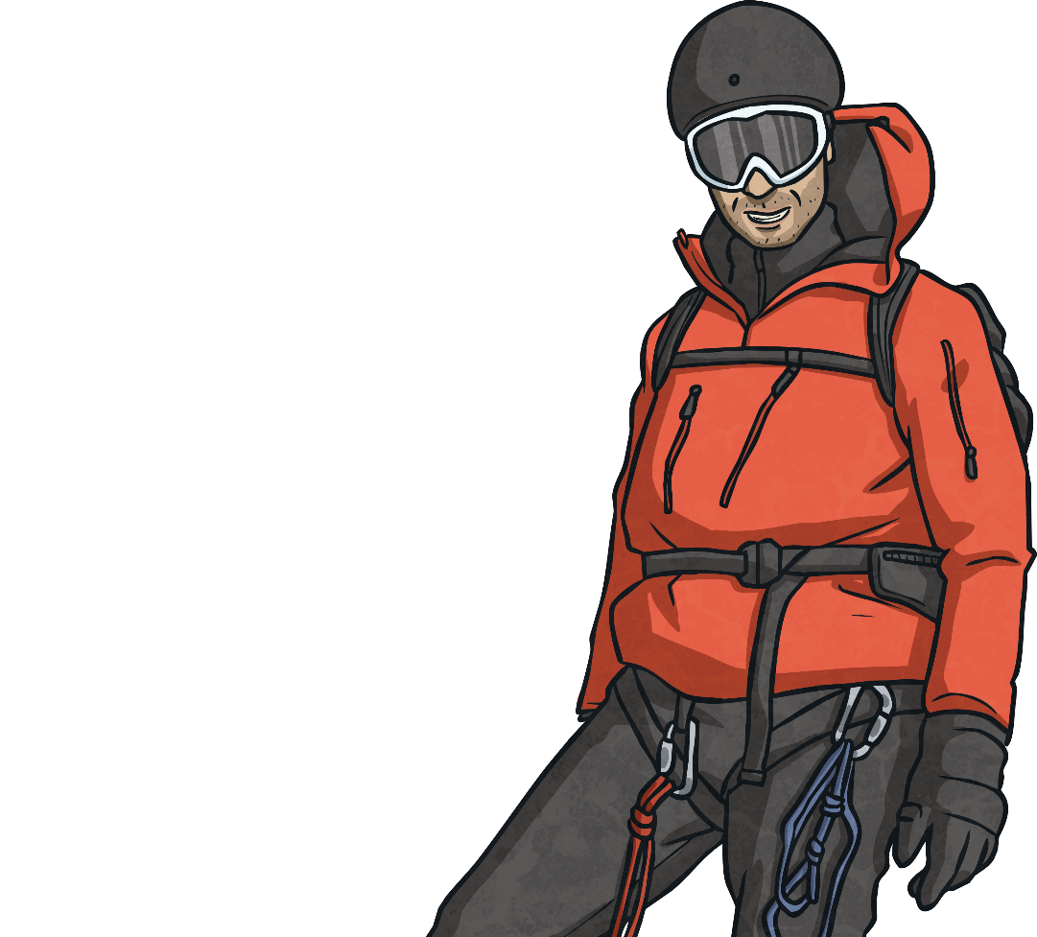

Translation with Coordinates
Deeper
Are these statements true or false?
If the triangle was translated down, the y coordinate would change.
The coordinates of the translated shape could be (2,1) (6,1) (2,5).
8
7
6
(2,5)
5
False. This shape would not be congruent to the original shape. The
final pair of
coordinates
should be (2,4).
4
3
True. The second digit would change which
is the y coordinate.
2
1
0
1
2
3
4
5
6
7
8

Slide 7

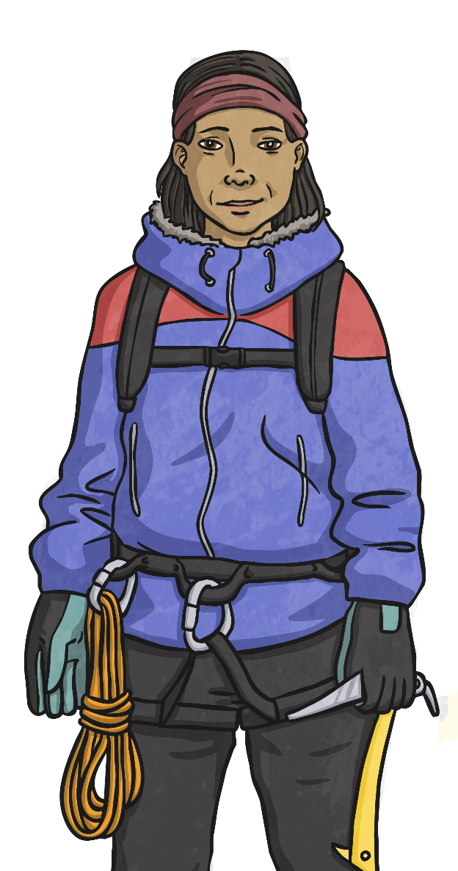
Translation with Coordinates
Deepest
Sienna has translated a square in the first quadrant (1 left, 2 up). Here is the translated square. What were the original coordinates of vertices A and D?
A
(4,6)
Vertex A (2,4)
Vertex D (5,1)
(1,3)
D

Slide 8
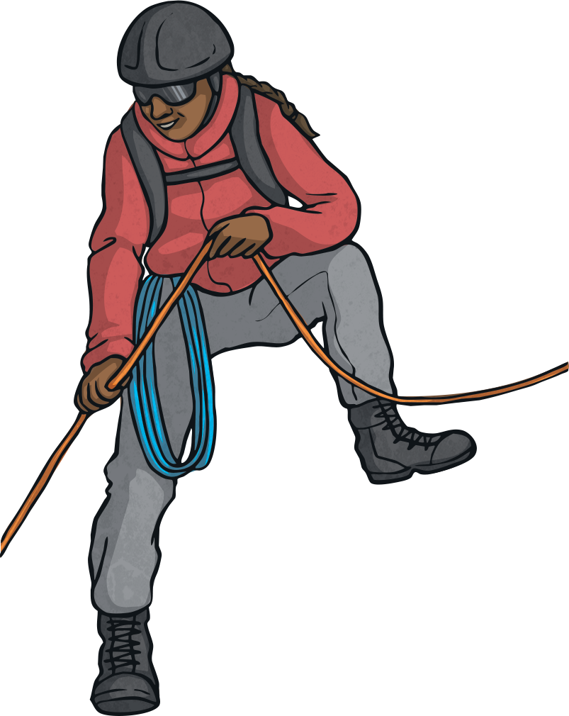
Translation with Coordinates
Deepest
Celia has drawn a square in the first quadrant but has hidden the grid.
She reveals the coordinates of two vertices.
When Celia translates the square, one of the coordinates is (6,5). What are the possible ways the square has been translated?
A
(7,6)
(left 1, up 1)
(left 1, down 1)
(right 1, up 1)
(right 1, down 1)
(5,4)
B

Slide 9


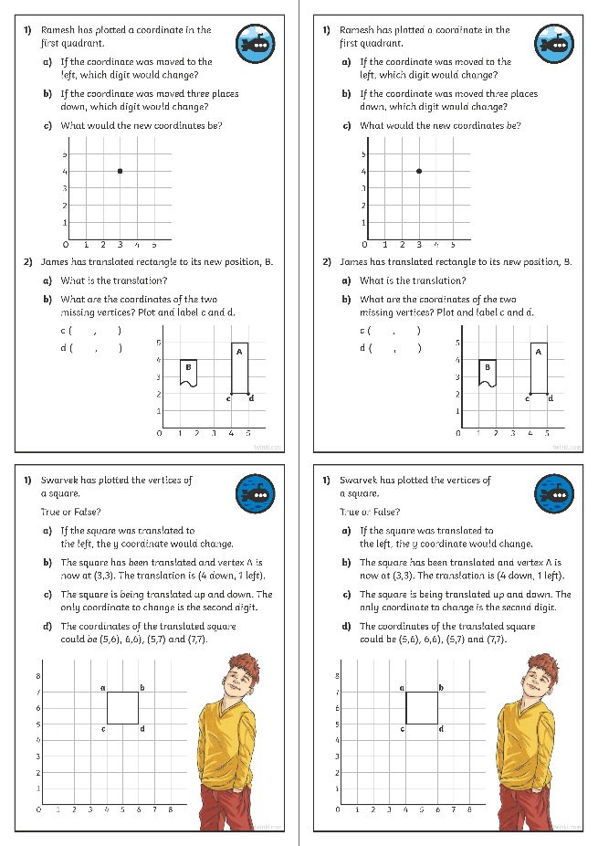
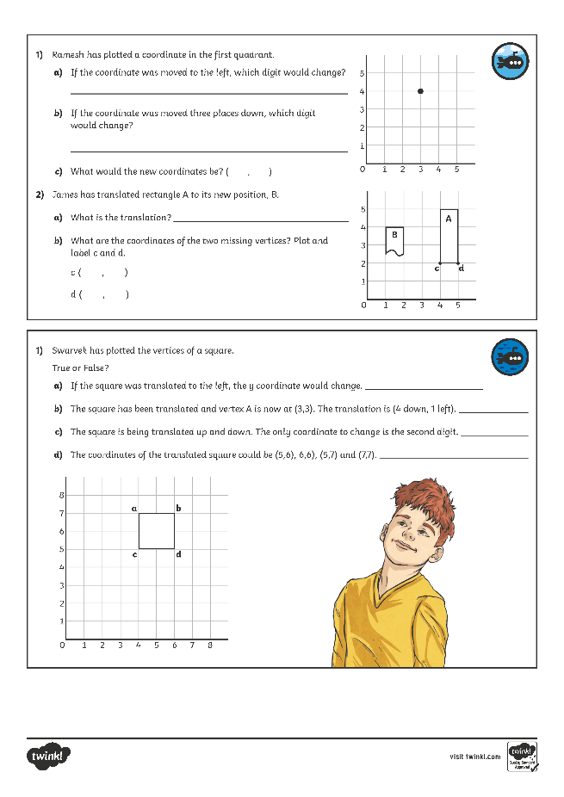
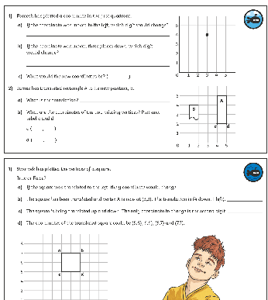
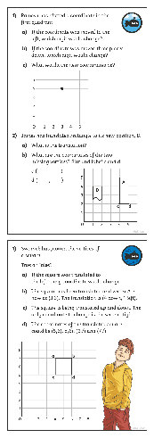
Translation with Coordinates
Dive in by completing your own activity!

Slide 10
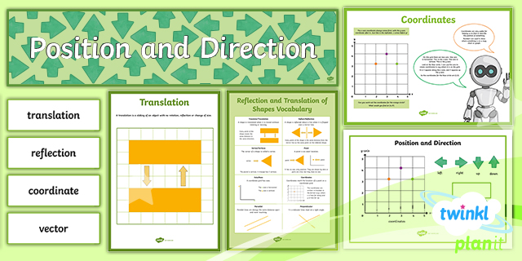
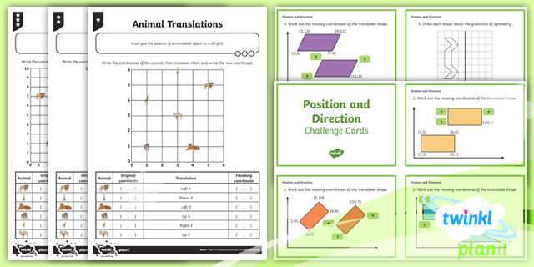

Need Planning to Complement this Resource?
National Curriculum Aim
Identify, describe and represent the position of a shape following a reflection or translation, using the appropriate language, and know that the shape has not changed.
For more planning resources to support this aim, click here.
Twinkl PlanIt is our award-winning scheme of work
with over 4000 resources.

